Slide 2
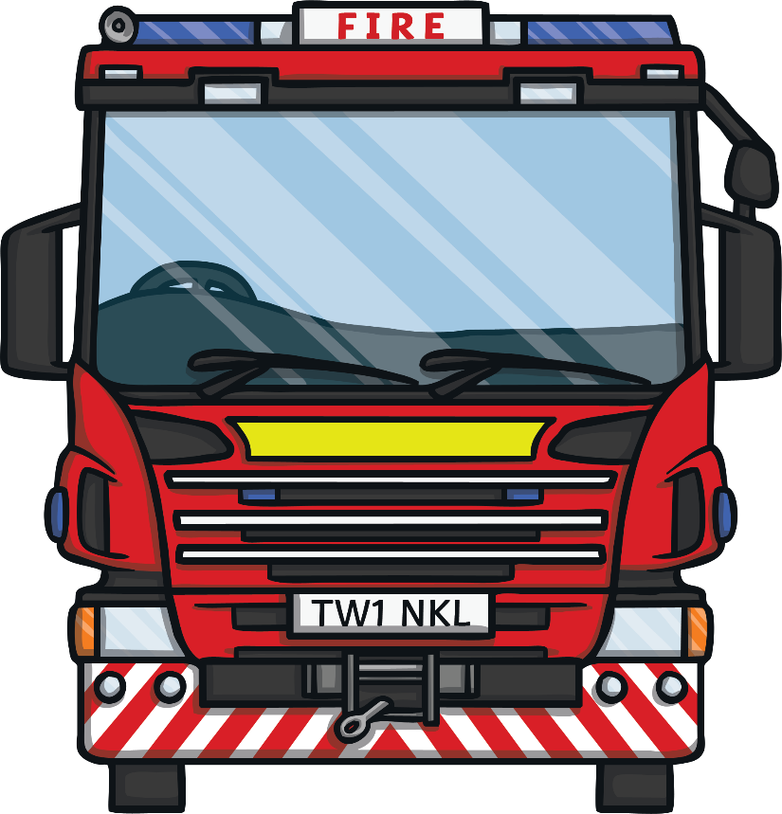
History
Today, we are lucky to have a fire service as part of our emergency services.
If there is a fire, we can call 999 and the fire service will come to put it out. Sometimes, they help rescue animals or people stuck in cars.
We are very lucky to have our fire service but we didn’t always have these everyday heroes. A long time ago, there were no firefighters.

Slide 3
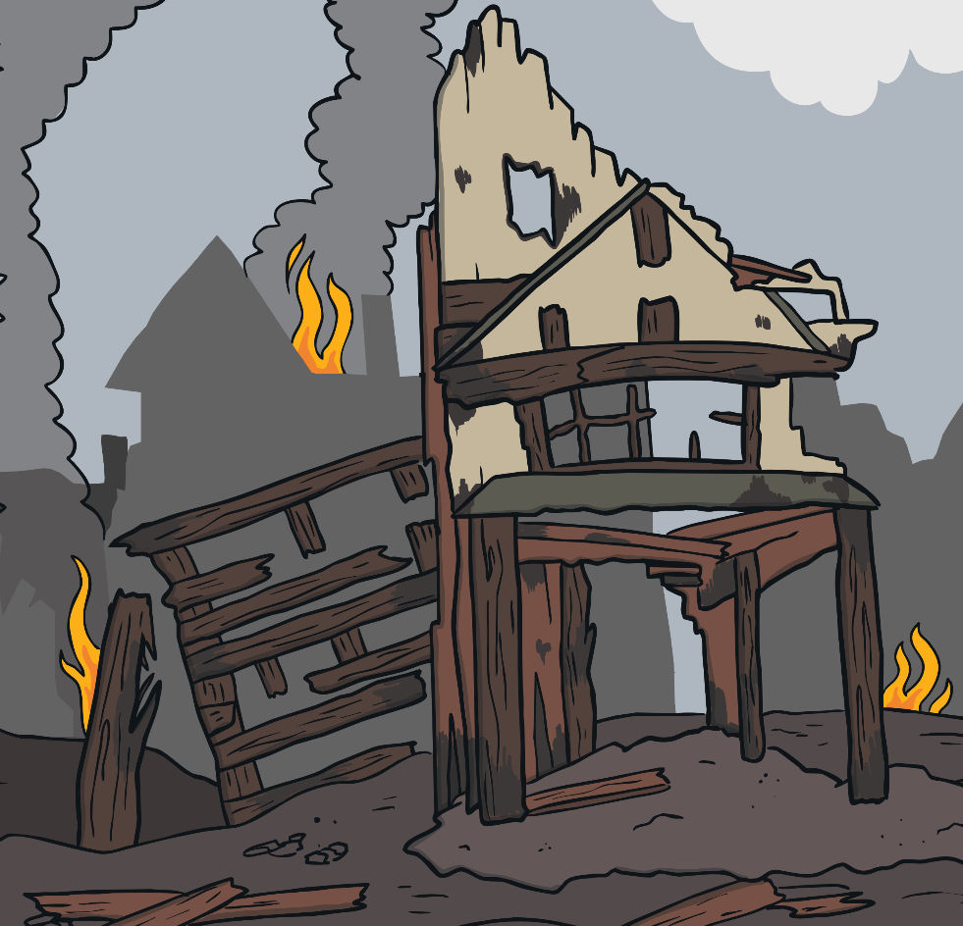
The Great Fire of London
Over 350 years ago, there was a fire in London. It started in a baker’s shop on Pudding Lane on Sunday 2nd September 1666.
All of the houses and shops were made from wood and they were built very close together. This meant that the fire spread quickly.

Slide 4
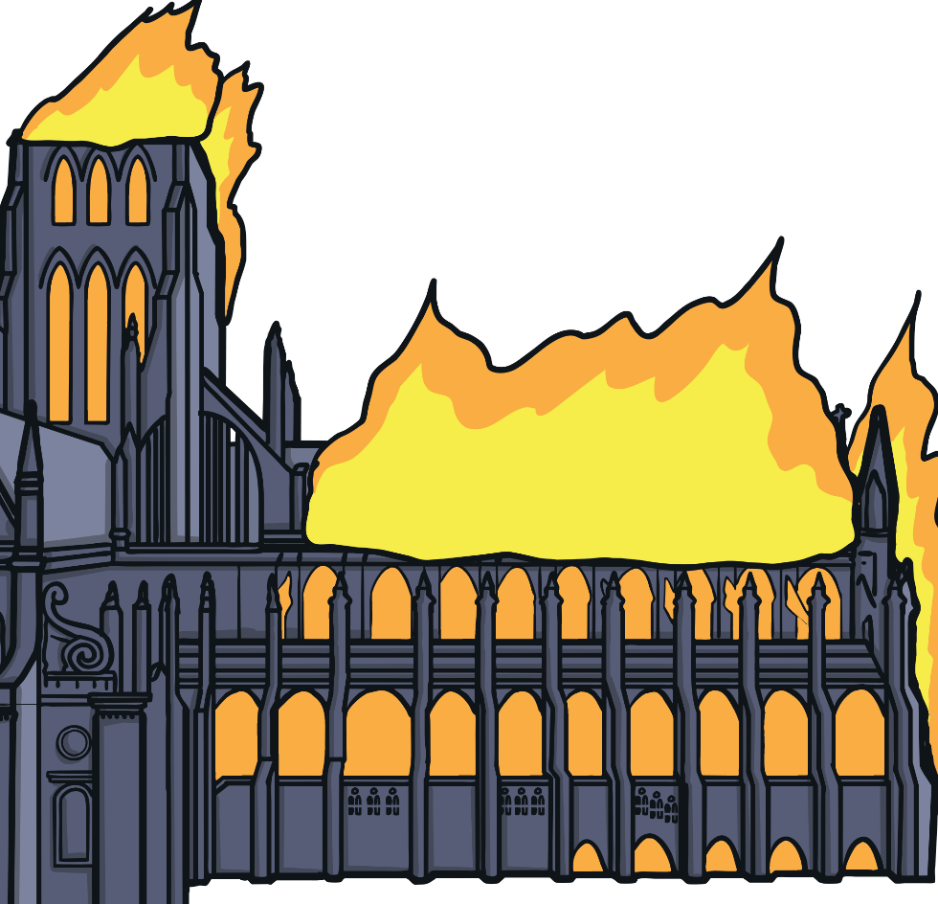
The Great Fire of London
There was no fire service so lots of people tried to put the fire out.
They only had leather buckets, which they filled with water, axes, fire hooks and squirters.
Leather buckets had to be passed from person to person in a long chain to get the water from the river to the burning buildings.

Slide 5
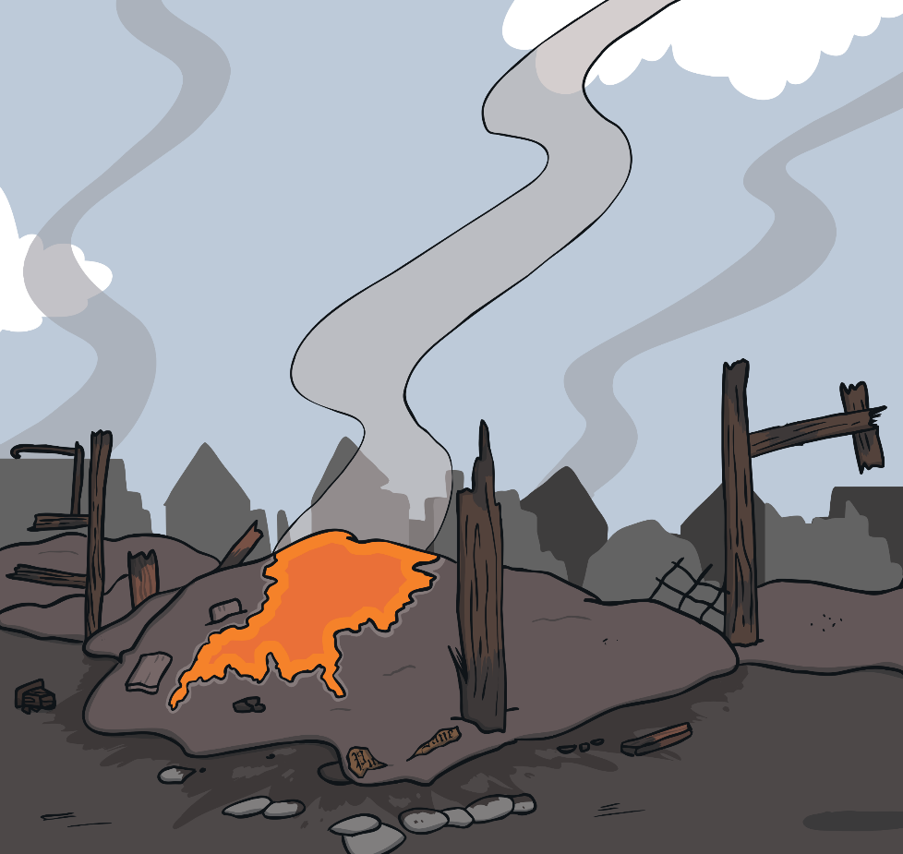
The Great Fire of London
Gunpowder was sometimes used to create a ‘fire break’, where houses were blown up to try to stop the fire spreading.
The fire burnt for days. When the fire went out, many houses and shops in London were destroyed.

Slide 6
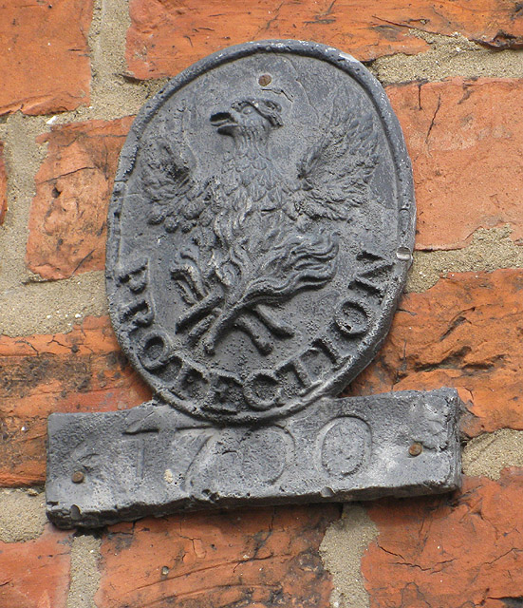
The Earliest Fire Service
After the Great Fire of London, people wanted to make sure that there would never be a fire like this again. New buildings were made from bricks so they wouldn’t burn so quickly and the streets were widened.
One year after the Great Fire of London, the first fire service was set up. They would go to a fire and put it out if people needed them. This fire service didn’t put every fire out, though. Instead, they only went to the homes of people who had paid them money to look after (insure) their house. The fire brigades put a ‘fire mark’ on each house that had paid to be looked after (insured).

Slide 7
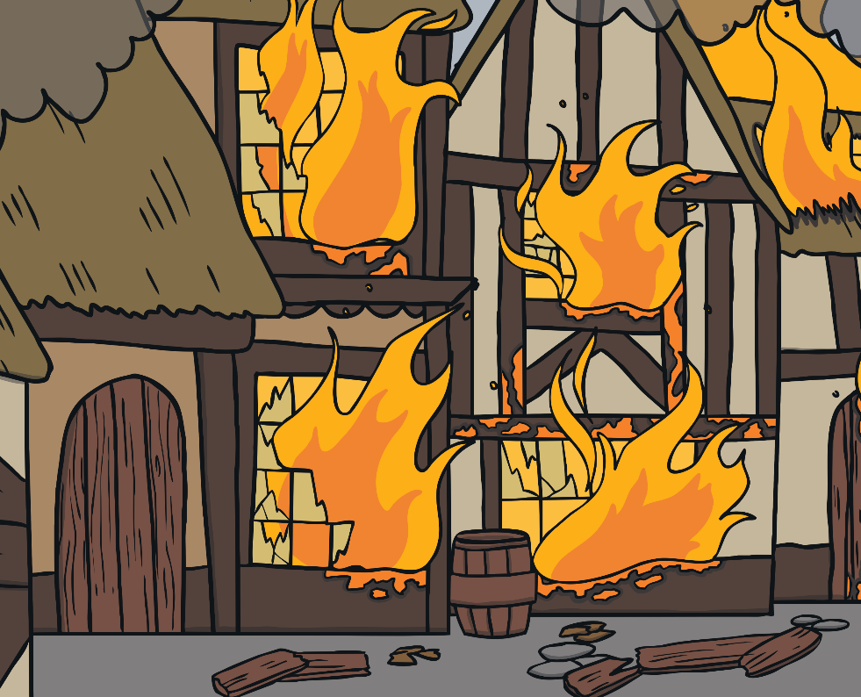
The Earliest Fire Service
In 1833, ten fire brigades in London joined together to make one fire service which later became the London Fire Brigade. Eventually, the government passed a law that meant every county in the UK had their own fire brigade.

Slide 8
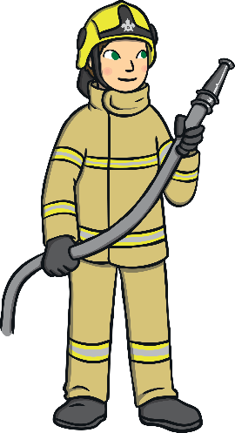
Female Firefighters
In 1939, the UK was involved in the Second World War. Many young men had joined the British army to fight in the war. This meant that there were not enough men to join the fire service.
During the Second World War, women were allowed
to join. They were only allowed to be fire watchers
(people who look out for fires), drivers and to
manage the communication systems.
Women were finally allowed to join the fire service around 40 years ago. The first woman to join the fire service was called Josephine Reynolds and she joined
in 1982.

Slide 9


Uniforms and Equipment
1666 – The Great Fire of London
Uniform
no uniform
no fire service
Equipment
leather buckets
axes
squirters
fire hooks

Slide 10
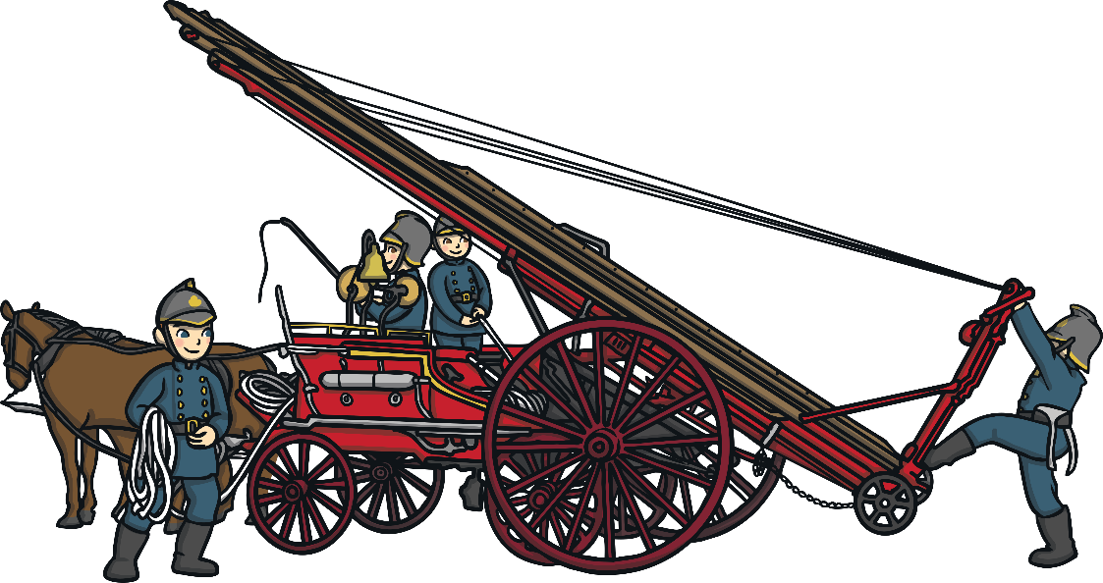
Uniforms and Equipment
1866
Uniform
blue double-breasted tunic, made from wool
woollen trousers
brass helmets
Equipment
an axe and a hose spanner
fire trailers that were pulled
by horses

Slide 11
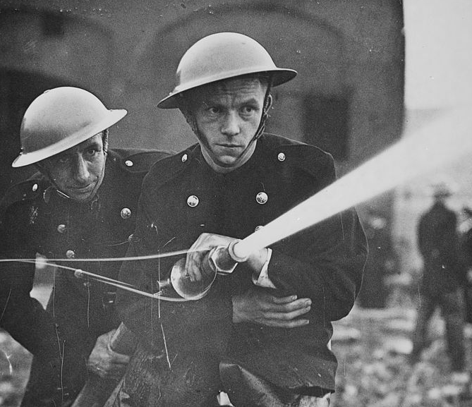
Uniforms and Equipment
Second World War
Uniform
steel helmet
rubber boots
trousers
Equipment
trailer pumps towed by taxis

Slide 12
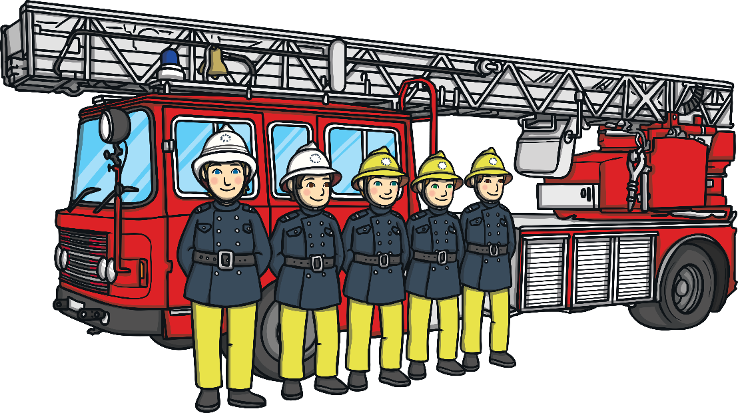
Uniforms and Equipment
1974
Uniform
woollen tunic
yellow rubber leggings, keeping firefighters safer and making them visible
Equipment
trailer pumps towed by taxis

Slide 13
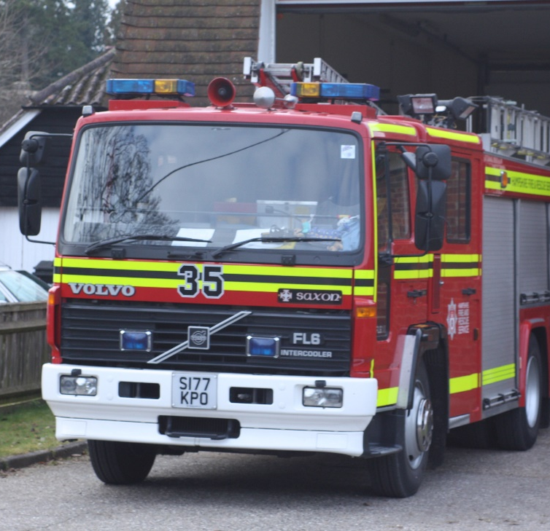
Uniforms and Equipment
1989
Uniform
the first suit that had the same protection in the coat and
the trousers
waterproof uniform
better protection against the heat and flames
'Hampshire fire engine' by deltaalpha24 is licensed under CC BY 2.0
Equipment
modern fire engine with flashing blue lights and fluorescent
yellow stripes

Slide 14

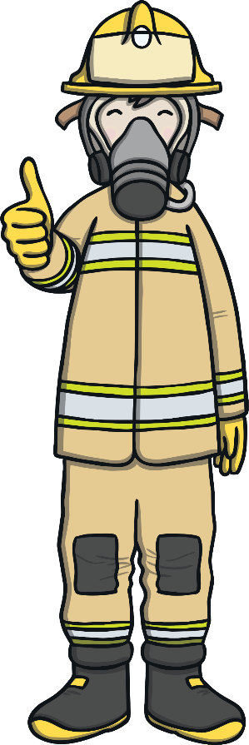
Firefighters Today
Today, firefighting is very different to when it started.
Uniform
Today’s uniform is a golden colour. It is made from a special, protective material. This means that firefighters are protected against fire and any spillages.
Firefighters wear helmets which have a built-in torch.
Radios are worn so firefighters can speak to each other.

Slide 15
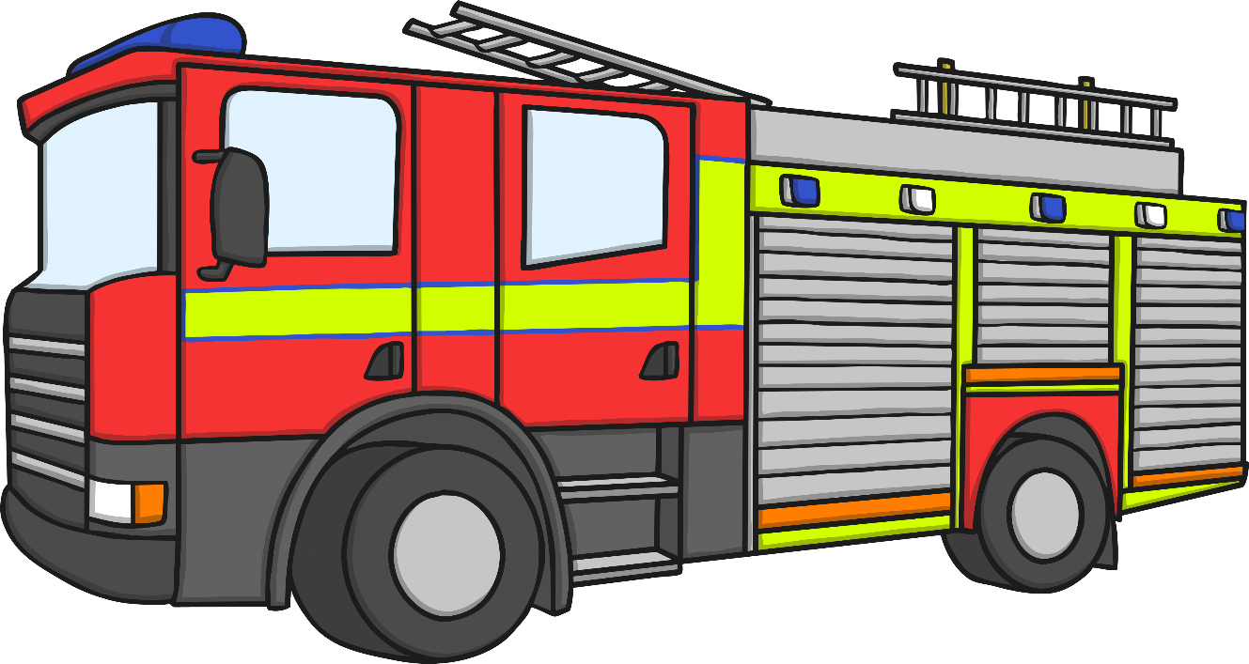
Firefighters Today
Vehicles
The fire service uses large fire engines. Fire brigades are hoping that, in the future, some of these will be powered by electricity because this will cut down pollution.

Slide 16
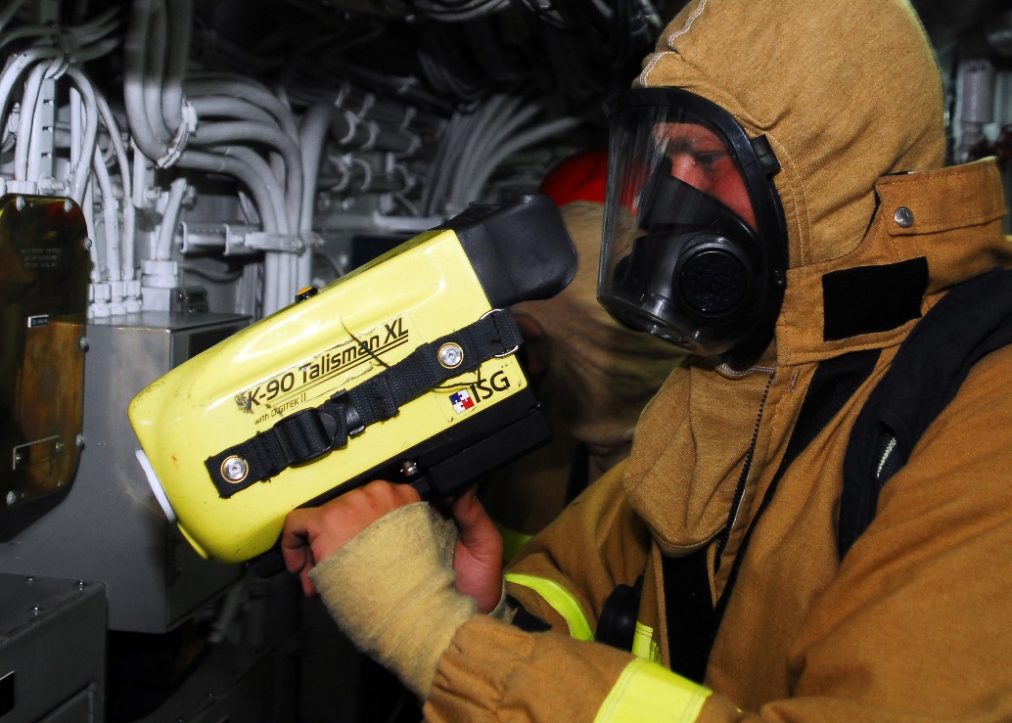
Firefighters Today
Technology
Firefighters wear a tracking device, which connects to a computer and tells other firefighters exactly where they are.
Firefighters carry a thermal imaging camera. This is a special camera that shows a firefighter how warm things are. It is very useful when there is so much smoke or darkness that firefighters can’t see clearly.

Slide 17
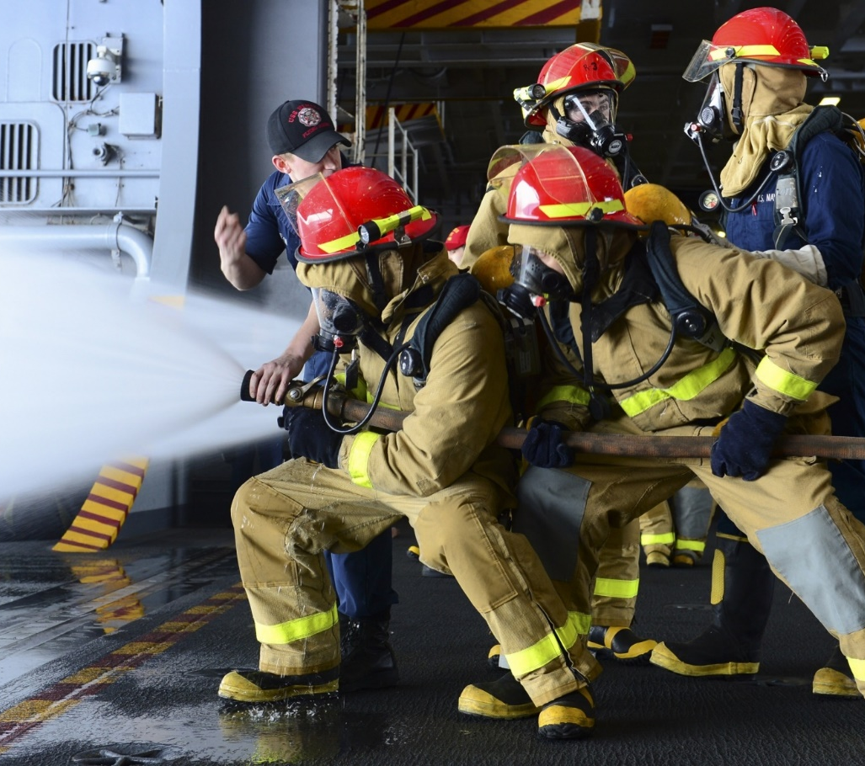
Firefighters Today
Shifts
Firefighters work long hours during the day and all through the night. These shifts mean that there is always someone able to come and fight a fire at any time of the day or night when you call 999.

