Slide 2
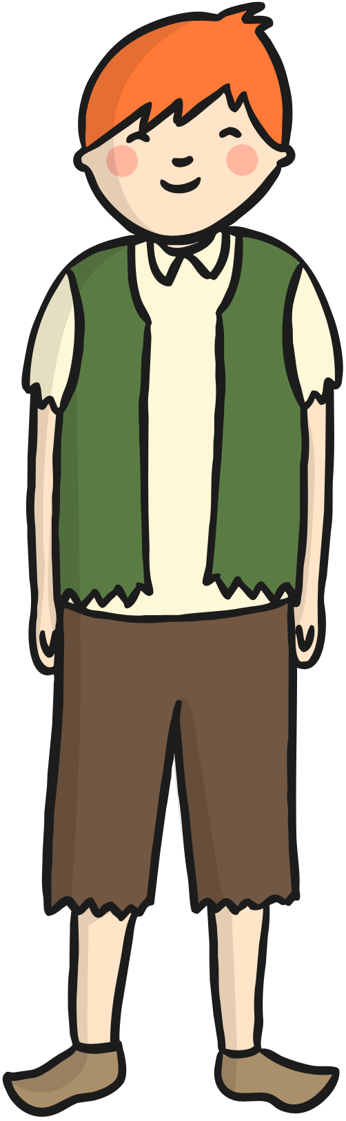
Once upon a time there was a boy called Jack.

Slide 3
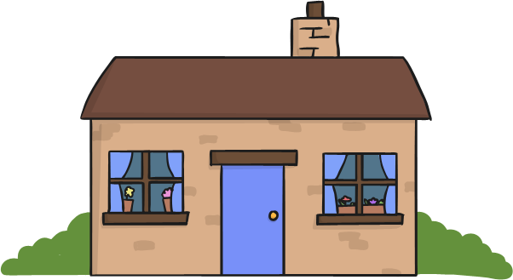

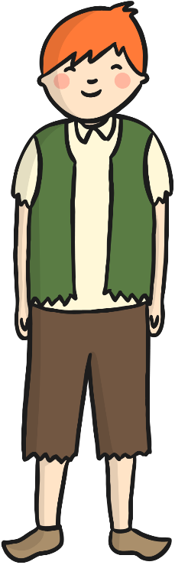
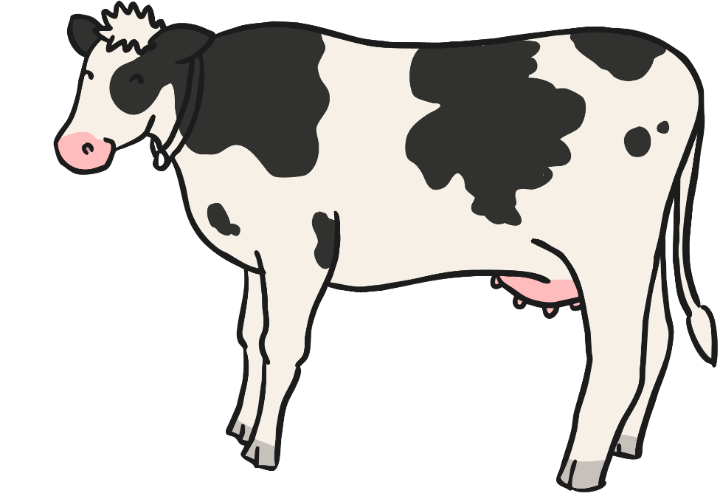
Jack lived in a cottage with his mother.
They were very poor.

Slide 4

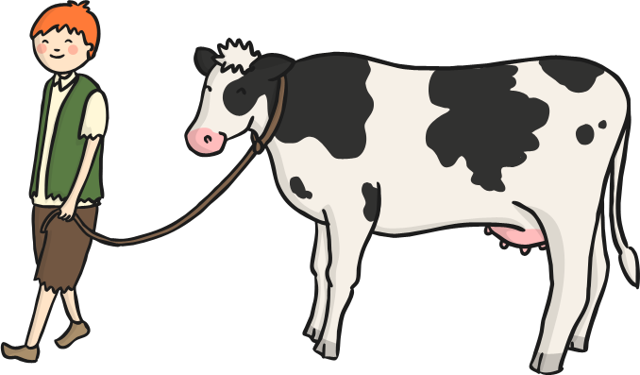
One day, Jack’s mother asked him to take the cow to market.

Slide 5
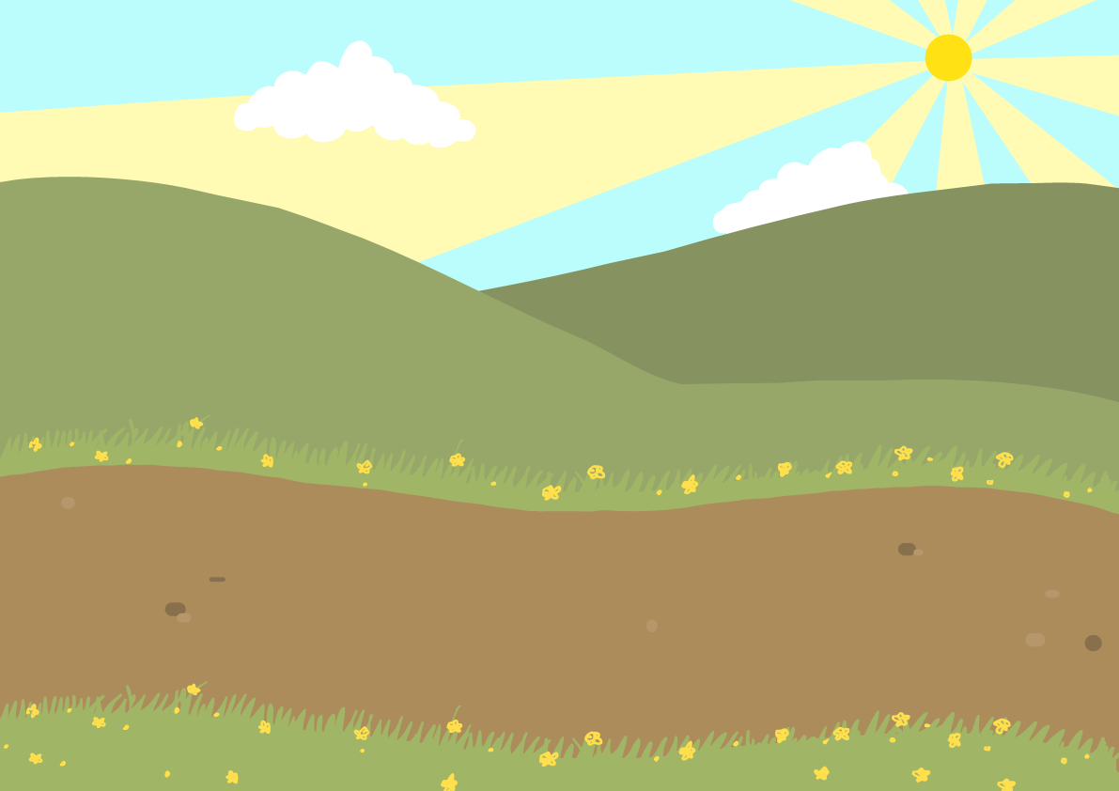
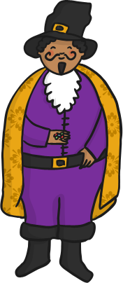
On the way, Jack met a man who gave him some magic beans in exchange for the cow.

Slide 6
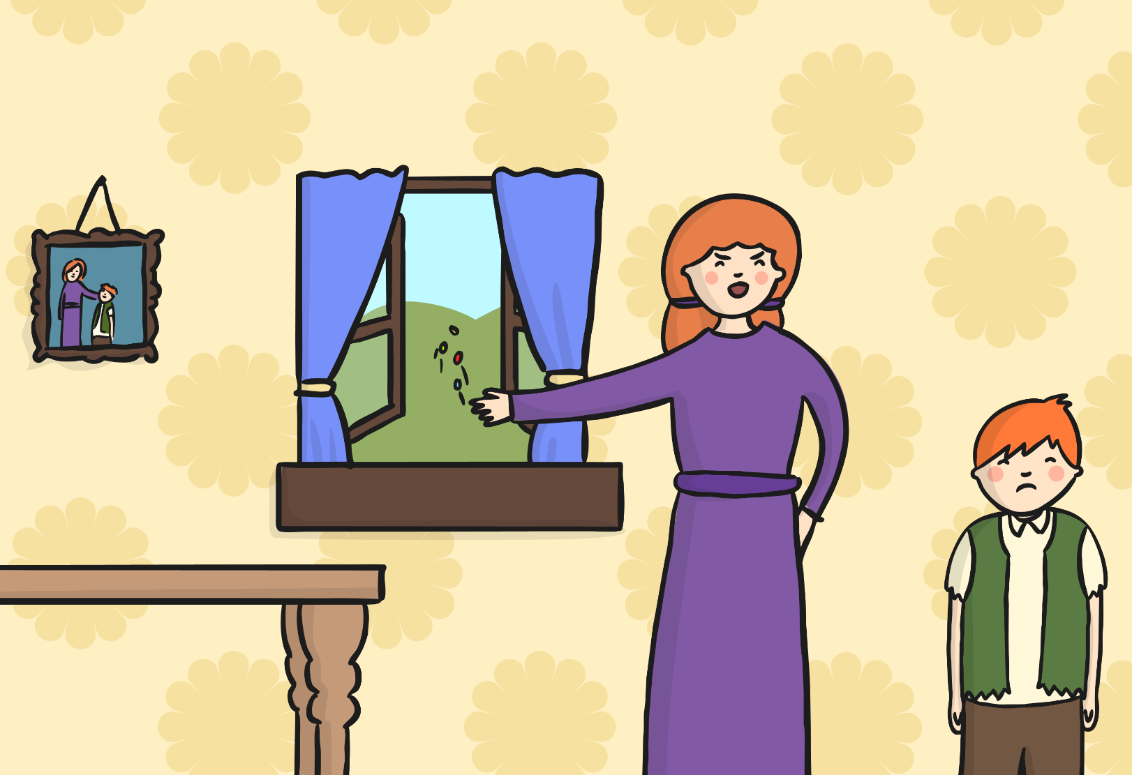
When Jack came home his mother was angry.
She threw the beans out of the window and sent him to bed.

Slide 7
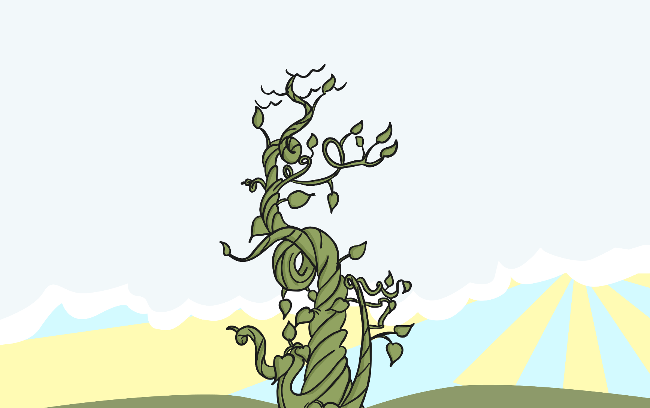
The next morning, Jack looked out of the window.
A giant beanstalk had grown.

Slide 8
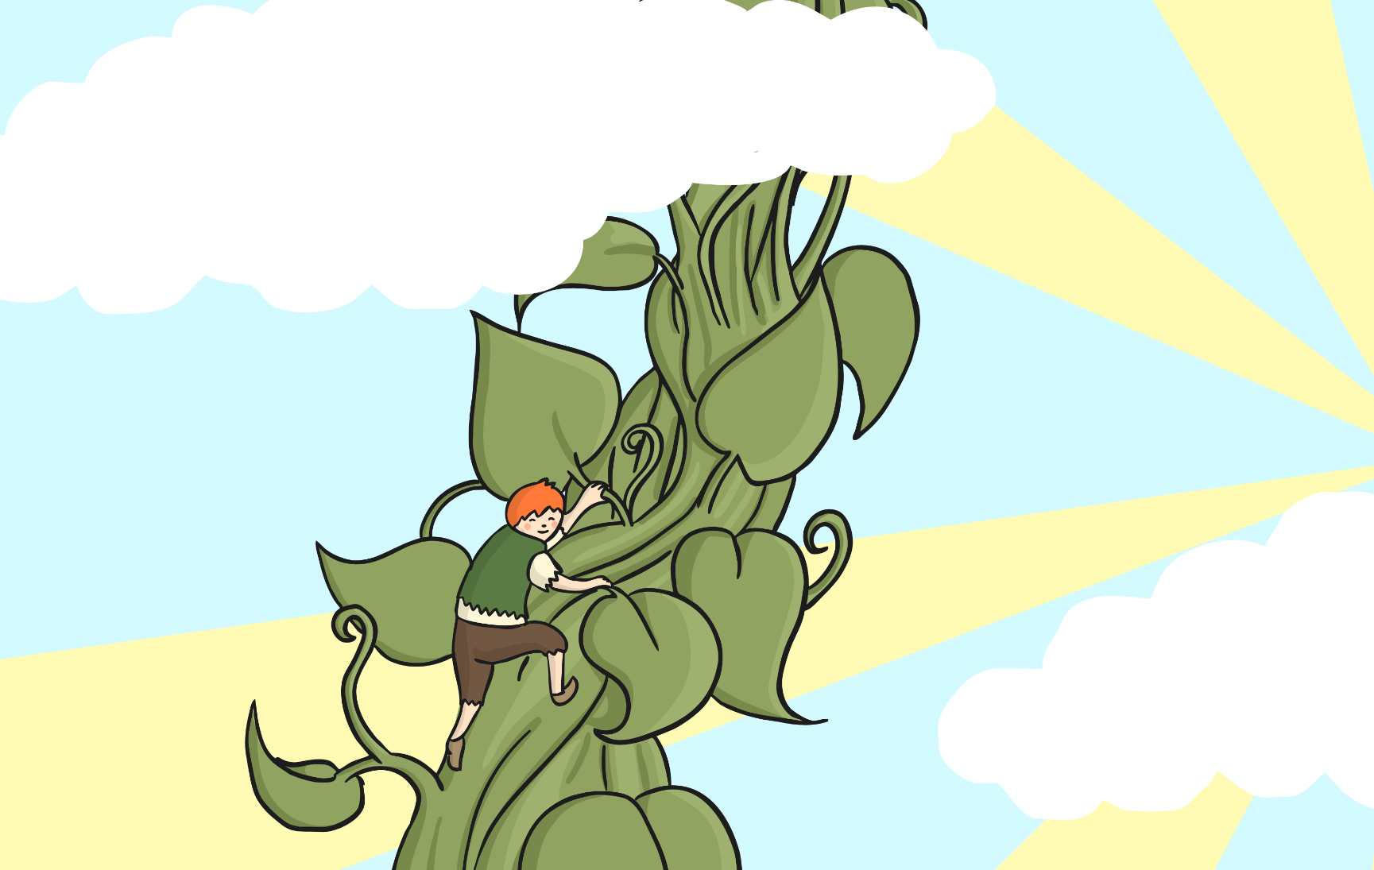
Jack decided to climb the beanstalk. It was so tall it went right up to the sky.

Slide 9
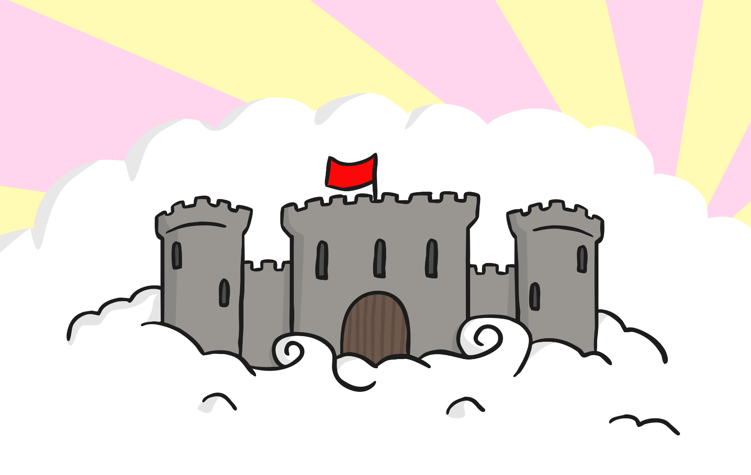
When Jack finally reached the top, he saw an enormous castle.

Slide 10
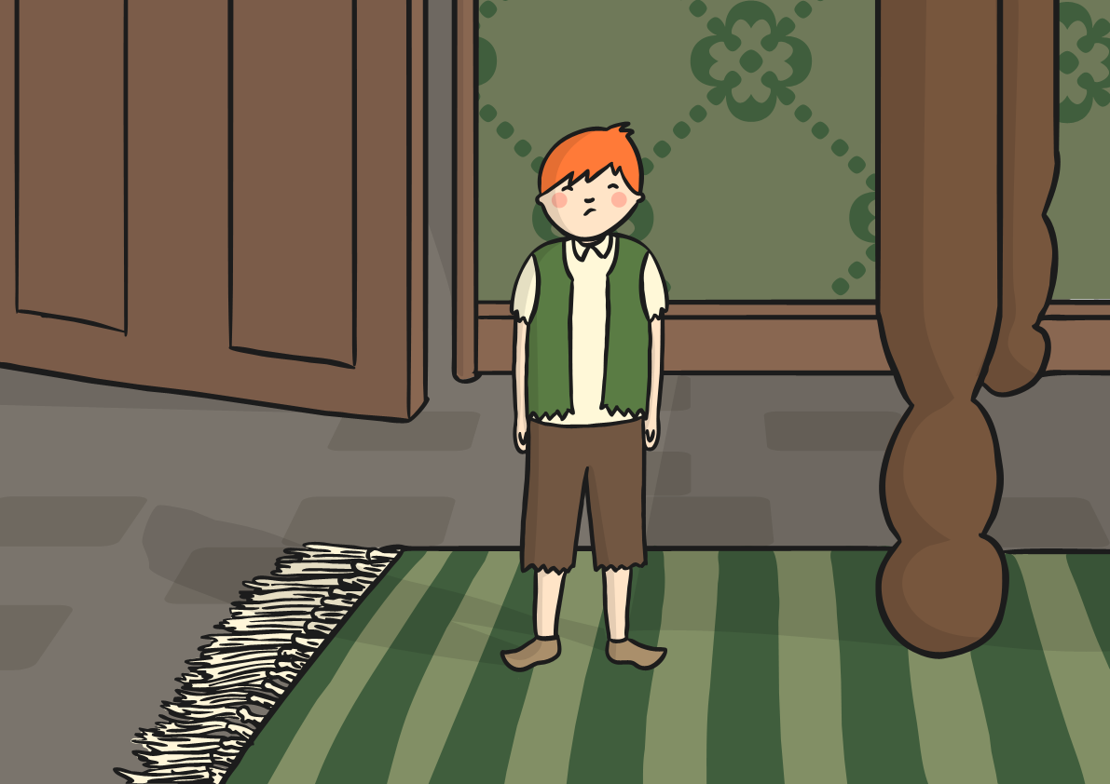
Jack decided to go inside; all the furniture was huge!

Slide 11
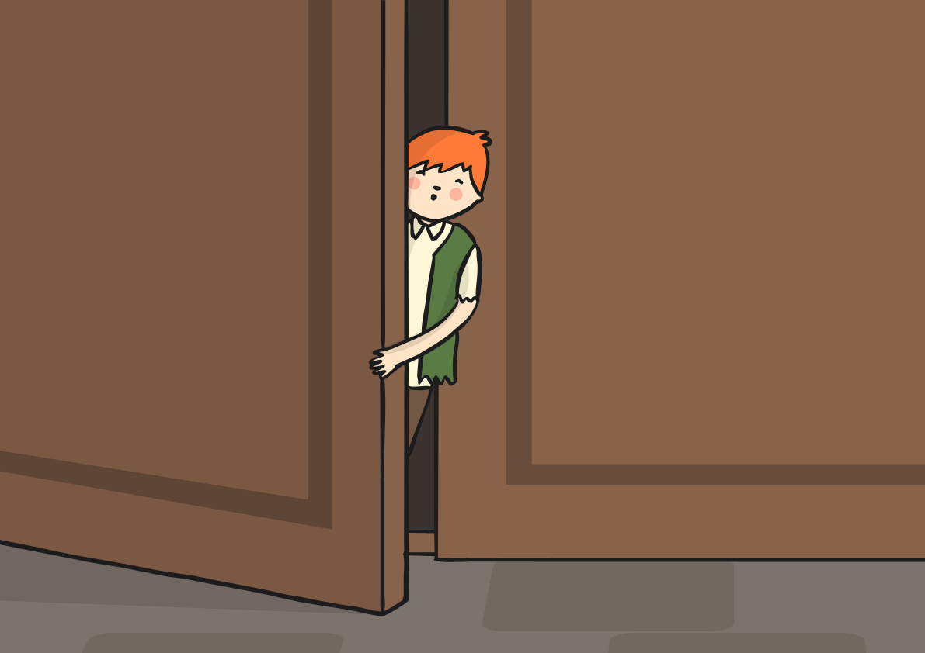
Suddenly, Jack heard a loud noise.
He ran and hid.

Slide 12
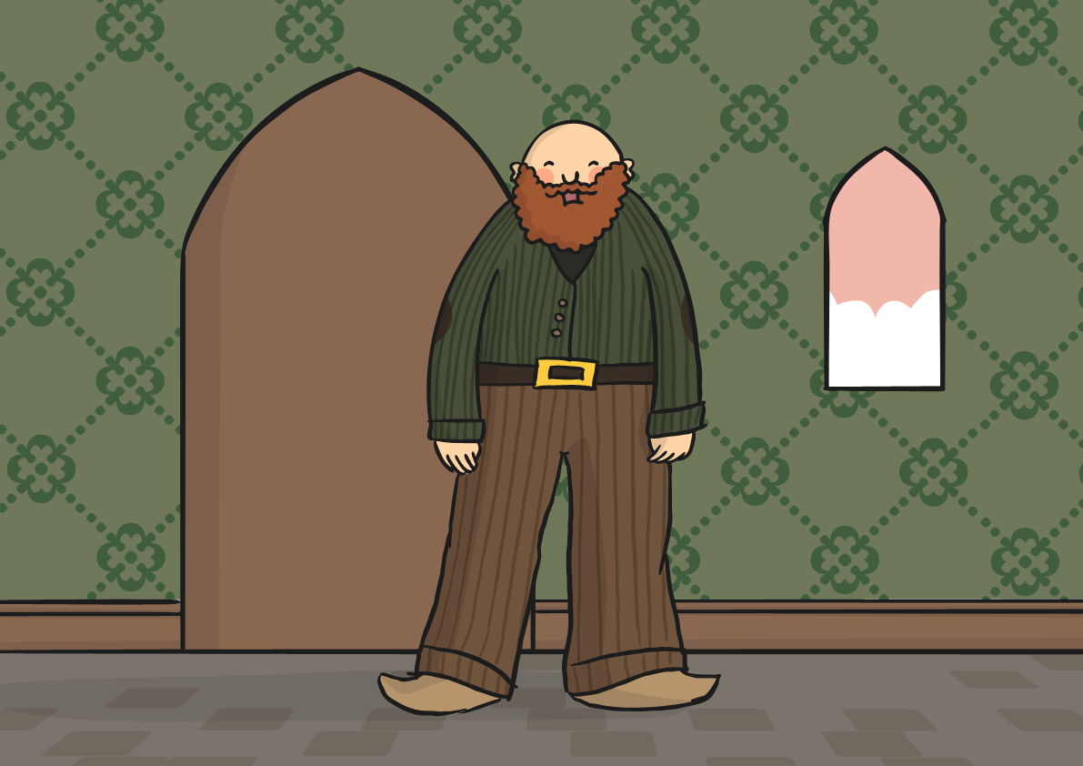
An enormous giant came into the room.
“Fee, Fi, Fo, Fum, I smell the blood of an Englishman!” he bellowed.

Slide 13
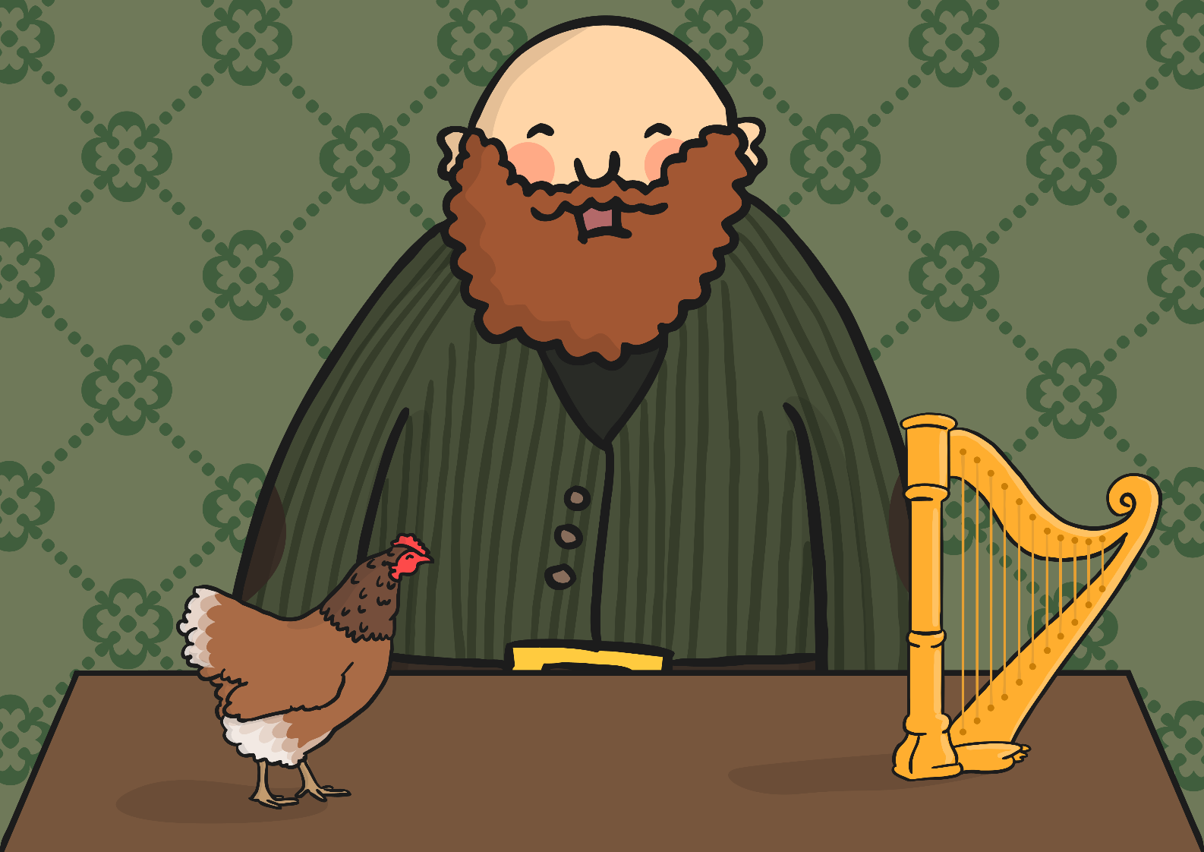
The giant sat down at the table.
On the table was a hen and a golden harp.

Slide 14
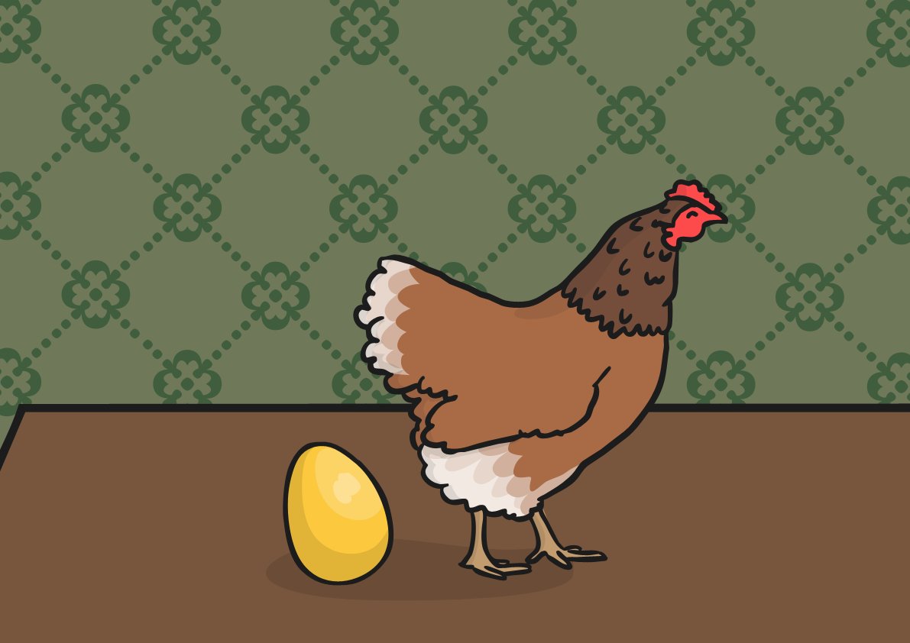
“Lay!” said the giant.
The hen laid a solid, golden egg.

Slide 15
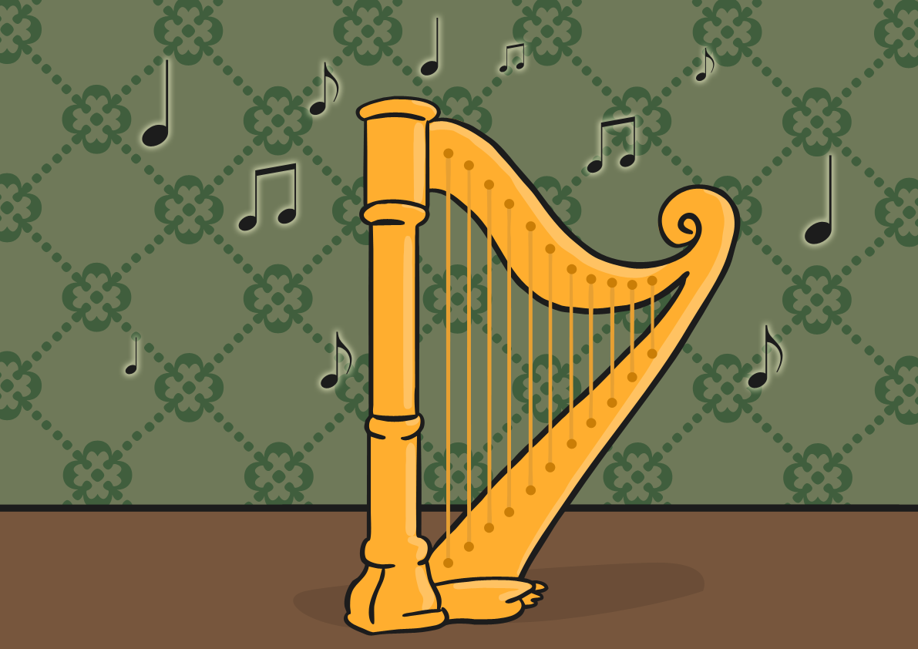
“Sing!” said the giant.
The harp sang and the giant fell asleep.

Slide 16
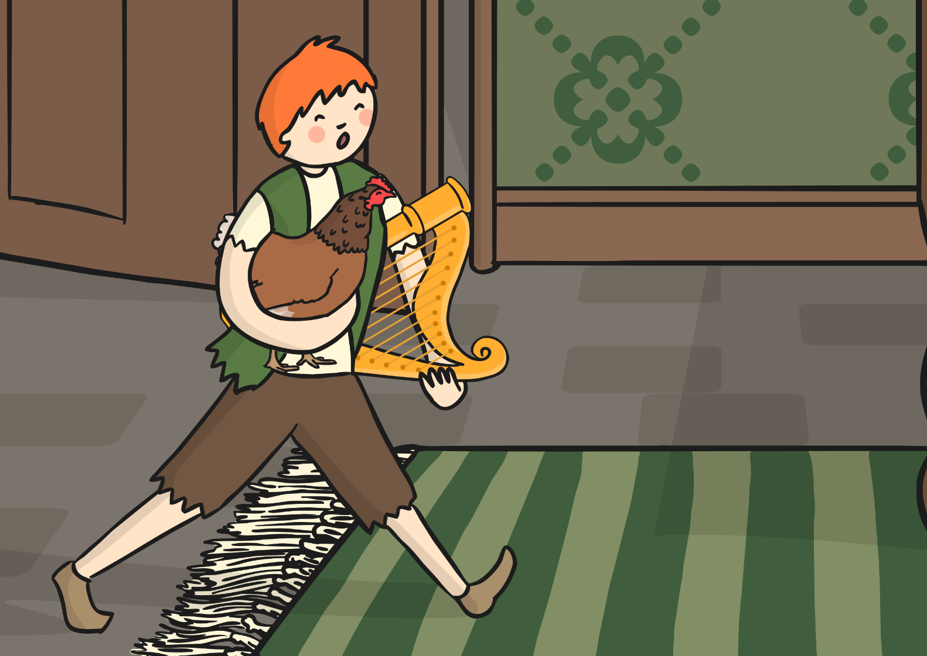
Jack jumped out of the cupboard and took the hen and the harp.

Slide 17
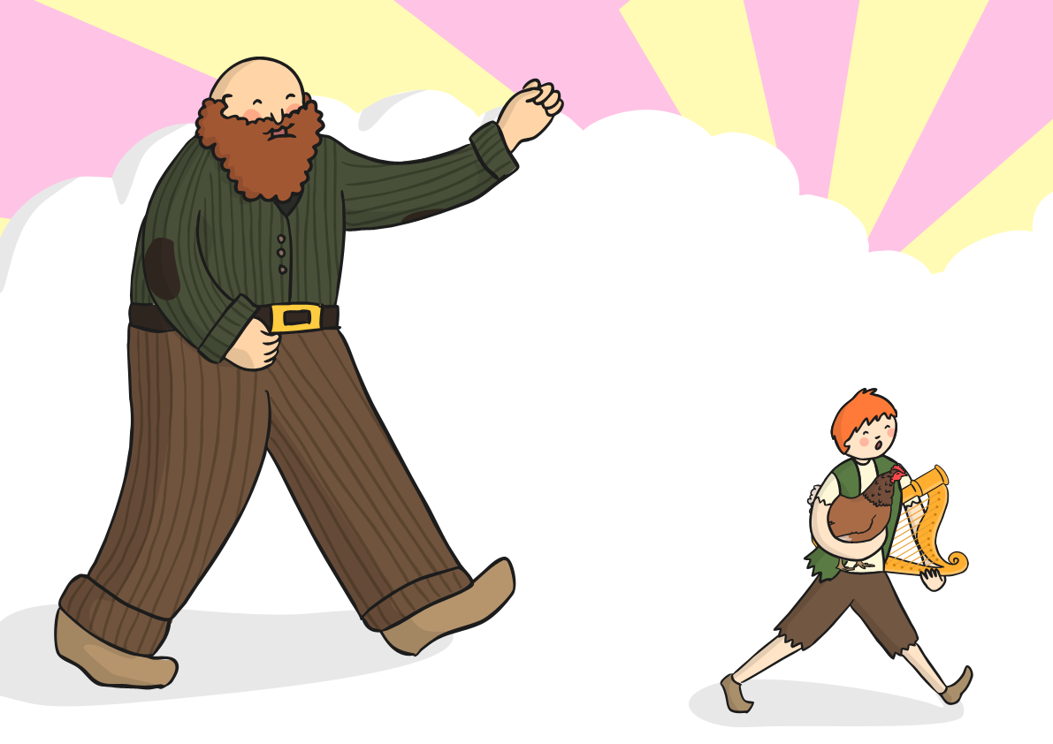
The giant woke up and called, “Fee, Fi, Fo, Fum, I smell the blood of an Englishman!” He chased Jack to the top of the beanstalk.

Slide 18
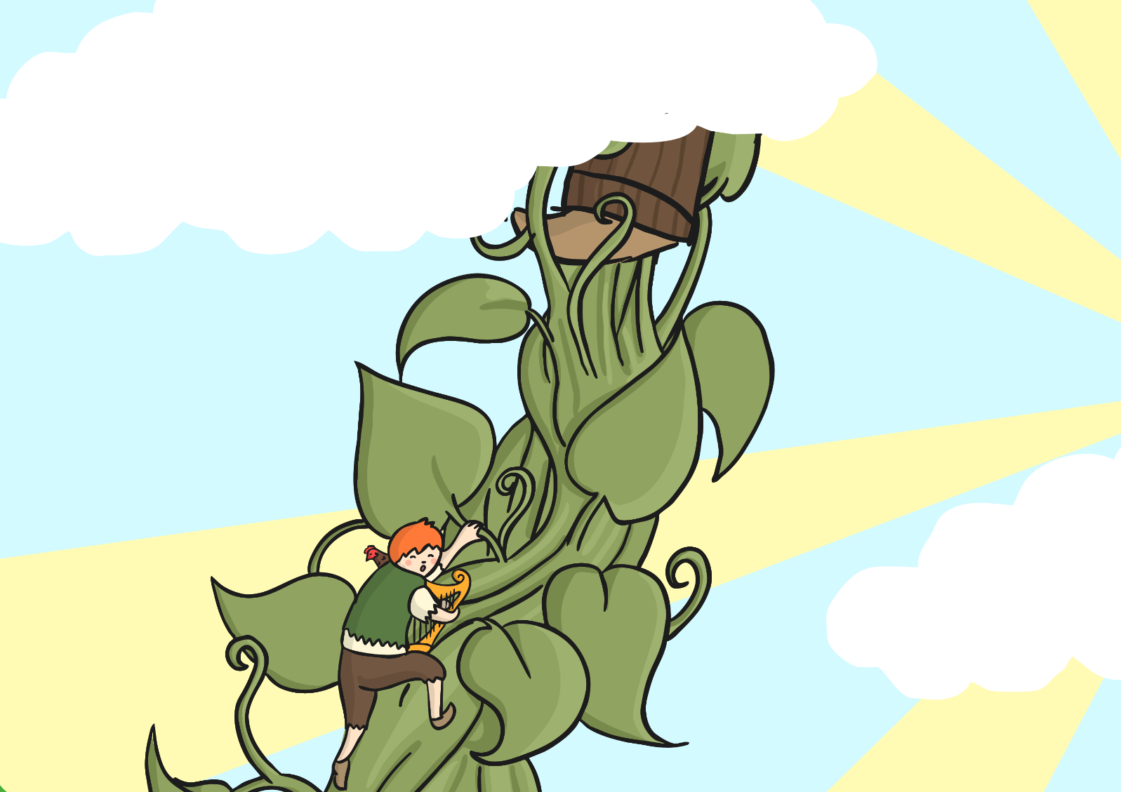
Jack climbed down the beanstalk and the giant followed him.

Slide 19
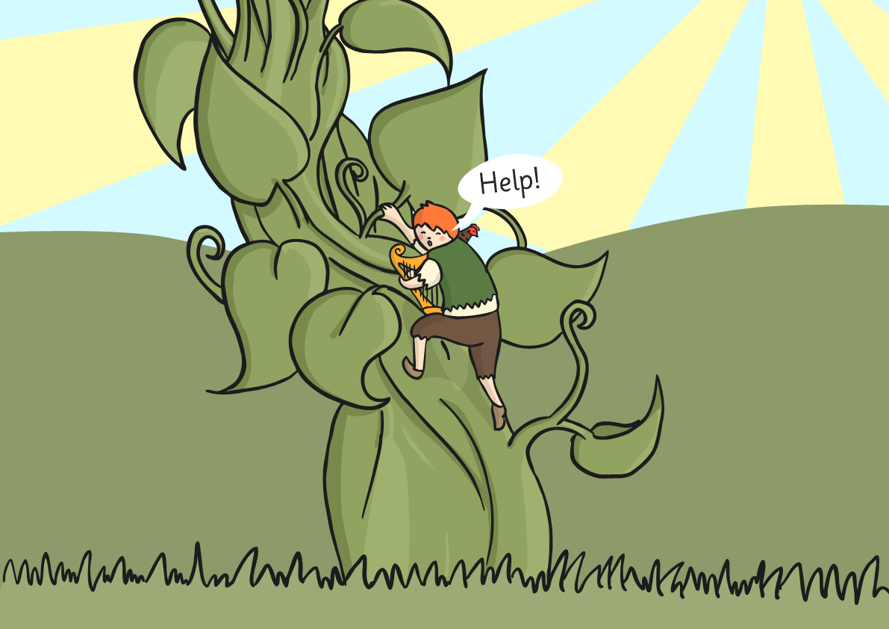
As Jack got to the bottom of the beanstalk he shouted, “Help!”

Slide 20
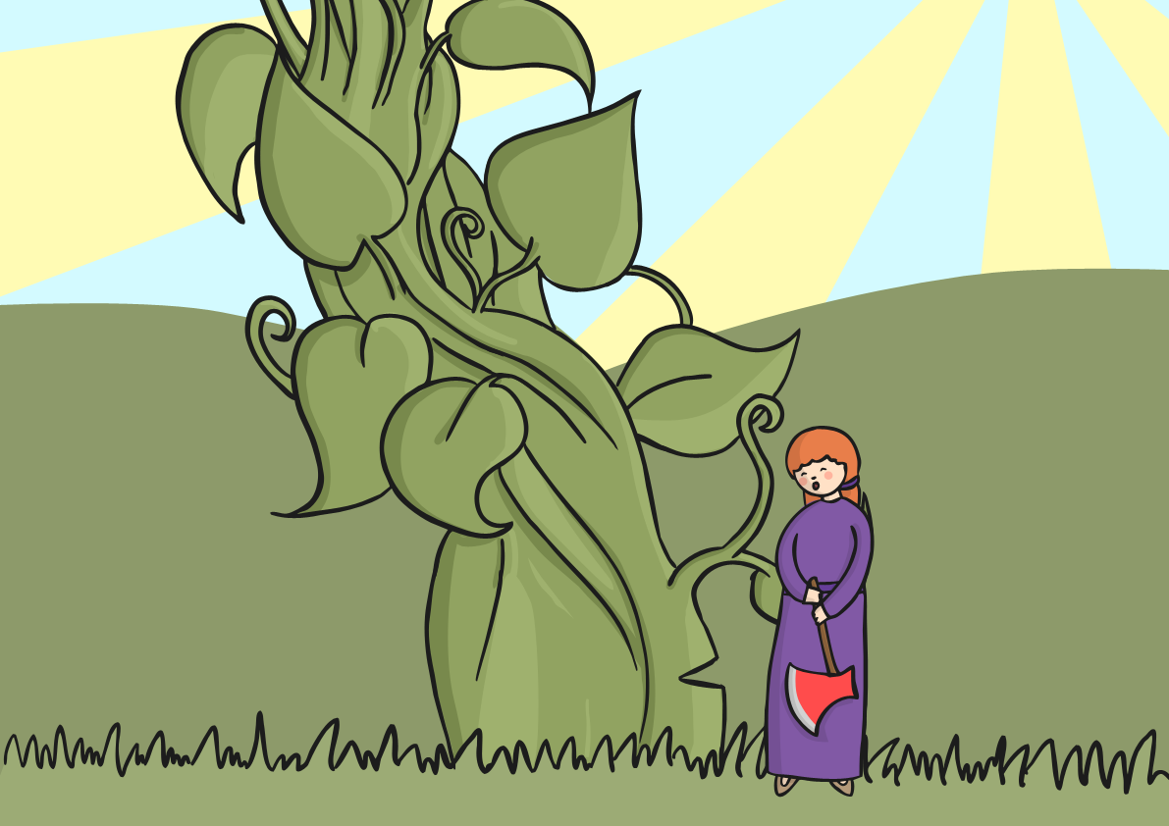
Jack’s mother came out with an axe and cut the beanstalk down.

Slide 21
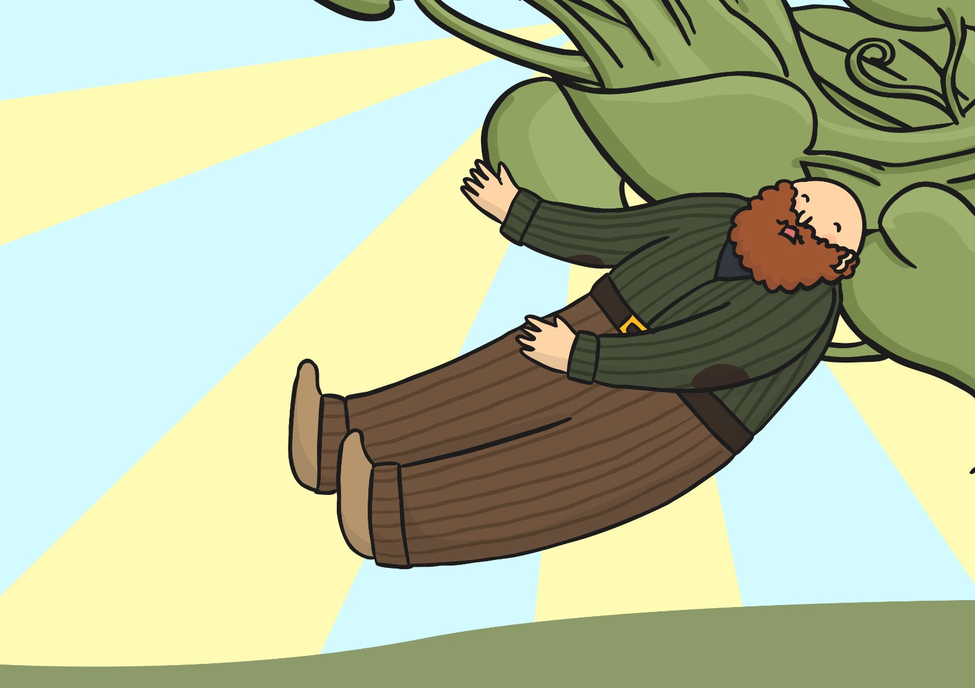
The giant fell and crashed to the ground.
He was never seen again.

Slide 22
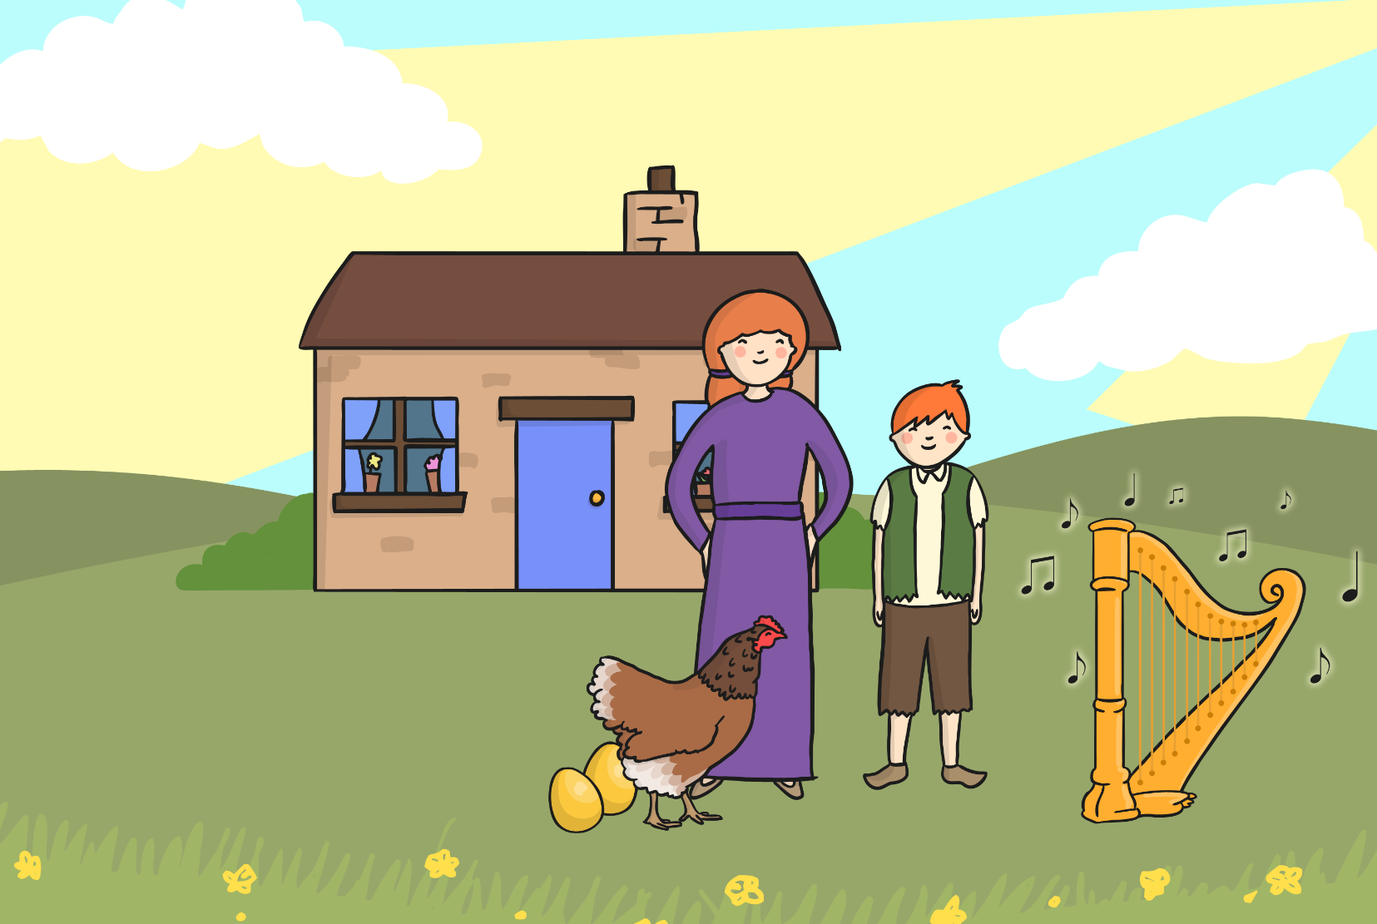
Jack and his mother lived happily ever after.

