Slide 1
Think of three words (positive, negative or neutral) about spelling.
Your own personal experience or how you think children feel about it.

Slide 2
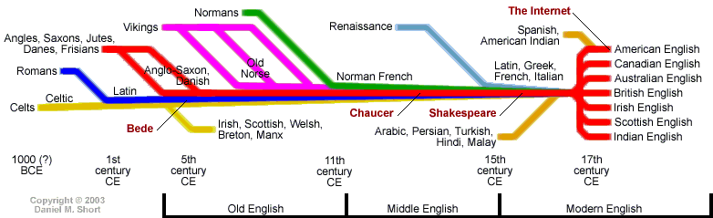
We have a very complex language!

Slide 3
Phonics
What do you know about phonics?

Slide 4
Phonics is the teaching of reading and spelling

Slide 5
At times our language may seem inconsistent and irregular in terms of spelling but there is a pattern!
Phonics discretely teaches children the phonemes (sounds) and all of the graphemes (spellings) which represent them.

Slide 6
At Northway, the teaching of phonics and spelling has been designed to help children to become fluent, confident readers and writers as soon as possible.
In EYFS and KS1 children are taught reading and spelling in discrete phonics sessions, in a fun and creative way. The lessons are underpinned by the programme ‘Letters and Sounds’ but have been designed so children revisit the more complex sounds each term and in more complex words. They are discretely taught each sound and in Summer term, move to looking at ‘sound families’ to support their using of the correct spelling of a sound in a word.

Slide 7
Phonics is a whole school teaching strategy

Slide 8
From Year 2 to Year 6, the majority of children move to a spelling programme called Read Write Inc in which their spelling skills are embedded. Children have a 15-20 minute spelling lesson every day where they learn spelling rules and practice spelling a range of words with these spelling patterns. Each week they focus on a different spelling pattern.
Read Write Inc supports the new curriculum exceptionally well and aims to provide your child with an advanced knowledge of spelling which they will apply to their writing.

Slide 9
Spellings of the Sounds!

Slide 10
 | "ae"
b a b y |  | p l ay
n a m e |  | r ai n
great |  | eight

Slide 11
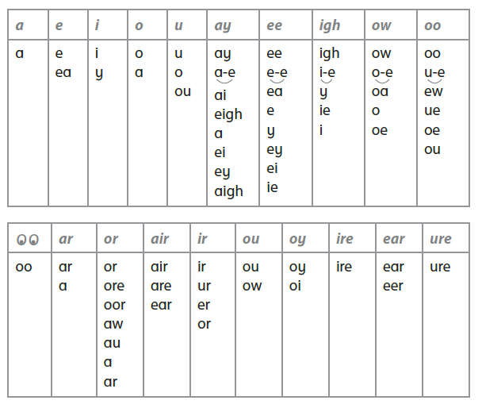

Slide 12
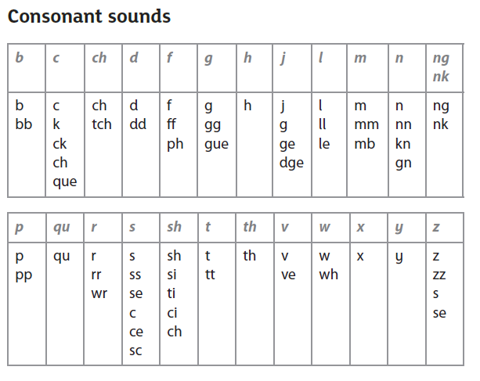

Slide 13
We teach one sound (or sound family) a week.

Slide 14
Technical Vocabulary (Don’t panic!)

Slide 15
Phoneme
Grapheme
Digraph/trigraph
Split digraph
GPC
Blend
Segment

Slide 16
Phoneme-sound you hear ‘a’
Grapheme the written representation of the sound ai/ay/a-e
Digraph/trigraph grapheme were 2/3 letters represent 1 sound
Split digraph two letter represent a sound but are split by another letter.
GPC grapheme phoneme correspondence
Blend combining the sounds to read the word
Segment split a word into sounds (not letters) when reading or spelling

Slide 17
How we teach children to read (blend) and spell (segment) using the sounds.

Slide 18
Dots and Dashes
play
like
snail
these

Slide 19
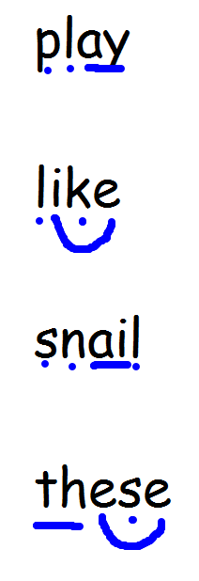
Dots and Dashes

Slide 20
Common Exception Words
the
was
like
where

Slide 21
Supporting children in the classroom
(outside of the phonics lesson)

Slide 22
If a child asks you for a spelling, how do you answer?

Slide 23
If we only tell children the letter names, we are giving them the spelling but not the tools to allow them to spell the word independently next time.

Slide 24
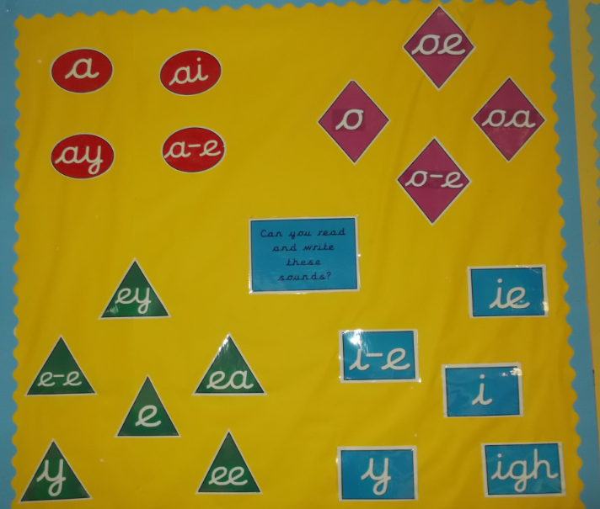
Children become familiar with the common spellings of sounds. They become more skilled at recognising when they have the correct phoneme but the wrong grapheme as the word doesn’t ‘look right’. They apply their reading skills to do this.

Slide 25
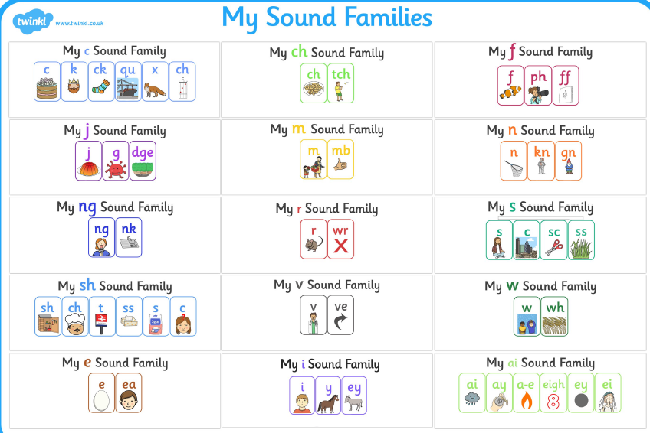

Slide 26
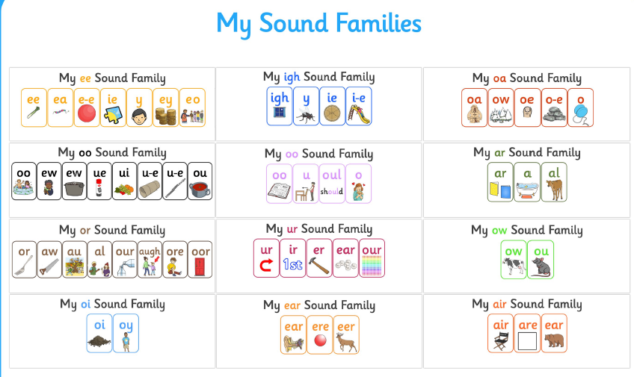

Slide 29
In Year 1 children sit the ‘Phonics Screening Test’. Children who do not reach the expected standard in Year 1 have to re-sit the test in Year 2.
They have to read (not spell) 20 real words and 20 pseudo words containing sounds up to phase 5. Most words contain more than one diagraph in them.
Shine Whape
Scrap Braft
Stroke Thrant
Waiting Strow
Portrait Sprop

Slide 30
At Northway, our children score well above the national average during the annual Year 1 Phonics Screening check.
Children who do not meet the required standard in Year 1, retake the check in Year 2.

Slide 31
Read Write Inc

Slide 32
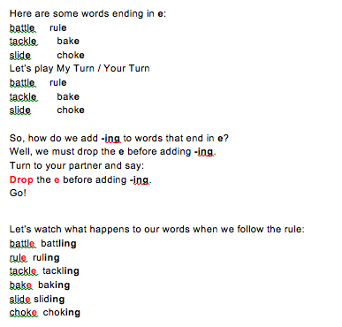
Read Write Inc

Slide 33
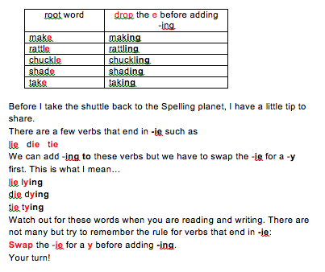
Read Write Inc

Slide 34
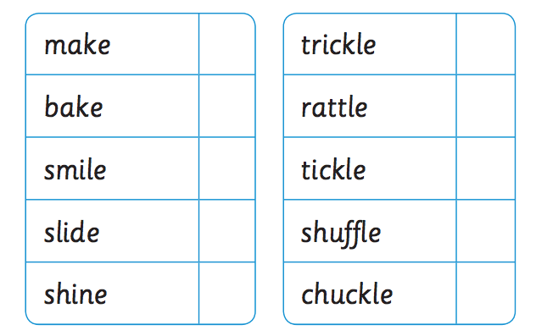
Read Write Inc

Slide 35
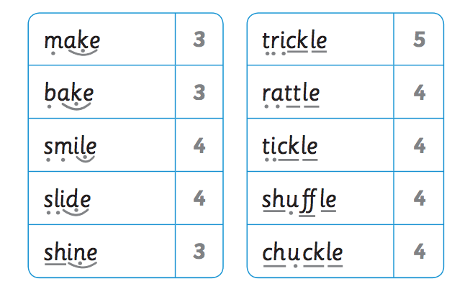
Read Write Inc

Slide 36
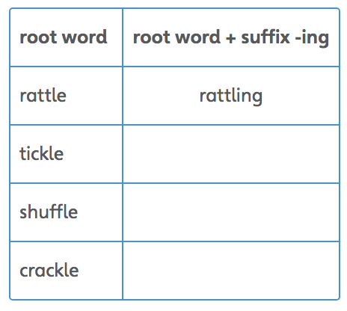
Read Write Inc

Slide 37
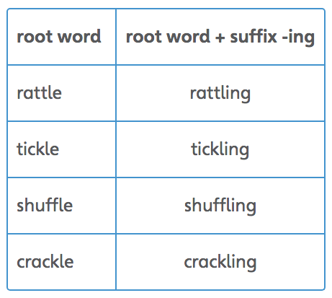
Read Write Inc

Slide 38
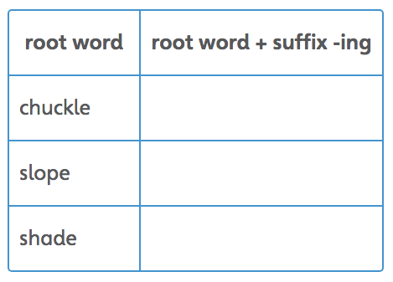
Read Write Inc

Slide 39
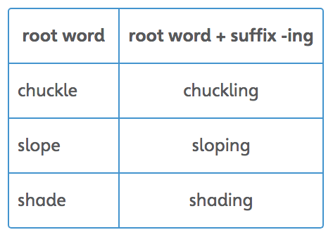
Read Write Inc

Slide 40
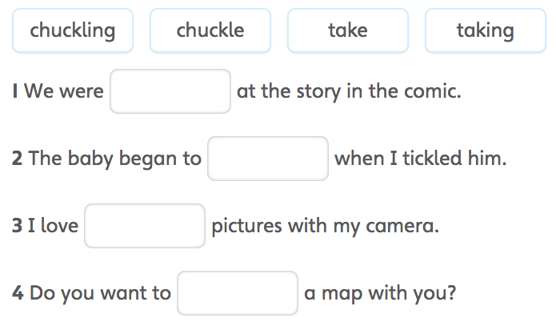
Read Write Inc

Slide 41
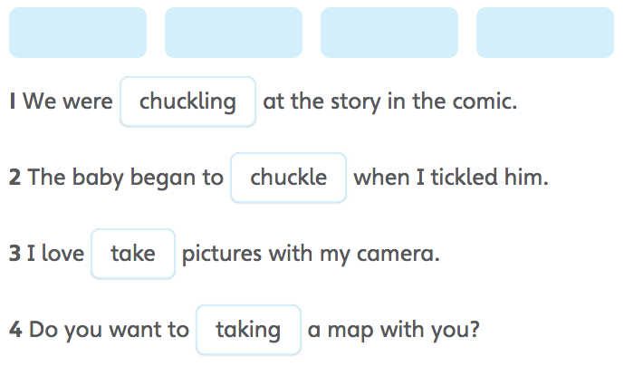
Read Write Inc

Slide 42
Using phonics when supporting your child at home:
Home reading
Learning spelling
Year 1 and 2 Common Exception Words

Slide 43
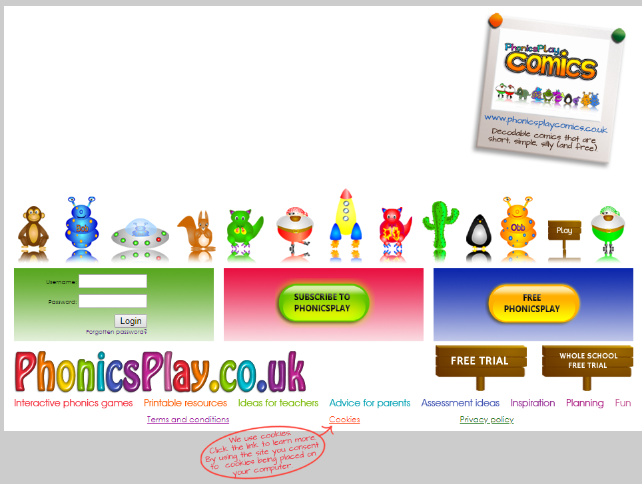
Phonics Play
Username – northway
Password – l319aa
https://www.phonicsplay.co.uk

