Slide 1


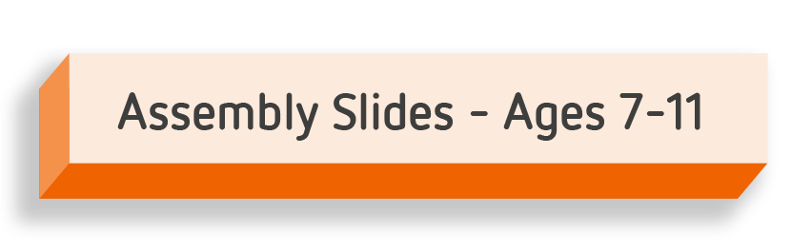

Slide 2

What is
Safer Internet Day?
Notes:
Today is Safer Internet Day (if applicable). Safer Internet Day is celebrated across the globe in over 170 countries, with thousands of children joining in across the UK. It’s a day when we celebrate all the great things about being online and remind ourselves how we can stay safe.

Slide 3
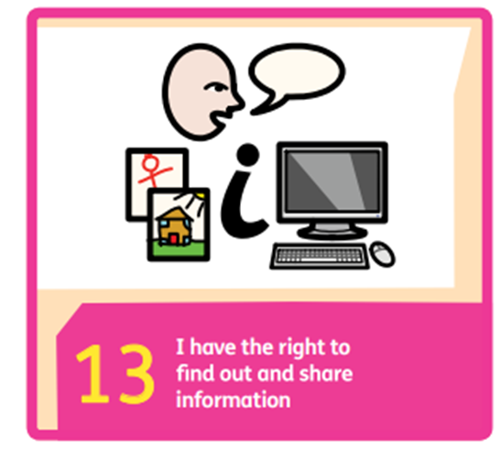
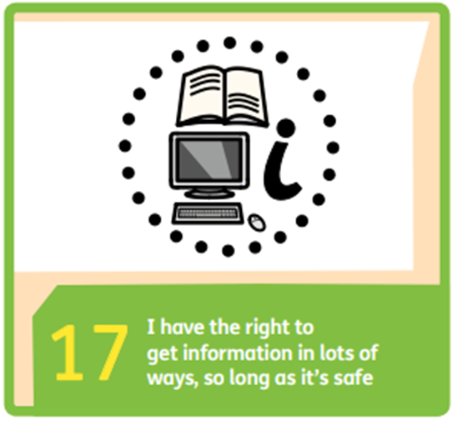
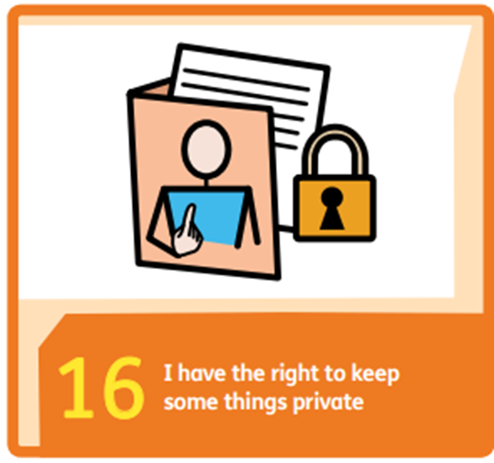

Slide 4
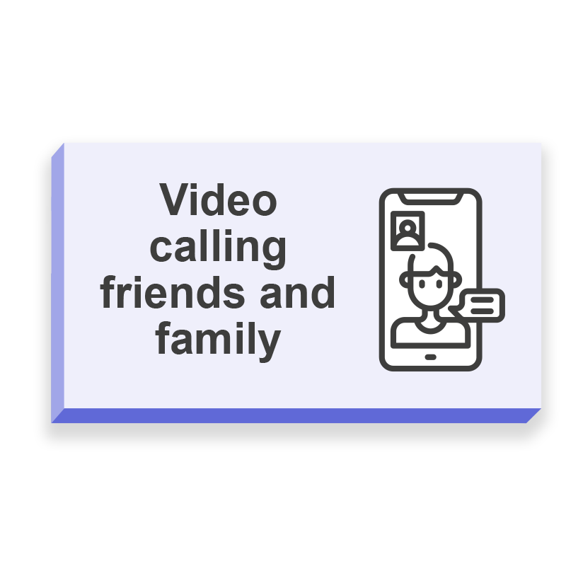
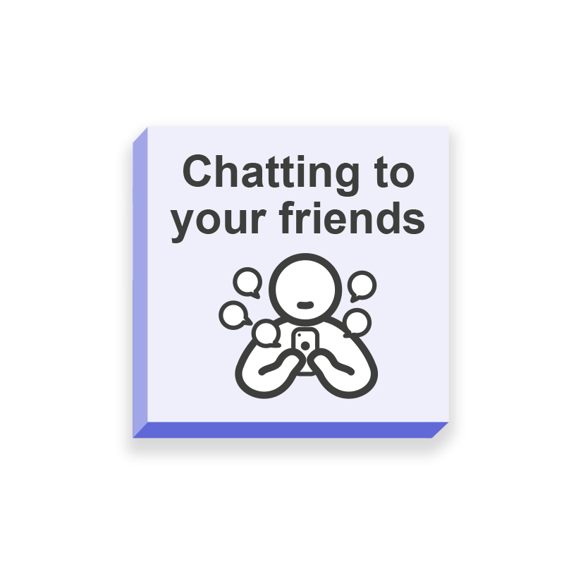
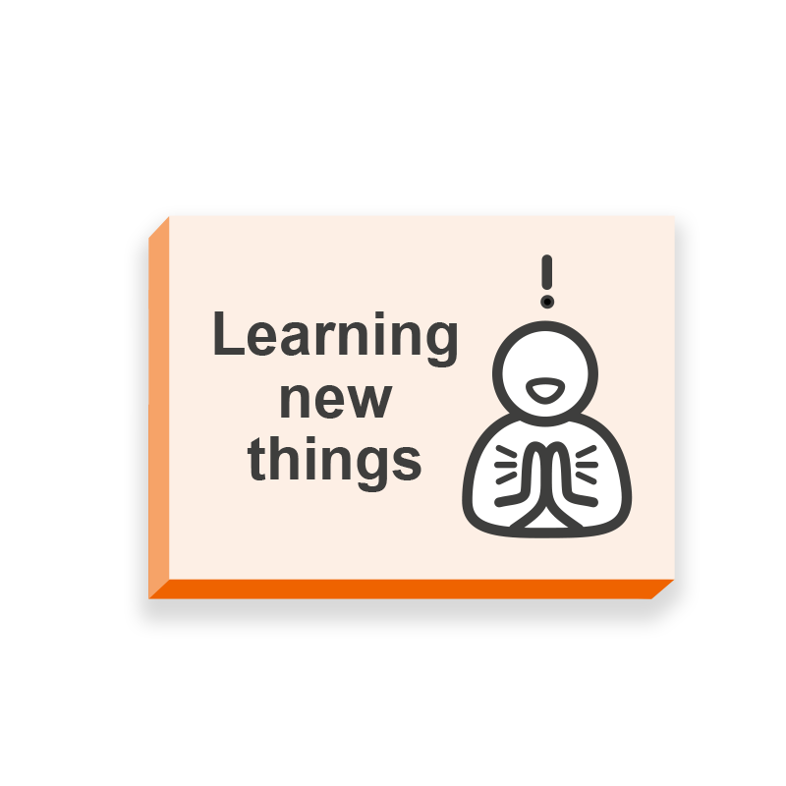

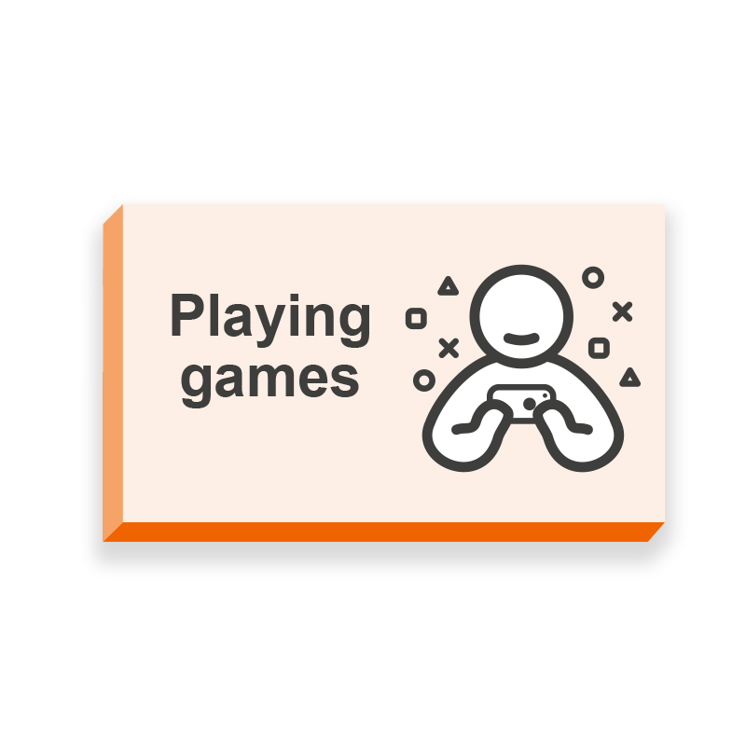

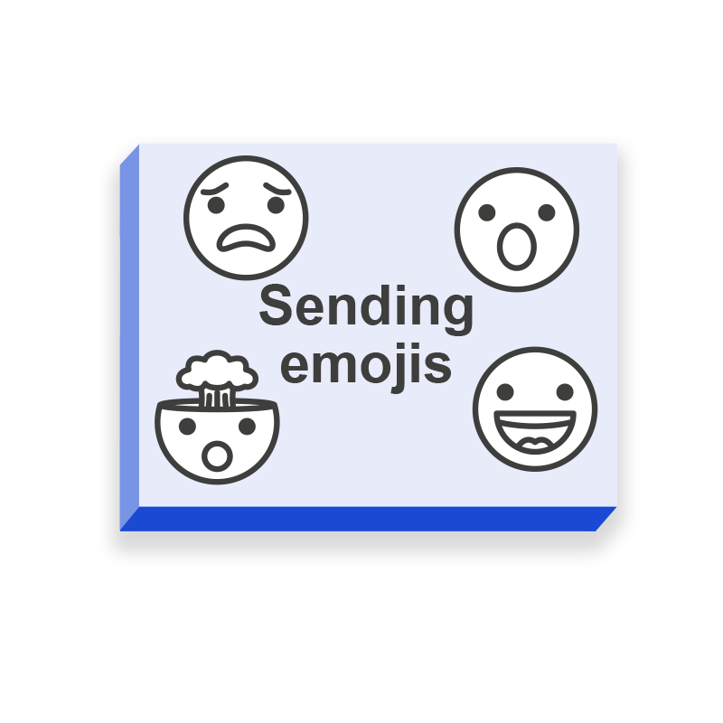
How do you have fun online?
Notes:
On Safer Internet Day we celebrate the best parts of being online:
Put your hand up if you do any of these things online
Video calling friends and family
Chatting to your friends
Learning new things
Listening to music
Watching videos
Sending emojis
Playing games
Wow! They’re so many amazing things to do online – let’s focus on that last one.

Slide 5
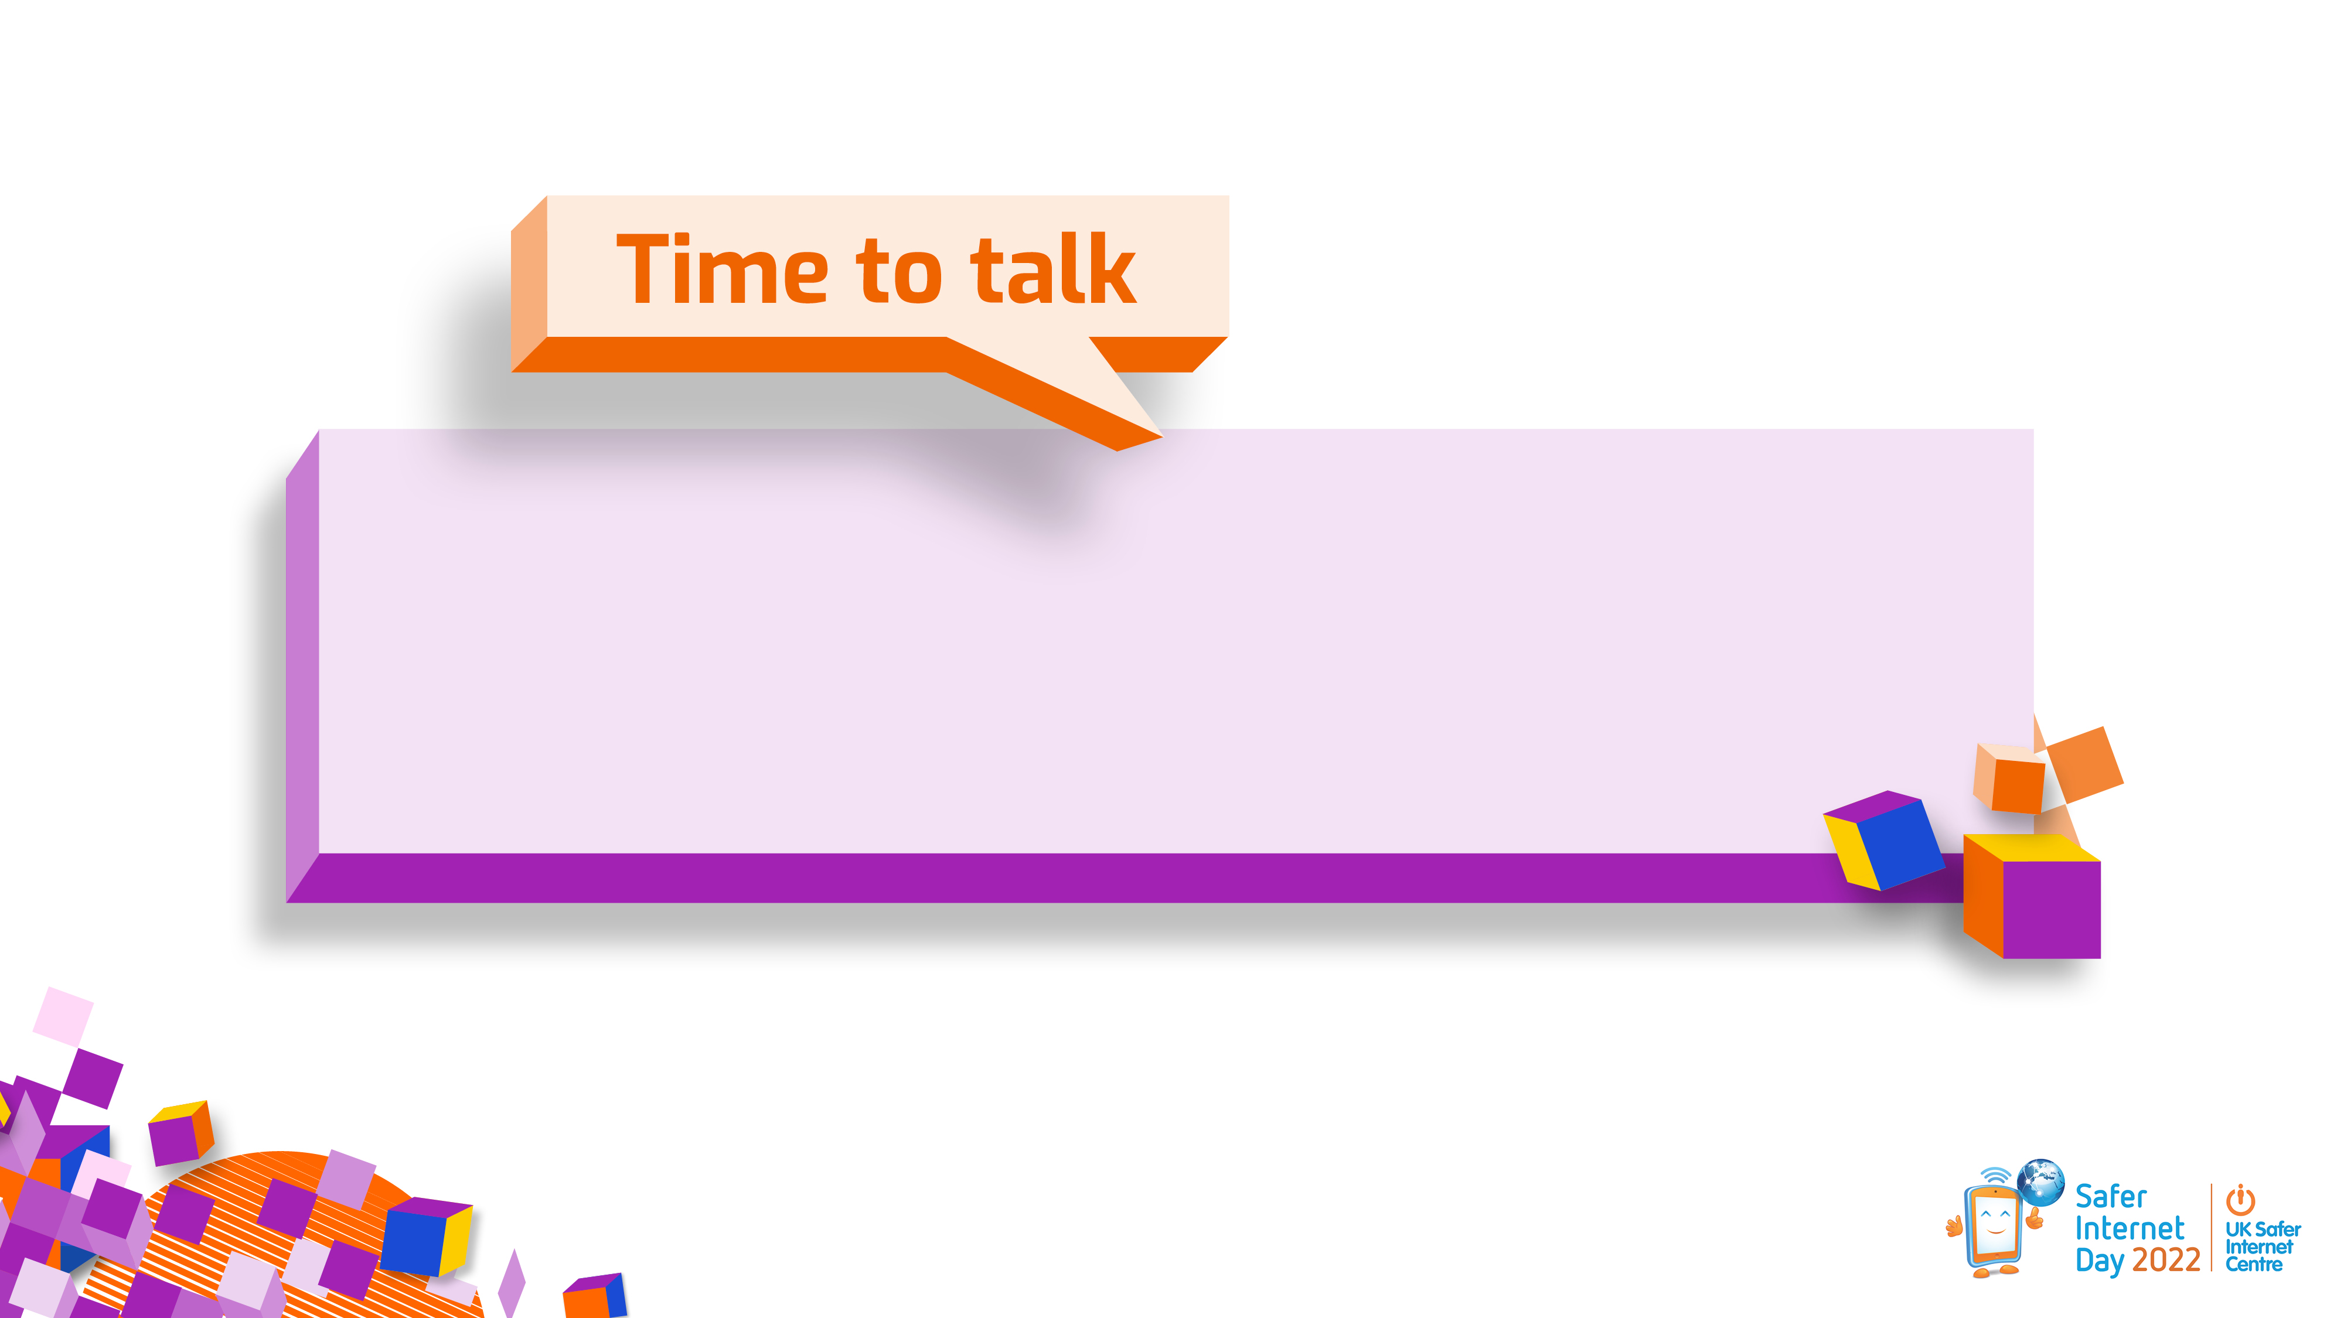
What games and apps do you enjoy?
Notes:
I’m going to give you 30 seconds to turn to the person next to you and tell them about your favourite apps and games for having fun.
Give a short time for learners to discuss, then take a selection of responses.
It’s amazing to hear about all the apps and games you enjoy using online.
Today we are going to be thinking about them further because this Safer Internet Day is all about respect and relationships when playing your favourite games and having fun online.

Slide 6
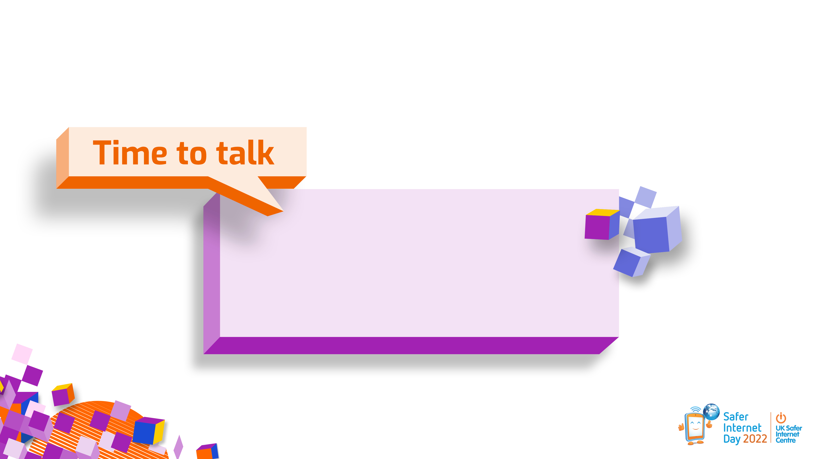
Today we are thinking about respect online.
What does respect mean?
Notes:
Have you heard of the word, ‘respect’?
I’m going to give you 30 seconds to turn and tell the person next to you what you think ‘respect’ is and then we’ll discuss this as a group.
Allow 30 seconds to pass.
Who would like to share what they think respect is?
Take 3-5 answers.
Thank you for sharing your ideas!

Slide 7
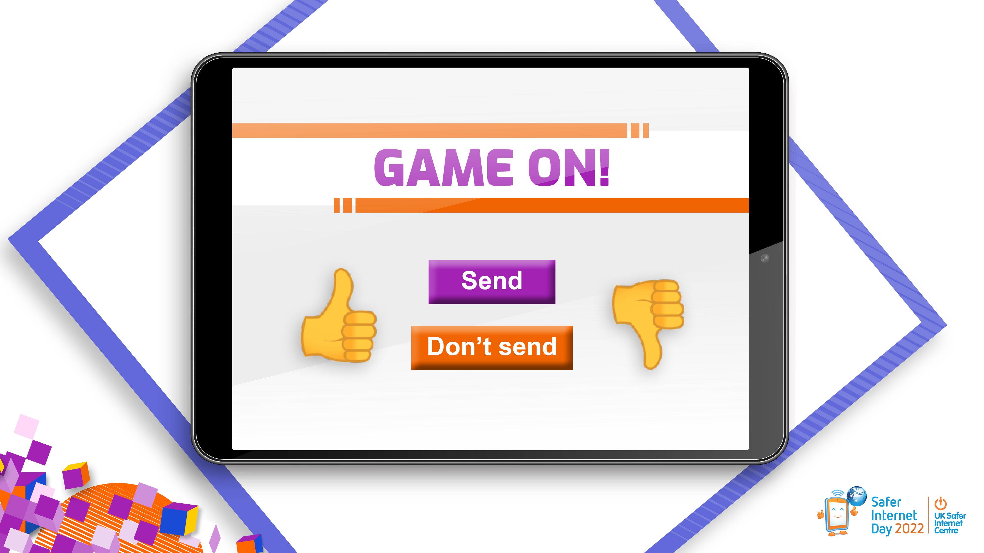
Notes:
Note for educators: Choose the most appropriate examples for your learners from slides 8-14, dependent on time available.
To help us explore what respect looks like some more, let’s look at some examples together in ‘Game On!’
For each example shown on the screen you need decide if the final message is okay or not okay to send. Does it look respectful or not? You can put your thumbs up if you think it’s okay or thumbs down if you think it’s not okay.
After each one, I may pick some of you to share your reasons and we can discuss what might be a better, more respectful response.
Let’s have a look at the first one.

Slide 8

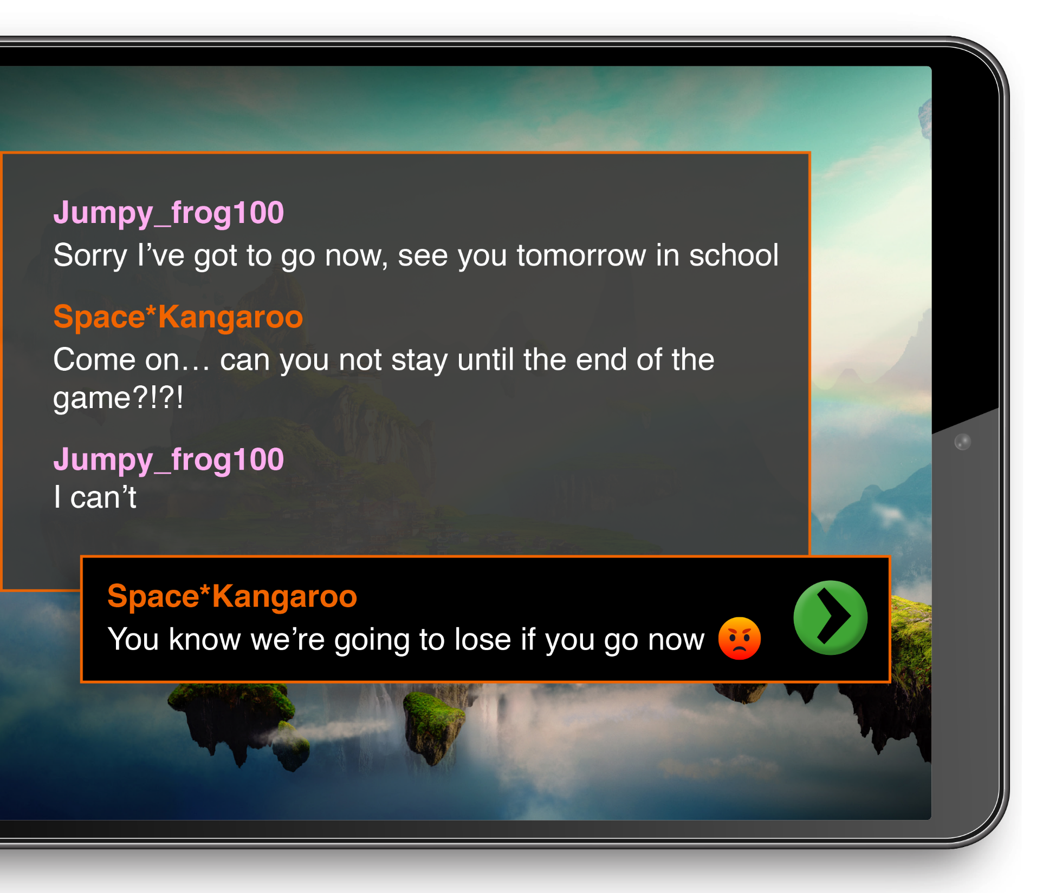


Not everyone is available all the time. It’s not okay to put pressure on someone or make them feel guilty if they need to leave a game.
What could Space*Kangaroo say or do instead?
Notes:
Read out the gaming chat shown on the slide.
Let’s look at the last message. Put your thumbs up if you think this message is okay to send and put your thumbs down if you think it’s not okay to send.
Take 2-3 reasons for their decision and discuss.
Let’s have a look at some advice. Click and read advice bubble.
Ask the learners if there is another more respectful message they could send. Take 1-2 answers.
Now let’s look at the next example.

Slide 9
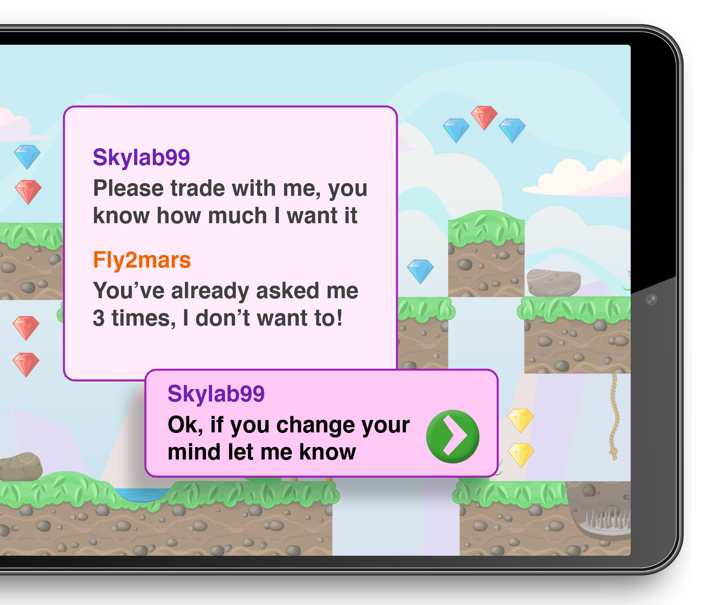



It can be fun to trade things with other people, but remember not everyone wants to trade all the time and it’s okay to say no. Skylab99 has done the right thing here by accepting their decision.
Remember – a trade should always be done using the official trading feature in the game. This will help make sure it happens safely. But you should still make sure that you feel the trade is fair before accepting.
Notes:
Read out the gaming chat.
Put your thumbs up if you think the final message is okay to send and put your thumbs down if you think it’s not okay to send.
Take 2-3 reasons for their decision and discuss.
Let’s have a look at some advice. Read advice bubble.
Now let’s look at the next example.

Slide 10
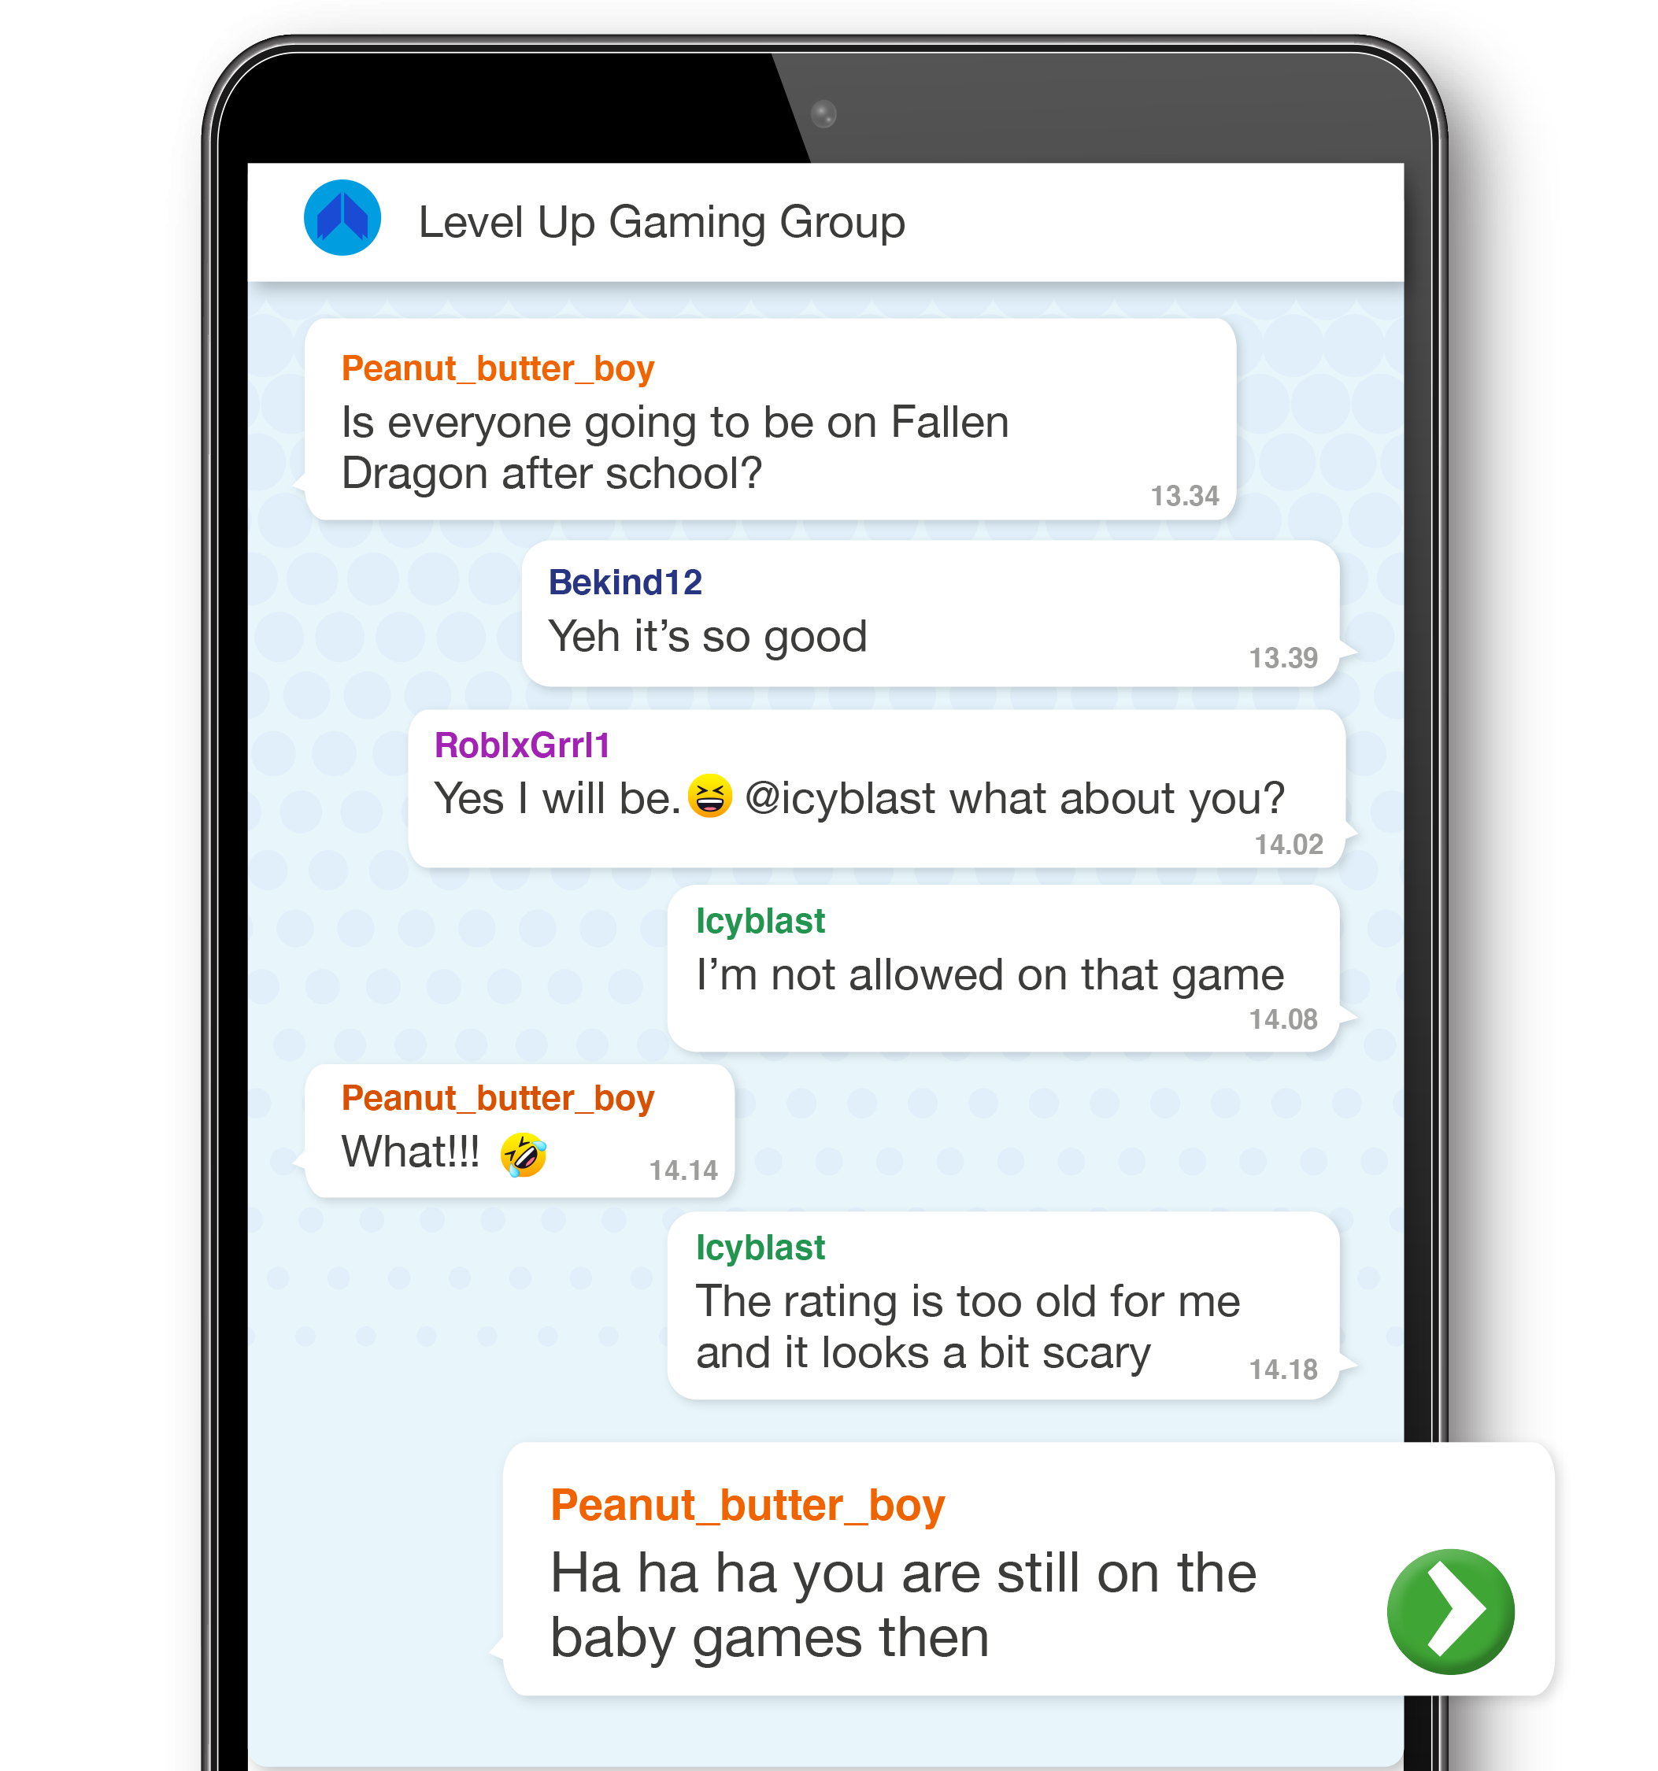
Remember that the age ratings on games are there to help you and your families decide whether you’re ready to play them yet.
Someone you live with might give you permission to play on a game, but that doesn’t mean everyone else is allowed to or even feels comfortable with the game. It’s important to respect other peoples’ decisions.
What could Peanut_butter_boy or the others in the group say or do instead?
Notes:
Read out the group chat.
Put your thumbs up if you think this message is okay to send and put your thumbs down if you think it’s not okay to send.
Take 2-3 reasons for their decision and discuss.
Let’s have a look at some advice. Read advice bubble.
Ask the learners if there is another more respectful message they could send. Take 1-2 answers.
Now let’s look at the next example.

Slide 11
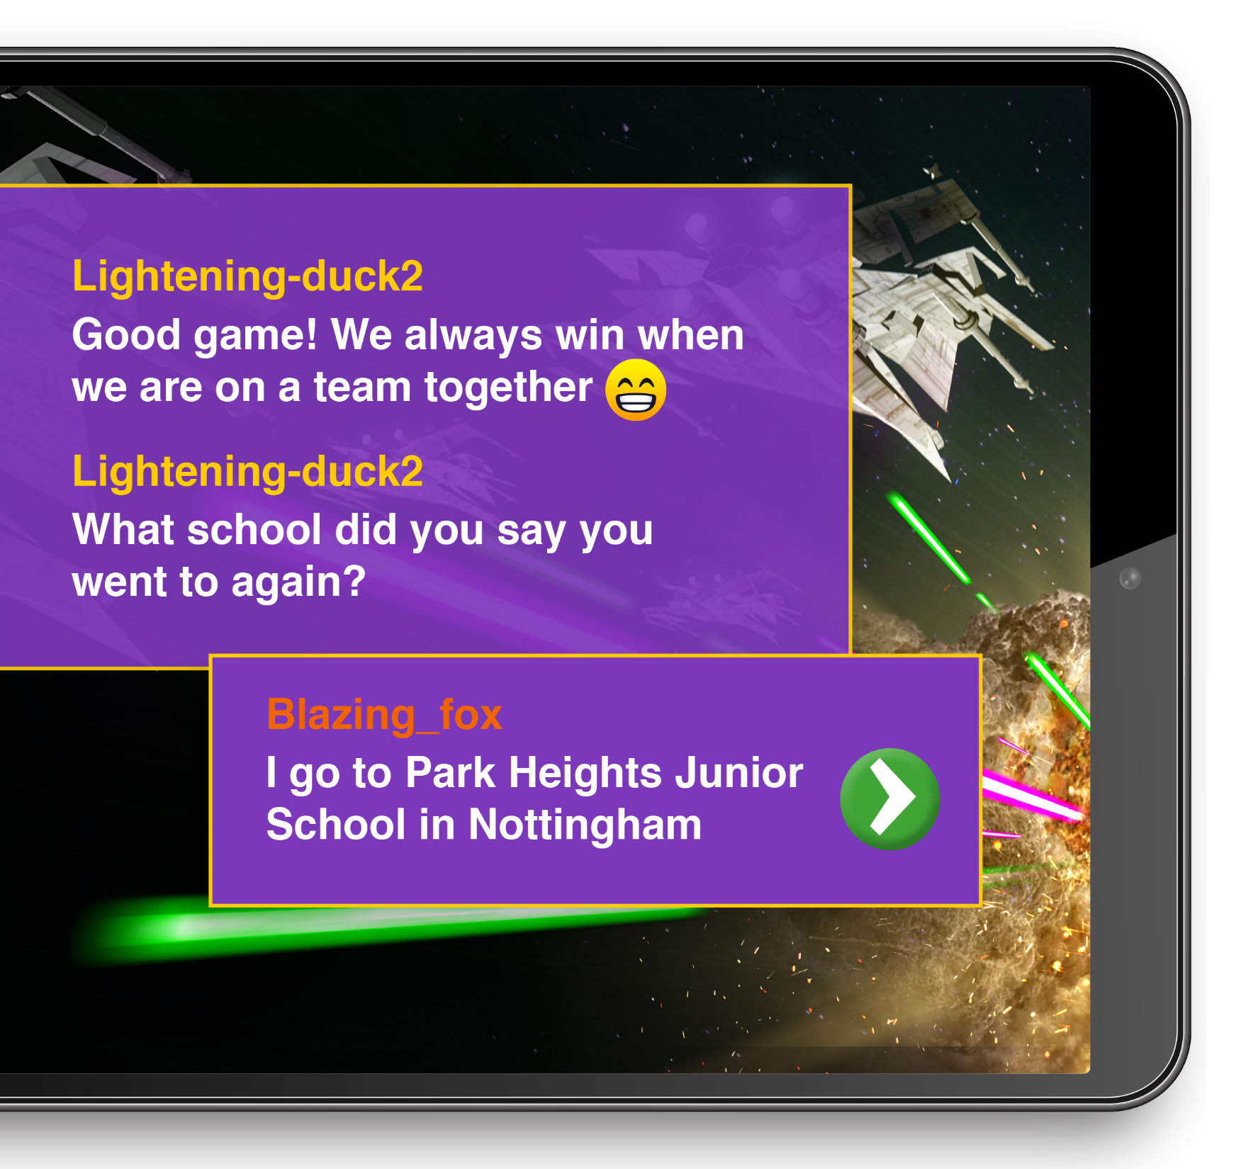
It’s important to keep personal information safe online. Even if you have been playing a game with someone for a long time, if you don’t know them offline they are still a stranger.
Always tell an adult if a player online asks for your personal information or to meet up.
Then together you could:
Say no to sharing personal information and move the conversation back to talking about the game
Decide not to reply at all
Choose to report, block or unfriend the player.
Notes:
Read out the gaming chat.
Put your thumbs up if you think this message is okay to send and put your thumbs down if you think it’s not okay to send.
Take 2-3 reasons for their decision and discuss.
Let’s have a look at some advice. Read advice bubble.
Now let’s look at the next example.

Slide 12
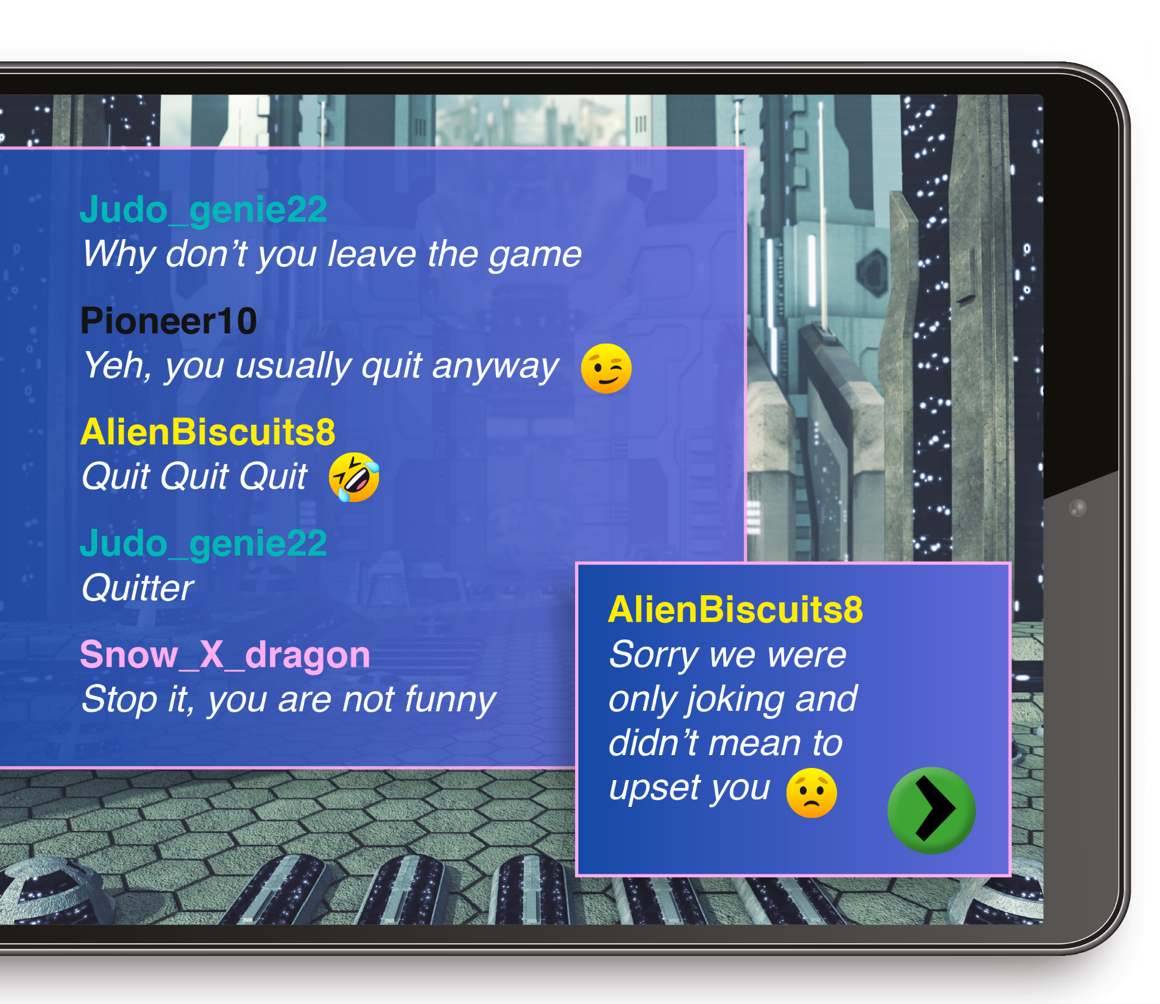
Sometimes what starts as a joke can still really hurt and upset someone. It’s important to think about other people’s feelings. If someone asks you to stop or you think they are upset it’s important to listen and take time to say sorry.
Notes:
Read out the gaming chat.
Put your thumbs up if you think this message is okay to send and put your thumbs down if you think it’s not okay to send.
Take 2-3 reasons for their decision and discuss.
Let’s have a look at some advice. Read advice bubble.
Now let’s look at the next example.

Slide 13
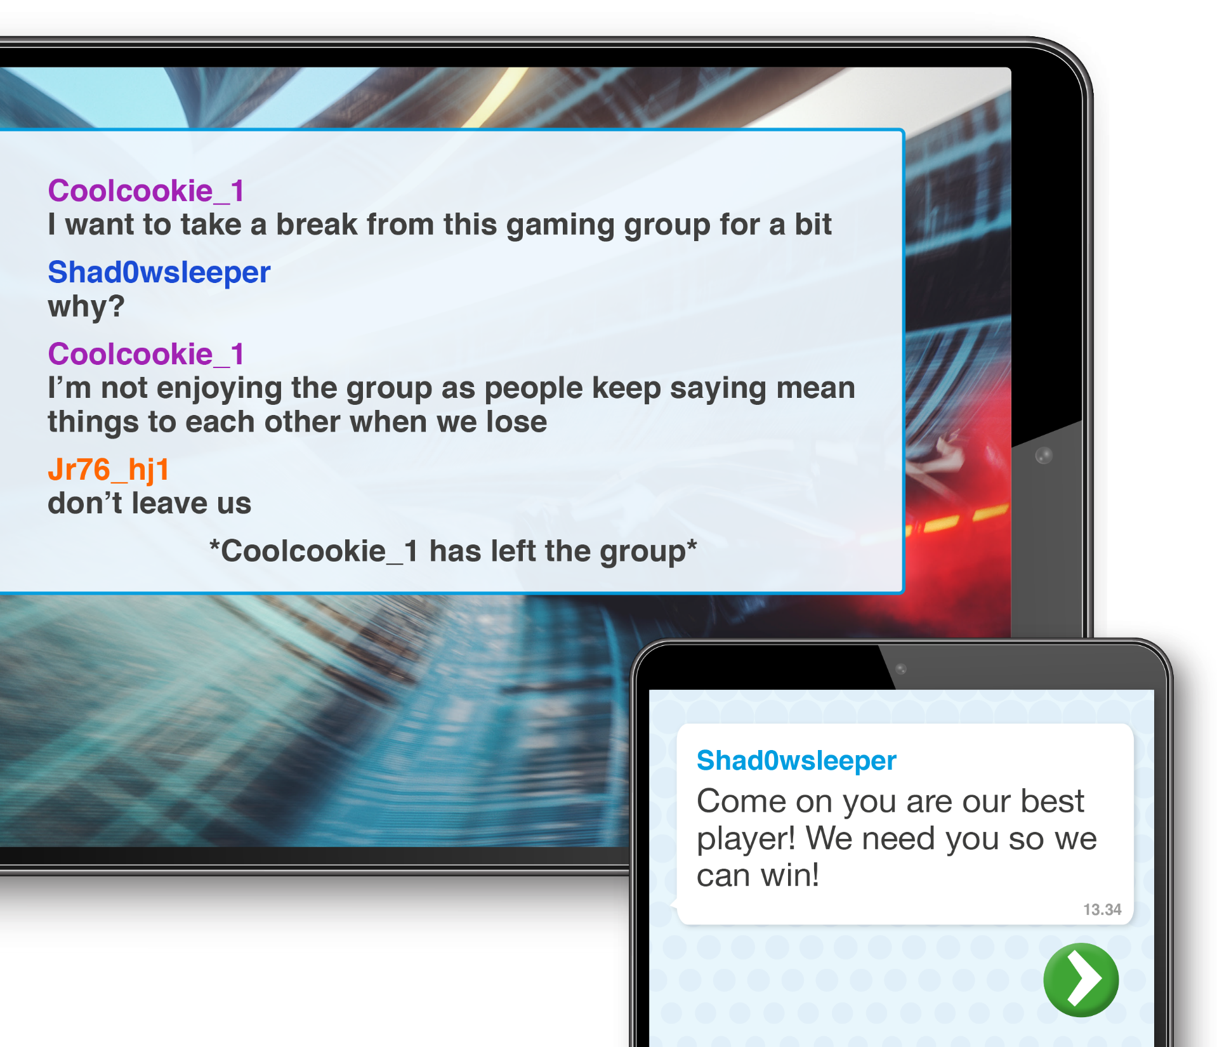
This is a difficult one!
Wanting someone on your team and sending them a message is nice but remember it’s important to respect other peoples decisions and boundaries.
What could Shad0wsleeper do or say instead?
Notes:
Read out the gaming chat.
Then read out the final message and note that this is being sent to the same person but on a different group.
Put your thumbs up if you think this message is okay to send and put your thumbs down if you think it’s not okay to send.
Take 2-3 reasons for their decision and discuss.
Let’s have a look at some advice. Read advice bubble.
Ask the learners if there is a better way to respond. What would they do? Take 1-2 answers.
Now let’s look at the next example.

Slide 14
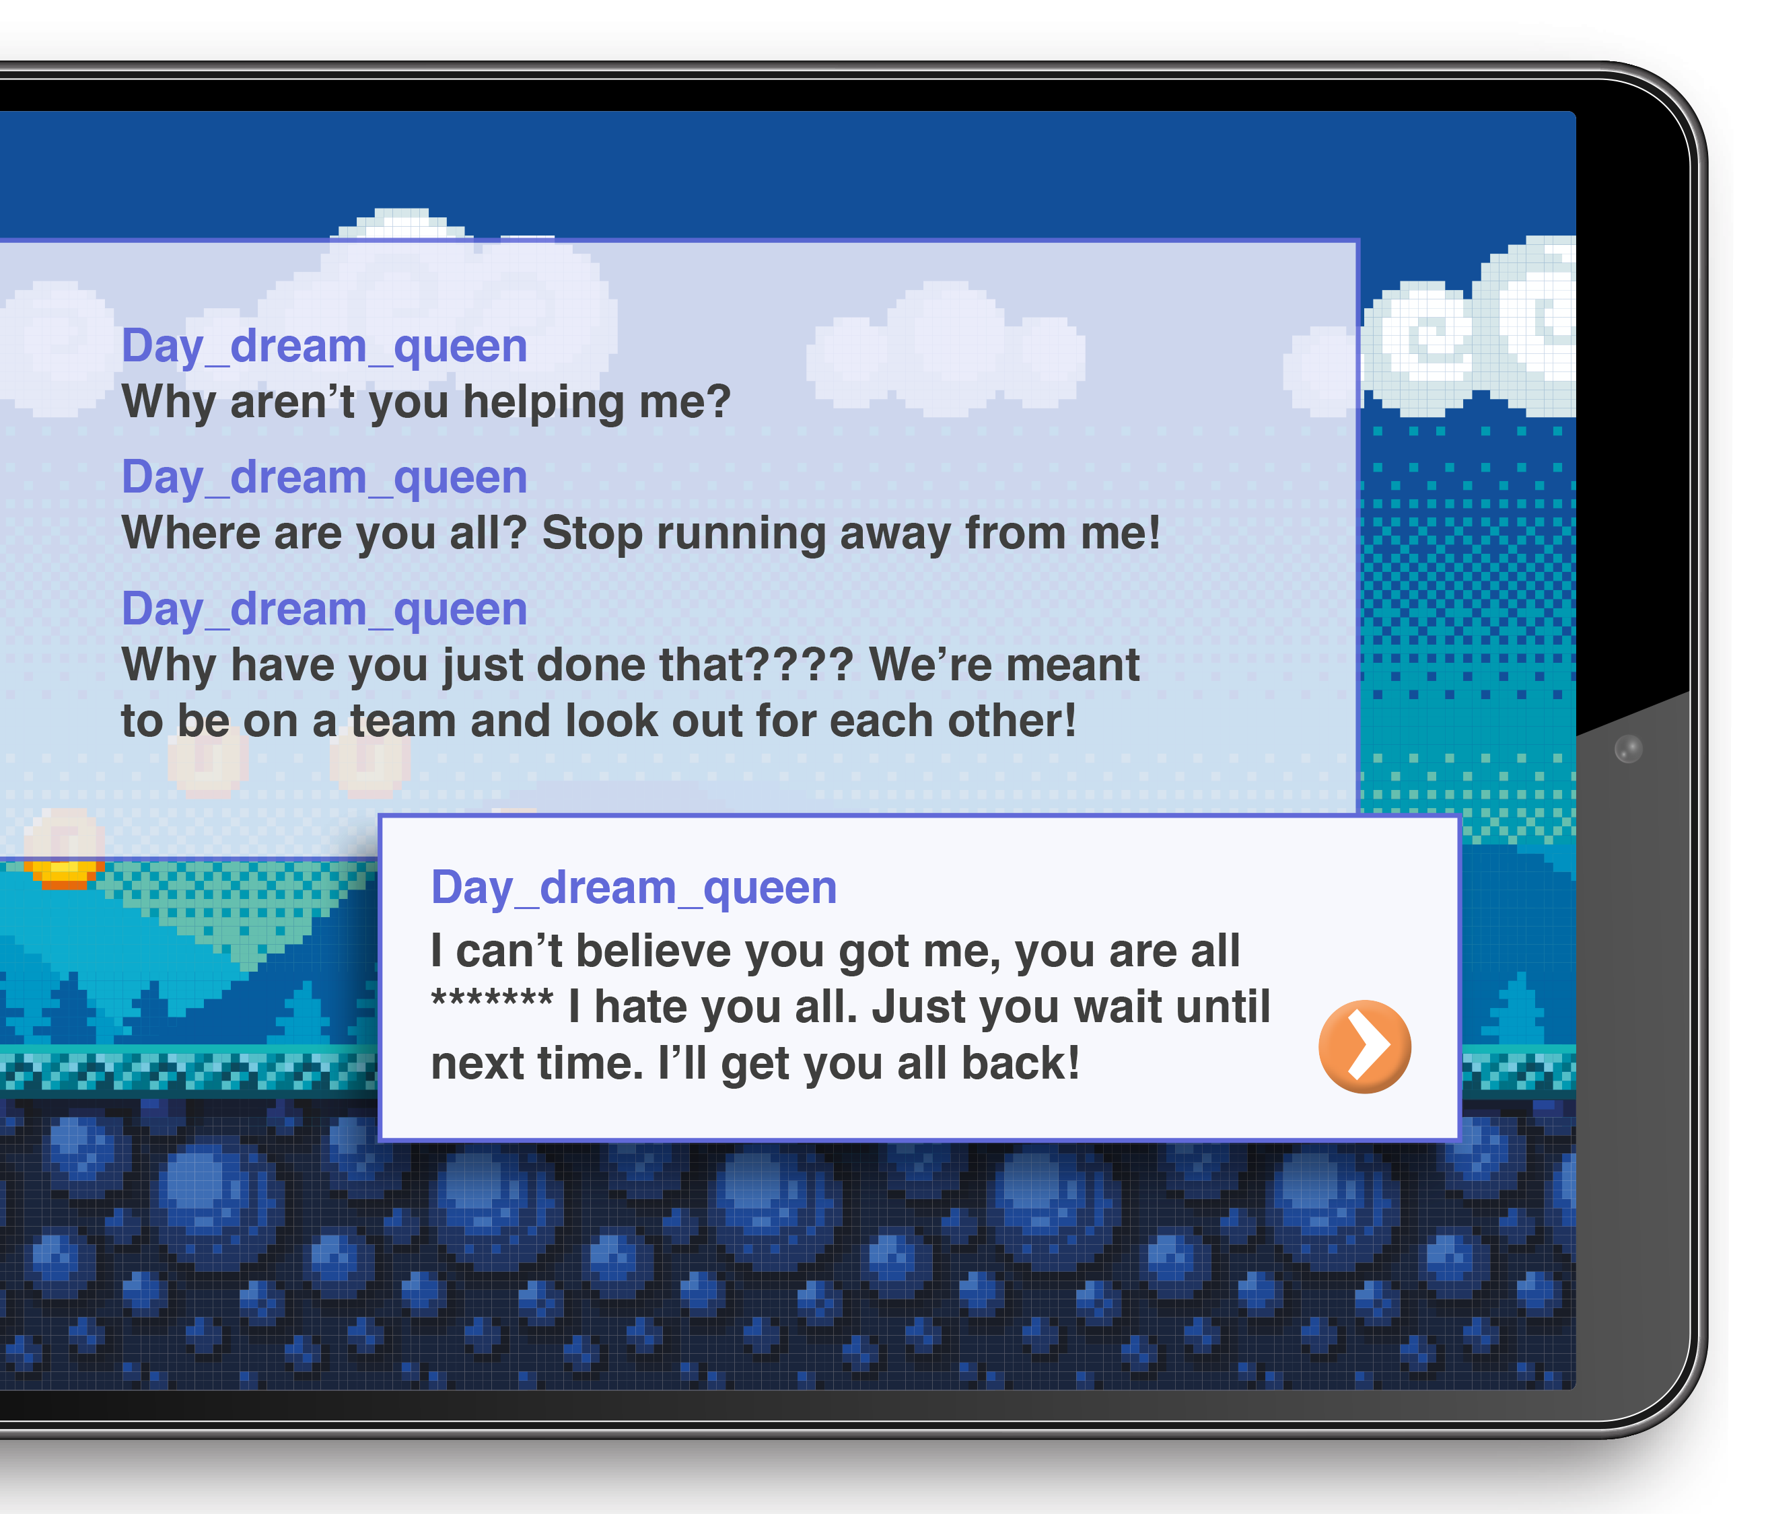
It wasn’t nice or respectful of the other players to treat
Day_dream_queen like that.
But even if someone has been unkind, or you’re feeling angry and upset, it’s never the right choice
to retaliate by sending a mean message back.
What could Day_dream_queen say or do instead?
Notes:
Read out the gaming chat.
Put your thumbs up if you think this message is okay to send and put your thumbs down if you think it’s not okay to send.
Take 2-3 reasons for their decision and discuss.
Let’s have a look at some advice. Read advice bubble.
Ask the learners if there is a better way to respond. What would they do? Take 1-2 answers.

Slide 15
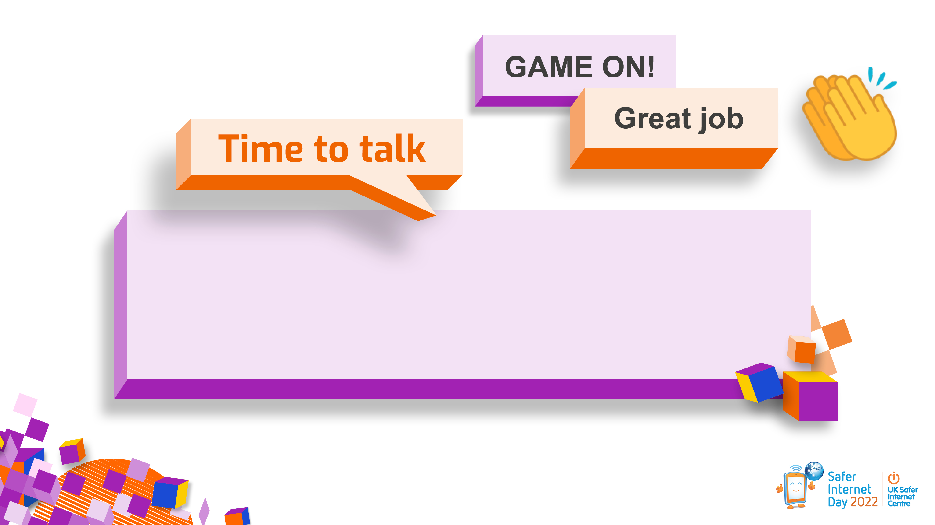
What does being respectful online look like?
Notes:
Well done everyone! Now we’ve had some practice at making respectful choices online, I wonder if you could help answer the next question.
What does being respectful online look like?
I’m going to give you 30 seconds to turn to the person next to you and share your ideas.
Take 3-5 answers.

Slide 16

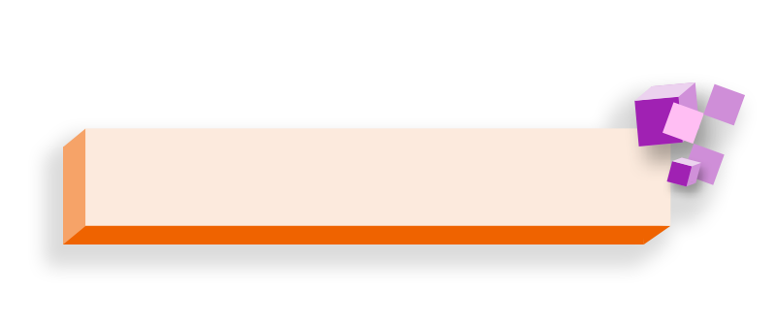




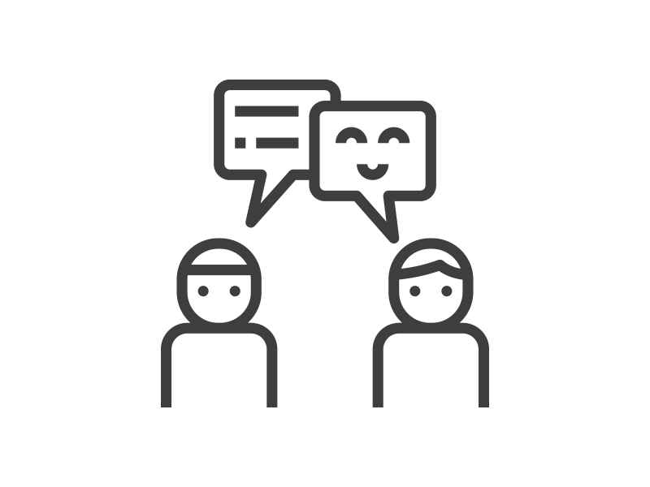




Being respectful online means:
Including people
when they want Listening to other people to be included
Understanding that someone might not want the same things as you
Being kind and supportive
Thinking about how your words and actions make other people feel
Not putting pressure on someone and accepting their boundaries
Notes:
Great answers everyone. Being respectful online means…
Read out slide on how to be respectful online.

Slide 17




Take a screenshot
If someone is being
disrespectful you can…
Tell them how you feel or ask them to stop politely
Block
Report
Notes:
We know that sadly not everyone online is respectful all the time. If someone is being disrespectful online, here are some things you can do.
Read strategies from the slide.

Slide 18







but if anything online makes you feel…
Upset
Scared
Curious
Angry
Worried
Confused
What can you do?
Notes:
But remember if anything at all online makes you feel upset, scared, angry, worried or confused… can anyone tell me, what’s the most important thing to do?
Take answers until a learner says ‘tell someone/an adult’ then move on.

Slide 19
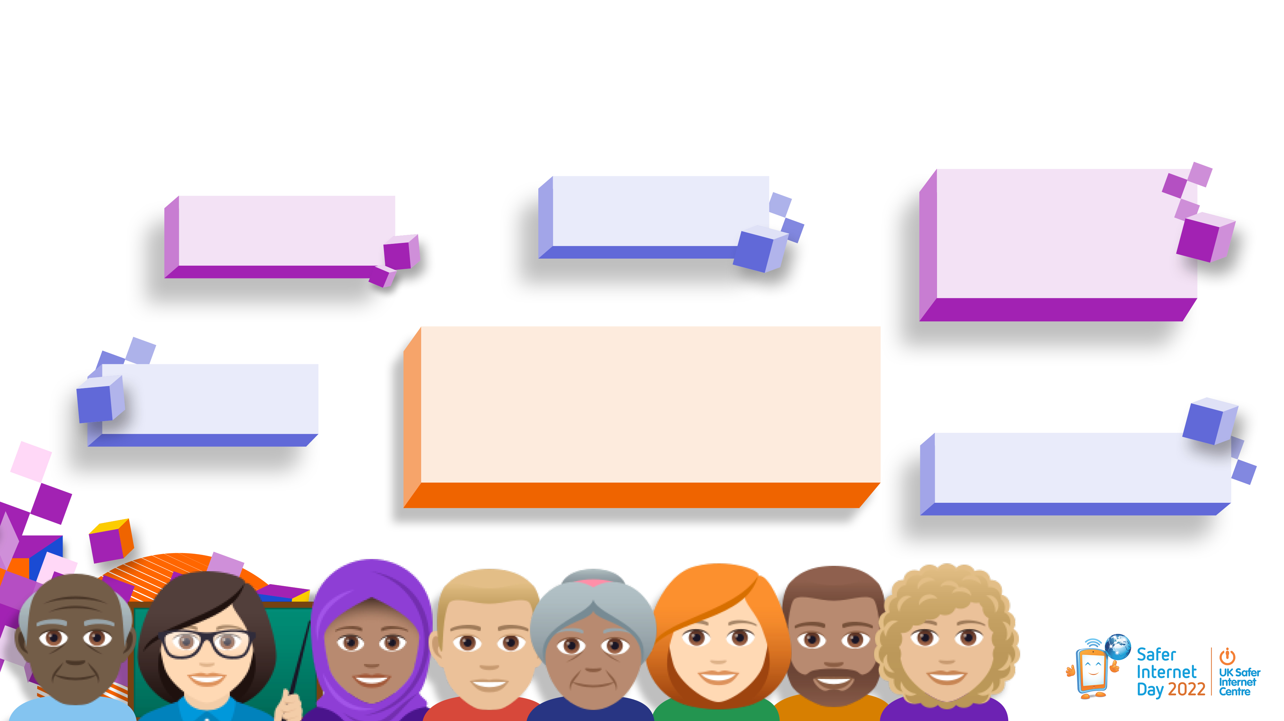
Talk to an adult for help and support!
Mum
Teaching Assistant
Teacher
Any adult you know and trust
Dad
Grandparent
Notes:
That’s right, the most important thing of all is to talk to an adult you trust for help. That could be an adult at school or at home.

Slide 20



You might
not be able to control other people’s behaviour but you can control your own and
make respectful choices!
Notes:
Remember that when you are online you might not be able to control other people’s behaviour, but you can control your own and make respectful choices!
You’ll be learning more about respect and relationships online later today/this week (if applicable).
Thank you for joining in and sharing your thoughts. I hope everyone has a happy Safer Internet Day this year!

Slide 21


