Slide 1




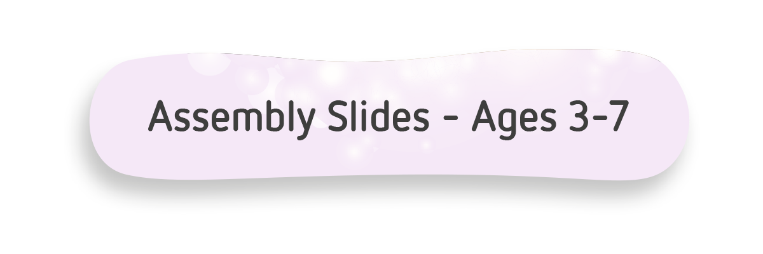




Slide 2



What is
Safer Internet Day?
Notes:
Today is Safer Internet Day (if applicable). Safer Internet Day is celebrated across the globe in over 170 countries, with thousands of children joining in across the UK.
It’s a day when we celebrate all the great things about being online and remind ourselves how we can stay safe.
This year for Safer Internet Day, we’re looking at two things: having fun online, like playing your favourite games or watching your favourite shows, and how you behave with other people online.
Firstly, let’s have a quick think about what we mean by the word online.
Can anyone give me another word for what online means?
[Using the internet].
You’re absolutely right! Going online, means using the internet.

Slide 3
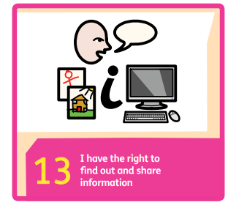
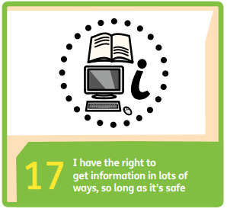
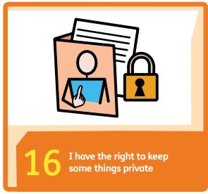
What is
Safer Internet Day?

Slide 4


















What can you do online?
Notes:
There are so many things you can do online, and the internet can help to make things easier
This slide shows us just a few of the amazing things that you can do online, or that you might see people in your family doing at home.
[Click for animation]. You might use the internet to chat, or video call family and friends that you’ve not seen for a while.
[Click for animation]. You might watch TV shows, or movies, or listen to music online.
[Click for animation]. You can find out what’s happening in the news or use the internet to find out new things.
[Click for animation]. You or your family might share photos, or videos – if you have a talent for something…
[Click for animation]. Or, one of the things you might do is play games online.

Slide 5
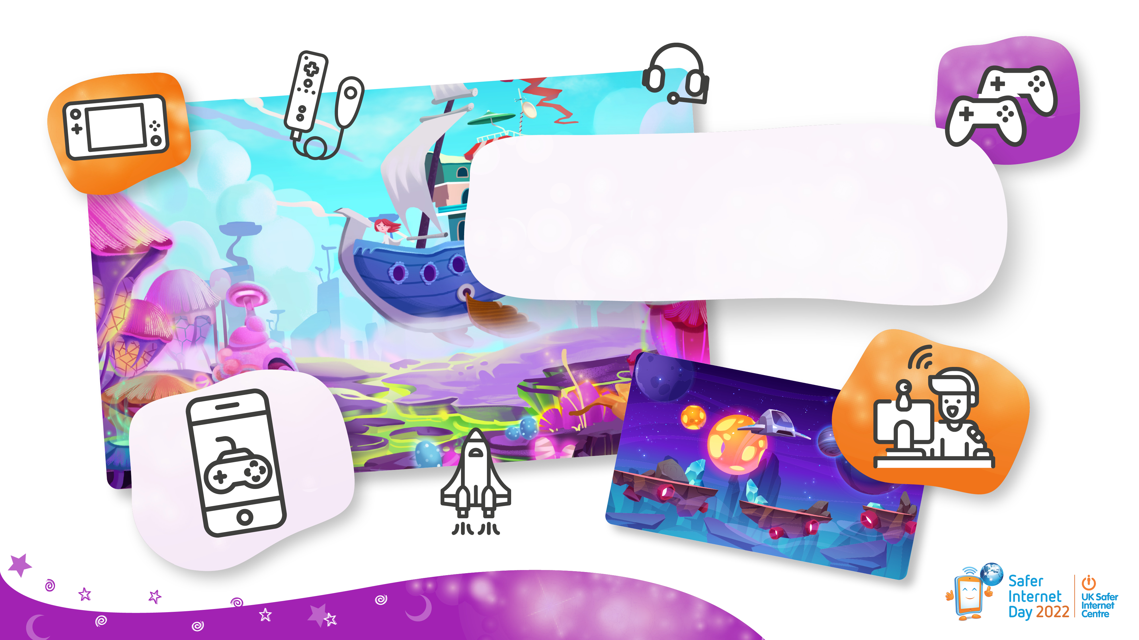
Who likes playing games online?
Notes:
Can you give me a hands-up if you like playing games online? Or if anyone else in your house does.
Fantastic!
I’m going to give you one minute to have a chat with a friend next to you, to let each other know what your favourite games are, and why you like them so much. Go!
Wait one minute then take some answers.
Wow, it sounds like playing games is a really popular and fun thing to do!

Slide 6



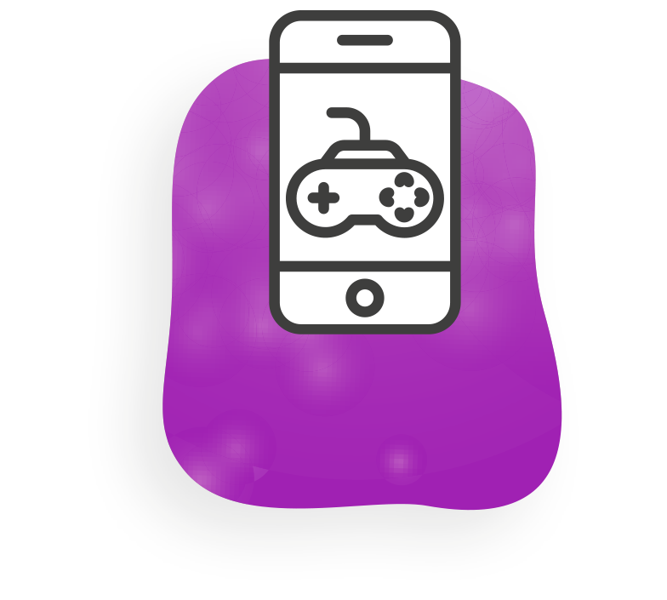





Do you play your games on a…
Phone?
Console?
Laptop?
Tablet?
Computer?
Notes:
Now, I’d love to know how you play your games! Look at the screen and for each one, give me a thumbs up if you’ve ever used that kind of thing, or technology to play a game.
Read through each option and wait for the children to give a thumbs up (if they’ve used it), before moving on.
Phone
Laptop
Tablet
Computer
Console
There are so many ways that you can play games online, aren’t there? Now, I mentioned that games were just one of the things we were going to be looking at today. The other thing was how you act or behave towards other people online.

Slide 7
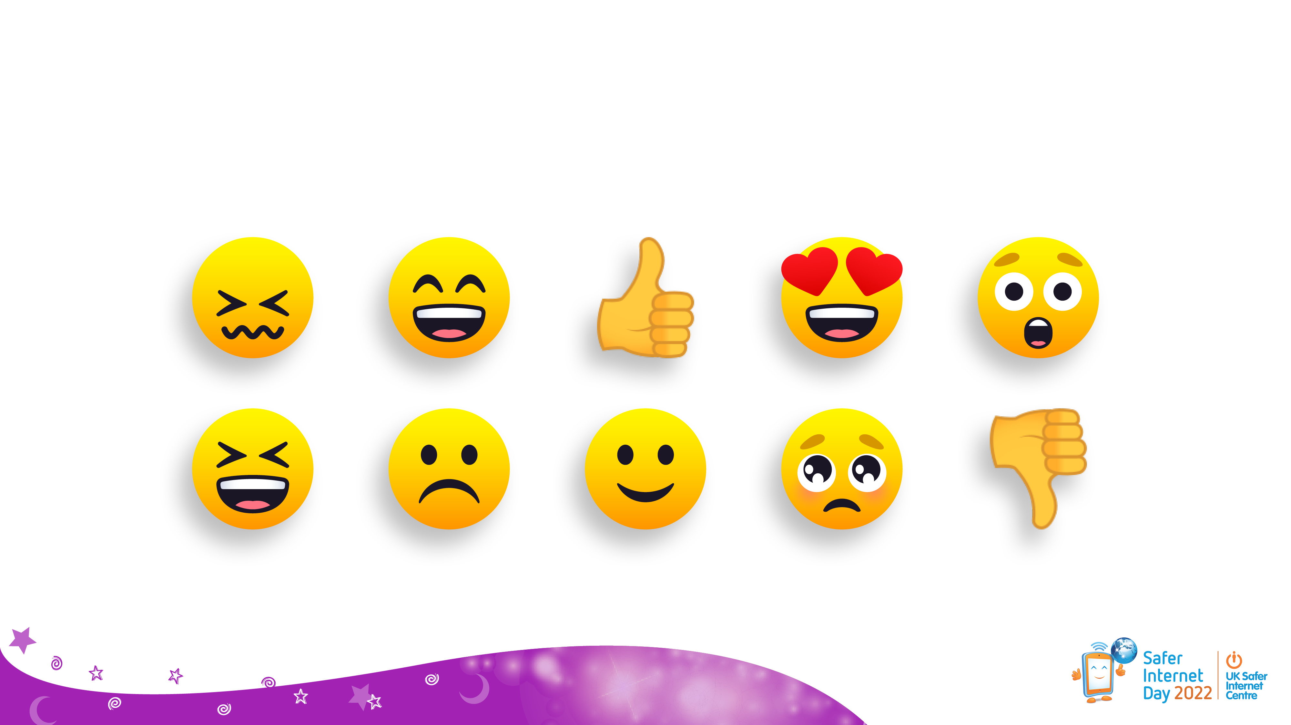






How should you behave online?
Notes:
Note for educators: Choose the question(s) you would like to use in advance and hide or delete the other slides.
So, I’ve got a question on the screen here for you to have a think about by yourself for a moment.
[Read aloud the question that you have chosen, then allow a little thinking time to pass].
Who thinks they can answer this question for me?
[Take answers from the children, who will hopefully suggest positive behaviours].
That’s absolutely correct.
Whatever you’re doing online, whether it’s playing games or anything else, it’s so important to think about the feelings of others. In the same way we all try to be kind offline, we should also do this when we’re online.

Slide 8
Why is it important to be kind online?
Notes:
Note for educators: Choose the question(s) you would like to use in advance and hide or delete the other slides.
So, I’ve got a question on the screen here for you to have a think about by yourself for a moment.
[Read aloud the question that you have chosen, then allow a little thinking time to pass].
Who thinks they can answer this question for me?
[Take answers from the children, who will hopefully suggest positive behaviours].
That’s absolutely correct.
Whatever you’re doing online, whether it’s playing games or anything else, it’s so important to think about the feelings of others. In the same way we all try to be kind offline, we should also do this when we’re online.

Slide 9
Should you behave the same way online, that you do offline? And why?
Notes:
Note for educators: Choose the question(s) you would like to use in advance and hide or delete the other slides.
So, I’ve got a question on the screen here for you to have a think about by yourself for a moment.
[Read aloud the question that you have chosen, then allow a little thinking time to pass].
Who thinks they can answer this question for me?
[Take answers from the children, who will hopefully suggest positive behaviours].
That’s absolutely correct.
Whatever you’re doing online, whether it’s playing games or anything else, it’s so important to think about the feelings of others. In the same way we all try to be kind offline, we should also do this when we’re online.

Slide 10
If you’re online and no one knows who you are, can you behave however you want?
Notes:
Note for educators: Choose the question(s) you would like to use in advance and hide or delete the other slides.
So, I’ve got a question on the screen here for you to have a think about by yourself for a moment.
[Read aloud the question that you have chosen, then allow a little thinking time to pass].
Who thinks they can answer this question for me?
[Take answers from the children, who will hopefully suggest positive behaviours].
That’s absolutely correct.
Whatever you’re doing online, whether it’s playing games or anything else, it’s so important to think about the feelings of others. In the same way we all try to be kind offline, we should also do this when we’re online.

Slide 11


Now let’s read, Digiduck and the Magic Castle
childnet.com/digiduck-magic
Notes:
I’m going to read you a story now, about a duck called Digiduck who loves to use the internet. If you’ve heard of Digiduck before, this is the newest story in the series.
It’s called ‘Digiduck and the Magic Castle’, and it’s all about playing games online.
Read the ‘Digiduck and the Magic Castle’ story to the learners. The story is available at: childnet.com/digiduck-magic
Ask the discussion questions at the end of the story, to assess the learners’ understanding.

Slide 12

Additional questions…
Do you talk to family or friends online? How?
Can you think of any apps, websites or online games that let people talk to each other who don’t know each other in person?
What facts about yourself should you not tell to strangers online and offline? What can we call all these facts?
Which adults would you ask for help if something worried you online?
It is quite normal to disagree with your friends sometimes! If you have ever argued with a friend (online or or offline), how did you make it better?
Notes:
Note for educators: This slide contains additional questions for older learners – ask any you feel are appropriate to extend their learning.
Questions and suggested answers
Do you talk to family or friends online? How? Video calls, phone calls, messages, though games.
Can you think of any apps, websites or online games that let people talk to each other who don’t know each other in person? Many online games and other apps and services allow communication between users. Remember some of these will be age restricted.
Note for educators: If you are concerned about a child’s use of an online game or service that is inappropriate for their age, follow this up in line with your school/ organisation’s safeguarding procedure.
For more information see the ‘Establishing a safe learning environment and responding to disclosures’ document provided with these resources.
What facts about yourself should you not tell to strangers online and offline? What can we call all these facts? Personal information – full name, home address, school address, date of birth, passwords, images of ourselves.
Which adults would you ask for help if something worried you online? Any trusted adult at home, school, youth group etc.
It is quite normal to disagree with your friends sometimes! If you have ever argued with a friend (online or offline), how did you make it better? Answers will hopefully include – talked to an adult to get advice e.g. a parent or teacher, talked to the friend about how we both felt and why, compromised, apologised etc. Here you can reinforce the conflict resolution strategies that you would usually recommend in school.
You’ll be learning more about online gaming, and online behaviour this week (if applicable). Thank you for joining in and sharing your thoughts. I hope everyone has a happy Safer Internet Day this year!

Slide 13


