Slide 2
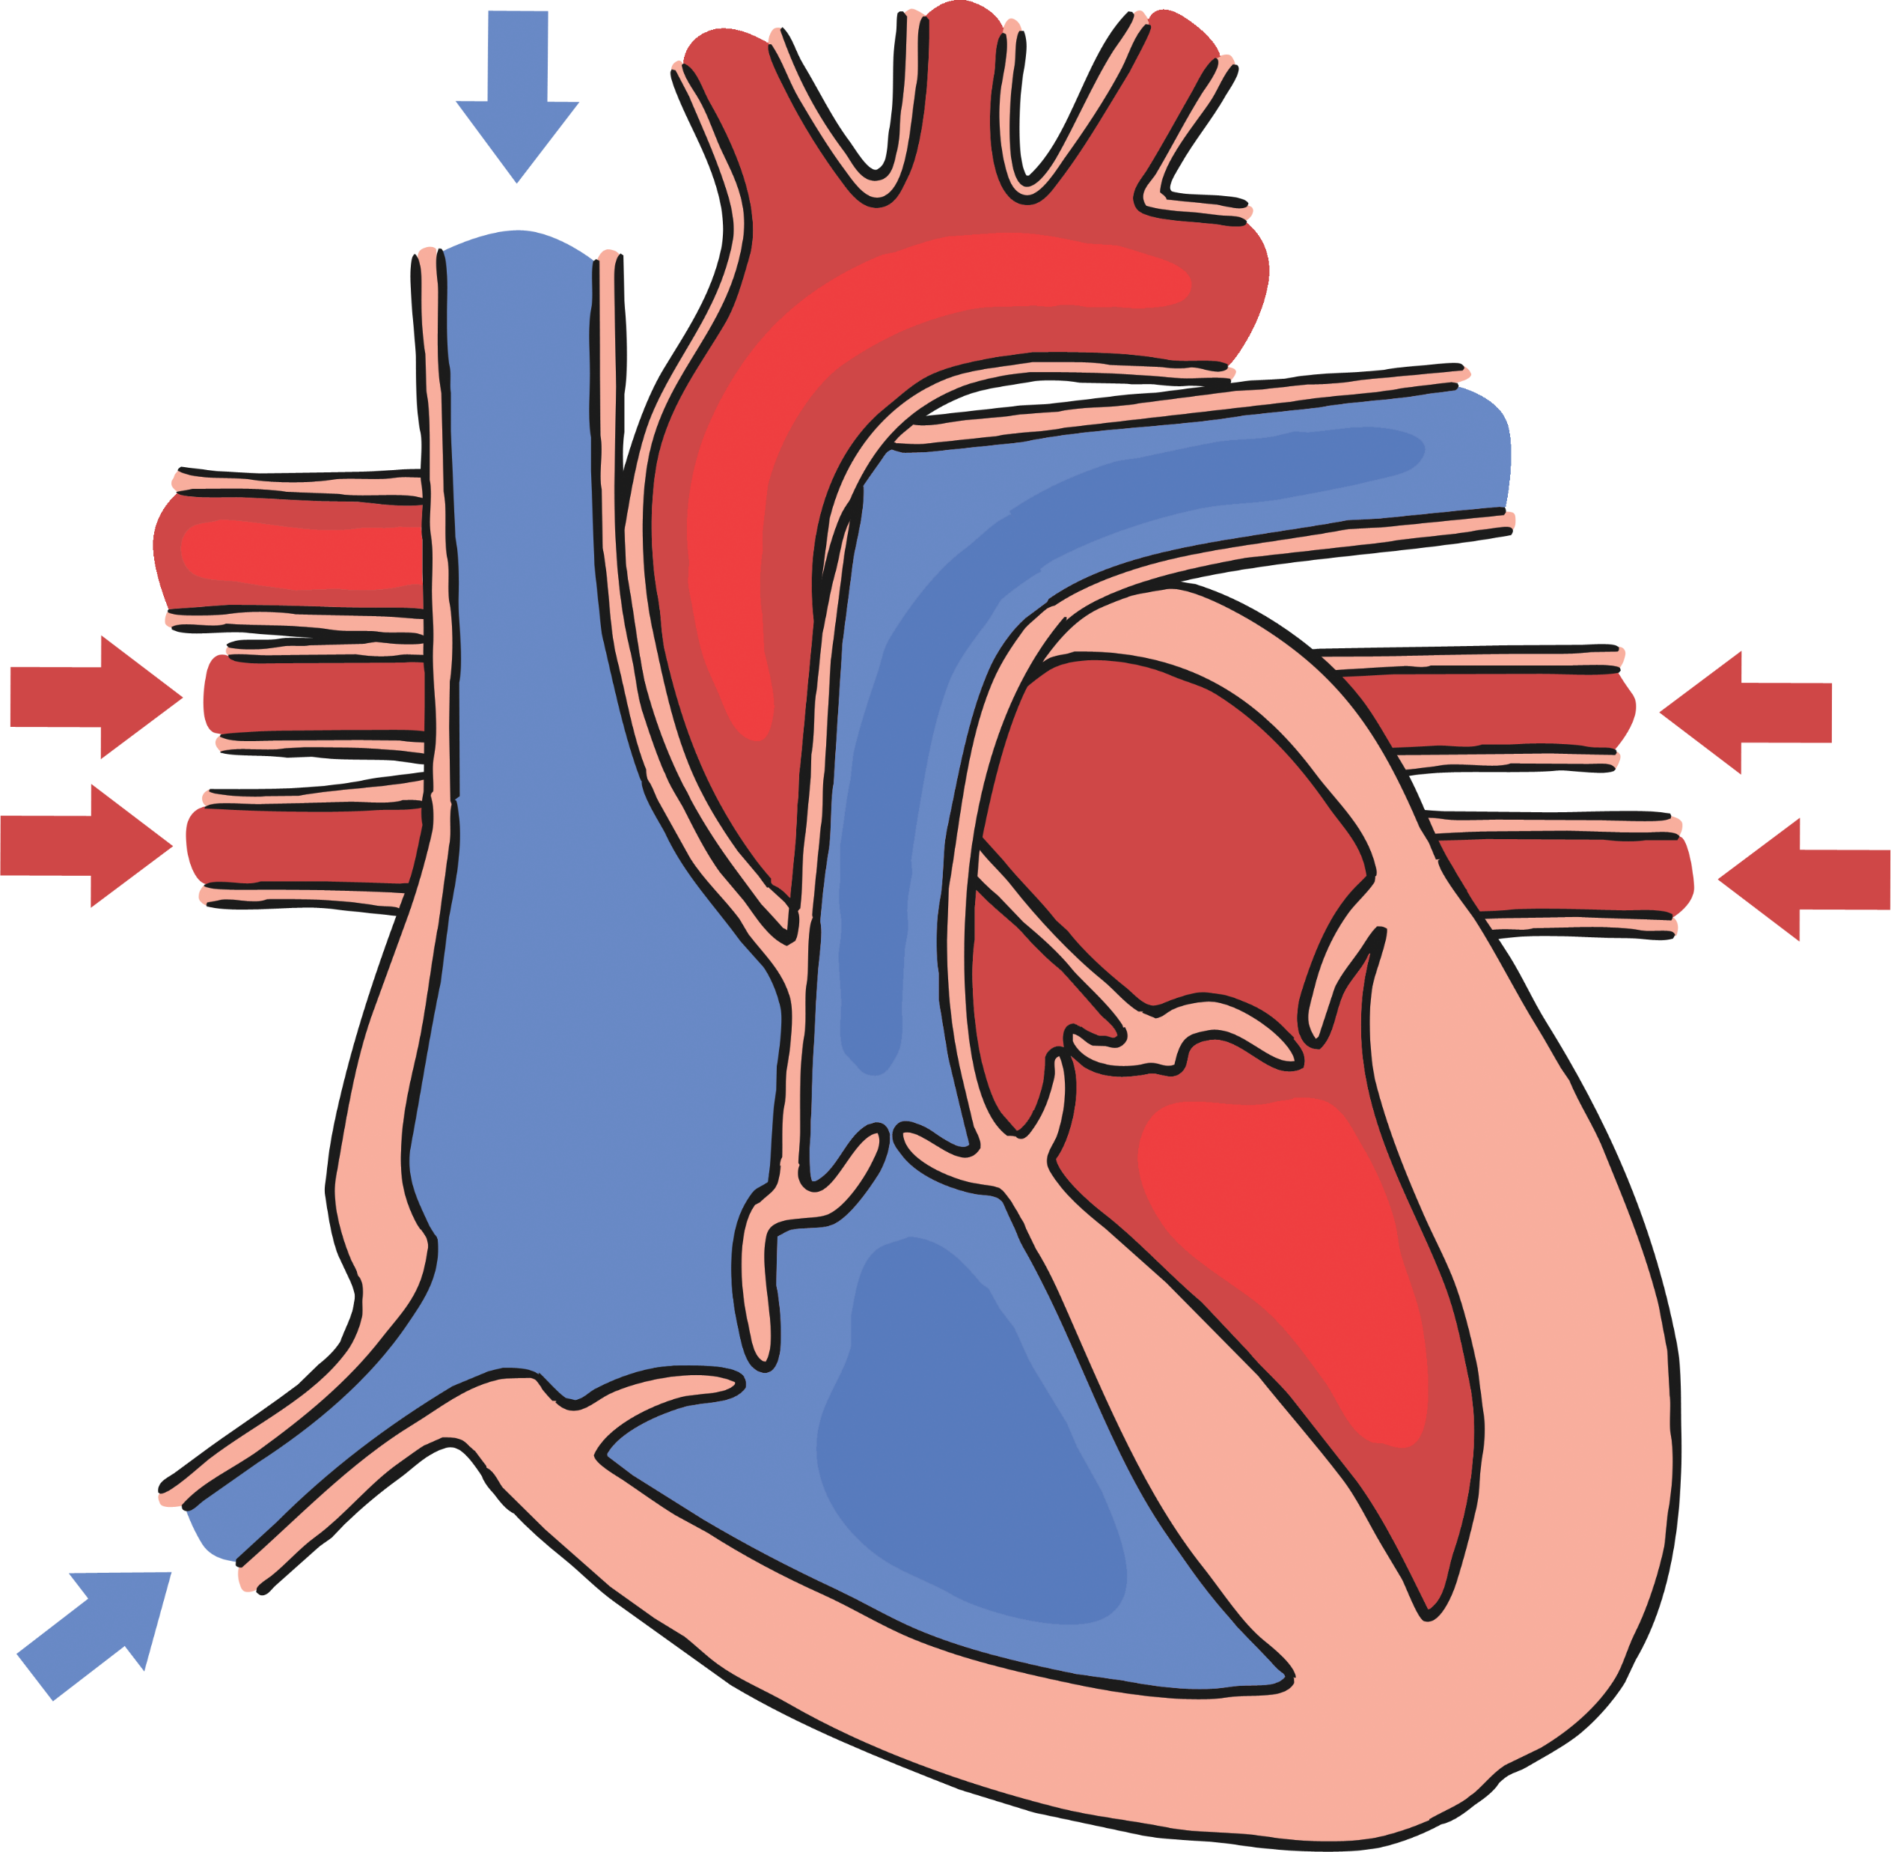
The Function of the Heart
aorta
The heart is a powerful muscle that is situated between your lungs, protected by the ribcage.
The heart pumps blood to the lungs to get oxygen.
The heart pumps the oxygenated blood to the rest of the body.
aortic valve
pulmonary artery (left)
left pulmonary veins
right atrium
left atrium
left ventricle
right ventricle

Slide 3
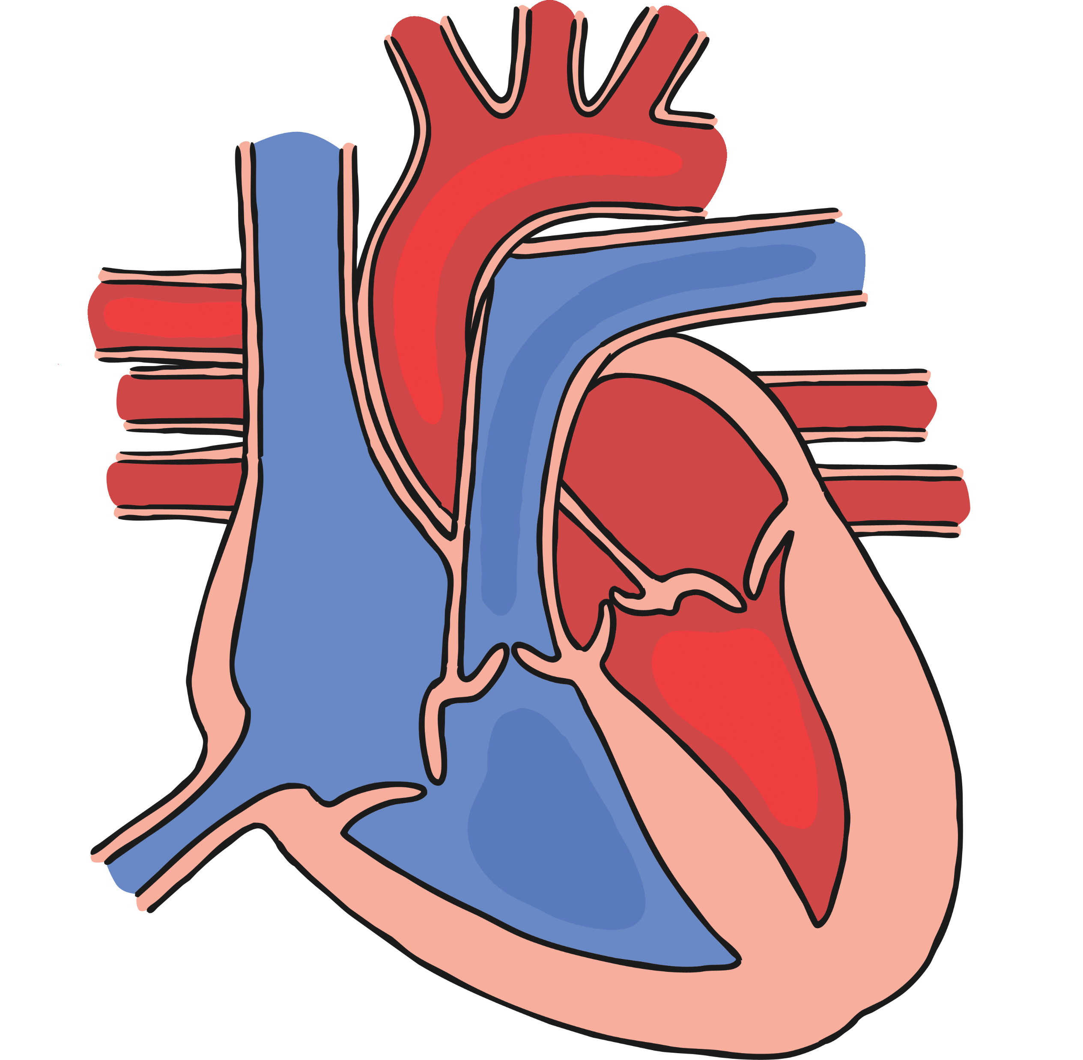
How the Heart Works
Click to go through each stage of the process.
right atrium
right ventricle
pulmonic valve
pulmonary artery (left)
left pulmonary veins
left atrium
left ventricle
aortic valve
aorta

Slide 4
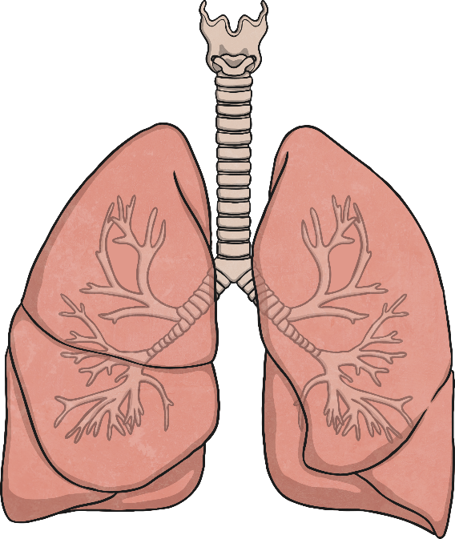
The Function of the Lungs
When we breathe in (inhale), the intercostal muscles contract and the diaphragm pulls down, making the chest expand. This causes air to be sucked into the lungs.
The intercostal muscles and diaphragm then relax and the air is pushed out of the lungs (exhale) as the ribcage falls downward and inhale.
lung expands
lung shrinks
muscles contract
muscles relax
diaphragm pulls downwards
diaphragm relaxes

Slide 5
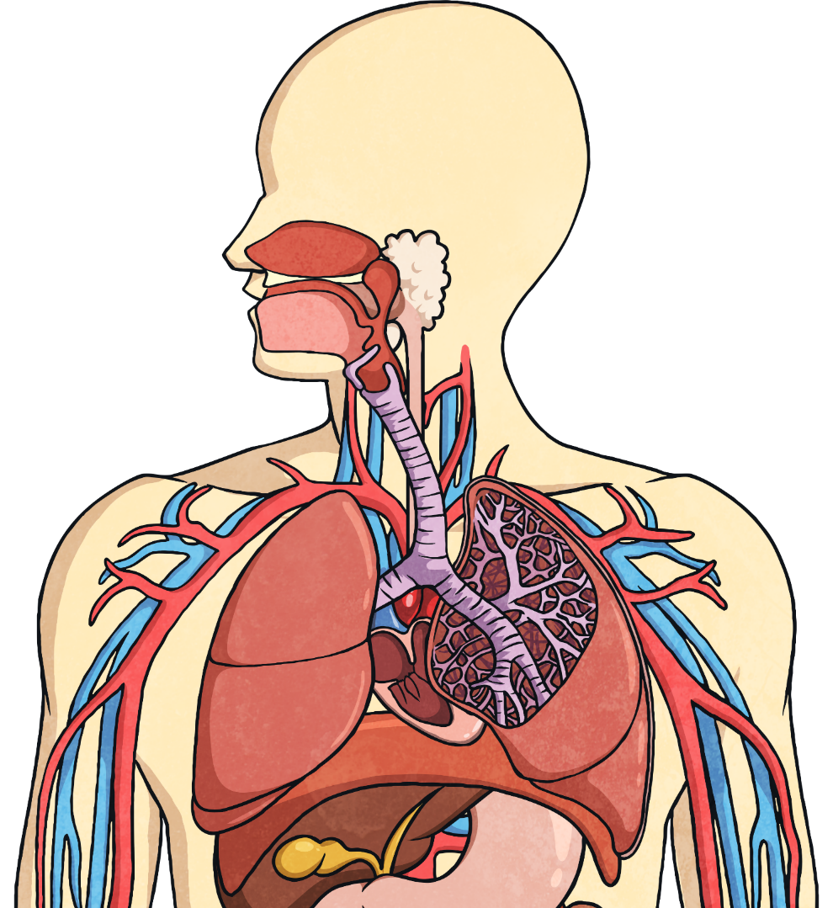
The Function of the Lungs
Air breathed in through the mouth or nose travels down the trachea, through the bronchi into one of the lungs. The air travels into the bronchioles and into the air sacs (alveoli).
trachea
intercostal muscles and ribs
bronchus
bronchiole
heart
diaphragm
air sacs (alveoli)

Slide 6
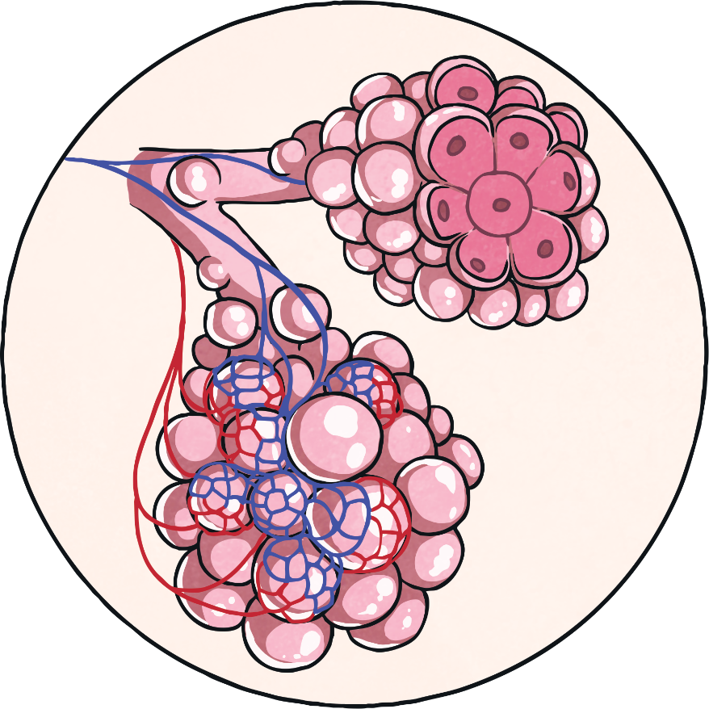
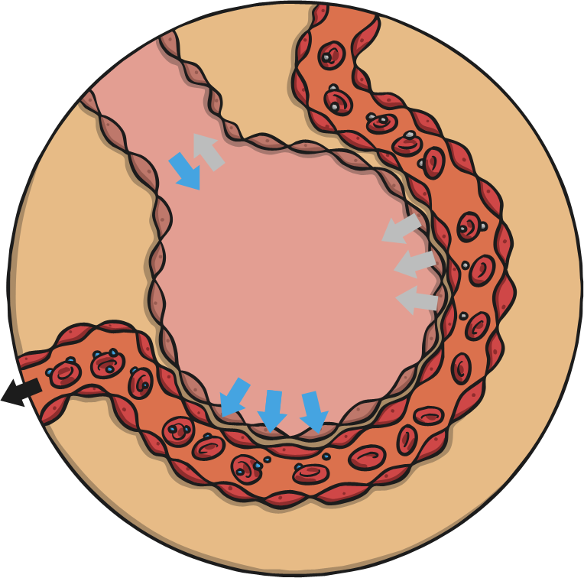
The Function of the Alveoli
The oxygen is absorbed into the blood through a layer of moisture in the air sacs (alveoli). Carbon dioxide in the blood is transferred back into the air, which then travels back out of the lungs.
C0₂
0₂

Slide 7
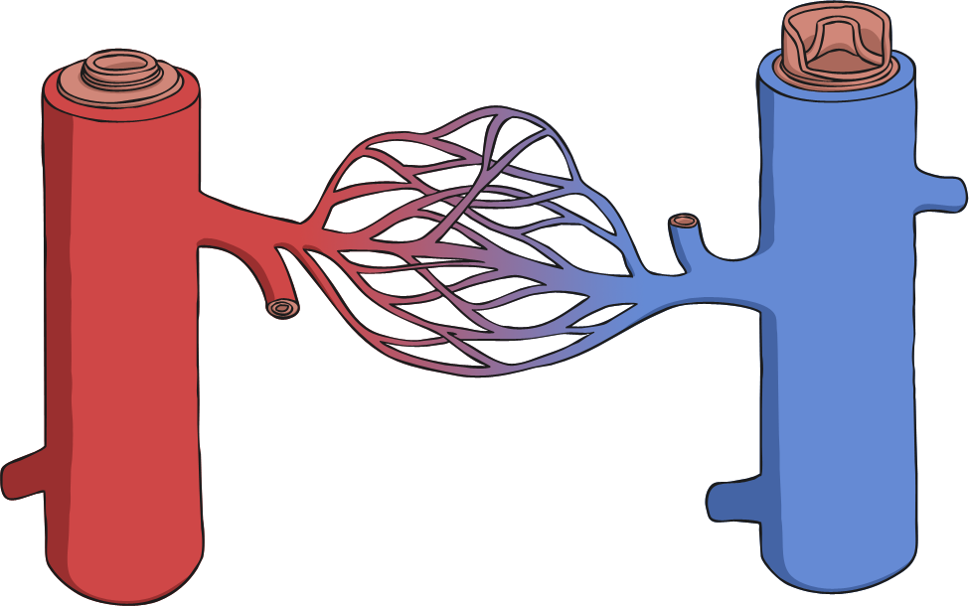
What Blood Vessels Do
Arteries – carries oxygenated blood away from the heart
Capillaries – enable exchange of oxygen with body
Veins – carries blood from capillaries back to the heart to be pumped to the lungs to be re-oxygenated.
capillaries
vein
artery

