Slide 1


Slide 2
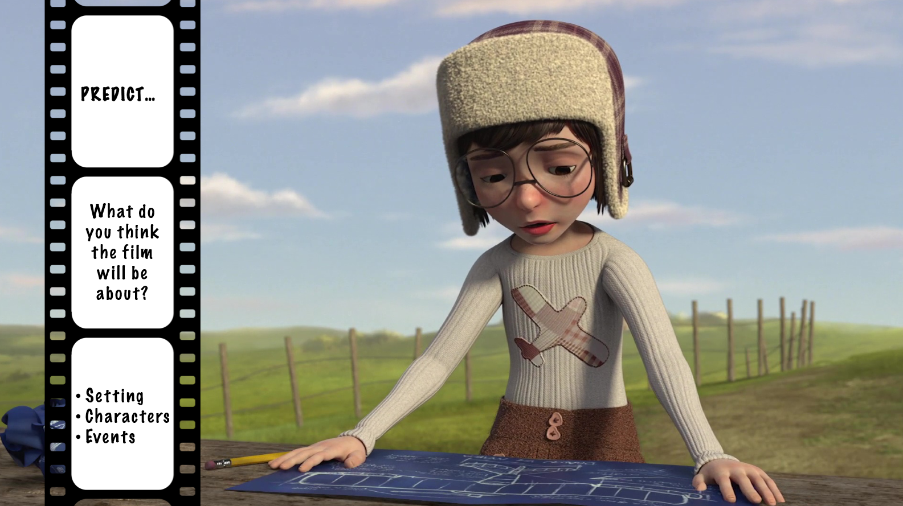

Slide 3
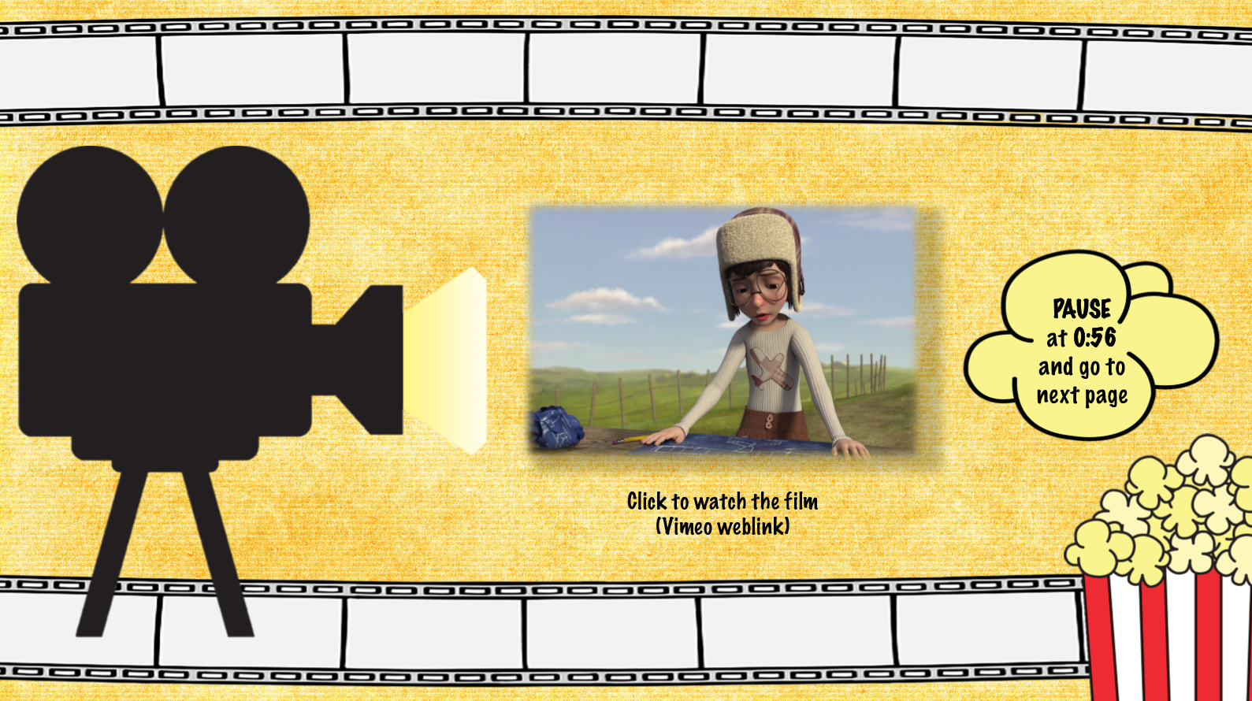
https://www.literacyshed.com/soar.html
https://www.literacyshed.com/soar.html

Slide 4
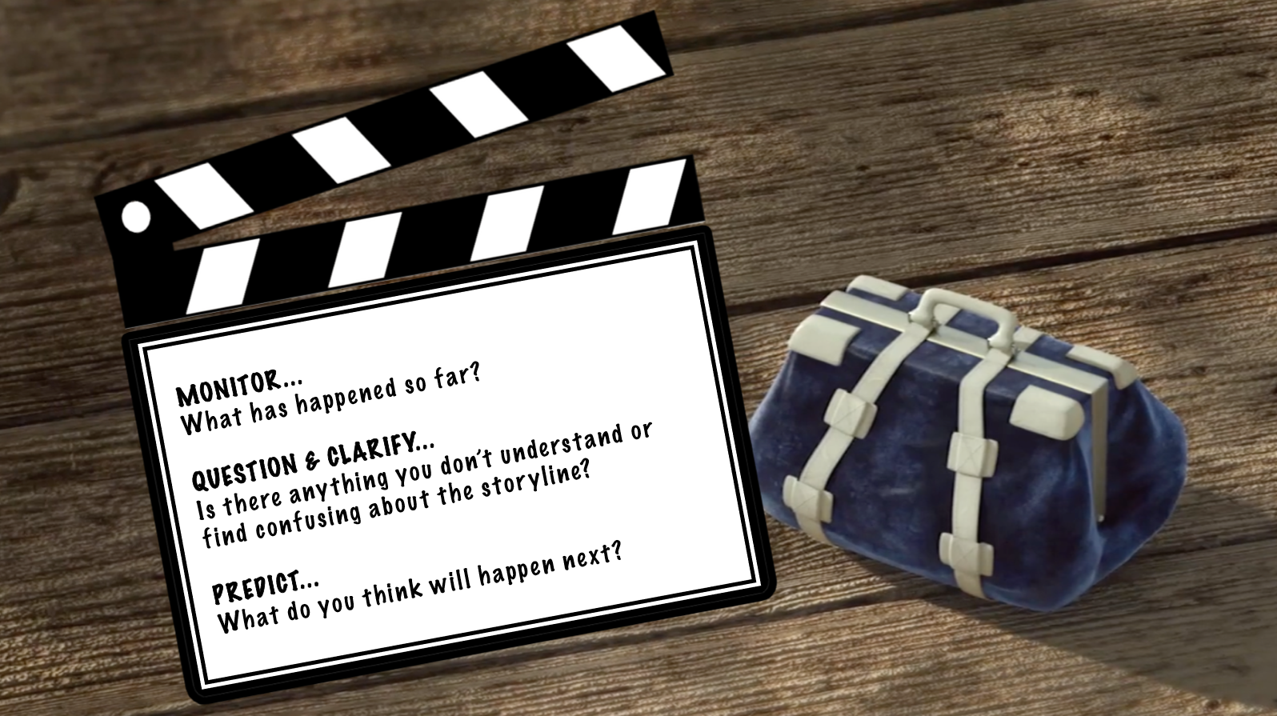

Slide 5
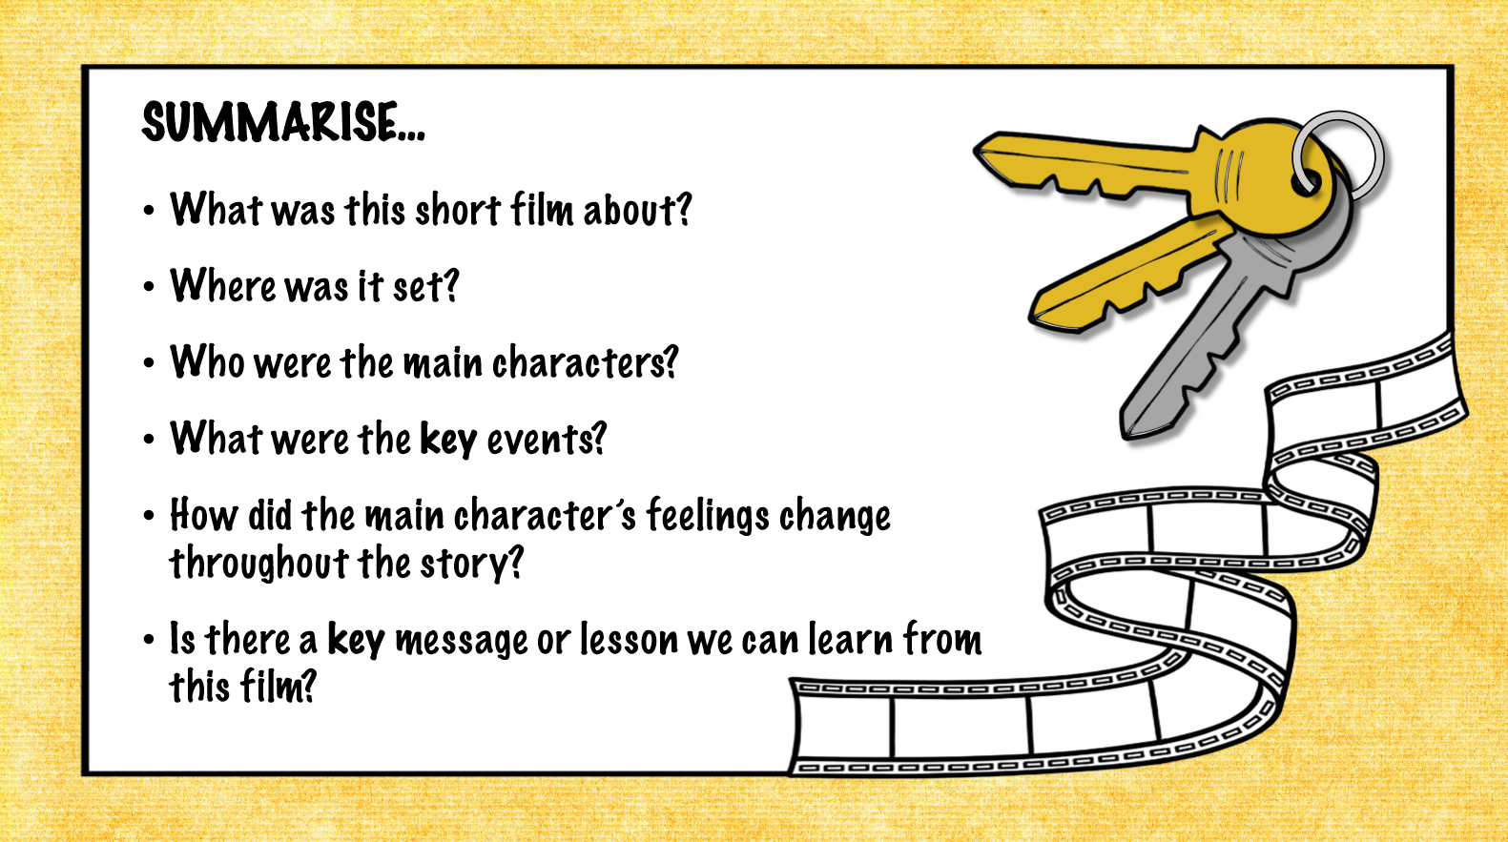

Slide 6


