Slide 2
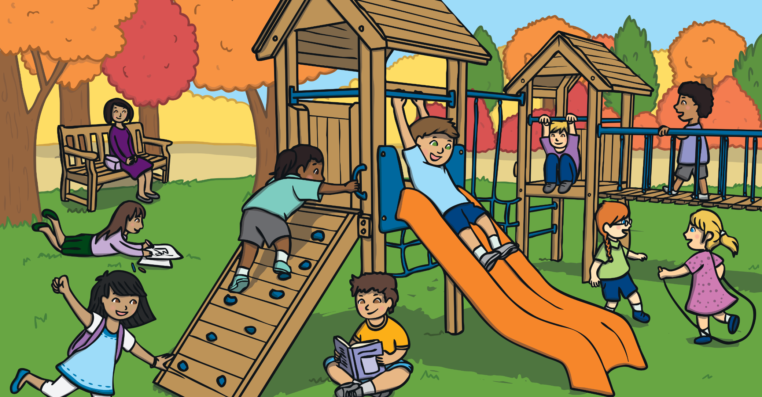
b
e
a
e
u
c
s
I have found the letters…
The word must be…

Slide 3
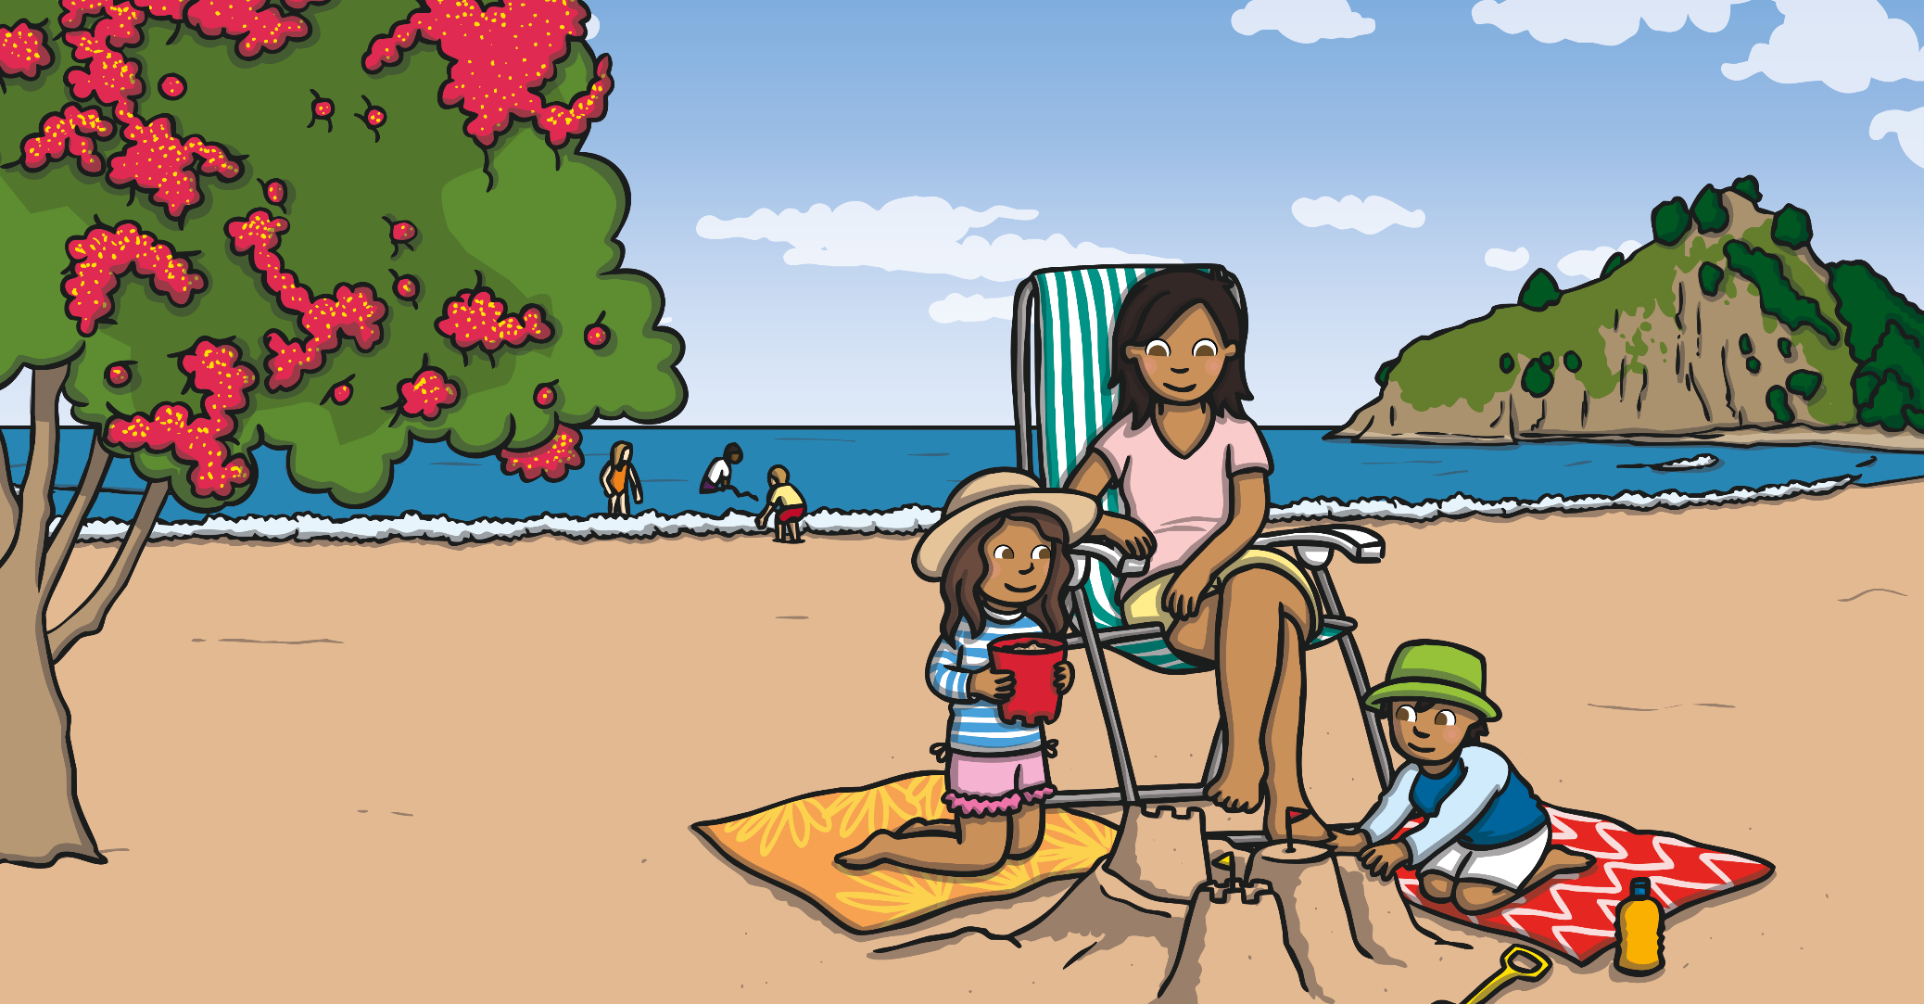
d
b
i
h
e
n
s
I have found the letters…
The word must be…

Slide 4
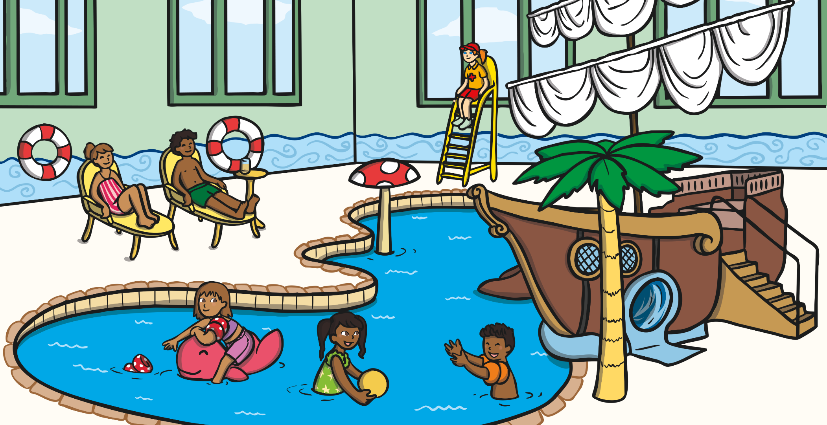
d
r
h
e
c
n
i
l
I have found the letters…
The word must be…

Slide 5
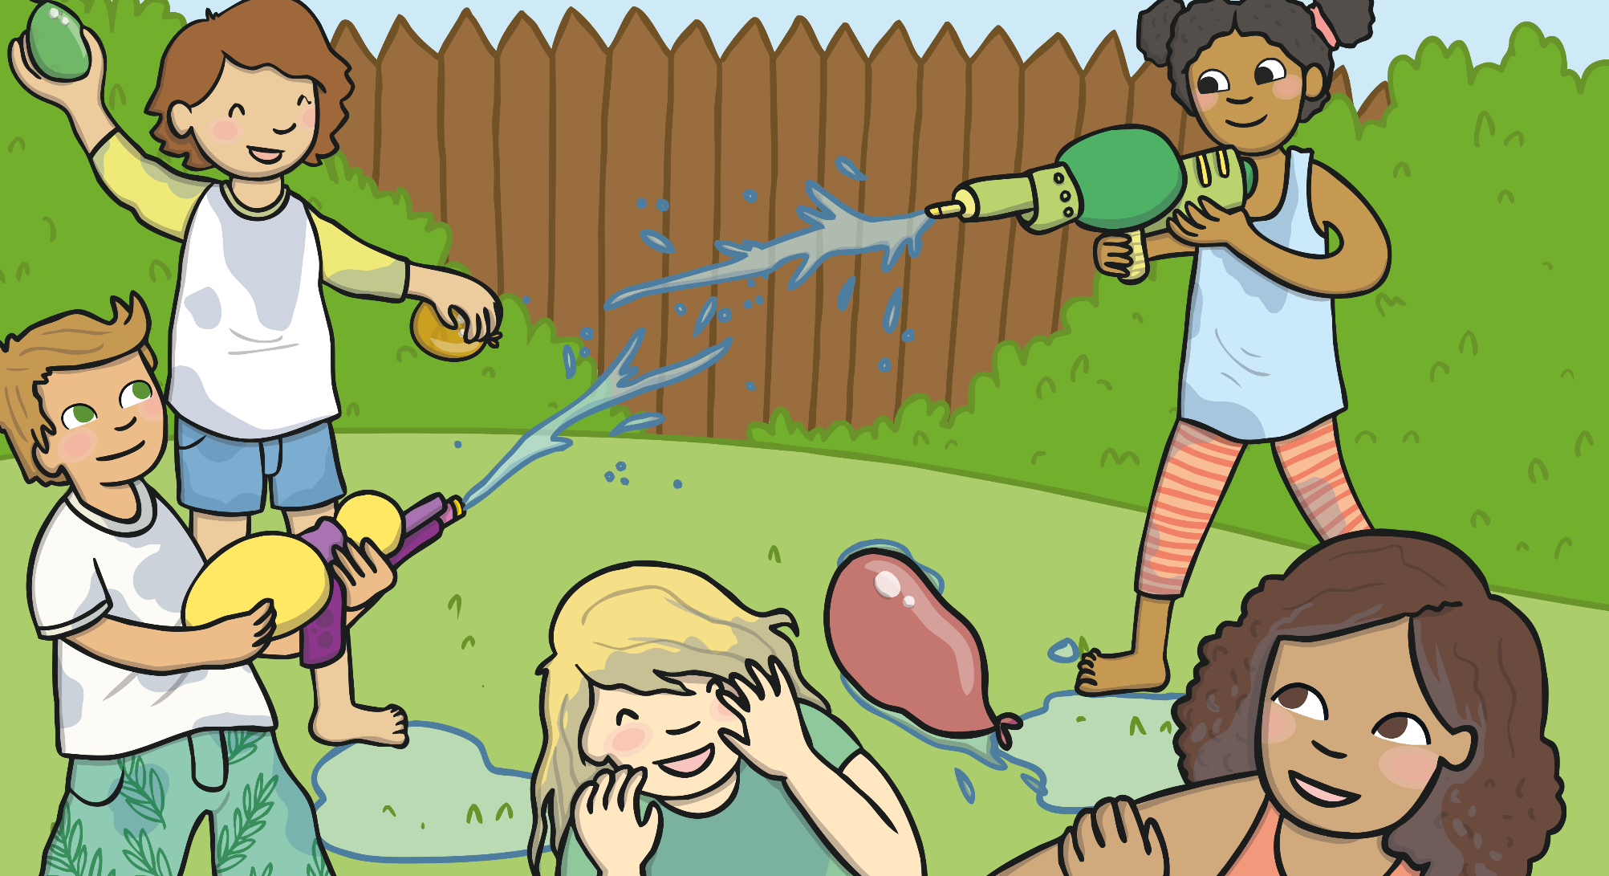
v
m
r
i
e
o
p
I have found the letters…
The word must be…

Slide 6
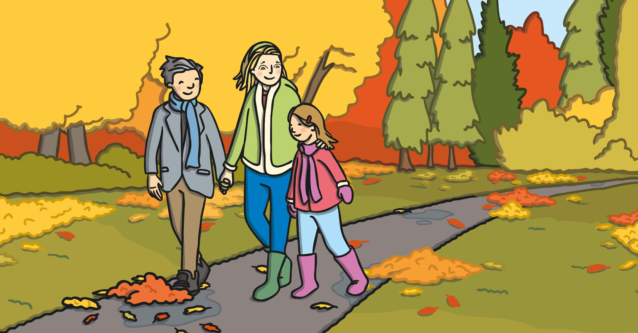
o
l
e
h
w
I have found the letters…
The word must be…

Slide 7
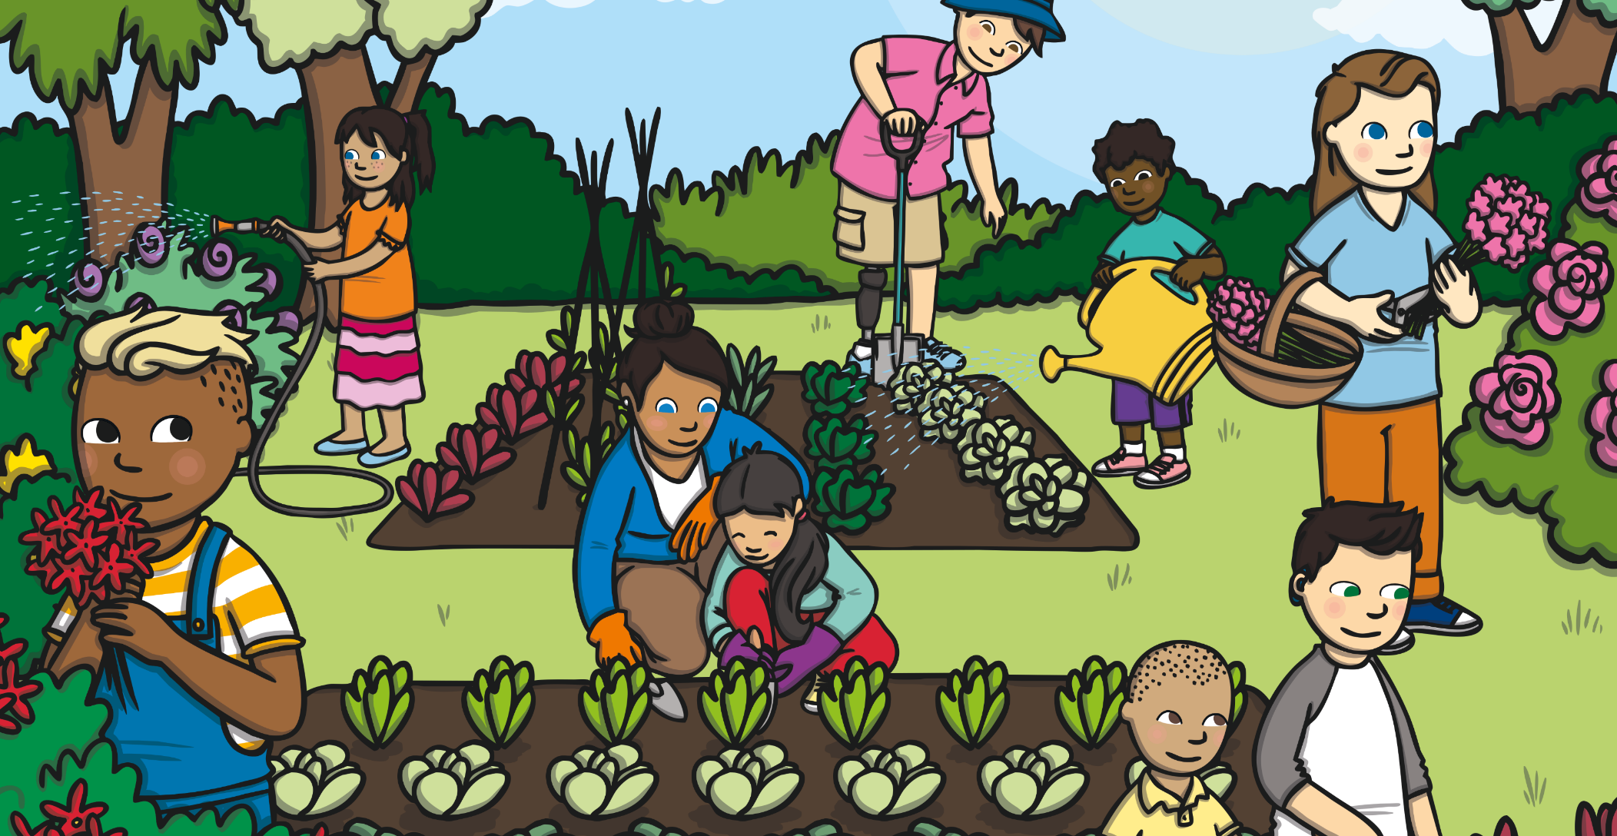
e
y
b
r
e
o
d
y
v
I have found the letters…
The word must be…

Slide 8
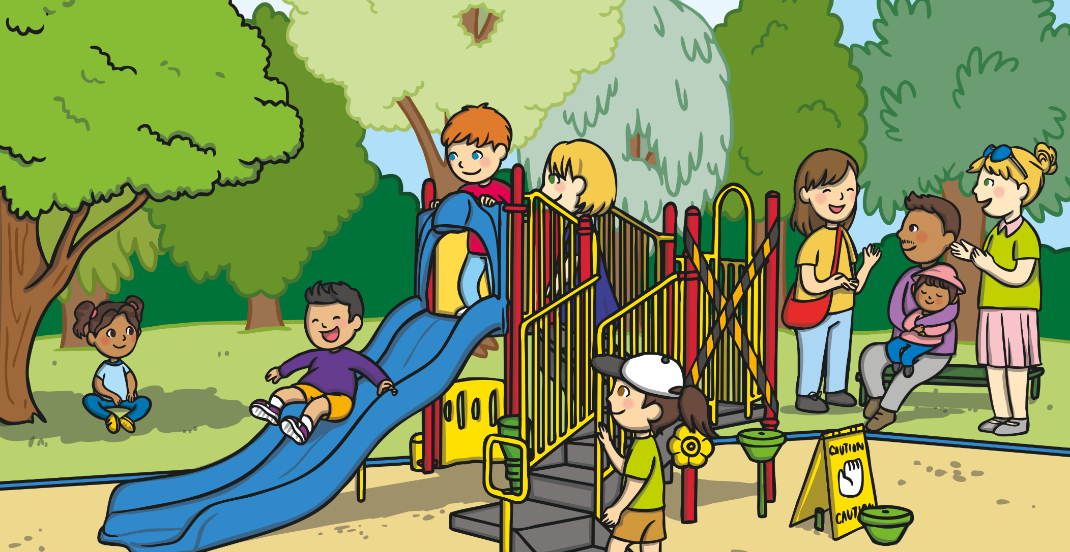
l
b
u
u
e
i
f
a
t
I have found the letters…
The word must be…

Slide 9
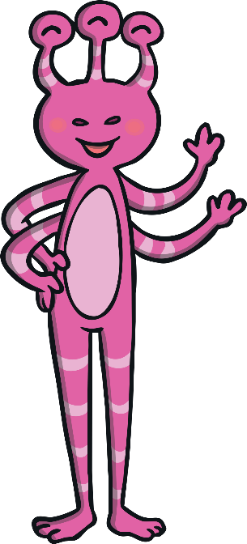
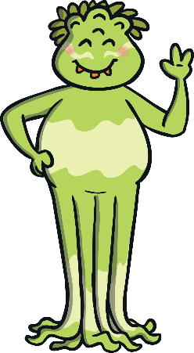
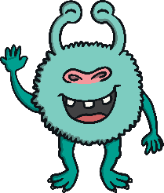

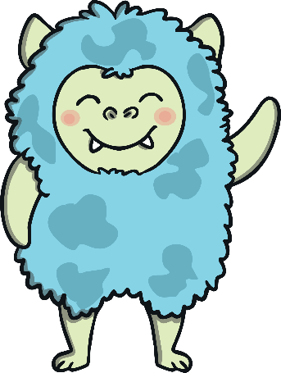
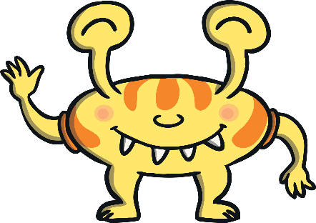
d
o
s
u
h
l
I have found the letters…
The word must be…

Slide 10
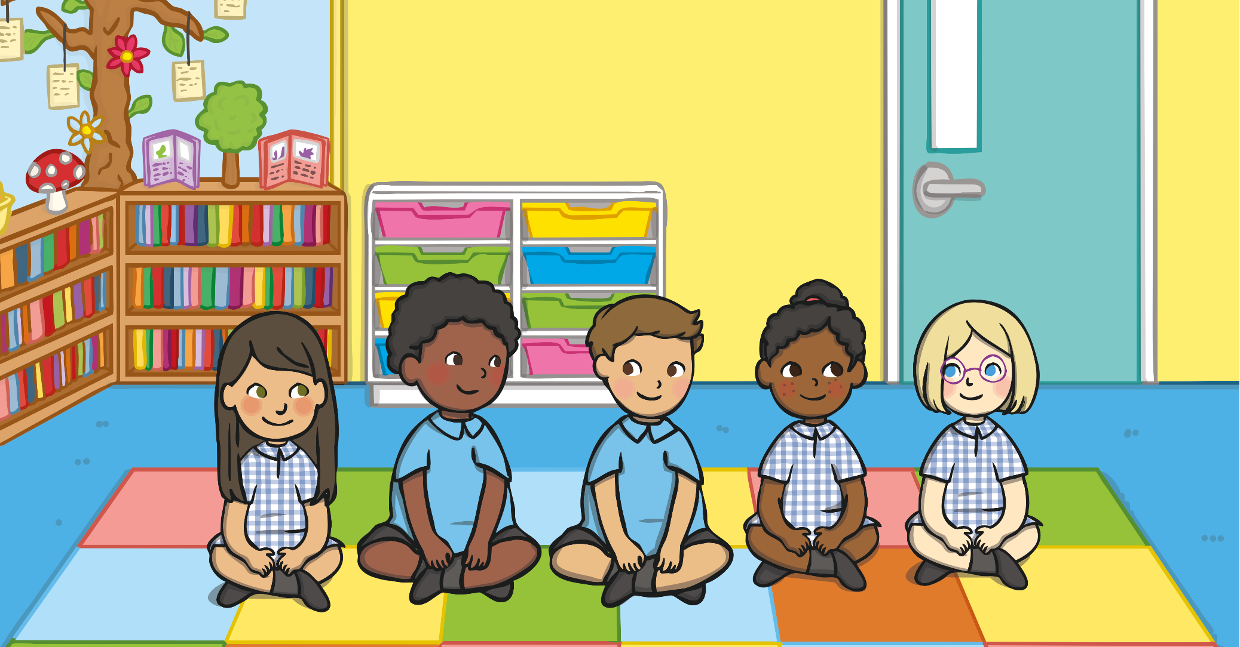
o
p
e
p
e
l
I have found the letters…
The word must be…

Slide 11
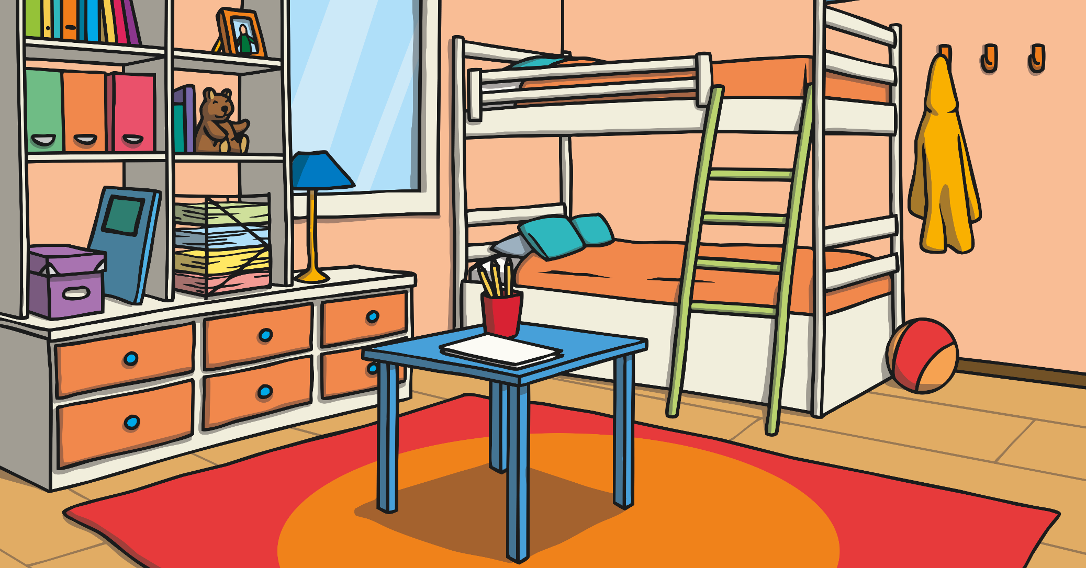
e
o
y
m
n
I have found the letters…
The word must be…

Slide 12
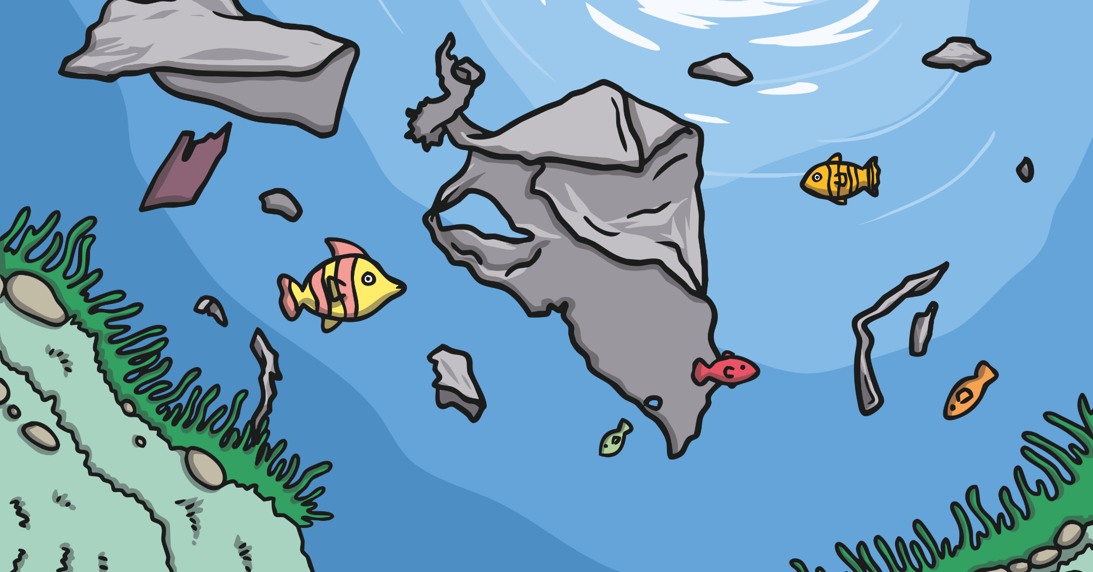
c
b
l
m
i
I have found the letters…
The word must be…

Slide 13
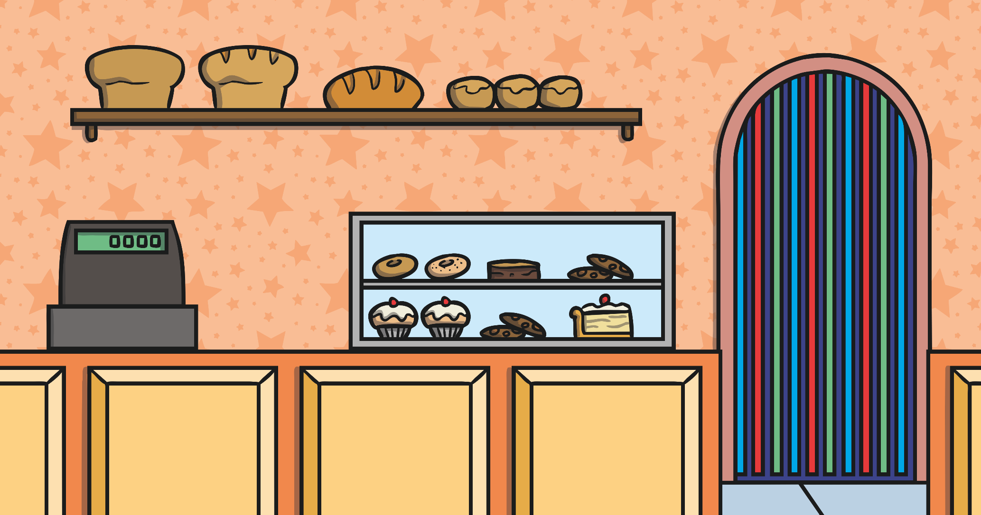
s
u
a
r
g
I have found the letters…
The word must be…

Slide 14
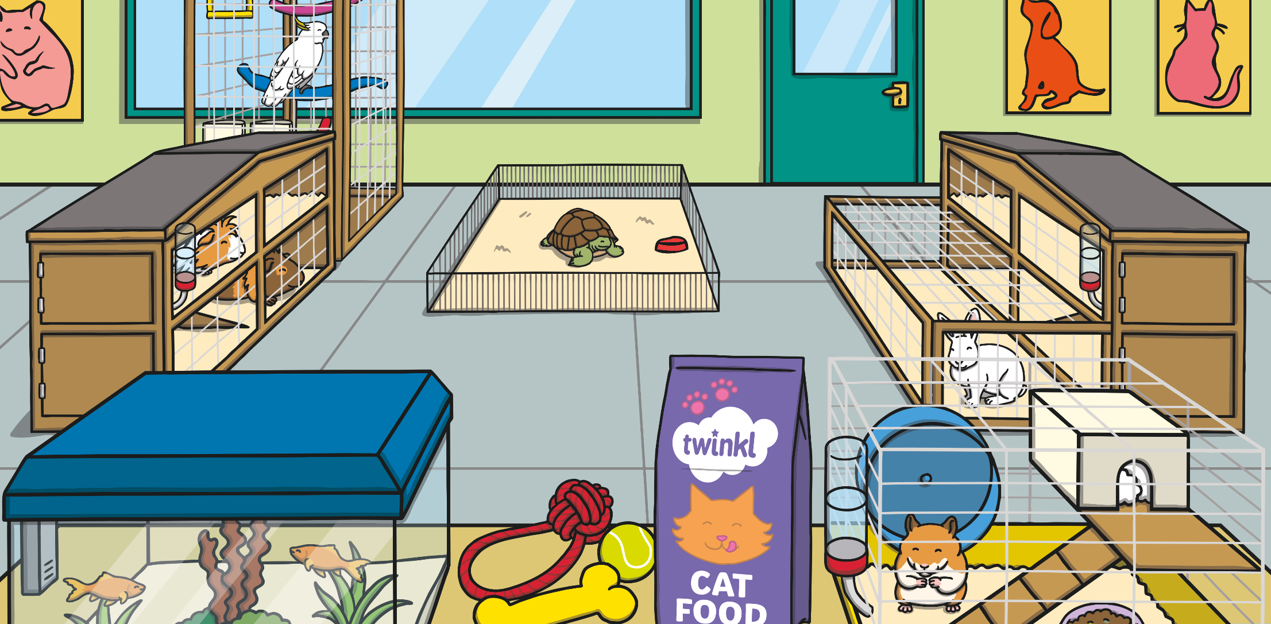
n
y
a
m
I have found the letters…
The word must be…

Slide 15
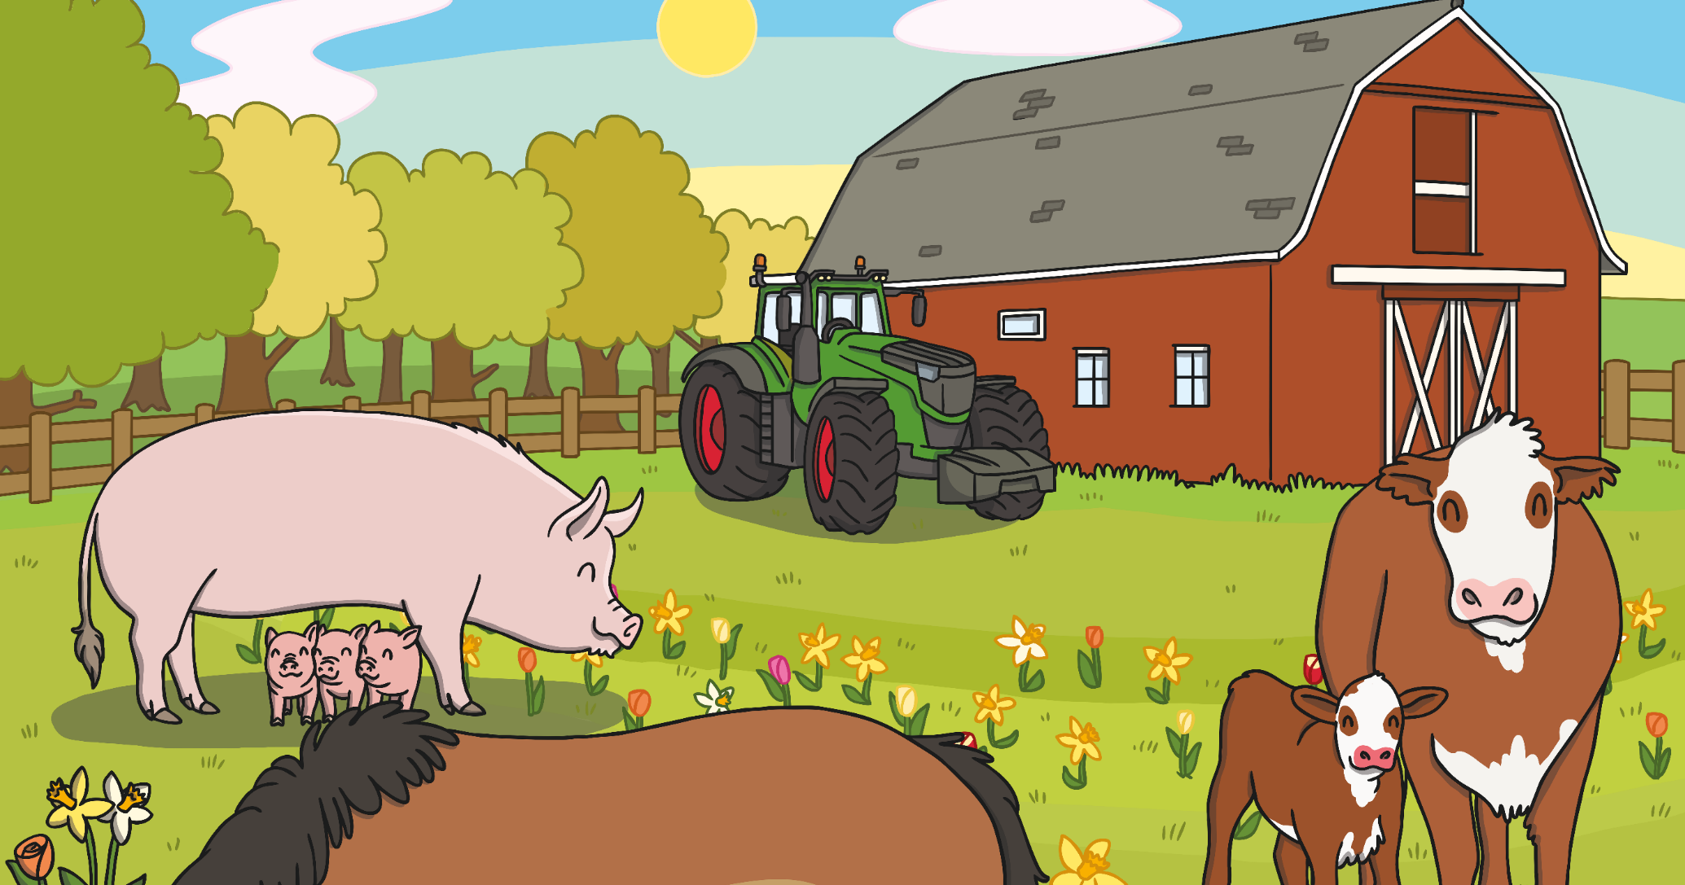
g
a
n
i
a
I have found the letters…
The word must be…

Slide 16
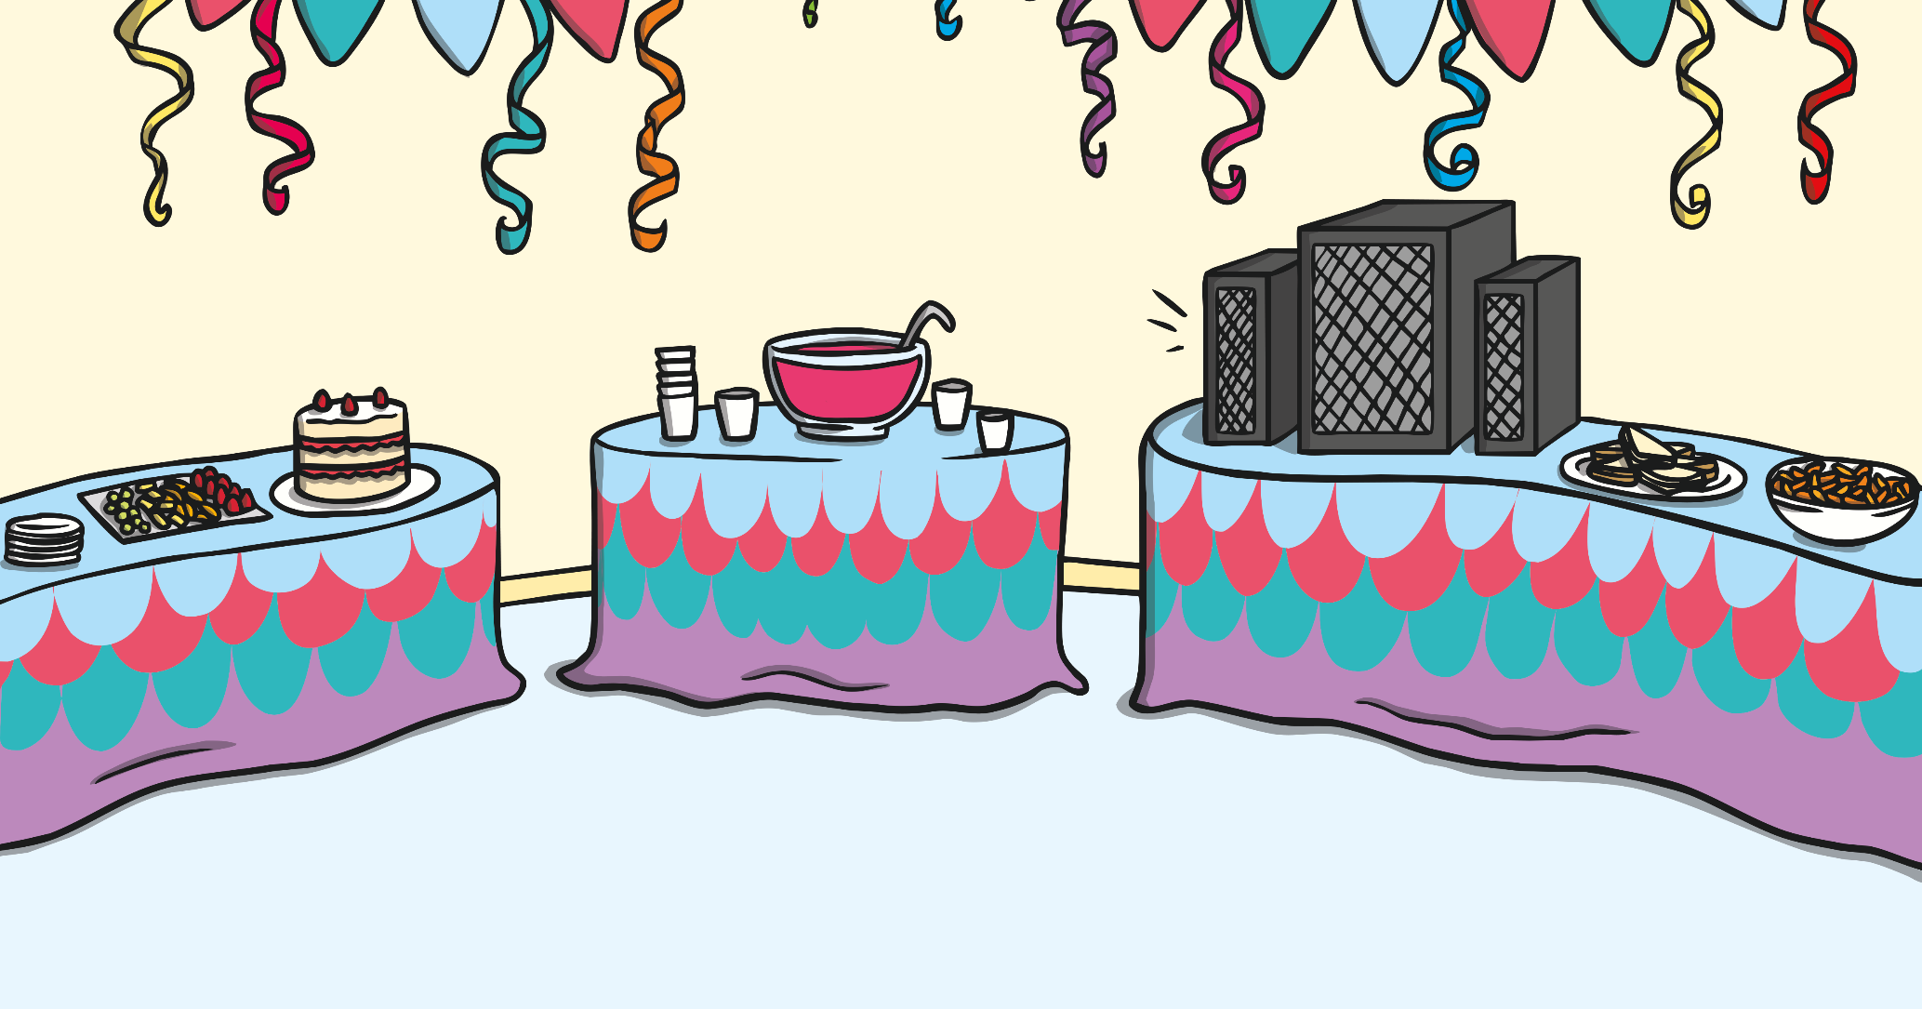
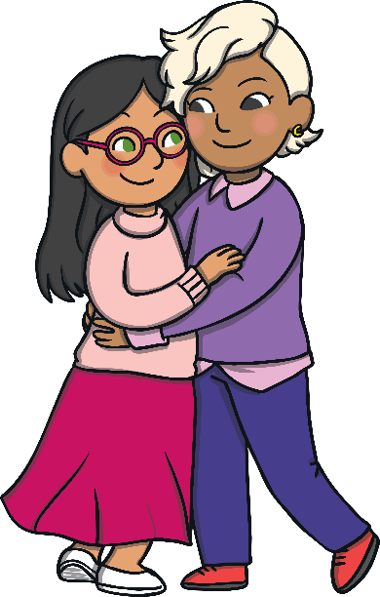
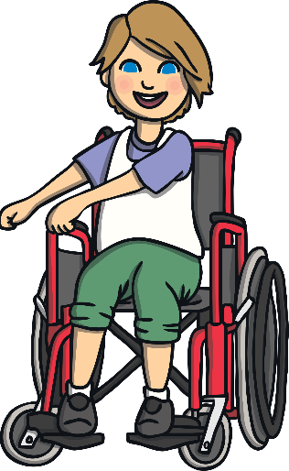
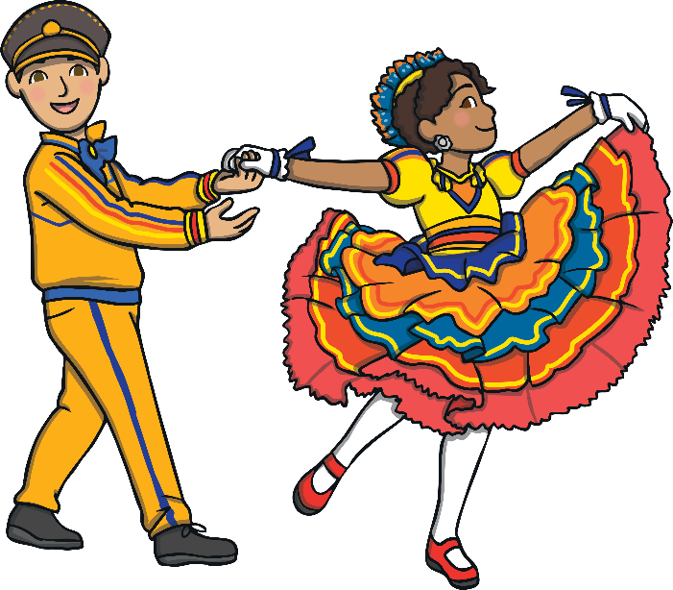
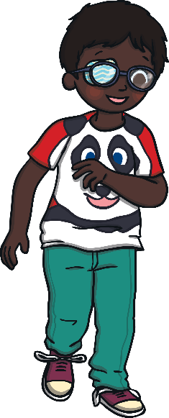
e
w
a
t
r
I have found the letters…
The word must be…

