Slide 1
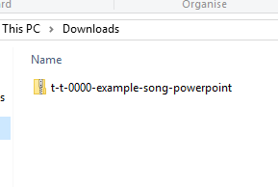
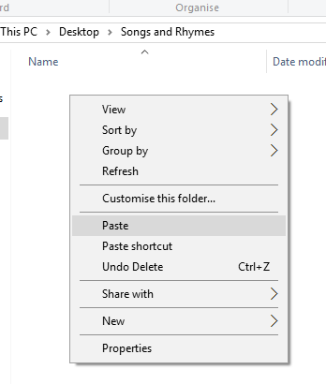

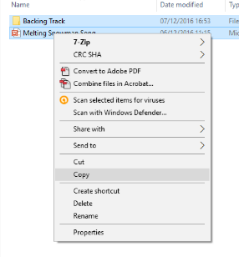
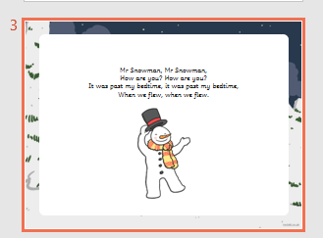
Guidance for Video/Audio in PowerPoints
1. Open the folder and copy all the files.
2. Paste the copied files into a new folder.
3. Open the PowerPoint file, enable editing and enter presentation mode (start the slide show).
Please note the embedded audio may not be compatible with early versions of PowerPoint.
You may wish to delete this slide before beginning the presentation.

Slide 3
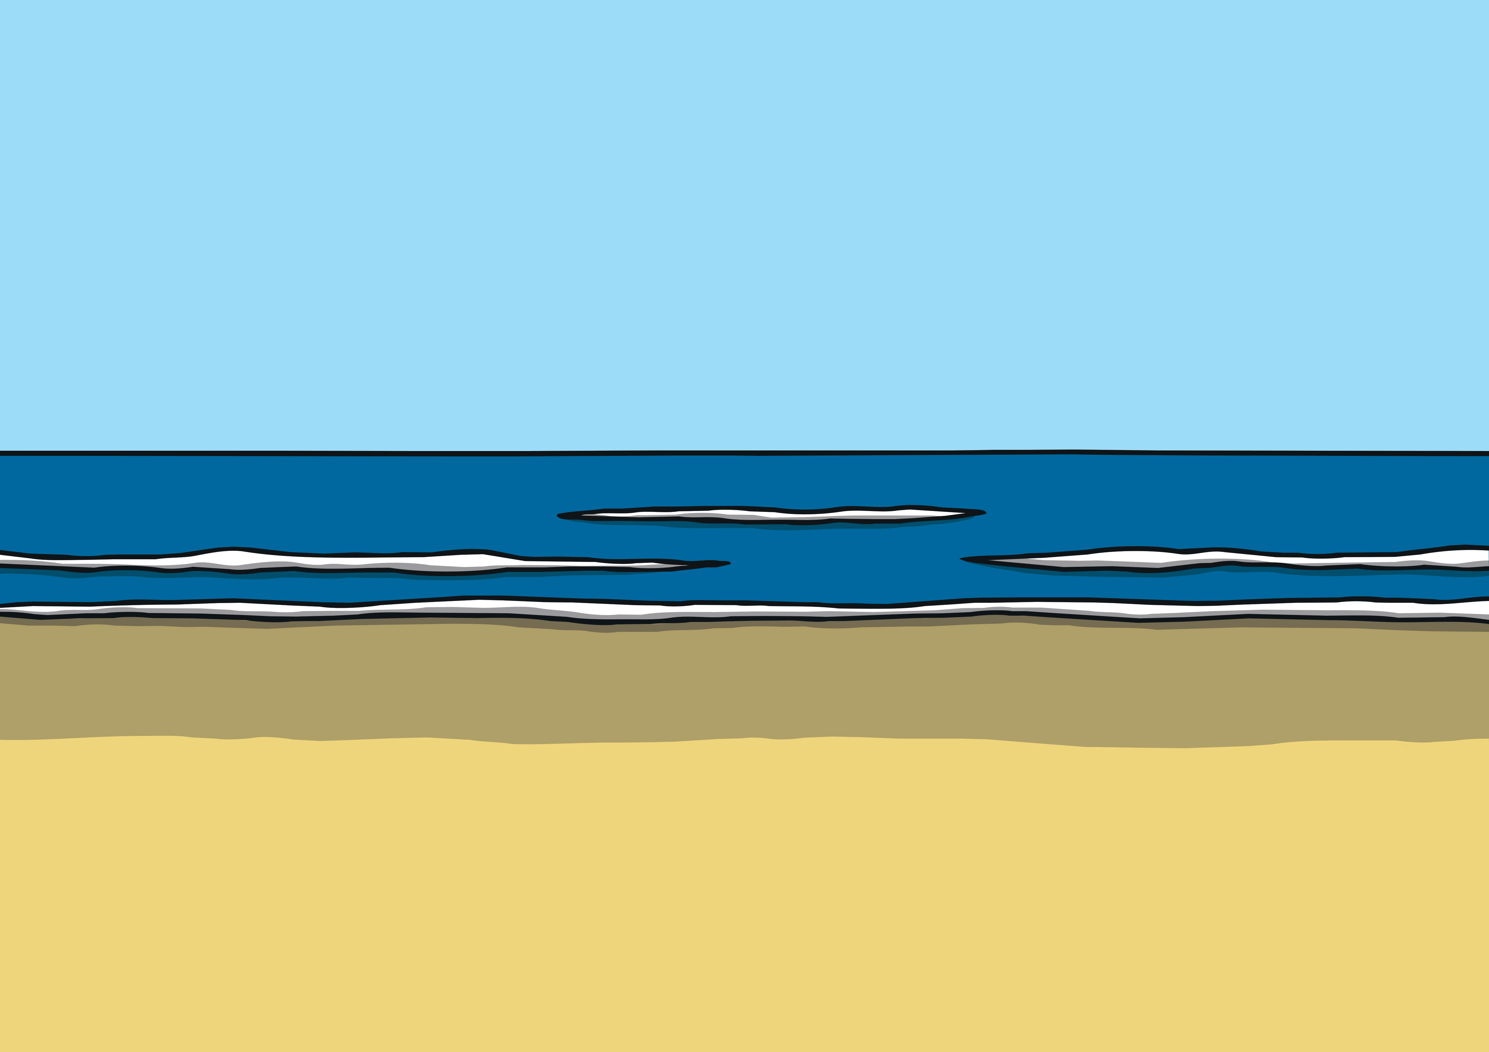

Habitats
Habitats are natural environments that plants and animals live in.
click for sound
What animals and plants might you see at the beach?

Slide 4
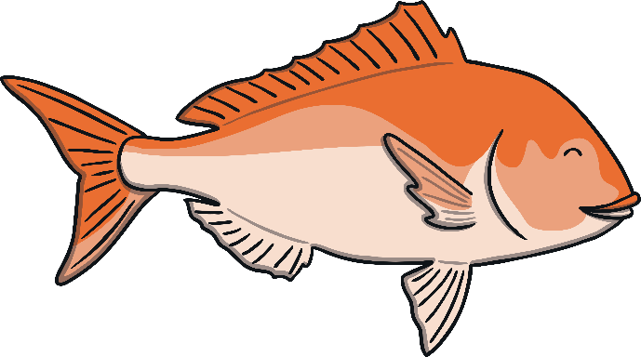
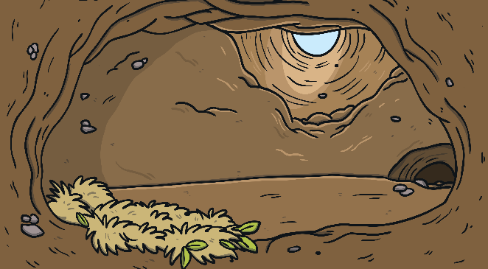
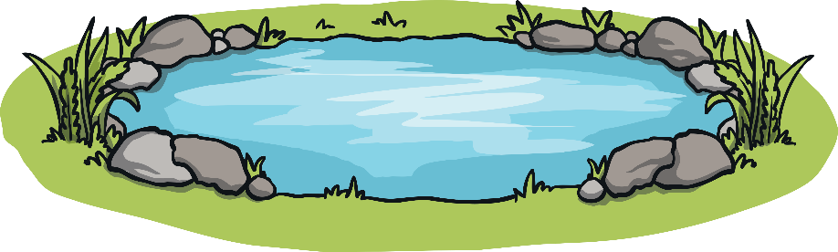
Habitats
Think about it...
What three things do animals and plants get from their habitat so they can live?
food
water
shelter (somewhere to sleep and to raise their young)

Slide 5
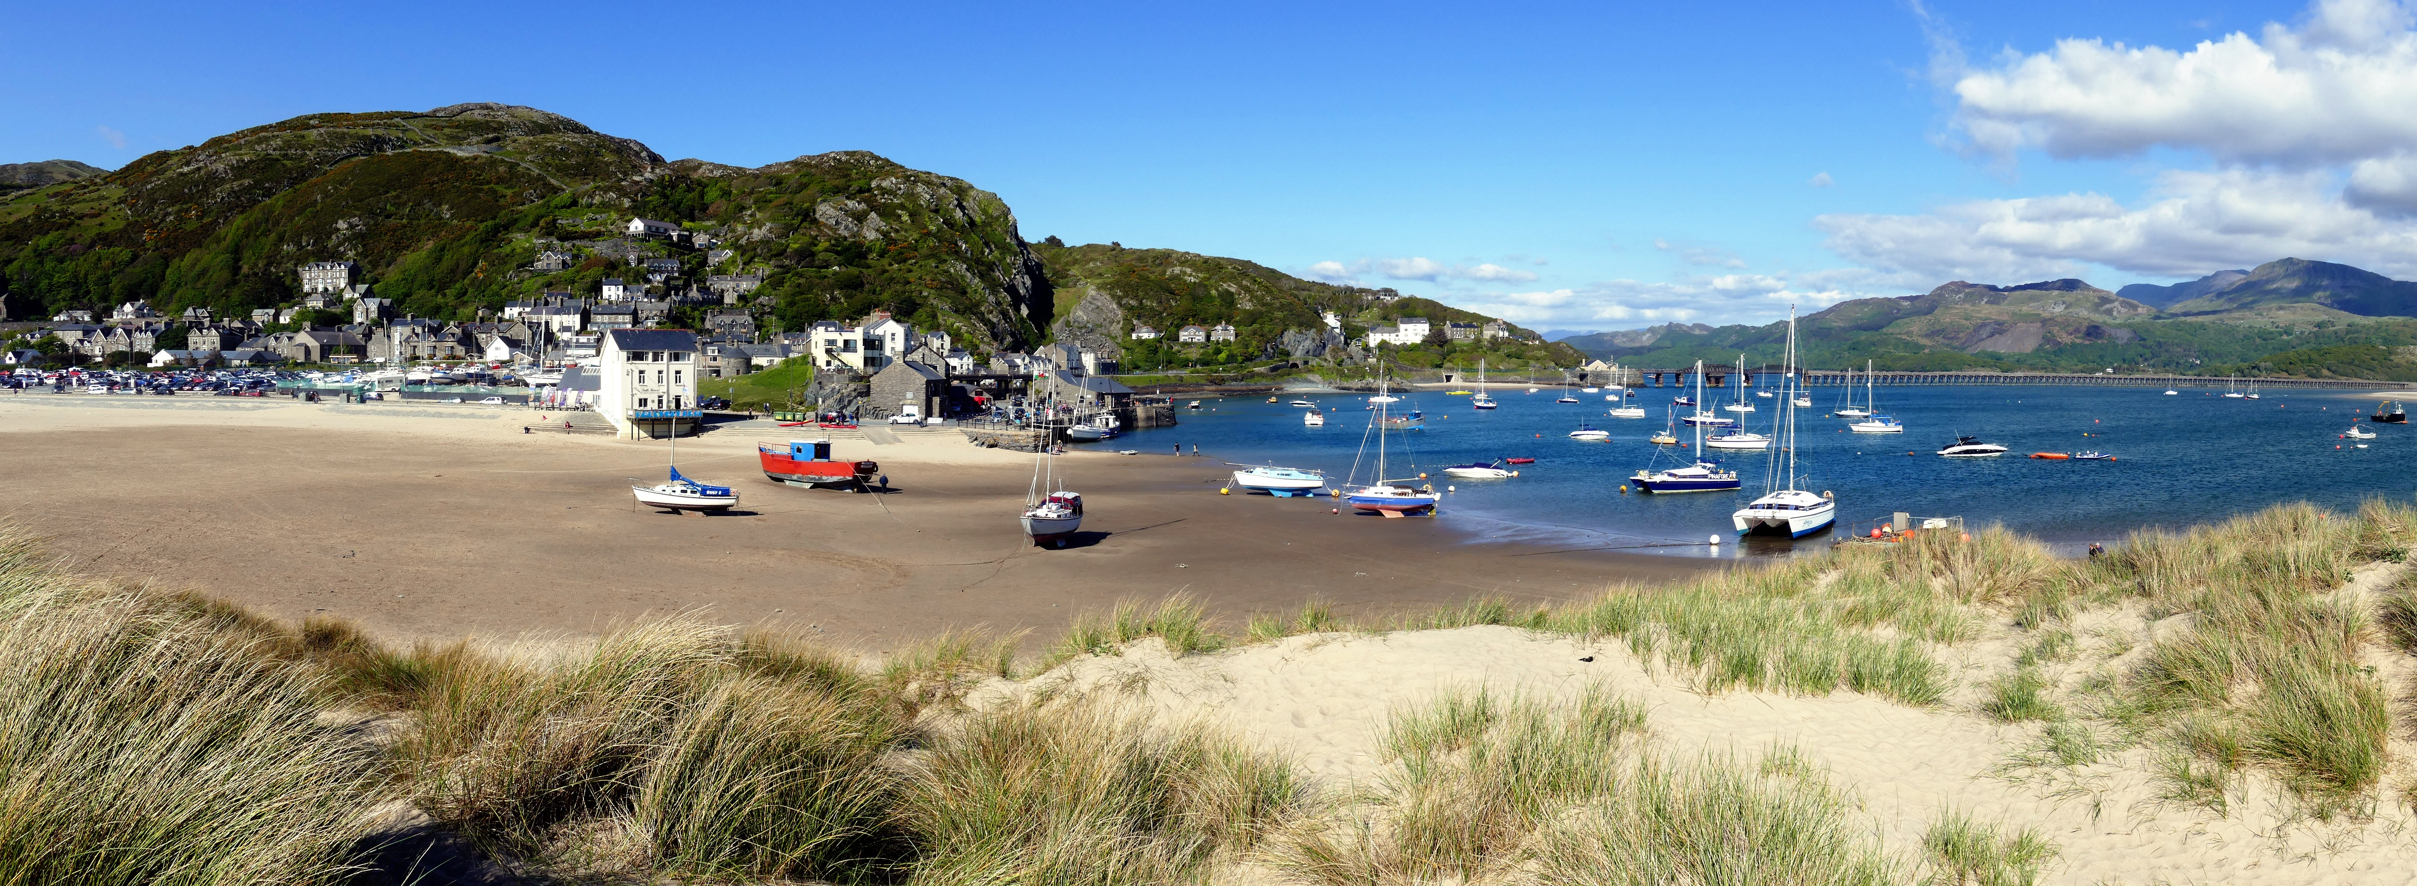
Coastal Habitats
We all live within 80 miles of a coast in the UK.
×
+
seaside towns and cities
beaches
+
×
+
sand dunes
×
Click on the buttons to reveal the different types of coastal habitats.

Slide 6
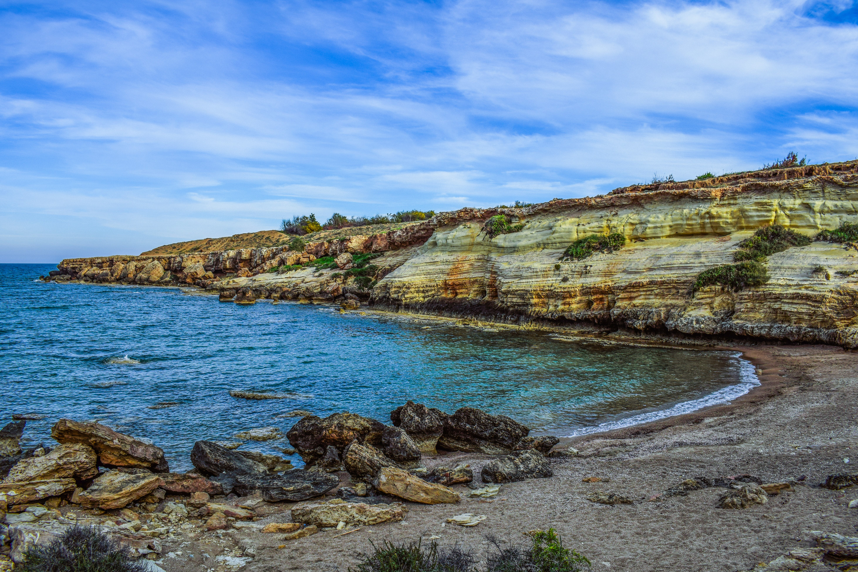
Coastal Habitats
We all live within 80 miles of a coast in the UK.
cliffs
+
×
+
×
rocky shore
Click on the buttons to reveal the different types of coastal habitats.

Slide 7
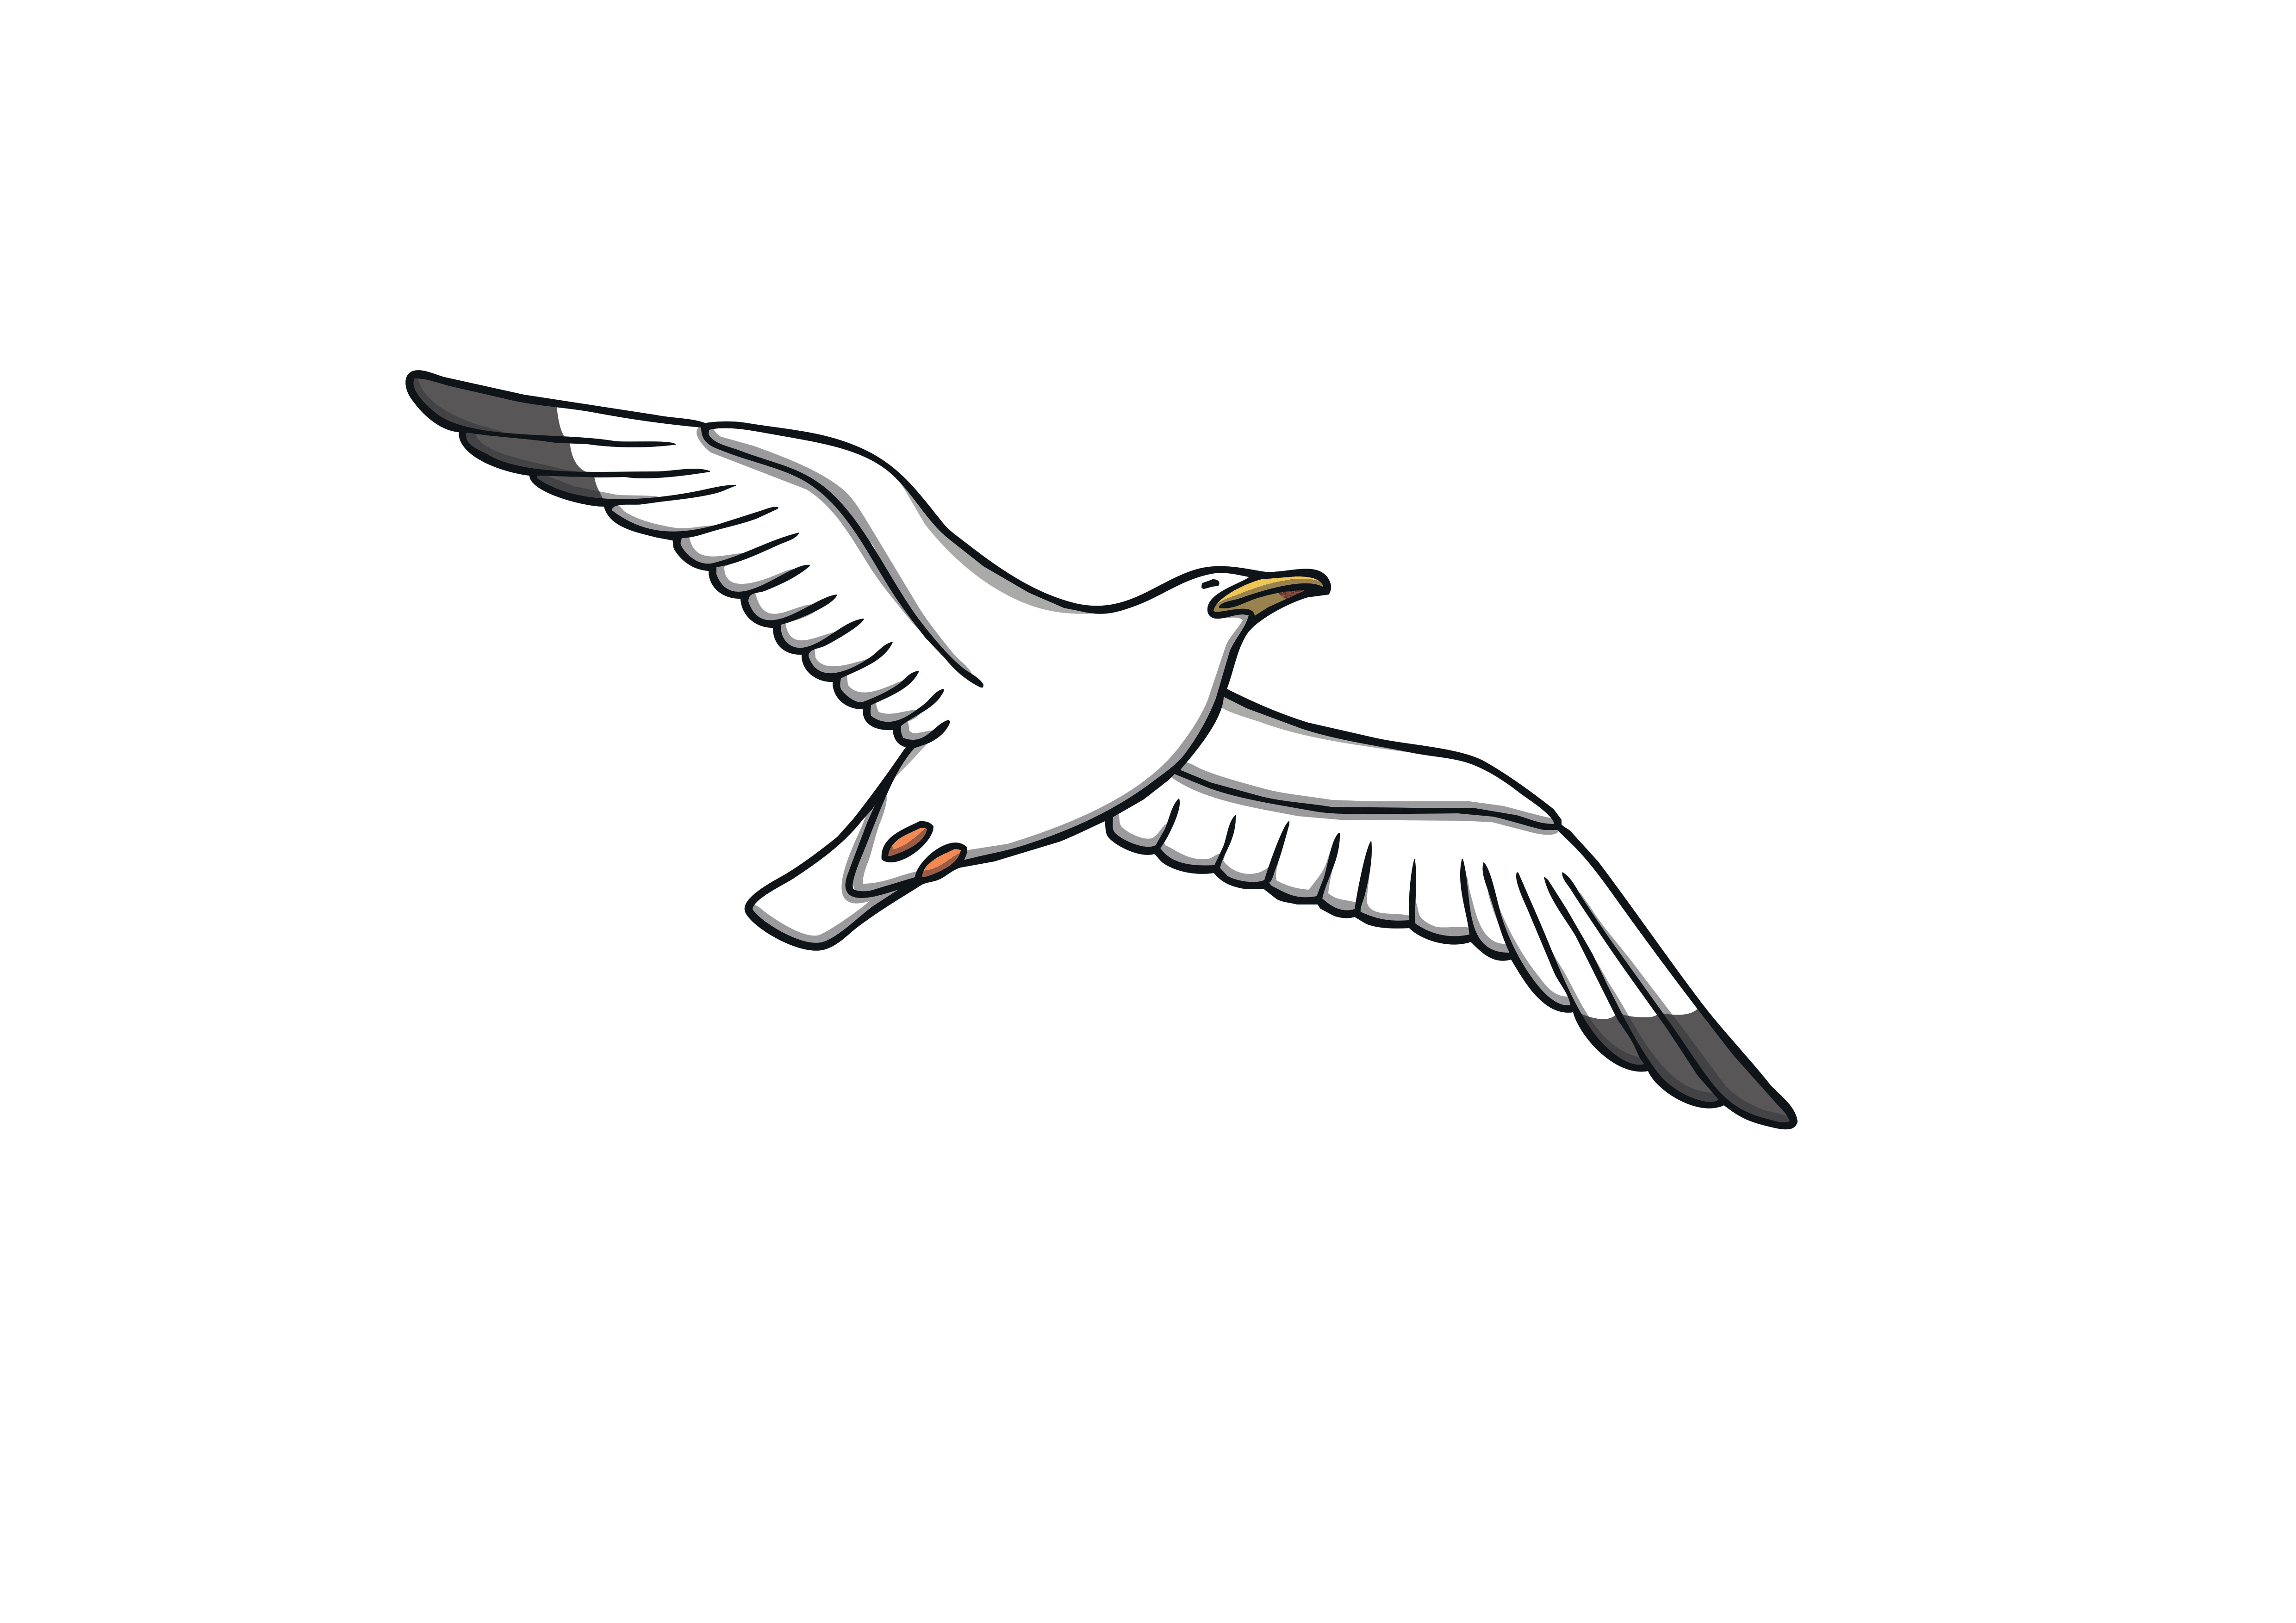
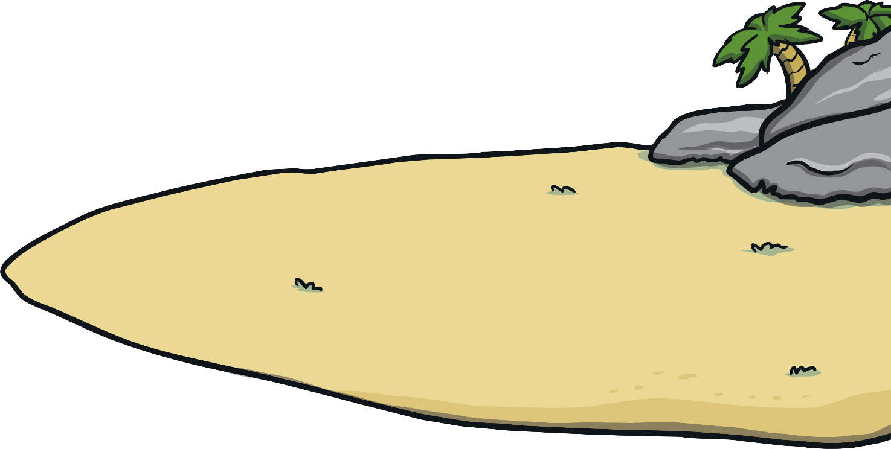
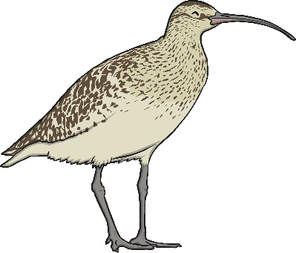
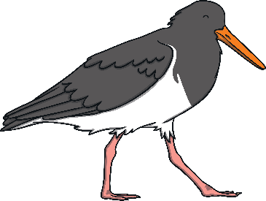
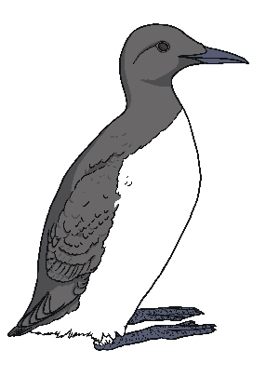
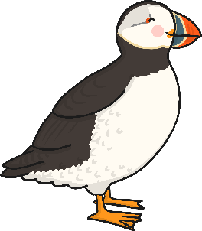
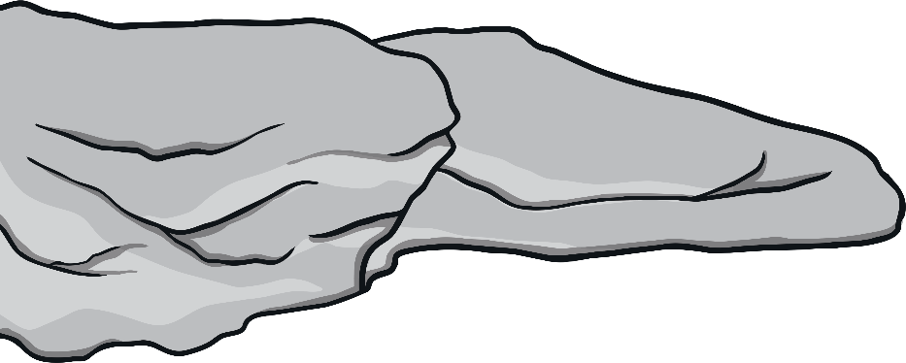
Coastal Birds
next slide
Beaches are important habitats for many plants and animals,
including birds. Click on the images to reveal more information.

Slide 8

Coastal Birds
Oystercatcher
They make very loud calls.
They have a long, strong, flattened, red bill.
They use their bills to eat cockles, mussels and other shellfish.
They nest along the coast, by rivers and on gravel pits.
previous slide

Slide 9

Coastal Birds
Puffin
They are also called sea parrots and are very small, just
33cm tall.
They have a very large, multicoloured beak.
Their burrows are at the top of cliffs in short grass.
They dive for fish using their wings to swim.
previous slide

Slide 10

Coastal Birds
Guillemot
Their eggs are pointed and narrow at one end: handy to stop them falling off cliffs.
They are brown and white and have white faces in winter.
They live on cliffs and ledges in big groups.
They eat crustaceans, molluscs and fish.
previous slide

Slide 11

Coastal Birds
Curlew
They are very big, around 50cm tall.
They are greyish-brown in colour with long blue-grey legs.
They are good at wading in water and using their bill to catch earthworms, shrimp and crabs.
They can be seen in wet grasslands and moorlands.
previous slide

Slide 12

Coastal Birds
Seagull
Herring gulls look the same as seagulls but have a red spot on their bill.
The adults are silver-grey and white with black wing tips. The young are silver-grey
all over.
They nest on rooftops, clifftops, farmland, wetlands, islands and around the coast.
They eat fish, insects and unfortunately scraps of food (like chips) left by humans.
previous slide

Slide 13
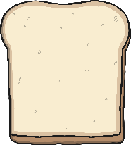
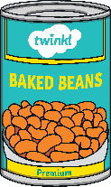
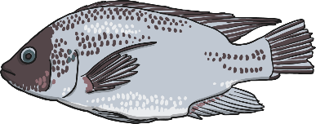
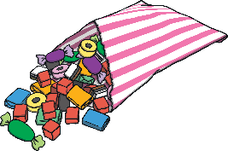
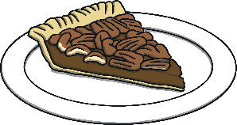
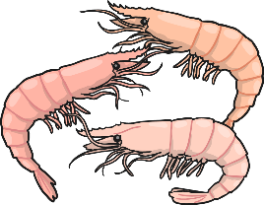
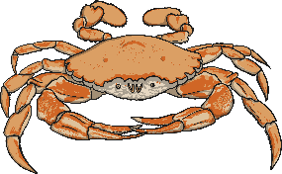
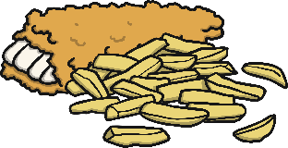
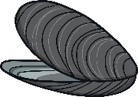

Birds and Their Habitats
Try it...
Which of these are food for birds in their habitat?
Click on each one to check!
bird food
not bird food

Slide 14
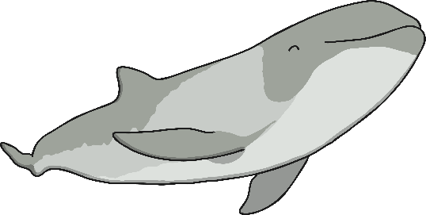
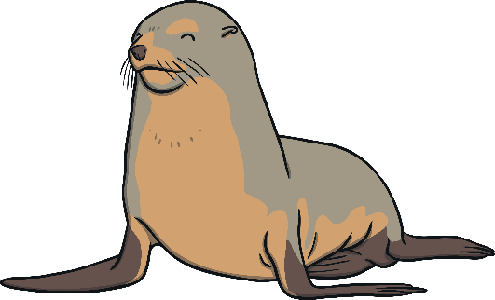

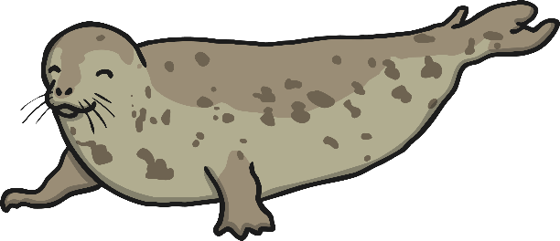
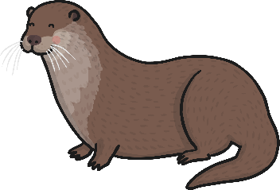
Marine Mammals
next slide
Beaches are important habitats for many plants and animals, including mammals. Click on the images to reveal more information.

Slide 15

Marine Mammals
Harbour Seal
Also known as the common seal, they can stay underwater for up to 10 minutes.
The common seal is the smaller seal and they eat octopus, squid, crabs and fish.
Can be blonde, grey, brown, silvery white and black, often with dark spots.
They have shorter snouts and their nostrils form a V shape.
previous slide

Slide 16

Marine Mammals
Grey Seal
They have a longer, more elongated snout and their nostrils do not meet in the middle.
Grey seals are more vocal than common seals and tend to lie closer together.
The pups are born white.
They eat sand eels, crabs, lobsters and fish.
previous slide

Slide 17

Marine Mammals
Harbour Porpoise
They are small toothed whales, closely related to dolphins, but less energetic.
They eat fatty fish like herring and mackerel. Sometimes they eat squid and octopus.
They might be seen on their own or in groups of up to 10.
They are smaller, darker and have
rounder heads than dolphins.
previous slide

Slide 18

Marine Mammals
Otter
Otters have strong tails and webbed feet.
They mainly eat fish, but also birds, crayfish and rabbits.
They have cubs in underground burrows called a holt.
Otters like having fun like making waterslides. Sea otters sometimes hold hands while sleeping to form rafts so they don’t drift away.
previous slide

Slide 19
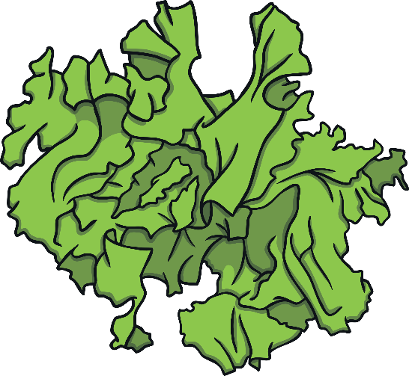
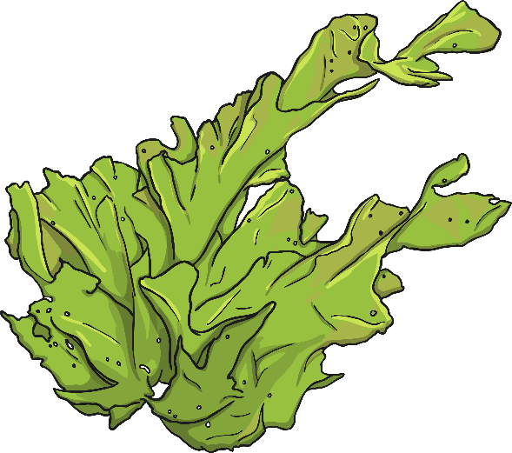
Underwater Plants
Beaches are important habitats for many living things,
including plants.
With your partner, discuss it...
Can you name any underwater plants?

Slide 20
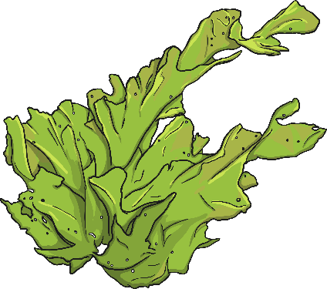
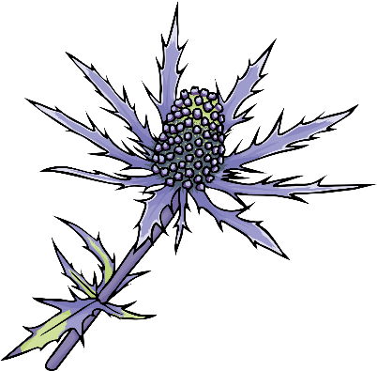
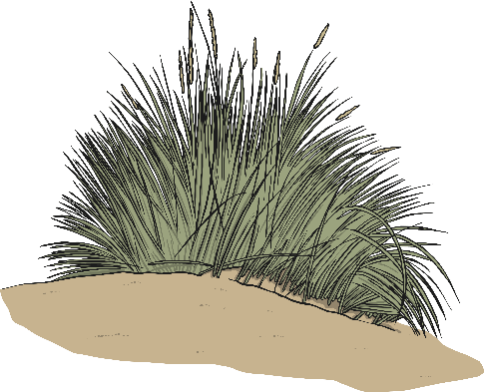

Underwater Plants
seaweed
sea holly
marram
sea lettuce
Click on these plants to check their names.

Slide 21


Seashore Minibeasts
Beaches are important habitats for minibeasts too.
Try it...
Try to think of as many minibeasts as you can that you might find at the beach.

Slide 22

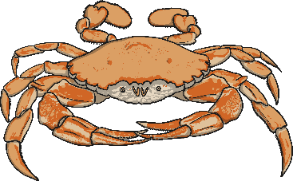
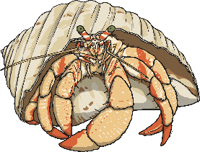
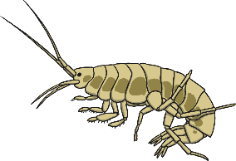

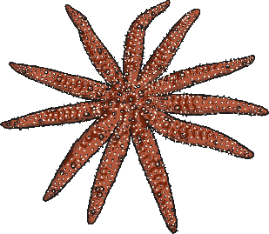
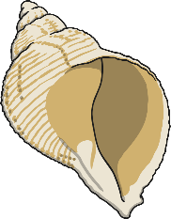
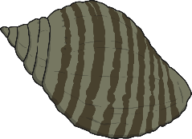

Seashore Minibeasts
mussel
shore crab
hermit crab
shrimp
prawns
starfish
common whelk
dog whelk
razor shell
Click on these minibeasts to check their names.

Slide 23



Help
We need to help birds, mammals, plants and minibeasts, as well as
our environment.
Think about it...
What could we do to help look after our beaches?

Slide 24
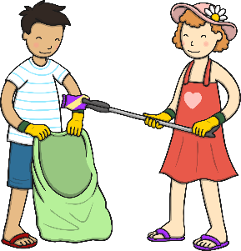
Looking After Our Beaches
Try it... Work out whether each rule belongs under Do or Do Not. Click on each rule to check.
Do
collect shells
drop litter
Do Not
keep a safe distance away from animals
leave shells at the beach
feed and leave food for animals
touch the animals
pick up litter
take pictures of leaves and flowers
pick leaves and flowers

