Slide 1
Unicef/Mawai
Notes:
Art works of street-based female adolescent drug users, who come to the APON Center at Mirpur, Dhaka on 20 October 2018.
Unicef/Mawa

Slide 2
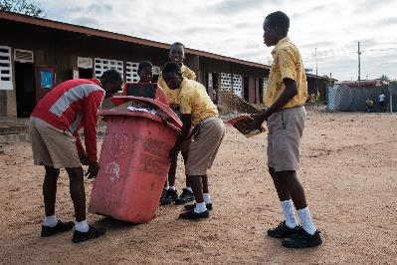
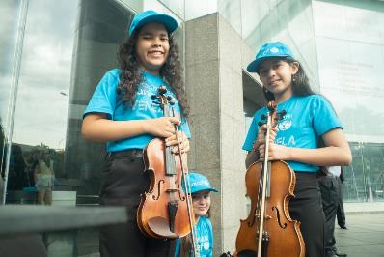
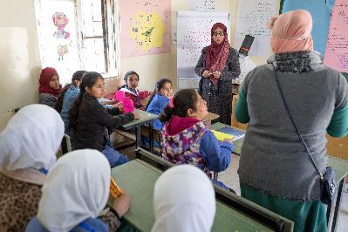
Guess the article
These pictures provide a clue to this week’s article.
Can you guess how they are linked together? Which article of the Convention do these pictures relate to?
Write down your thoughts or discuss with someone in your home.
Unicef/Quarmyne
Unicef/Pocaterra
UnicefMatas/

Slide 3

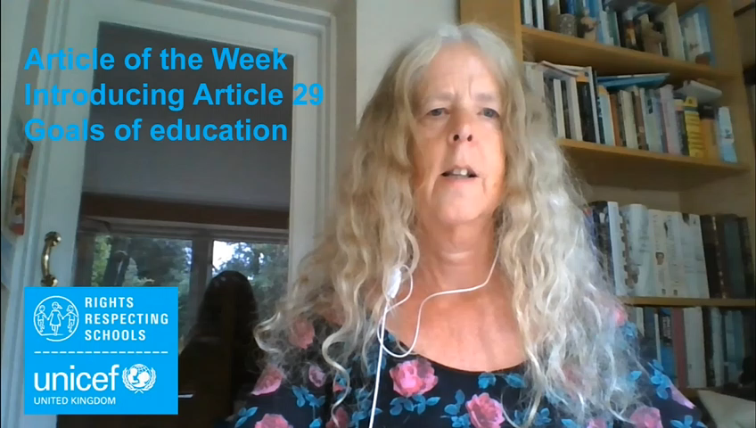
Introducing… Article 29
Frances introduces Article 29 – Goals of education
Article 29 – the goals of education
Education must develop every child’s personality, talents and abilities to the full. It must encourage the child’s respect for human rights, as well as respect for their parents, their own and other cultures and the environment.
Watch Frances on YouTube

Slide 4
Exploring Article 29
How many different ideas can you think of for the goals of education?
Write them down and then compare your answers with the next slide.
Make sure your answers are about what education can help you ACHIEVE.
.

Slide 5
Did you include these answers?
To be able to read, write and calculate and use this learning to solve real problems.
To learn about and experience lots of different things.
To be able to think critically.
To become the best I can be, whether in maths, sport, art or music.
To continue learning and develop throughout my life.
To resolve conflicts in a non-violent ways.
To live in a peaceful and fair world.
To respect and have good relationships with other people.
To learn about rights.
To respect and look after the environment.

Slide 6
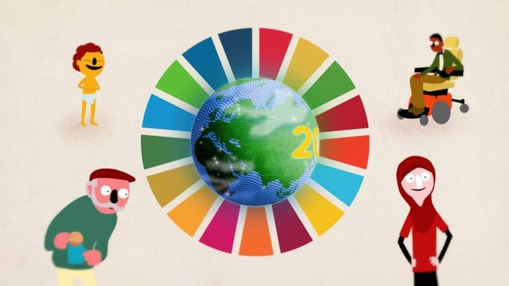
Activity Time
Paddington is the perfect champion for children at Unicef. He is friendly, kind and brave. Can you think of any other words to describe his personality. What words would you use to describe your personality or one of your friends?
What do you know about the World’s Sustainable Development Goals. Take a look at the Family Pack. or watch Malala introducing the Goals.
All these activities are related to…
Look back at the previous slide and talk to an adult about the aims of education. Agree how you score your school on each statement?
Your education should help you shine. Draw a picture showing how you love spending your time.
You don’t need to do every single activity
but if you have time you can do more than one.
Primary

Slide 7




Activity Time
Have you read the Harry Potter stories or other books set in schools? Decide which school fulfils the goals of education best. Discuss your reasons with your friends or family.
Do you have a Suggestion Box in your school? What would you put in it to make your school even better?
As it’s the end of another year of learning – think about an adult in school who has really helped you to get your right to education this year. Write them a thank you email or design a card to send them.
Try and list all the clubs, activities or school visits that you took part in last year. How many can you remember? How have they helped you develop your talents? Ask your friends and family to add to your list.
Imagine you are being asked to design a new school that will develop everybody’s personality, talents and abilities fully and encourage respect for rights and nature. Write about or draw what it would be like.
Everybody has talents and abilities. What are yours?
Primary

Slide 8



Activity time
Try and list all the clubs, activities and visits that your school provided last year. How do these opportunities help young people to develop their potential? Are there more to be added? Write a suggestion to school explaining your reasons for the new group you are proposing.
These activities will help you
understand how...
…can relate to your life.
You don’t need to do every activity, just do as many as you can.
What are your talents and abilities? How does your education help you to use and develop them?
Imagine you are being asked to design a new school that will develop everybody’s personality, talents and abilities fully and encourage respect for rights and nature. Write about or draw what it would be like.
Your education should help you understand and respect human rights. There are lots of other human rights agreements as well as the CRC. One of them is the Universal Declaration on Human Rights. Find out more about it.
Secondary

Slide 9
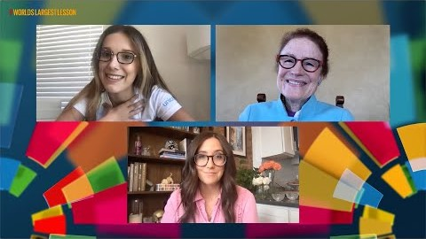


Activity time
A few weeks ago Unicef and others hosted a big discussion for young people about Covid-19 and the Global Goals. The
invitation was to reimagine education, health and youth activism. World’s Largest Lesson Live on Covid-19 and the SDGs shows people in dialogue with young people to reimagine education, health and youth activism. Watch the video and discuss with other people in your household.
Think about how well your school encourages young people to respect: themselves, others, human rights, their parents and the environment. Rate each category out of 5 with 0 as no encouragement and 5 for lots of encouragement. Share your results with a friend from your school or even different schools.
What could your school do to improve its rating?
The pandemic has meant that education has been interrupted for all children across the world. If you were the Minister of Education what guidance would you give to headteachers to ensure that all the goals of education can be achieved.
Secondary

Slide 10
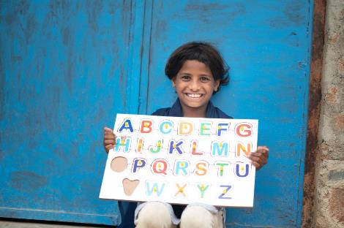
Reflection
Try to find somewhere peaceful and spend a few minutes being quiet and still… then think about these questions…
What do you do in your own life to respect your right and other people’s right to the goals of education?
How can we show our appreciation to our schools and why is this important?
Write down your thoughts and if you want, share this back with your teacher, friends or family.
Uncief/Panjwani

Slide 11
Thank you

