Slide 1
UNICEF/Dejongh
Notes:
Animata and her husband Abdoulle, with their newborn baby in a health center in Côte d'Ivoire.
Animata gave birth to her first child today, and Abdoulle arranged with the nurse the paperwork for the birth registration of the baby.
"Every individual has the right to an identity and we are aware of how important this is for the future of our child." says the father.

Slide 2
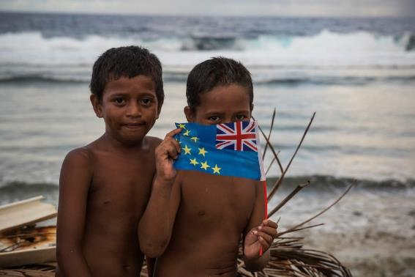
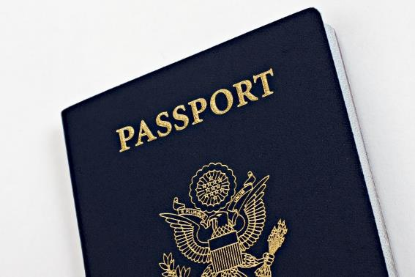
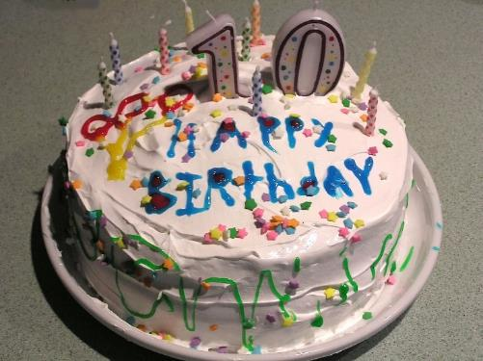
Guess the article
These pictures provide a clue to this week’s article.
How do these pictures help you? Can you guess how they are linked together?
Write down your thoughts or discuss with someone in your house.
UNICEF/Sokhin
Wikimedia commons
Wikimedia commons

Slide 3

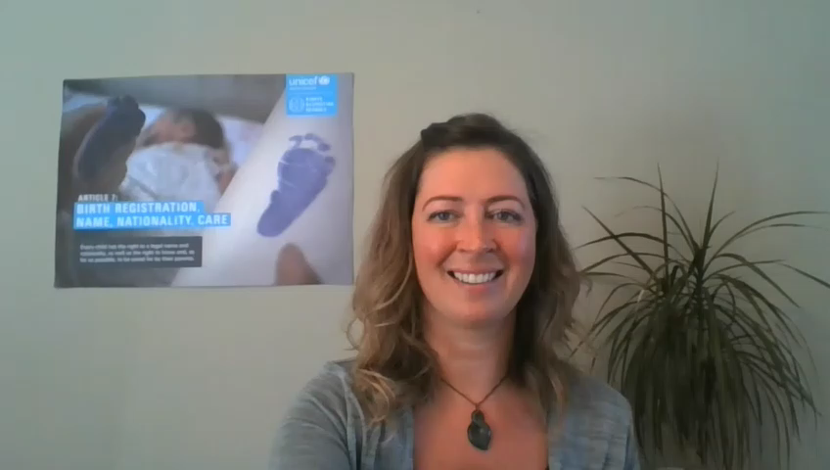
Introducing… Article 7
Jenny introduces Article 7
Article 7 – birth registration, name, nationality, care
Every child has the right to be registered at birth, to have a name and nationality, and, as far as possible, to know and be cared for by their parents.
Watch on YouTube

Slide 4
How can your name & nationality be respected?
What sort of things need to happen if you are to have your name and nationality respected?
What would help you? What should adults do?
Write them down and then compare your answers with the next slide.

Slide 5
How many of these did you get?
By being called your preferred name (shortened or in full)
Your name being pronounced properly and spelt correctly
A birth certificate
A passport (if you need to travel out of the UK)
You are encouraged to be proud of your name and nationality.
You get a chance to celebrate your national identity perhaps with a special day, food or music.
To know and be cared for by your parents - it might be two parents, or it might be one parent, or someone else in your family, like a grandparent or an aunt or uncle or maybe a carer, an adult who children live with, and are looked after by

Slide 6
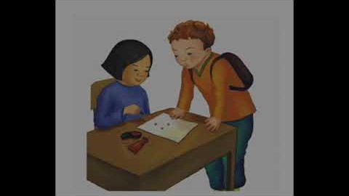


Activity Time
Read The Name Jar or watch the video and think about whether you respect other children’s names.
All these activities are related to…
Have you ever been to a naming and welcoming ceremony, like a christening or aqiqa? Write a short description of what happened or share what you remember by telling someone about it. Find out about naming ceremonies from other faiths or cultures.
Draw an identity hand!
Draw around one of your hands, write your full name in the thumb area, in the next finger, write your date of your birth, put the country you call home in the next finger. Then in the last two fingers, write the names of two adults who are important for you, like you parents, carers or grandparents. Draw the flag of your nationality on the palm. Finish your picture with your favourite colours or designs. Share these with your class and teacher.
Create a sign with your name on – this could be with paper and pen, paint or a collage with indoor or outdoor materials. Can you write an acrostic poem with your name and words that describe you?
You don’t need to do every single activity
but if you have time you can do more than one.
Primary

Slide 7
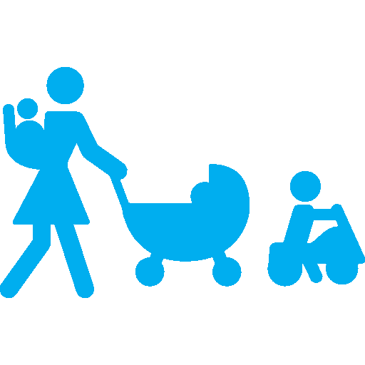



Activity Time
Ask your family about your name? Talk to your friends or family about their names. Do you know if they have a middle name? Do they like their names? Would they ever change them? Imagine if someone decided you had to have a new name, without your agreement. How would you feel? Write down your thoughts.
Do you celebrate the day you were born? Draw a picture of a memorable birthday. Create a bar chart to show the most popular birthday month amongst your friends or family. Try to include at least 10 people.
Why do you think it is important to be registered at birth?
What is your nationality? Do you know what the national flag looks like? Look at other flags, pick a favourite and find out which country it belongs to. Talk to your family about how you celebrate your nationality? Perhaps through days like Burns’ Night, St George’s Day or Chinese New Year?
A coat of arms of a family, town or organisation is a special design in the form of a shield that they use as a symbol of their identity. Design your own coat of arms with things that represent your identity - perhaps the things you like to do such as hobbies or sports.
Wikimedia Commons
Primary

Slide 8




Activity time
In 2015 a French court said a couple couldn't call their daughter Nutella – like the chocolate spread. Some other countries also have rules about what you can and can't name a baby too - can you find out any of these countries and their naming restrictions? What factors do you think parents should consider when choosing a name for their baby?
Ask your family why you have the name you have. Did they have another name for you? What does your name mean? Does it suit your personality? Research the most popular names in the UK. What were the most popular names in the year you were born?
These activities will help you
understand how...
…can relate to your life.
You don’t need to do every activity, just do as many as you can.
Find out what you have to do to register a birth. Is it the same in England, Wales, Scotland and Northern Ireland?
Do you have a passport? How often have you used it and why is it important? Find out what to do if you lose your passport.
Secondary

Slide 9
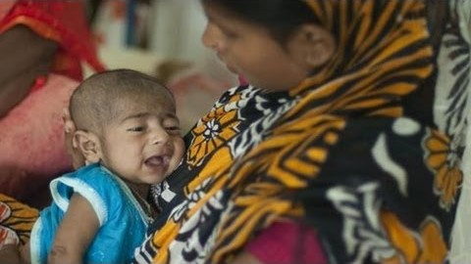



Activity time
Watch this short video from UNICEF to find out why it’s so important that a child’s birth is registered. Did anything surprise you? Did you spot how many children in the world are not registered?
Create a poster or a PowerPoint presentation to explain the different ways your nationality celebrates its identity. Warning: Watch out for stereotypes!!
Have you ever watched the BBC programme ‘Who do you think you are?’ It’s a documentary series where celebrities investigate their family history. They usually discover relatives with very surprising life stories, and this is often quite moving. Phone some relatives and write up some of your family stories.
Create something to represent your identity, such as the things you like, you as a person, what you enjoy and where you are from. It could be a song, a logo, a piece of art or dance… express yourself!
Secondary

Slide 10
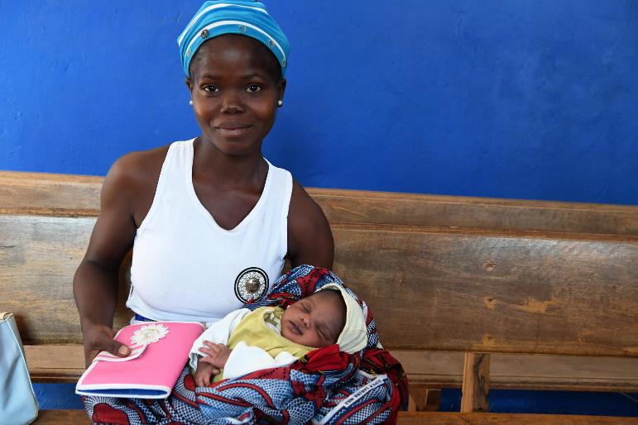
Reflection
Try to spend a few minutes thinking about these questions
Spend a few moments being quiet and still.. think about who you are, your name, your nationality, the people who care for you.
Do you always show respect for the right to a name and nationality in your life at home or school?
How does your school protect this right?
What could you do today to show respect for this right?
Why is this right important to you? How does it help you?
Write down your thoughts or talk to people in your home.
UNICEF/Dejongh

Slide 11
Thank you

