Slide 1
Unicef/Choufany
Notes:
UNICEF Child Rights Festival at the opening of the 30th anniversary of the Convention on the Rights of the Child in Lebanon (CRC)
Unicef/Choufany

Slide 2
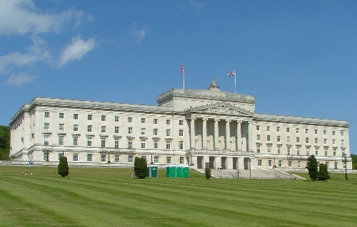

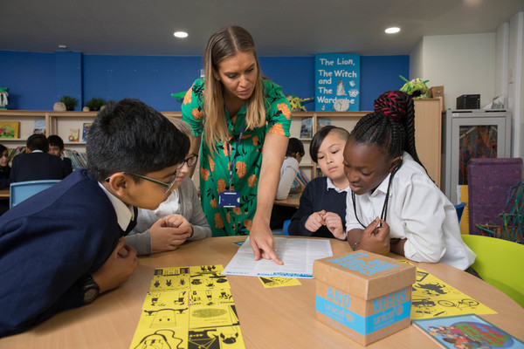
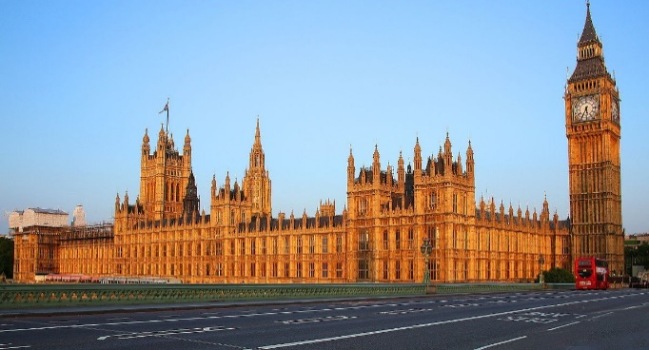
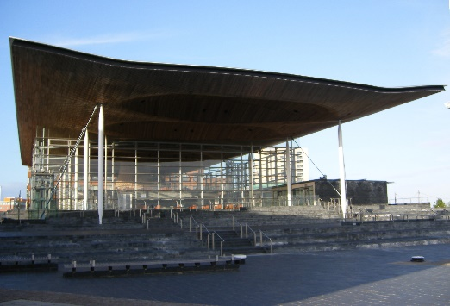
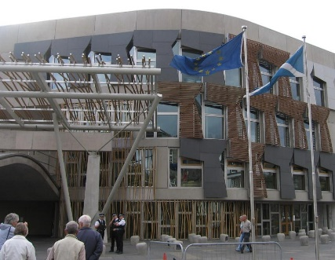
Guess the article
These pictures provide a clue to this week’s article.
What right is being shown in these pictures? Can you guess how they are linked together?
Write down your thoughts or discuss with someone in your home.
Unicef/Dawe
WikiCommons

Slide 3

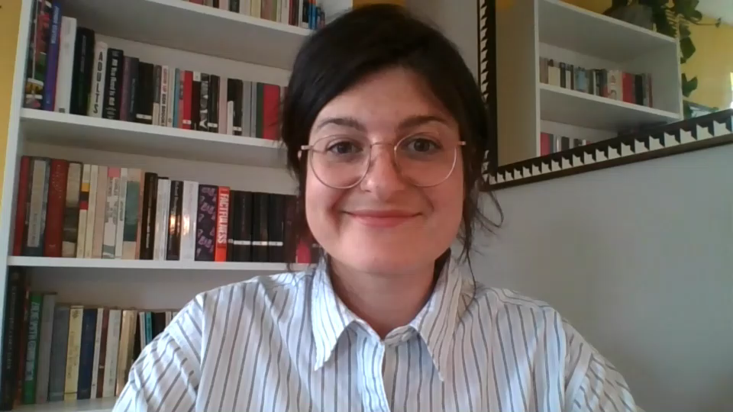
Introducing… Article 42
Sam introduces Article 42
Article 42 - knowledge of rights
Governments must actively work to make sure children and adults know about the Convention.
Watch Sam on YouTube

Slide 4
Exploring Article 42
What is needed for every adult and child to know about children's rights?
Write your thoughts down and then compare your answers with the next slide.

Slide 5
How many of these did you get?
The Government and politicians should talk about rights and help people to understand them.
It should feel ‘normal’ for people to know that children have rights.
All schools should teach about rights.
People who work with children such as teachers, youth workers, police and social workers should be trained about children’s rights.
Newspapers and other information sources report frequently, accurately and positively about rights.
Every young person and child should know who to go to if they feel their rights are not being met.
There are lots of rights so people will need reminding about them, perhaps in the news or with adverts.
Parents and carers should be helped to know about the rights their children have.
People should be able to talk about respecting each others’ rights.
What else did you think of?

Slide 6



Activity Time
Imagine that you didn’t know any rights and that all children everywhere have rights. How would you feel about that? Can you think of any problems children might face? Write a poem or story called “Child with no Rights”.
Do you know your ‘birthday right?’ This is a fun idea thought up by schools in the North East of England – look up, and remember if you can, the article with the same number as the day of the month you were born. Try to get all your family and friends to know their ‘Birthday Right’. Here are all the rights on one page.
All these activities are related to…
Article 42 says that all adults should know about rights. Can you explain why this matters?
Article 42 says that governments have to actively make sure everyone knows about the CRC, and that governments must be active about getting the message about children’s rights out to people. If you were the minister responsible for this what would you do? Have a go at your favourite or most creative idea.
You don’t need to do every single activity
but if you have time you can do more than one.
Primary

Slide 7


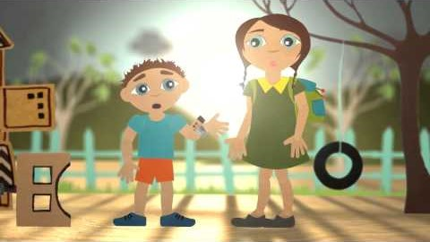
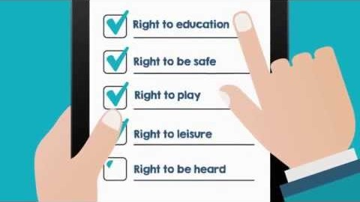
Activity Time
Make yourself a set of cards to represent the articles of the CRC than make up some games to play with the people in your home to help everyone learn about rights. There are ideas for games and a template for the cards here.
Have a look and a listen to some of the songs and videos made by schools to hep children learn about rights. Which one do you like best? Share this with your family and safely on-line with your friends.
Lots of organisations, as well as Unicef, help to promote children’s rights. This video is from the Equality and Human Rights Commission. Watch it and make a note of any facts that you did not know before. Share what you have learnt with your teacher or your family.
If you were a teacher of very young children, how would you help them to understand about their rights. This video made by Unicef Australia might help to get you started.
Primary

Slide 8


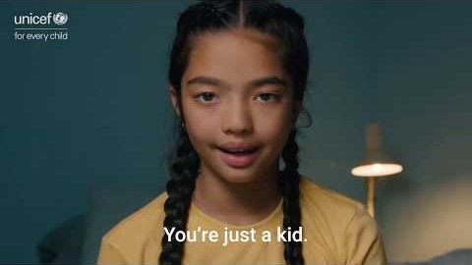
Activity time
Design a card game, a quiz or a board game for younger children, which teaches them their rights. Your game could be something simple like pairs, or snap, or something completely different –you decide! There are ideas for games to get you started here.
These activities will help you
understand how...
…can relate to your life.
You don’t need to do every activity, just do as many as you can.
Before your school started teaching you about children’s rights did you know what they were? Do you think knowing about your rights is important? Try to explain to somebody why you think this.
“Rights are of little use to people unless they are aware of them.” What do you think this sentence means? Do you agree? What could the Government do to promote rights to more people.
Watch the video on this Unicef page. Does it inspire you believe that the rights of children and young people are important? Having watched this, produce something creative (art, music, poetry…) entitled Children’s Rights Matter. Share your work with others.
Secondary

Slide 9
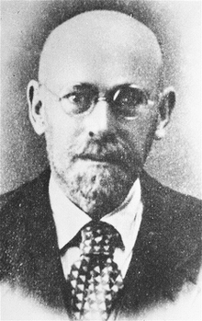

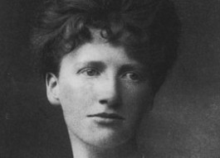

Activity time
The Convention on the Rights of the Child was adopted (agreed) by the United Nations in 1989 but there were decades of talk about rights for children before this. Research the history of children’s rights. You might like to find out in particular about Janusz Korczak and Eglantyne Jebb.
In the UK most secondary schools spend little time talking about rights. Do you think this should change? If so, come up with three convincing reasons why young people, and their teachers, should know about their rights. Share your ideas with your friends.
If you feel strongly about the importance of more people knowing about the rights of young people and children, you could start a campaign to get your message across. Have a look at our Advocacy Toolkit for some ideas.
Lots of organisations, as well as Unicef, help to promote children’s rights. This video is from the Queens University in Belfast. Watch it and make a note of any facts that you did not know before. Share this with your teacher or your family.
Secondary

Slide 10
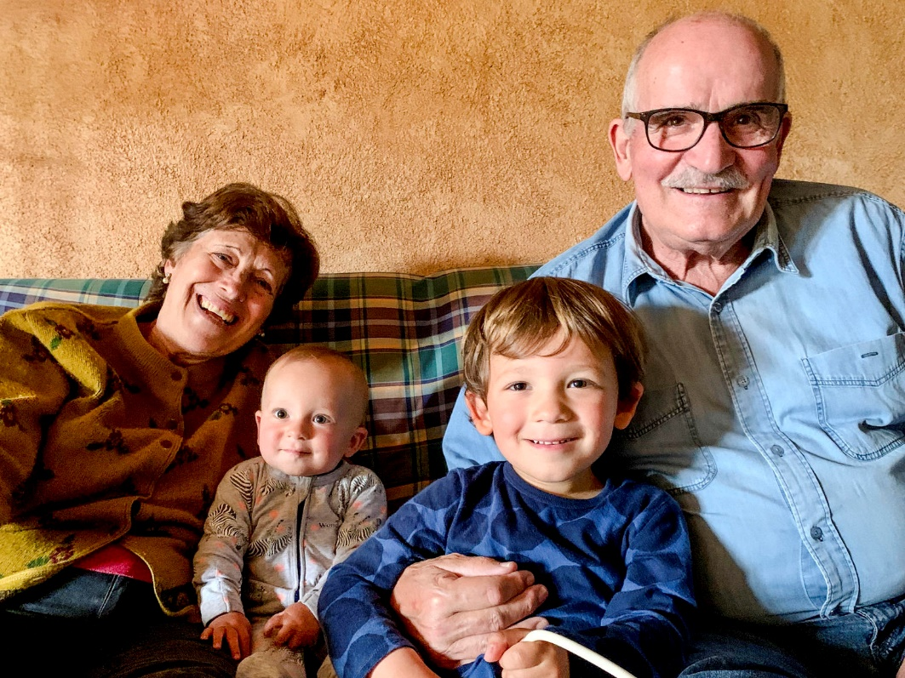
Reflection
Try to find somewhere peaceful and spend a few minutes being quiet and still.
Then think about these questions:
Why do your rights matter to you? What’s so special about them?
Imagine a world where every child enjoyed all their rights all the time?
When you are an adult what will you do to tell other people about rights?
Unicef/SalaFont

Slide 11
Thank you

