Slide 1
Unicef/Mawa
Notes:
Mosharef , a teacher dancing with students at Ambag Primary School Gazipur, Bangladesh. March 2019.
Unicef/Mawa

Slide 2
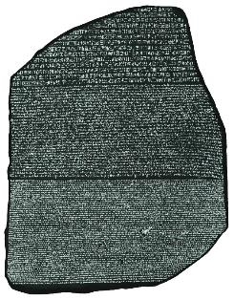
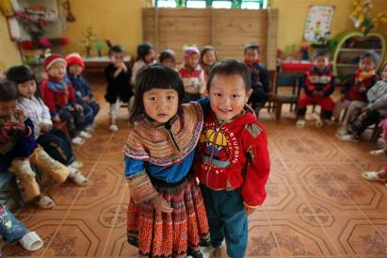
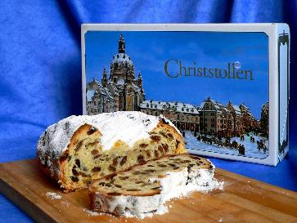
Guess the article
These pictures provide a clue to this week’s article.
Can you guess how they are linked together? Which article of the Convention do these pictures relate to?
Write down your thoughts or discuss with someone in your home.
WikiCommons
Unicef/Estey
WikiCommons
Notes:
From left to right:
1. Mumbai, India, December 2018: Members of the transgender community in India and allies protesting against the regressive provisions of the Transgender (Protection of Rights) Bill. Wikicommons
2. Recently married couples leaving the City Hall in Seattle are greeted by well-wishers on the first day of same-sex marriage in Washington state after enactment of Washington Referendum 74 Dennis Bratland/Wikicommons
3. Baltimore, US, July 2016: An image from a Black Lives Matter march through downtown Baltimore City. John Lucia/Wikicommons – licence: https://creativecommons.org/licenses/by/2.0/deed.en

Slide 3

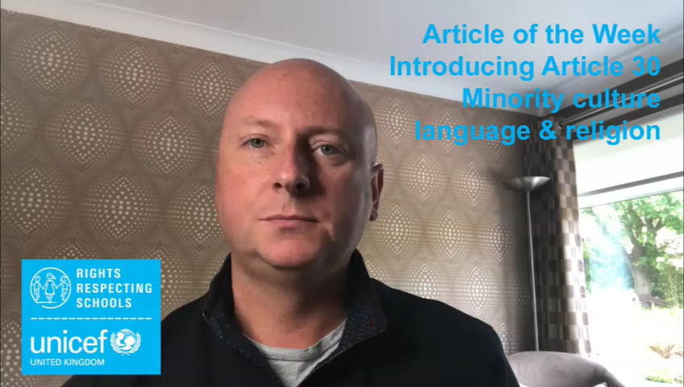
Introducing… Article 30
Gerry introduces Article 30
Article 30 - Minority or indigenous groups, culture, language and religion
Every child has the right to learn and use the language, customs and religion of their family whether or not these are shared by the majority of the people in the country where they live.
Watch Gerry on YouTube

Slide 4
Exploring Article 30
What can you do to help all children enjoy their right to learn and to use the language, customs and religion of their family even if they are not the majority?
Note down your thoughts and compare with the next slide.

Slide 5
How many of these did you get?
Be able to speak your own language with friends and family without other people saying it’s rude.
Learn about different languages, cultures and religions.
Read books by lots of different kinds of writers from all around the world.
Learn about the world through the eyes of different people.
Celebrate lots of special events like Burn’s night, Chinese New Year, St David’s Day, Carnival.
Enjoy food, music and dance from different countries.
What else did you think of?

Slide 6
Activity Time
Do you know any traditional dances? Research these safely online or ask a friend or grown up to teach you and practise the steps.
Find 10 characters from your favourite books. Do they come from a range of cultures or are they all just like you?
All these activities are related to…
Can you find out how to say ‘”Hello, how are you?”’ in 5 different languages.
Share with friends and see how many you can get as a group.
Culture means traditions that groups follow like food, dances, song and clothes. Draw or write about what is important in your culture. Then think of someone who comes from a different culture and share safely with them what is important about culture for each of you. This could be someone you know or you could pick a country or indigenous group and write to a child of that country or group.
You don’t need to do every single activity
but if you have time you can do more than one.
Primary

Slide 7
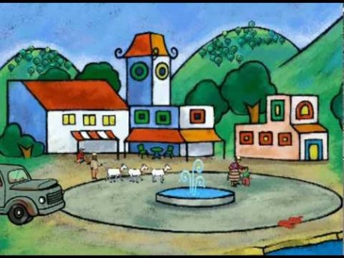
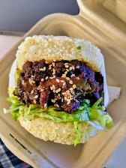

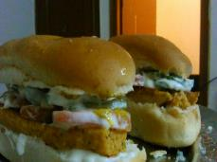
Activity Time
Watch ‘If the World were a Village of 100 People’ to find out about people around the world.
Keep a food and drink diary for the week. What cultures do your food and drink come from? Which are your favourites?
Can you guess what kinds of fusion foods these are? Fusion food combines elements from different cultures. Invent a recipe for your own fusion food.
A lot of our food originates from other cultures. Design a menu for your household for the week that involves food from different cultures. Prepare one or two of the meals for the people you live with.
What does it mean to be from a minority or indigenous group? Find out what the words mean and then think about which minority groups there are in the UK. Why do you think Article 30 is important and how does it link to last week’s work on Article 2?
Wikicommons
Primary

Slide 8
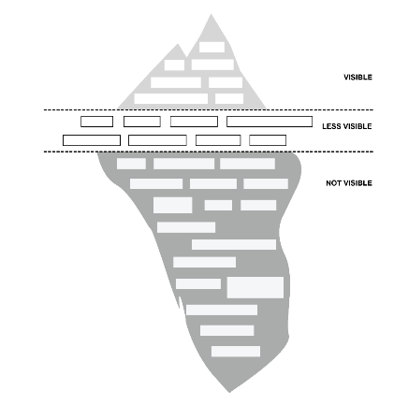
Activity time
Find out what a minority group is and then think about which minority groups there are in the UK. The 2011 census data will give more information. Choose some interesting facts and write a quiz for your family and friends.
These activities will help you
understand how...
…can relate to your life.
You don’t need to do every activity, just do as many as you can.
Culture means traditions that groups follow like food, dances, song and clothes. Draw or write about what is important in your culture. Think of someone who comes from a different culture and share safely with them what is important for each of you.
Design a menu for your household for the week that involves food from different cultures. Prepare one or two of the meals for the people you live with.
The characteristics that form a person’s culture can be visible, less visible or invisible. Assumptions based on how someone looks don’t necessarily reveal their culture, you may only be seeing the tip of the iceberg. Take a look at this empty diagram of an iceberg. Copy the diagram onto piece of paper and note down what characteristics might be visible (at the top of the iceberg), less visible (at sea level) and invisible (below the water). When you have done this you can continue the exercise on next slide…
Secondary

Slide 9
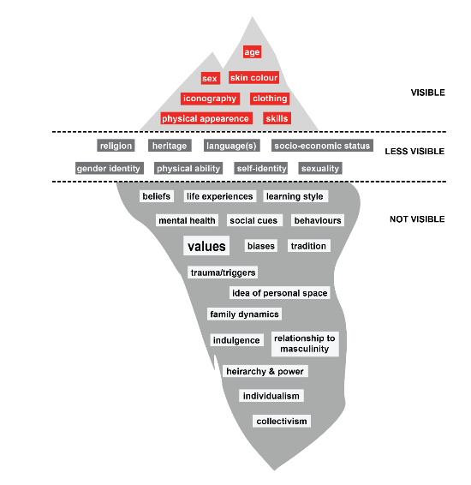
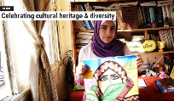

Activity time
Connect with other young people on Unicef Voices of Youth. Contribute your art and stories to share with other young people around the world. There is a whole section on culture on the Voices of Youth site.
Look at GCSE reading texts and Scottish set texts. Are they from different cultures? Which books would you choose to be relevant to your school students?
Can you identify some indigenous groups? Why do you think Article 30 is important for minority and indigenous groups and how does it link to last week’s work on Article 2?
Look at the Advocacy Academy newspapers and identify what changes you would make in the UK. Write to one of your teachers outlining your suggestions.
Find a selection of reports about people from different ethnic groups in the media. Identify whether the report is positive or negative about the group. How do you think these reports impact on children’s enjoyment of Article 30? Find out about an ethnic or minority group in your area, and research their religion, language or culture. Then, write a positive article about what you have found out.
Which of these visible, less visible and invisible cultural characteristics did you get? Are there any you want to add or move on your own iceberg diagram? Share your work back with your teacher and let them know what you have learned about cultural characteristics through completing your iceberg diagram.
Secondary

Slide 10
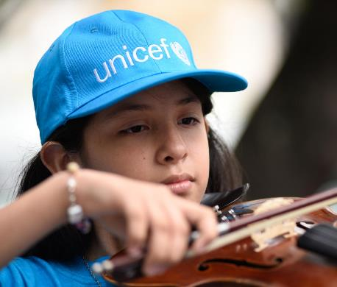
Reflection
Try to find somewhere peaceful and spend a few minutes being quiet and still … then think about these questions…
What do you do in your own life to respect your right and other children’s right to learn and use the language, customs and religion of their family?
How do you celebrate other children’s cultures?
When you hear people laughing at or being rude about other traditions, what do you do?
Write down your thoughts and if you want, share this back with your teacher, friends or family.
Uncief/Cabra

Slide 11
Thank you

