Slide 1
Unicef/Dawe
Notes:
Sehinemariam, 17, a grade 12 student attending classes via Radio which is one of the government’s initiative to support studying at home due to closed schools across Ethiopia.
Unicef/Tesfaye

Slide 2

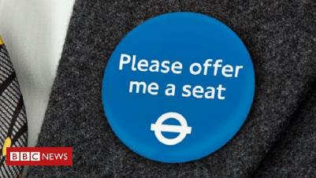
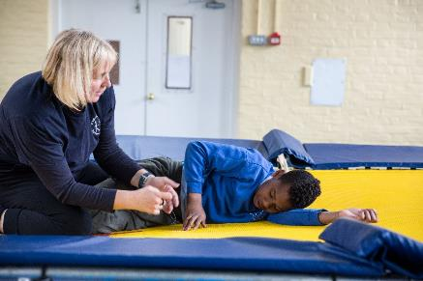
Guess the article
These pictures provide a clue to this week’s article.
Can you guess how they are linked together? Which article of the Convention do these pictures relate to?
Write down your thoughts or discuss with someone in your home.
BBC News
Unicef/Dawe
Accessible Icon Project

Slide 3

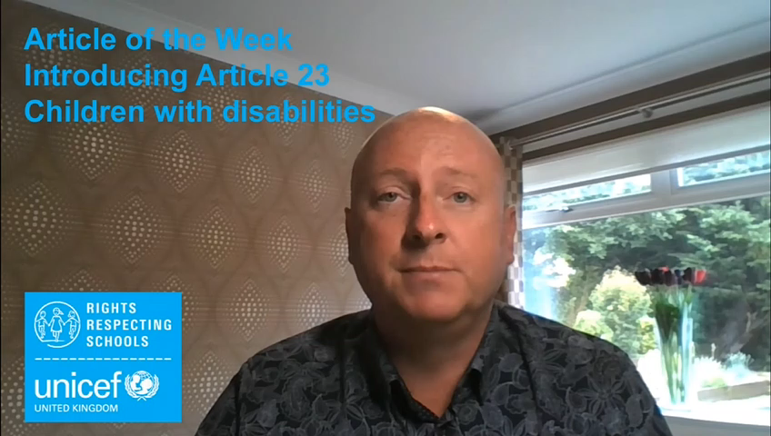
Introducing… Article 23
Gerry introduces Article 23 - Children with a disability
Article 23 - A child with a disability has the right to live a full and decent life with dignity, and as far as possible, independence, and to play an active part in their community.
Governments must do all they can to support disabled children and their families.
Watch Gerry on YouTube

Slide 4
Children with disabilities
The Convention says: “Children must be supported, included, listened to and involved in decisions about their education.
“A disability is a physical or mental impairment that has a substantial and long term negative effect on your ability to do daily activities.”
What can schools do
to support pupils who
have a disability?
Note down your thoughts and compare with the next slide.

Slide 5
How many of these did you get?
Make sure the building is physically accessible (ramps and lifts for example)
Work with specialist services to meet the needs of the child such as accessible buildings, specialist equipment or audio descriptions.
Make lessons and activities accessible for all (easy read, sign language, Braille)
Have quiet, calm and relaxing spaces such as a nurture room
Use special equipment such as a microphone or hearing loop
Listen to the child and help them to be included – every child is unique
Work together and create a plan – making sure the child is heard
Have toilets that are accessible
Make sure all children can enjoy the playground

Slide 6

Activity Time
Winnie has cerebral palsy and she enjoys horse riding. Do you have any hobbies? Write a letter to tell Winnie about the hobbies that you enjoy doing and maybe you have some questions for her. Watch Winnie tell her story here.
All these activities are related to…
What does disability mean to you? Do you know anyone who has a disability? How does your school help people with disabilities? Write down a list and talk to your friends about it.
Article 23 says that children have the right to live a “full and decent life with dignity”. Do you know what dignity is? Ask someone what they think it means or look it up and talk to someone about it.
Some children can’t use their hands to do things like drawing and painting. Watch this video and have a look at some art created by artists using only their mouth or feet. Have a go at painting this hedgehog (or anything else) with either your mouth or feet.
You don’t need to do every single activity
but if you have time you can do more than one.
Primary

Slide 7
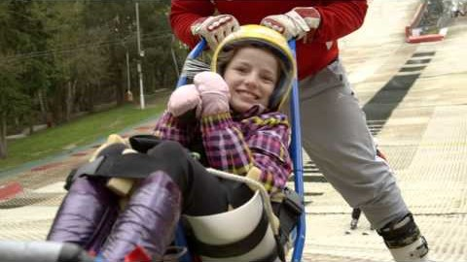
Activity Time
Sign language is a way of communicating using your hands, mostly used by people with loss of hearing. Have a look at this website and see if you can learn some sign language. Teach what you learn to a friend or with someone in your household. Maybe even share a video with your teachers. You could also try this one for animals/alphabet.
How would you feel if you couldn’t join in with games in the playground? What should a playground that can be used by everyone look like? Draw a picture and share with your friends. Have a look at this comic.
It is important that a child with a disability is included and treated with respect. Watch this video and listen to Phoebe who has Cerebral Palsy share her story about the importance of being included and involved in everything she wants to do. Think about what you would ask Phoebe or what you would want to talk to Phoebe about.
Find out about a Paralympic sport that interests you and find a way to show your findings in something like a story, poster, PowerPoint or drawing.
Primary

Slide 8
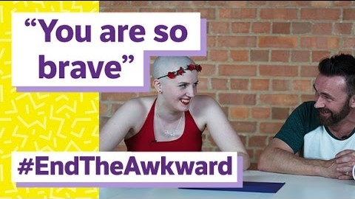
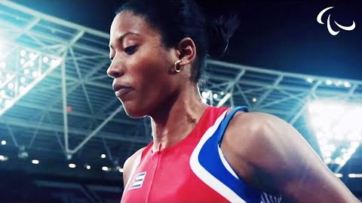
Activity time
What does inclusive education mean? How are disabled children and young people included and supported in your school? Write a list and see if you can think of ways of making things even better.
These activities will help you
understand how...
…can relate to your life.
You don’t need to do every activity, just do as many as you can.
What does disability mean to you? Do you know anyone who has a disability? Is disability always visible? Do you agree with the term ‘disability’? Watch this video in which people are talking about attitudes to disability. What did you learn from the video? Did it change your thinking in any way? Is the language you use always respectful? Write a 400 word reflection on what you have seen.
You are disabled under the Equality Act 2010 if you have a physical or mental impairment that has a ‘substantial’ and ‘long-term’ negative effect on your ability to do “normal daily activities”. (Definition of disability according the UK government - not including Northern Ireland). How does the UK government support children (and their families) with a disability? Try to find out online - source of definition can be found here.
What do you know about the Paralympics? Watch this short film highlighting the importance of change and acceptance. Do some research about a Paralympic sport or sportsperson.
Secondary

Slide 9
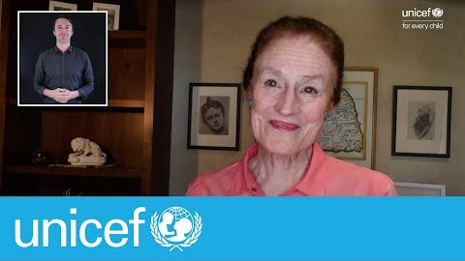
Activity time
It is important that a child with a disability is included and treated with respect. Watch this video and listen to Phoebe who has Cerebral Palsy share her story. She wants people to just talk to her as a human being. Think about what you would ask Phoebe or what you would want to talk to Phoebe about.
Do you know of any people with a disability who you admire – this could be a celebrity, a sports star or perhaps someone in your community. Find out their story, their history, what their strengths and skills are. Design a poster about the person and their strengths and abilities.
Have you ever seen disability rights being infringed upon? Is there anything else that the government or your local community, or you, can do to better support those with disabilities? Write a letter to someone to explain your opinions and ideas to make things better.
Covid-19 has been very difficult for every child and adult and something we have all faced together. Children with a disability can be vulnerable and need extra care and protection. Watch this Unicef video and then write down how it makes you feel.
Secondary

Slide 10
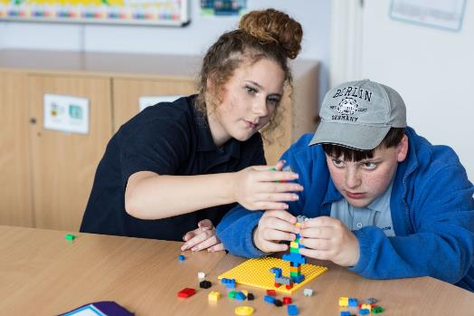
Reflection
Try to find somewhere peaceful and spend a few minutes being quiet and still… then think about these questions…
What do you do in your own life to respect the rights of disabled children to live a full and decent life with dignity?
Is your local playpark accessible for children with disabilities? If not, what can you do to help improve things?
Write down your thoughts and if you want, share this back with your teacher, friends or family.
Uncief/Dawe

Slide 11
Thank you

