Slide 1
Unicef/Tesfaye
Notes:
Sehinemariam, 17, a grade 12 student attending classes via Radio which is one of the government’s initiative to support studying at home due to closed schools across Ethiopia.
Unicef/Tesfaye

Slide 2
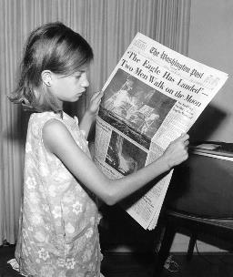

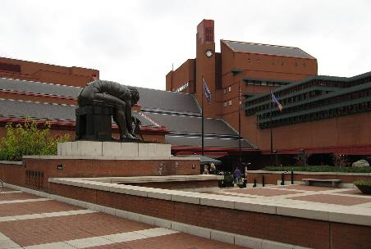
Guess the article
These pictures provide a clue to this week’s article.
Can you guess how they are linked together? Which article of the Convention do these pictures relate to?
Write down your thoughts or discuss with someone in your home.
All WikiCommons

Slide 3
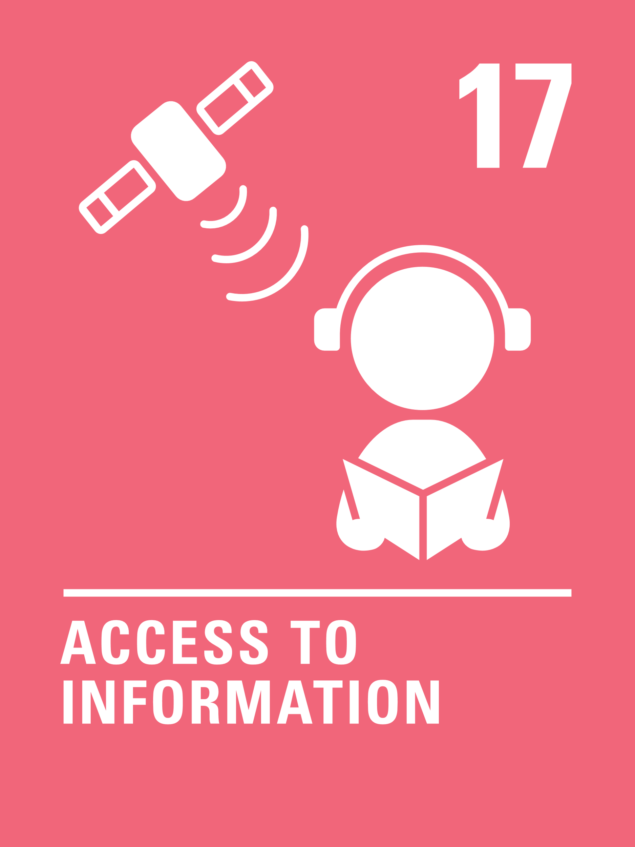
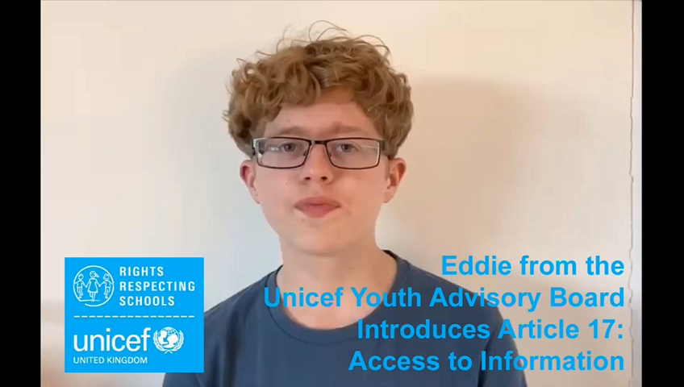
Introducing… Article 17
Eddie introduces Article 17
Article 17 - Access to information from the media
Every child has the right to reliable information from a variety of sources, and governments should encourage the media to provide information that children can understand.
Governments must help protect children from materials that could harm them.
Watch Eddie on YouTube

Slide 4
Exploring Article 17
Learning about reliable information helps you to…
Note down your thoughts and compare with the next slide.

Slide 5
How many of these did you get?
To know that not everything you read is true.
To help you learn about where information comes from.
To be able to discuss information you find, with people you trust.
To learn about bias and ‘fake news’.
To know that it’s okay to ask more questions if something doesn't seem right.
To be aware that people have lots of different opinions.
To learn the difference between a fact and an opinion.
To feel confident to say ‘I’m not sure if that’s true’.
To know that some people deliberately put false information online.
What else did you think of?

Slide 6


Activity Time
School has changed a lot over the years, have a go at this Horrible Histories quiz! What did you learn about children’s education in the past?
All these activities are related to…
Write down all the places you can get reliable information from.
Using household items, build a ‘newsroom’ and be a newsreader for the day, reporting about the day’s events in your house
What would a species from another planet need to know when they arrived on planet earth? Write them a welcome letter, telling them ten things they need to know, to feel welcome and be safe on planet earth. Where will you find reliable information to include in the letter?
You don’t need to do every single activity
but if you have time you can do more than one.
Primary

Slide 7


Activity Time
Watch the story of Goldilocks. This video tells you the story from Goldilocks' point of view. Imagine you are a reporter. Tell the story from the view of the baby bear.
Government and other adults must make sure that children are protected from harmful information. Films and computer games all have different classifications. How many different categories of classifications can you find?
List five really interesting things you’ve learnt this week. You might have learnt something from a friend; maybe you watched the news and a story really stood out; or perhaps one of your parents has wowed you with a fascinating fact.
Primary

Slide 8

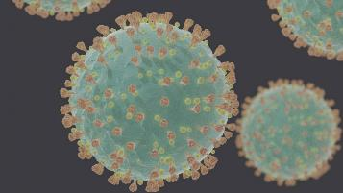
Activity time
WikiCommons
These activities will help you
understand how...
…can relate to your life.
You don’t need to do every activity, just do as many as you can.
Sometimes we don’t understand a particular issue because it’s complicated and needs careful explanation. Have a go at explaining an issue or event you care about for younger children.
The BBC has debunked some of the claims about Coronavirus: had you heard about any of these, or these ones?
BBC Bite Size have put together some great activities to help you spot fake news
Fact or Fiction?
There’s lots of misinformation about Coronavirus and this can be dangerous: the BBC have published some great content that explains how this misinformation spreads. Does this help you identify fact from fiction?
Secondary

Slide 9

Activity time
Try coming up with a list of information sources you think would be reliable if you had a question about:
Your physical health
Your mental health
Entry fees for your favourite attraction or theme park
How much it costs to send a package to a family member or friend in another country
Making your favourite bake from the last series of the Great British Bake Off
Volunteering at your local charity shop
How do you know these are reliable?
The Office of Communication identifies that the internet is the most used platform for news consumption for 16-24 year olds. Where do you get your news information from? Spend a day analysing the top stories on the BBC and another source such as the Guardian or a tabloid. Are they the same or different? What is different in each about the way they present information about similar topics?
WikiCommons
Imagine you’re the Prime Minister – list all the things you would do, to protect children and young people from misinformation
Secondary

Slide 10
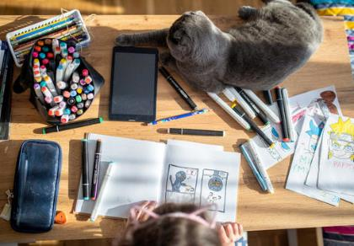
Reflection
Try to find somewhere peaceful and spend a few minutes being quiet and still… then think about these questions…
What do you do in your own life to make sure you are able to access the information you need? Why is this important?
Article 17 is also about protection from harmful media. What can make some media harmful and why is it important, particularly now, to avoid unreliable information in the media.
Write down your thoughts and if you want, share this back with your teacher, friends or family.
UnciefFilippov/

Slide 11
Thank you

