Slide 1
Unicef/Dejongh
Notes:
U-Reporters in Daloa, in the West of Côte d'Ivoire.
Unicef/Dejongh

Slide 2
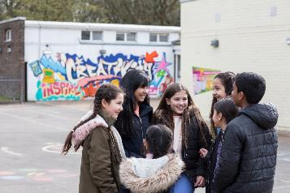
Guess the article
These pictures provide a clue to this week’s article. All these pictures were all taken before social distancing measures were put in place.
What rights is being shown in these pictures? Can you guess how they are linked together?
Write down your thoughts or discuss with someone in your home.
UNICEF/Pawelczyk
UNICEF/Herwig
Unicef/Dawe

Slide 3

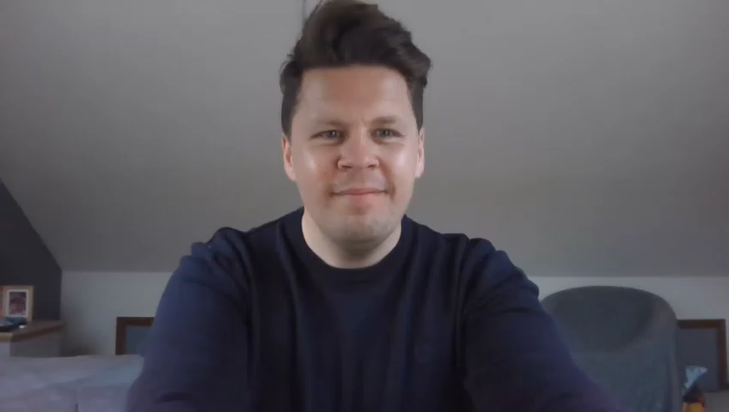
Introducing… Article 15
Stuart introduces Article 15
Article 15 – Freedom of association
Every child has the right to meet with other children and to join groups and organisations, as long as this does not stop other people from enjoying their rights.
Watch Stuart in YouTube

Slide 4
Exploring Article 15
What is needed for you to enjoy the right to get together and join up with other children and young people?
Write them down and then compare your answers with the next slide.

Slide 5
How many of these did you get?
Clubs, organisations and groups that are near to you or can be accessed safely.
Groups and organisations that have fun and appropriate activities.
Safe places to meet.
Choice of clubs in school.
Encouragement from parents and carers to get involved.
Activities to join in with that do not disrupt the rights of others.
Freedom to start a group if there is something you feel strongly about.
Clubs and organisations should not be too expensive to join.
Any other ideas…

Slide 6



Activity Time
The word ‘association’ is interesting. You have perhaps heard of the Football Association (FA) or the Automobile Association (AA) Look up the meaning of ASSOCIATION and explain to somebody in your home what it means.
All these activities are related to…
During these times it can be difficult to stay in touch with other young people and groups that we are part of. Make a list of 5 children that you would like to get in contact with. Write them a letter or video call them this week to find out how their week has been.
Imagine you are meeting a new child for the first time – it could be in a club or in your class. Make a list of questions you would like to find out to get to know them. What would you tell them about yourself?
Think about a group or club you are part of. Create a poster or leaflet to encourage other people to join. Make sure to list all of the reasons why it is a good idea to join this group.
You don’t need to do every single activity
but if you have time you can do more than one.
Primary

Slide 7




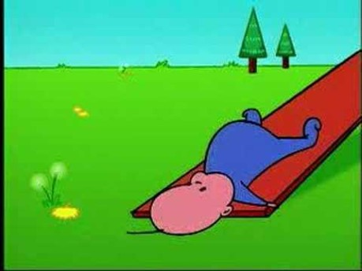
Activity Time
Think of the story ‘Cinderella’ How was her right to associate with others restricted? How would this have made her feel? Can you think of any other characters from books or stories that could not easily enjoy Article 15?
Make a list of all of the organisations and groups that you belong to. Can you group them in different ways? Are they school groups? Clubs? Religious groups? Sport or special interest groups?
Working with somebody at home, or by yourself, see if you can come up with a catchy phrase to remind people that all children have this particular right. Pass on your phrase to at least 5 people you know.
Watch this short video. What can you learn from this? How does it link to Article 15?
Primary

Slide 8


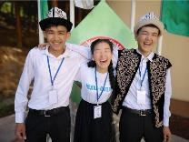
Activity time
Research “Mosquito devices” (sonic anti-loitering devices) and what the purpose of these is? How do these relate to your rights? Should they be banned? Discuss with someone.
Think of your favourite places to meet up with other young people. What makes for a place good for children/young people to get together?
These activities will help you
understand how...
…can relate to your life.
You don’t need to do every activity, just do as many as you can.
Have a look at these stories. Think about young people you know who have made a difference in society. What issues do you believe need changing? How could you get together with others to make something happen?
Talk to someone in your home or a friend on the phone or safely online about the different ways that you can get to know new people– some funny memories might come up about the first time you met one of your friends.
Secondary

Slide 9



Activity time
The word ‘association’ is interesting. You have perhaps heard of the Football Association (FA) or the Automobile Association (AA) Look up the meaning of ASSOCIATION and explain to somebody in your home what it means. Write a poem, song, story or letter about the importance of freedom of association for young people.
Can you think of any fictional or historical characters who have had their right to associate with others restricted. How did this feel for them? How did they overcome it?
Connect with other young people on Unicef Voices of Youth. Contribute and share your ideas with other young people around the world.
Get together safely with your friends online and discuss the issues affecting you during this time of lockdown. What messages or questions do you have for school and politicians, linked to Article 15. Create a flier or a digital message to get your points across.
Secondary

Slide 10
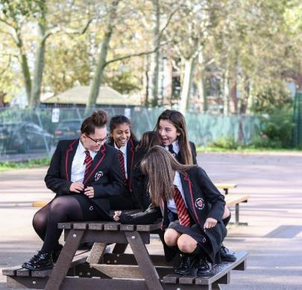
Reflection
This week’s article is all about being with others but it is good for us sometimes to have reflection time on our own. Find some space and time and spend a few minutes thinking about these questions:
Not being able to be with others physically in our groups and clubs is hard. What are the things you miss most about this? (Perhaps discuss this with an adult later)
Who are the adults who help to run your groups or clubs? Have you thanked them recently?
Hopefully all our groups, clubs and activities will happen again when it’s safe to do so. What will you do to enjoy, celebrate and respect freedom of association – yours and other peoples?
UNICEF/Dejongh

Slide 11
Thank you

