Slide 1
Unicef/@katchyphotos
Notes:
“It is not okay how society is targeting Asian people recently because of the coronavirus. Just because the virus was first found in China doesn't mean that Asians were the reason why the virus is spreading. It is not our fault. we are all humans with feelings and emotions and we're all feeling scared too but that doesn't excuse discrimination and racial slurs towards us Asians. This is affecting our community such as a local Asian businesses are closing down because no one is willing to go there and there is a spread of Asian harassment believe it or not. So this is a reminder that we are all on the same page and that we are not the enemy. we should work together to fight the virus not the people.”
Sophia (pictured) lives in the US, and is an avid social media user. She was ecstatic to hear that she would have no school or homework for over a month because of the coronavirus crisis; however, it wasn’t until about two days in when she started to feel the effects of not being able to see her friends. Lots of teens were searching for a way to express themselves through their photographs and be creative during this unique time. All shared a thirst for new inspiration and the tenacity to continue documenting their lives with our photographs.
Using Instagram's messaging system, a small group of teen photographers was formed and created Covid-19 Photos For Teens on 16 March 2020. They are a group of 15 boys and girls from places such as Denmark, India, Canada, and the US. Covid-19 Photos For Teens is becoming known for their positive outlook on current situations. Their Instagram posts encourage kids to support, create, and inspire one another.
Unicef/@katchyaphotos

Slide 2
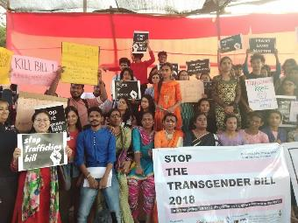
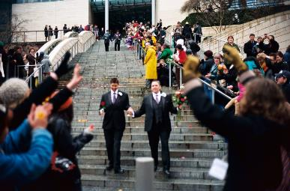
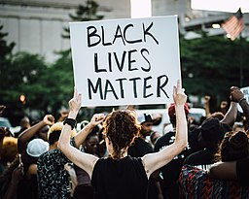
Guess the article
These pictures provide a clue to this week’s article.
Can you guess how they are linked together? Which article of the Convention do these pictures relate to?
Write down your thoughts or discuss with someone in your home.
All WikiCommons – see presenter notes for descriptions
Notes:
From left to right:
1. Mumbai, India, December 2018: Members of the transgender community in India and allies protesting against the regressive provisions of the Transgender (Protection of Rights) Bill. Wikicommons
2. Recently married couples leaving the City Hall in Seattle are greeted by well-wishers on the first day of same-sex marriage in Washington state after enactment of Washington Referendum 74 Dennis Bratland/Wikicommons
3. Baltimore, US, July 2016: An image from a Black Lives Matter march through downtown Baltimore City. John Lucia/Wikicommons – licence: https://creativecommons.org/licenses/by/2.0/deed.en

Slide 3

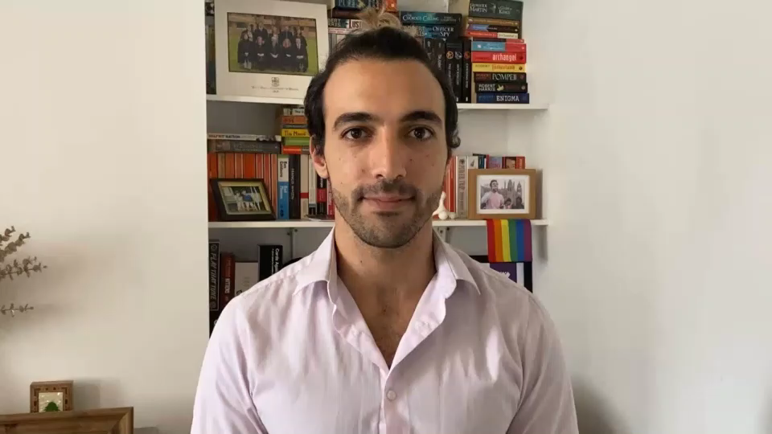
Introducing… Article 2
Danny introduces Article 2
Article 2 - (non-discrimination) The Convention applies to every child without discrimination, whatever their ethnicity, gender, religion, language, abilities or any other status, whatever they think or say, whatever their family background.
Watch Danny on YouTube

Slide 4
Exploring Article 2
What is needed for every child to be able to enjoy all their rights fairly and equally?
Note down your thoughts and compare with the next slide.

Slide 5
How many of these did you get?
Every young person and child should know that their race, gender, ability, nationality (or other characteristic or identities) should not stop them enjoying all their rights.
Nobody should feel that they are treated differently because of who they are.
All people should accept, respect and value others for who they are.
All schools should teach and practise and actively celebrate respect for all.
Learning should include opportunities to empathise with those who are discriminated against.
Government decisions and the law should show the way against all forms of discrimination.
Everyone should be open to the fact that we all have prejudices and be ready to challenge them.
People challenge and speak up about any discrimination they experience or see.
Newspapers and other information sources should promote and celebrate diversity and inclusion.
What else did you think of? Are there any other characteristics or identities that might cause a person to be discriminated against?

Slide 6
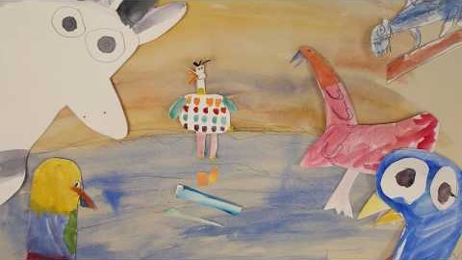
Activity Time
Imagine that you are treated differently and not allowed to go to school, have friends and play because of the colour of your hair. … How would this feel? What would you say and do? Discuss this with the grown ups at home.
Being happy and proud about who we are as people is important. Have you read ‘The Flamingo Who Didn’t Want To Be Pink’? Watch the story made by children at William Tyndale School. Try to get all your family and friends to tell you the best things they like about being themselves and the best things about you.
All these activities are related to…
Article 2 uses some words you might not know very well. Look up discrimination, ethnicity, race and gender to find out what they mean. Try to explain Article 2 to somebody at home now that you know the meaning of these words.
Think of somewhere that you know well. It might be a library, a park or a swimming pool. Does it welcome everyone? Can all children take part there equally? Talk to your friends or family about what could make this place better for everyone.
You don’t need to do every single activity
but if you have time you can do more than one.
Primary

Slide 7
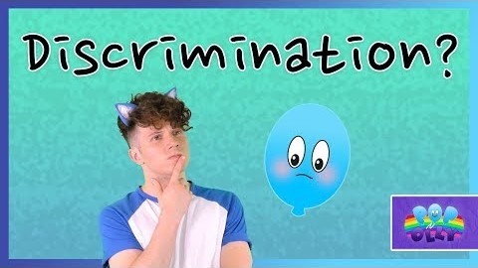
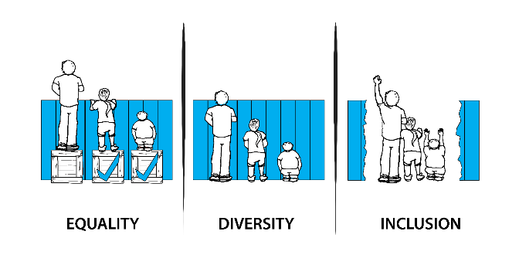
Activity Time
Think about people through history who have campaigned against unfair discrimination Martin Luther King Jnr; Dame Tanni Grey Thompson, Malala Yousufzai. Find out more about what they campaigned for and share what you find with a friend.
Discrimination is against rights – in the UK it’s also against the law. Watch this video to learn more. The video says ‘set a good example’ – how can you do this in school? Discuss this with your friends safely online or send a message to your teachers.
Look at these images illustrating Equality, Diversity and Inclusion. Create a poster showing these images with a written caption explaining what each word means and why Article 2: Non-Discrimination is important.
The charity Childline has an informative page about discrimination, hate crime and equality. Have a look here and share with your friends something new that you found out about these issues.
Primary

Slide 8
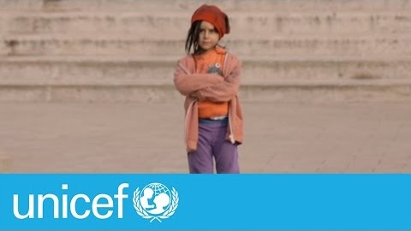
Activity time
Unicef in Georgia made a video to help people think about and understand prejudice and discrimination. Watch the video and share with an adult at home what messages you take from it.
Discrimination is key to Article 2 and it often sits beside other terms such as prejudice and xenophobia. Do a bit of research on this vocabulary and as well as looking up these three words you could also look up racism.
These activities will help you
understand how...
…can relate to your life.
You don’t need to do every activity, just do as many as you can.
The Convention on the Rights of the Child promotes Inclusion and Diversity. Look up the meaning of these words and create a blog post or an advert to promote them.
Lots of organisations and movements stand against discrimination: Stonewall; Show Racism the Red Card; Black Lives Matter, Disability Rights UK – choose one or more of these and find out more about their work. Share your research with your friends safely on line.
‘All people are born free and equal in dignity and rights’ – This is the opening of the Universal Declaration of Human Rights. What sort of attitudes and actions in history and in today’s world go against this? What do you feel about this? – Get creative and use art, movement, music or words to express yourself. Share this with your friends.
Secondary

Slide 9
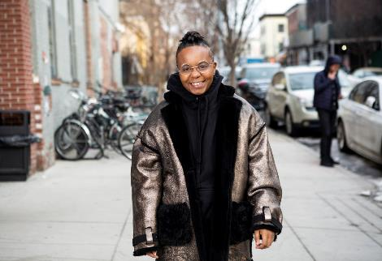
Reflection
Try to find somewhere peaceful and spend a few minutes being quiet and still … then think about these questions…
What makes you different from everyone else? What makes you proud to be you?
What could you do or say to other people to help them feel positive about who they are as people?
When you see or hear racism and other forms of discrimination what do you do to challenge what you are witnessing?
Write down your thoughts and if you want share this back with your teacher, friends or family.
Image: Beyond the Binary

Slide 10
Thank you

