Slide 1
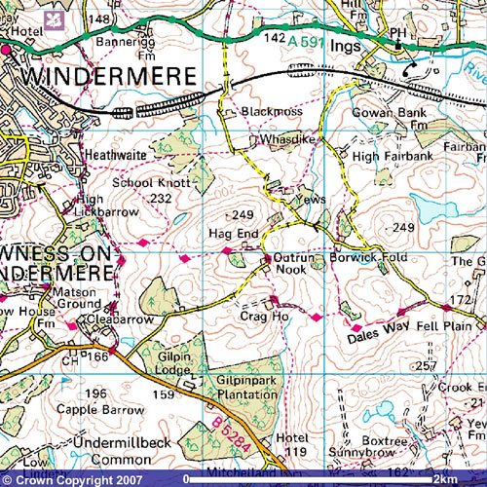
Map Symbols

Slide 2
It would be too confusing to have pictures or photographs on a map so we have symbols instead. The symbols show us where places or things are.

Slide 3
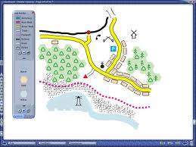
Maps have lots of different symbols on.

Slide 4

Do you know what this symbol means?

Slide 5
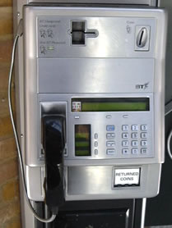
It means that there is a public telephone.

Slide 6

Do you know what this symbol means?

Slide 7
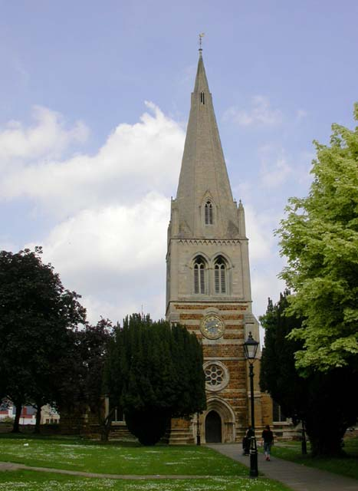
It means that there is a church.

Slide 8
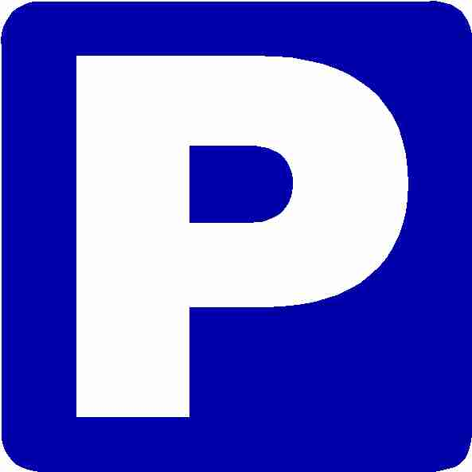
Do you know what this symbol means?

Slide 9
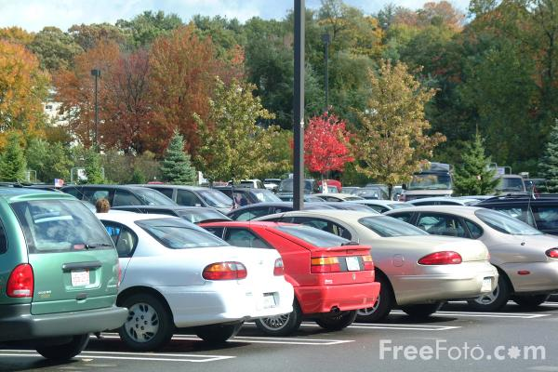
It means that there is a car park.

Slide 10
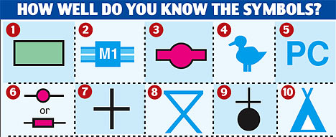
Symbols on maps show us where there are useful things or interesting places. Do you know what these symbols mean?

Slide 11
Here are the answers;
1. Mud
2.Motorway
3. Bus station
4. Nature Reserve
5. Public toilet
6. Railway station
7. Place of worship
8. Picnic site
9. Church with sire
10. Camp site.

