Slide 1
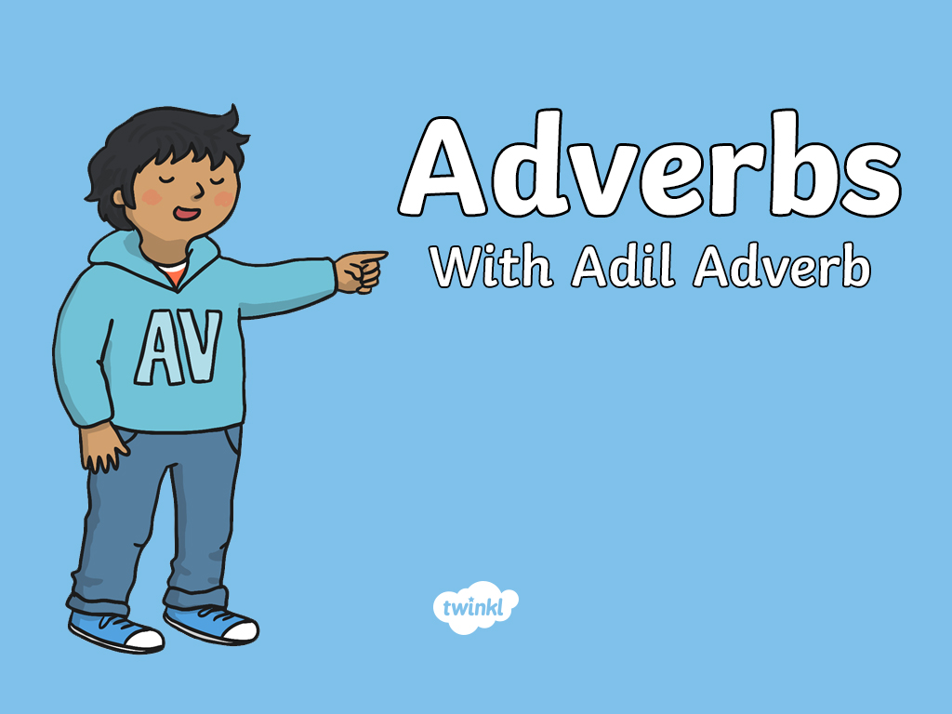


Slide 2
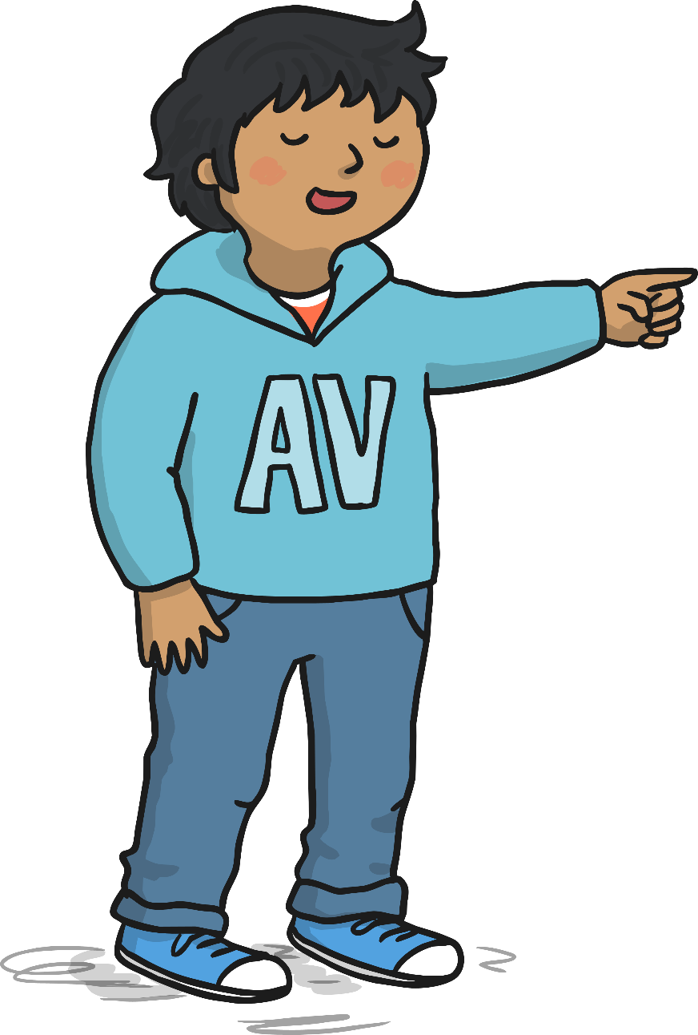

My name is Adil Adverb. You’ll often find me close to Veronica Verb.
I love to describe her actions.
For example:
Veronica Verb always laughs loudly and she runs quickly.
That’s my job - to tell
you more about a verb.
An adverb tells you where, why or how much something is done.

Slide 3
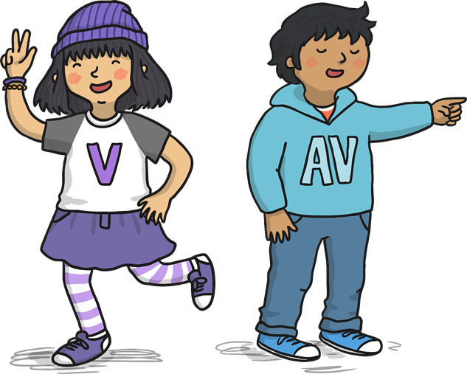
Can you spot the adverb in this sentence?
Jessica shouted loudly.
The adverb in blue tells us how Jessica shouted: she
shouted loudly.
The verb (the
action) is in purple.

Slide 4
Can you spot the adverb in this sentence?
Isabelle tried hard.
The verb (the
action) is in purple.
The adverb in blue tells us ‘how much’ Isabelle tried.

Slide 5
Can you spot the adverb in this sentence?
Abigail threw the ball up.
The verb (the
action) is in purple.
The adverb in blue tells us ‘where’ Abigail threw the ball.

Slide 6
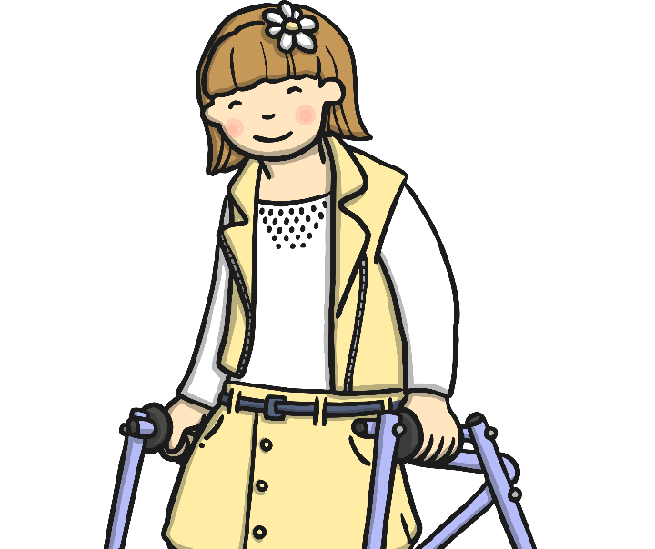

Some adverbs are made by adding ‘ly’
onto the end of the word.
kind + ly = kindly
careful + ly = carefully
Daniel coloured his
picture carefully.
Lilly smiled kindly.

Slide 7
Some adverbs describe where
an action is happening.
Liam ran upstairs.
Can you choose one of these adverbs and use it in a sentence?
Here, ‘upstairs’ is describing where Liam ran, which makes it an adverb.
here
there
above

Slide 8
Some adverbs describe how
an action is happening.
Helen laughed nervously.
Can you choose one of these adverbs and use it in a sentence?
Here, ‘nervously’ is describing how Helen laughed, which makes it an adverb.
quickly
loudly
sadly

Slide 9
Some adverbs describe when
an action is happening.
The penguins swam yesterday.
Can you choose one of these adverbs and use it in a sentence?
Here, ‘yesterday’ is describing when the penguins swam, which makes it an adverb.
earlier
later
today

Slide 10
Some adverbs describe how often
an action is happening.
The lion roared daily.
Can you choose one of these adverbs and use it in a sentence?
Here, ‘daily’ is describing how often the lion roars, which makes it an adverb.
weekly
always
sometimes

Slide 11
Some adverbs describe how much
an action is happening.
Amy tried hard to finish her homework.
Can you choose one of these adverbs and use it in a sentence?
Here, ‘hard’ is describing how much effort Amy put in, which makes it an adverb.
very
completely
almost

Slide 12

Find the adverbs
Tom painted his picture beautifully.
Annie quickly brushed her hair.
Amjid read his books today in the library.
Neena swam well without arm bands.
Ben always rides his bike to school.

Slide 13


