Slide 1


Maths
Number and Place Value
Year One
Maths | Year 2 | Number and Place Value | Recognise Place Value | Lesson 2 of 6: Tens and Ones

Slide 2
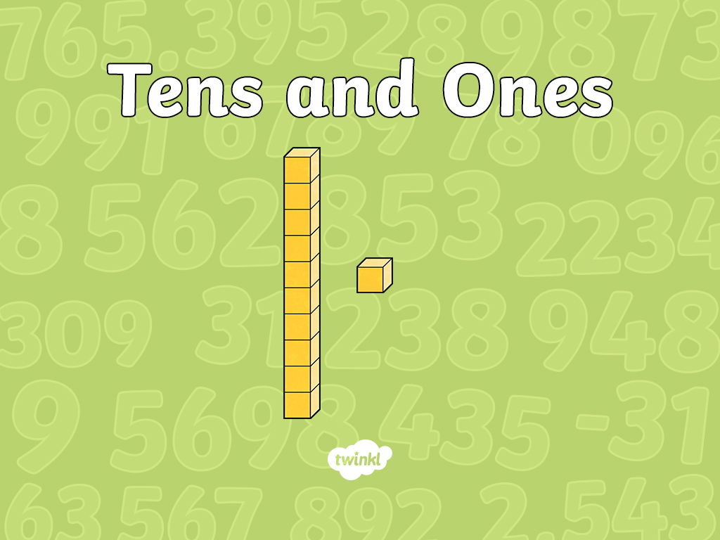

Slide 3
Aim
I can say what each digit in a two-digit number represents.
Success Criteria
I can identify the place value of a digit in a number.
I can say whether a digit in a number represents tens or ones.
I can read two-digit numbers.

Slide 4
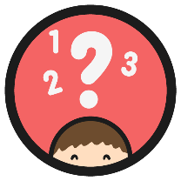
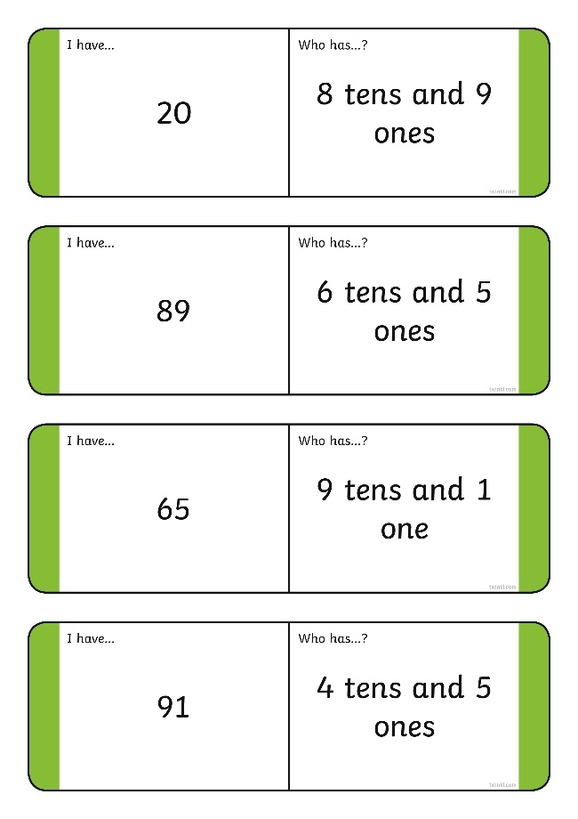
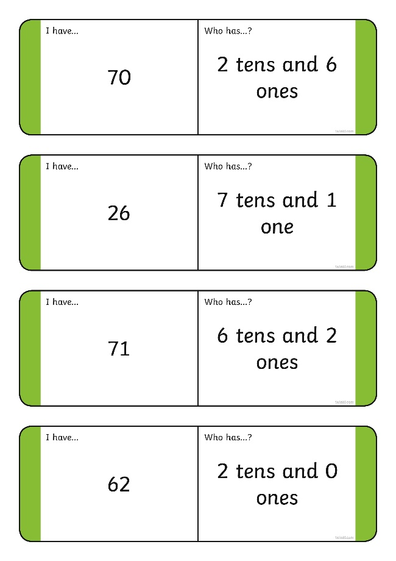
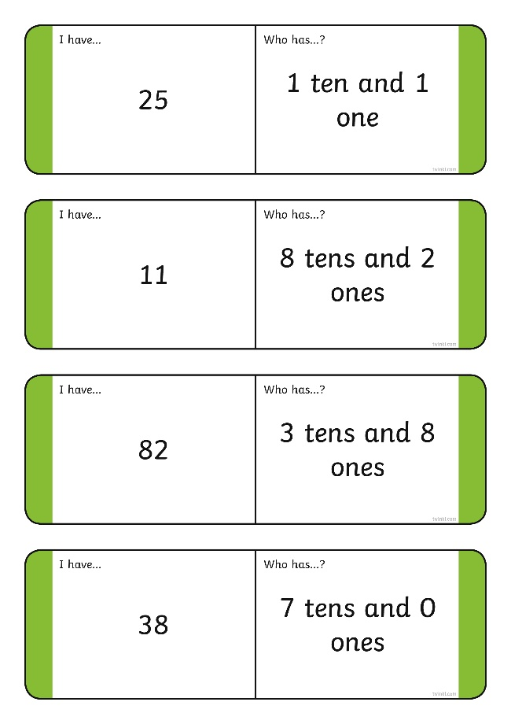
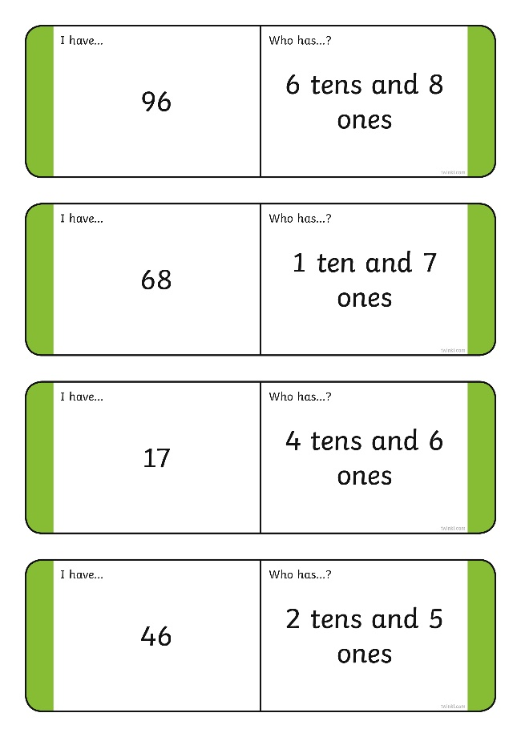
Place Value Loop Cards
Can you close the loop?

Slide 5

Place Value
What do you know about this number?
This is the number 2.
It is a one-digit number.
2

Slide 6

Place Value
What do you know about this number?
This is a digit.
This is a digit.
12
This is the number 12.
It is a two-digit number.
Each of the digits has a different value.

Slide 7
Place Value
tens
ones
1
2
This is the ones place. There is a 2 in the ones place.
This means 2 ones. It has a value of 2.
This is the tens place. There is a 1 in the tens place. This means 1 ten. It has a value of 10.
1 ten and 2 ones make 12.

Slide 8
Place Value
What do you know about this number?
tens
ones
2
6
This is the ones place. There is a 6 in the ones place.
This means 6 ones. It has a value of 6.
This is the tens place. There is a 2 in the tens place. This means 2 tens. It has a value of 20.
2 tens and 6 ones make 26.

Slide 9

Place Value
What is the place?
What is the value?
What is the place?
What is the value?
tens
ones
3
5
This is the ones place. There is a 5 in the ones place.
This means 5 ones. It has a value of 5.
This is the tens place. There is a 3 in the tens place. This means 3 tens. It has a value of 30.
3 tens and 5 ones make 35.

Slide 10
Place Value
What is the place?
What is the value?
tens
ones
What is the place?
What is the value?
2
9
This is the ones place. There is a 9 in the ones place.
This means 9 ones. It has a value of 9.
This is the tens place. There is a 2 in the tens place. This means 2 tens. It has a value of 20.
2 tens and 9 ones make 29.

Slide 11
Place Value
What is the place?
What is the value?
What is the place?
What is the value?
tens
ones
4
1
This is the ones place. There is a 1 in the ones place.
This means 1 ones. It has a value of 1.
This is the tens place. There is a 4 in the tens place. This means 4 tens. It has a value of 40.
4 tens and 1 one make 41.

Slide 12

Place Value
Which number has a 5 in the tens place and a 3 in the ones place?
Which number has a 2 in the tens place and a 6 in the ones place?
Which number has an 8 in the tens place a 2 in the ones place?
53
26
82

Slide 13
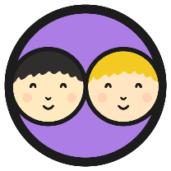
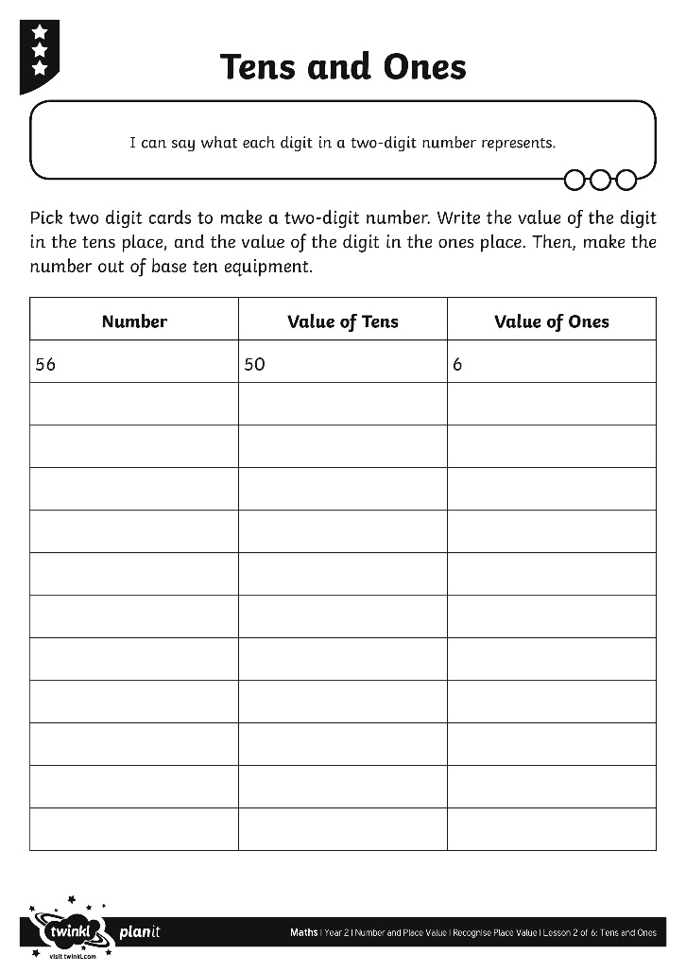
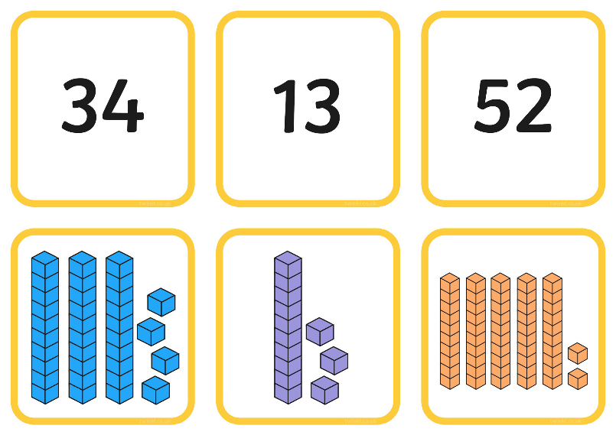
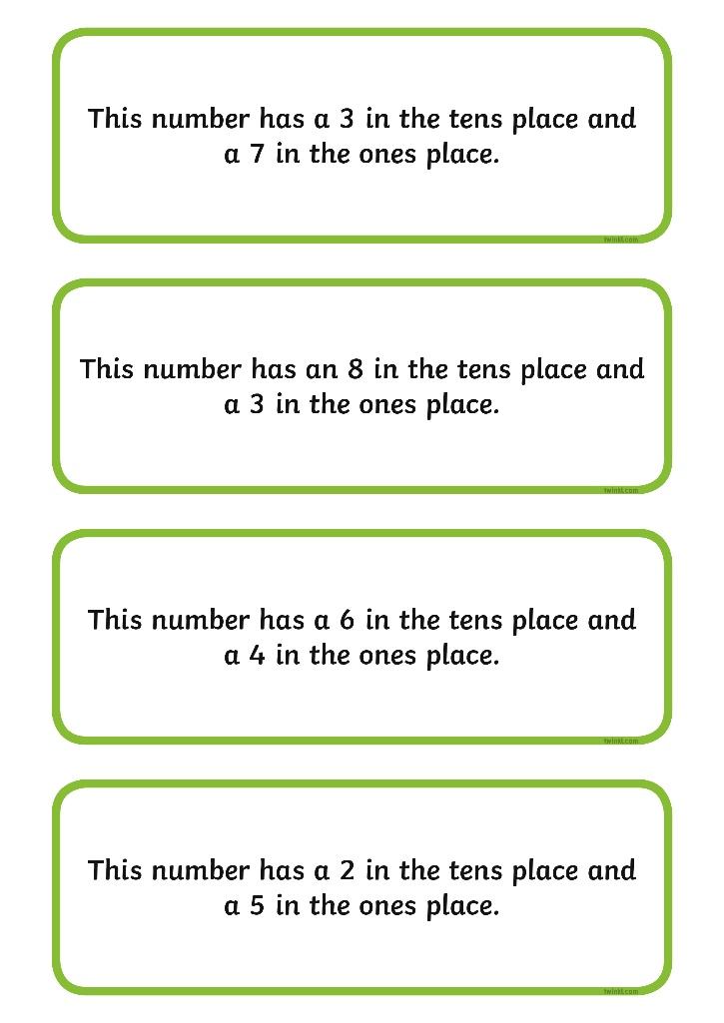
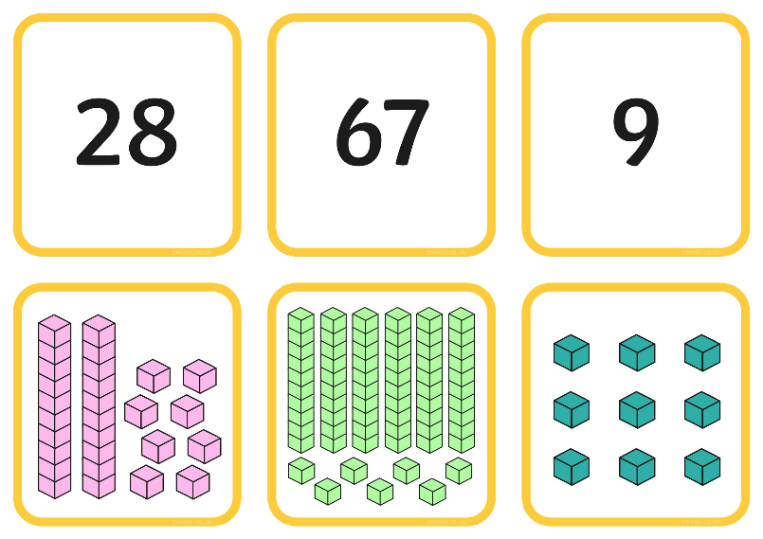
Tens and Ones Activities

Slide 14
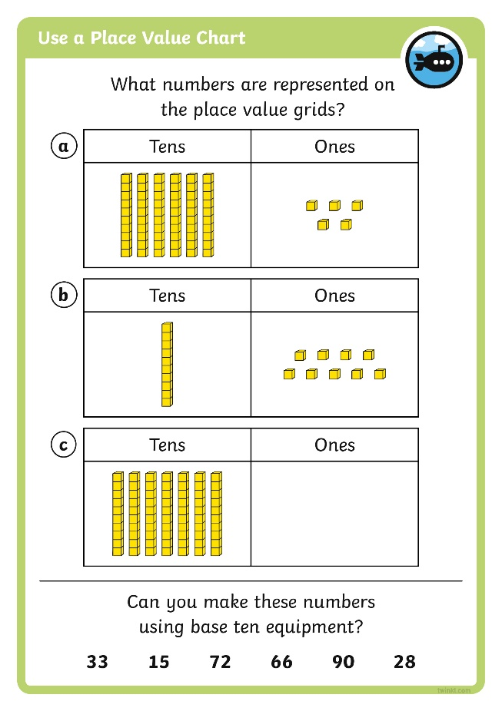
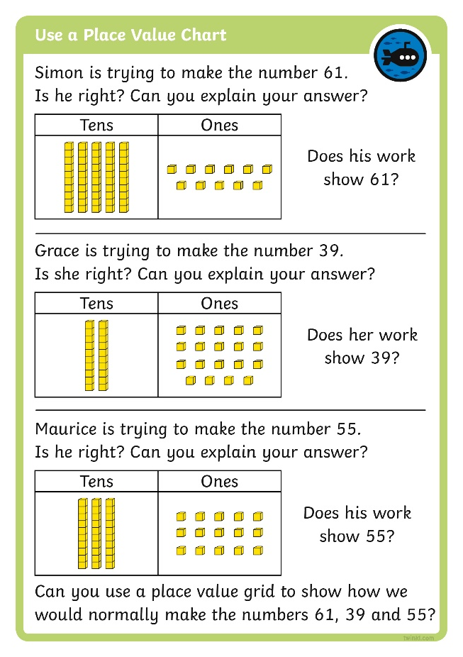
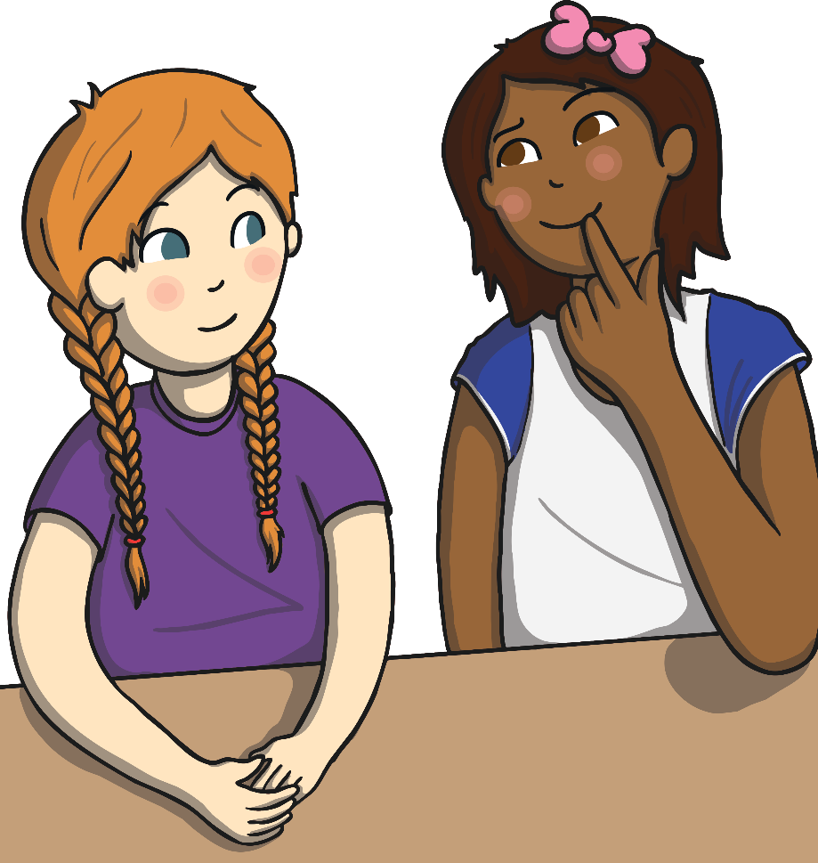
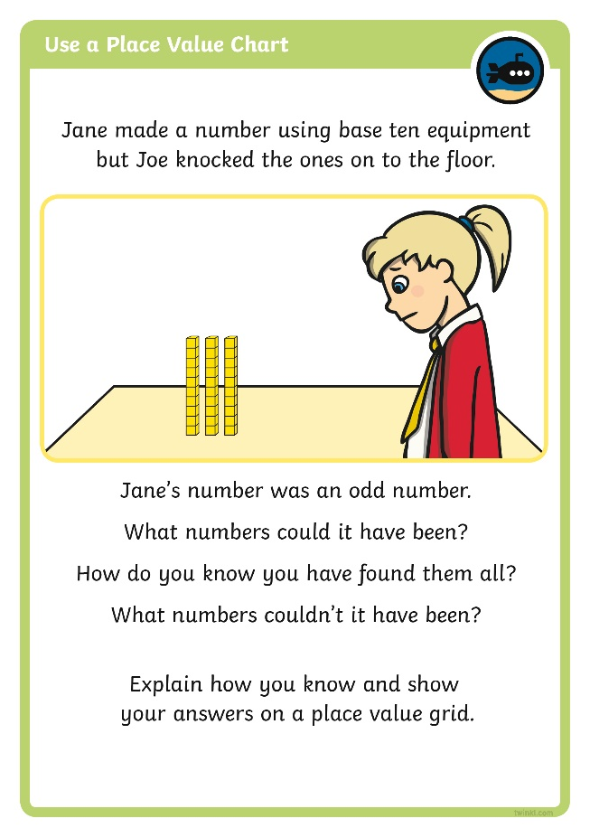
Diving into Mastery
Dive in by completing your own activity!

Slide 15
Show Me
Show me a number that has…
a 9 in the ones place
four tens and two ones
a 6 in the tens place
two digits
a 3 in the tens place
one digit
seven tens and five ones
Can you explain your answer?

Slide 16

Aim
I can say what each digit in a two-digit number represents.
Success Criteria
I can identify the place value of a digit in a number.
I can say whether a digit in a number represents tens or ones.
I can read two-digit numbers.

