Slide 1
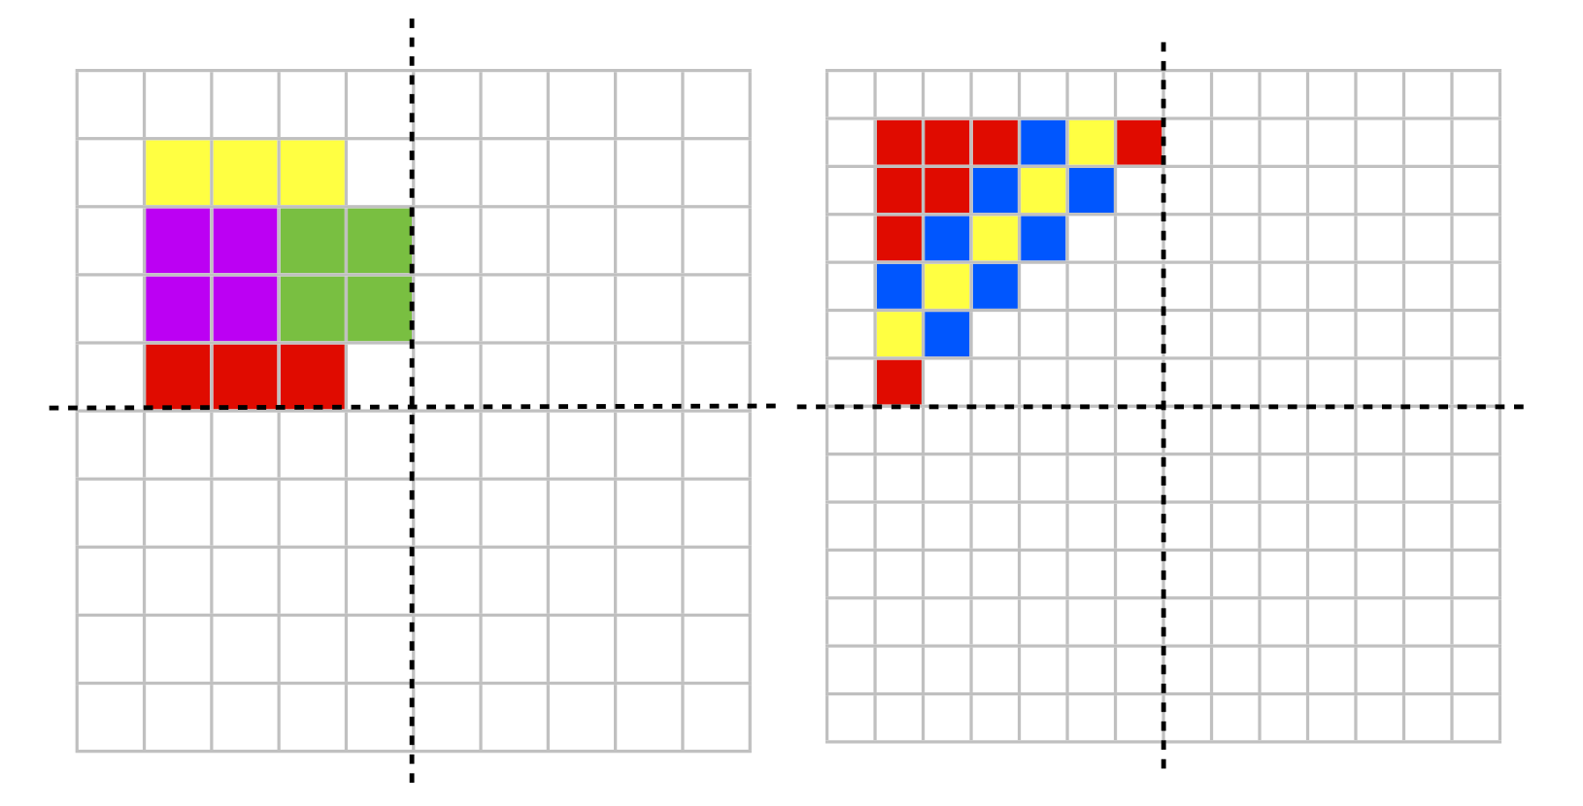
LO: I can complete a pattern to show reflective symmetry

Slide 2
Create your own

