Slide 1
How Can We Group Animals?
Animals
Vertebrates
Invertebrates
Mammal
Bird
Reptile
Amphibian
Fish
Arthropod
Annelid
Mollusc
Echinoderm
Cnidarian
Sponge

Slide 2
TASK 1
Monday

Slide 3
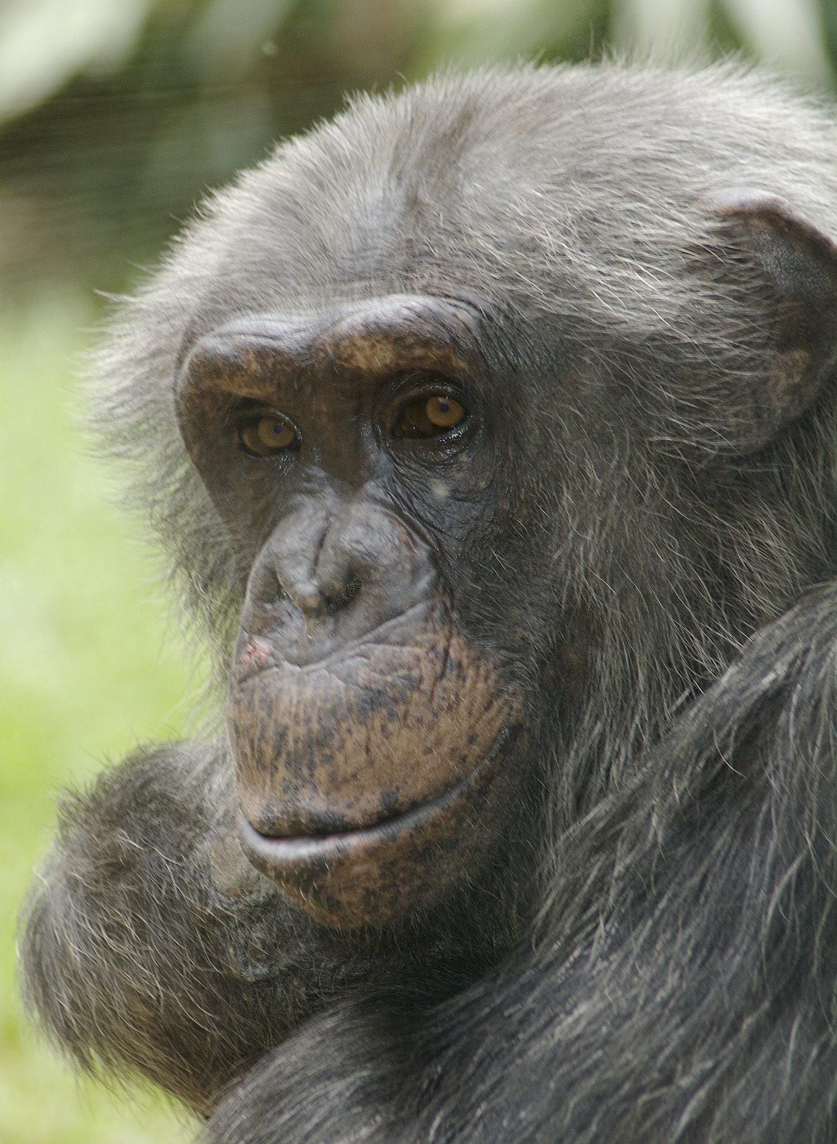
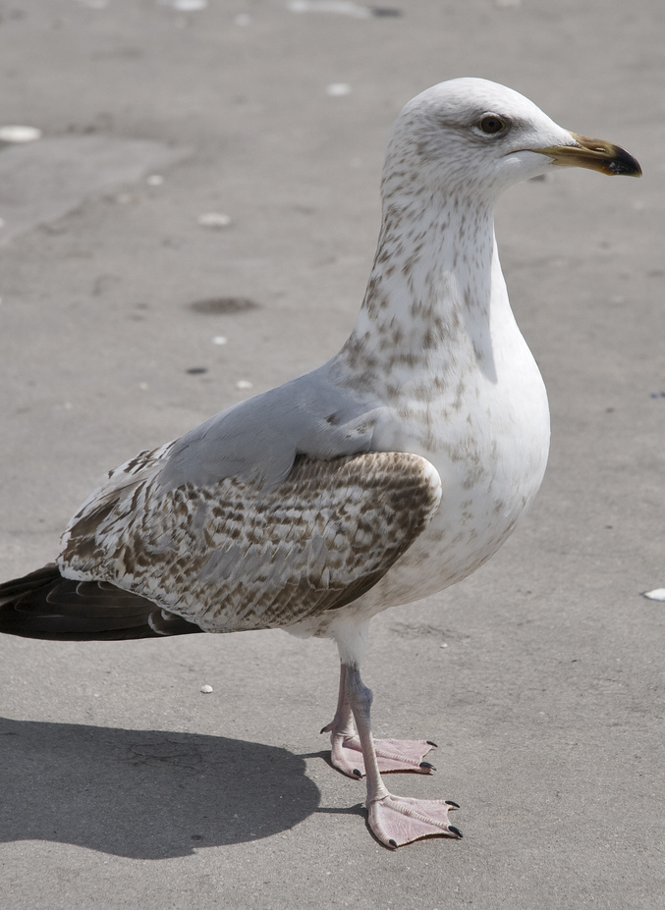
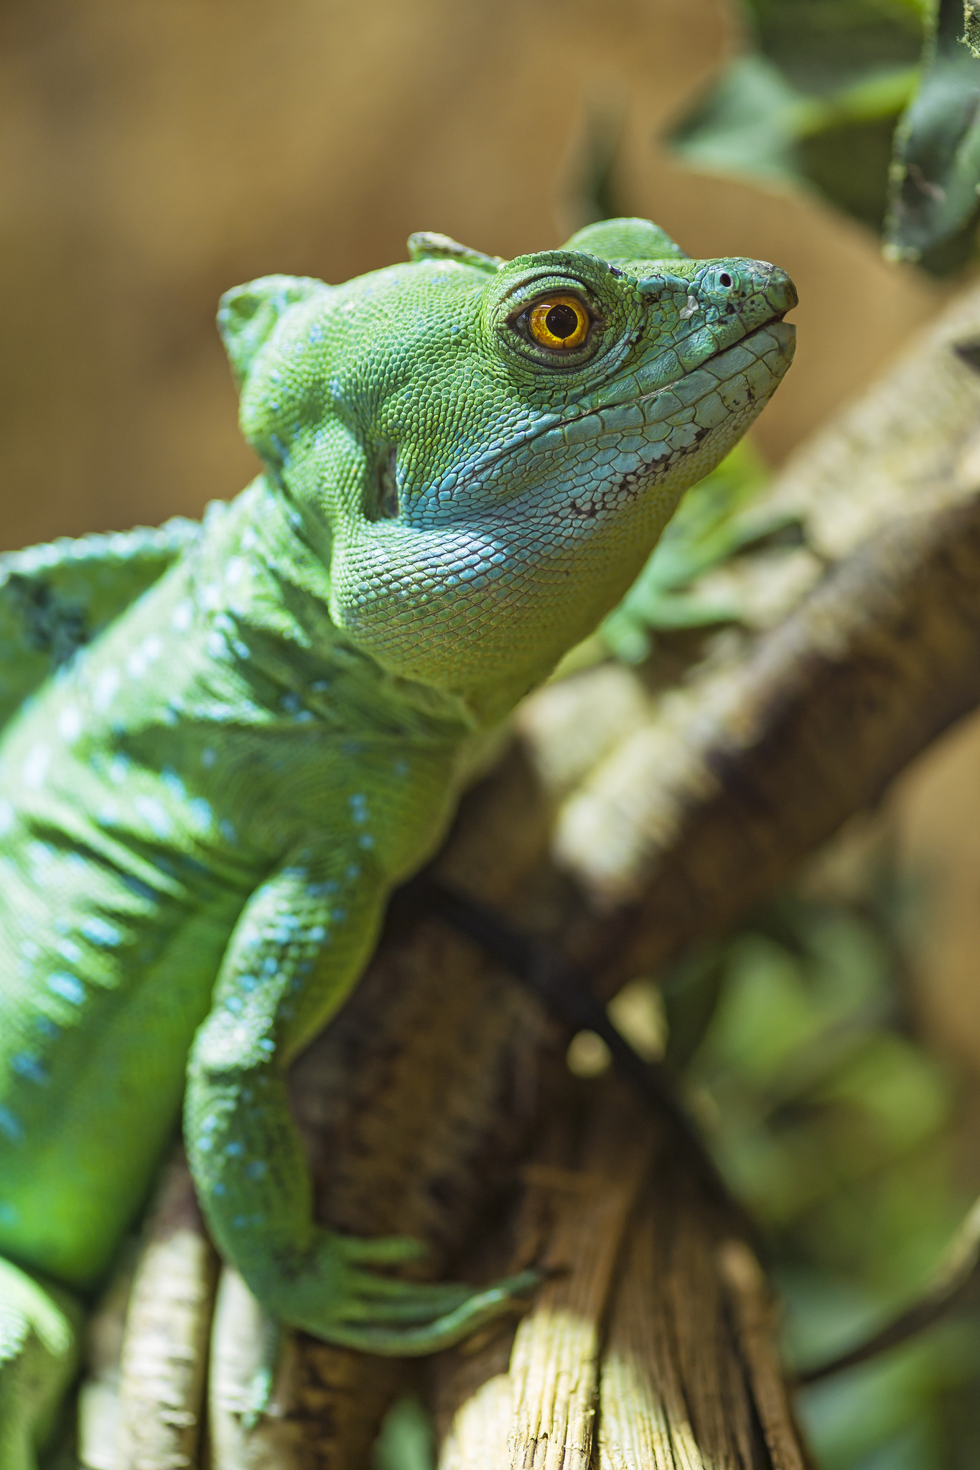
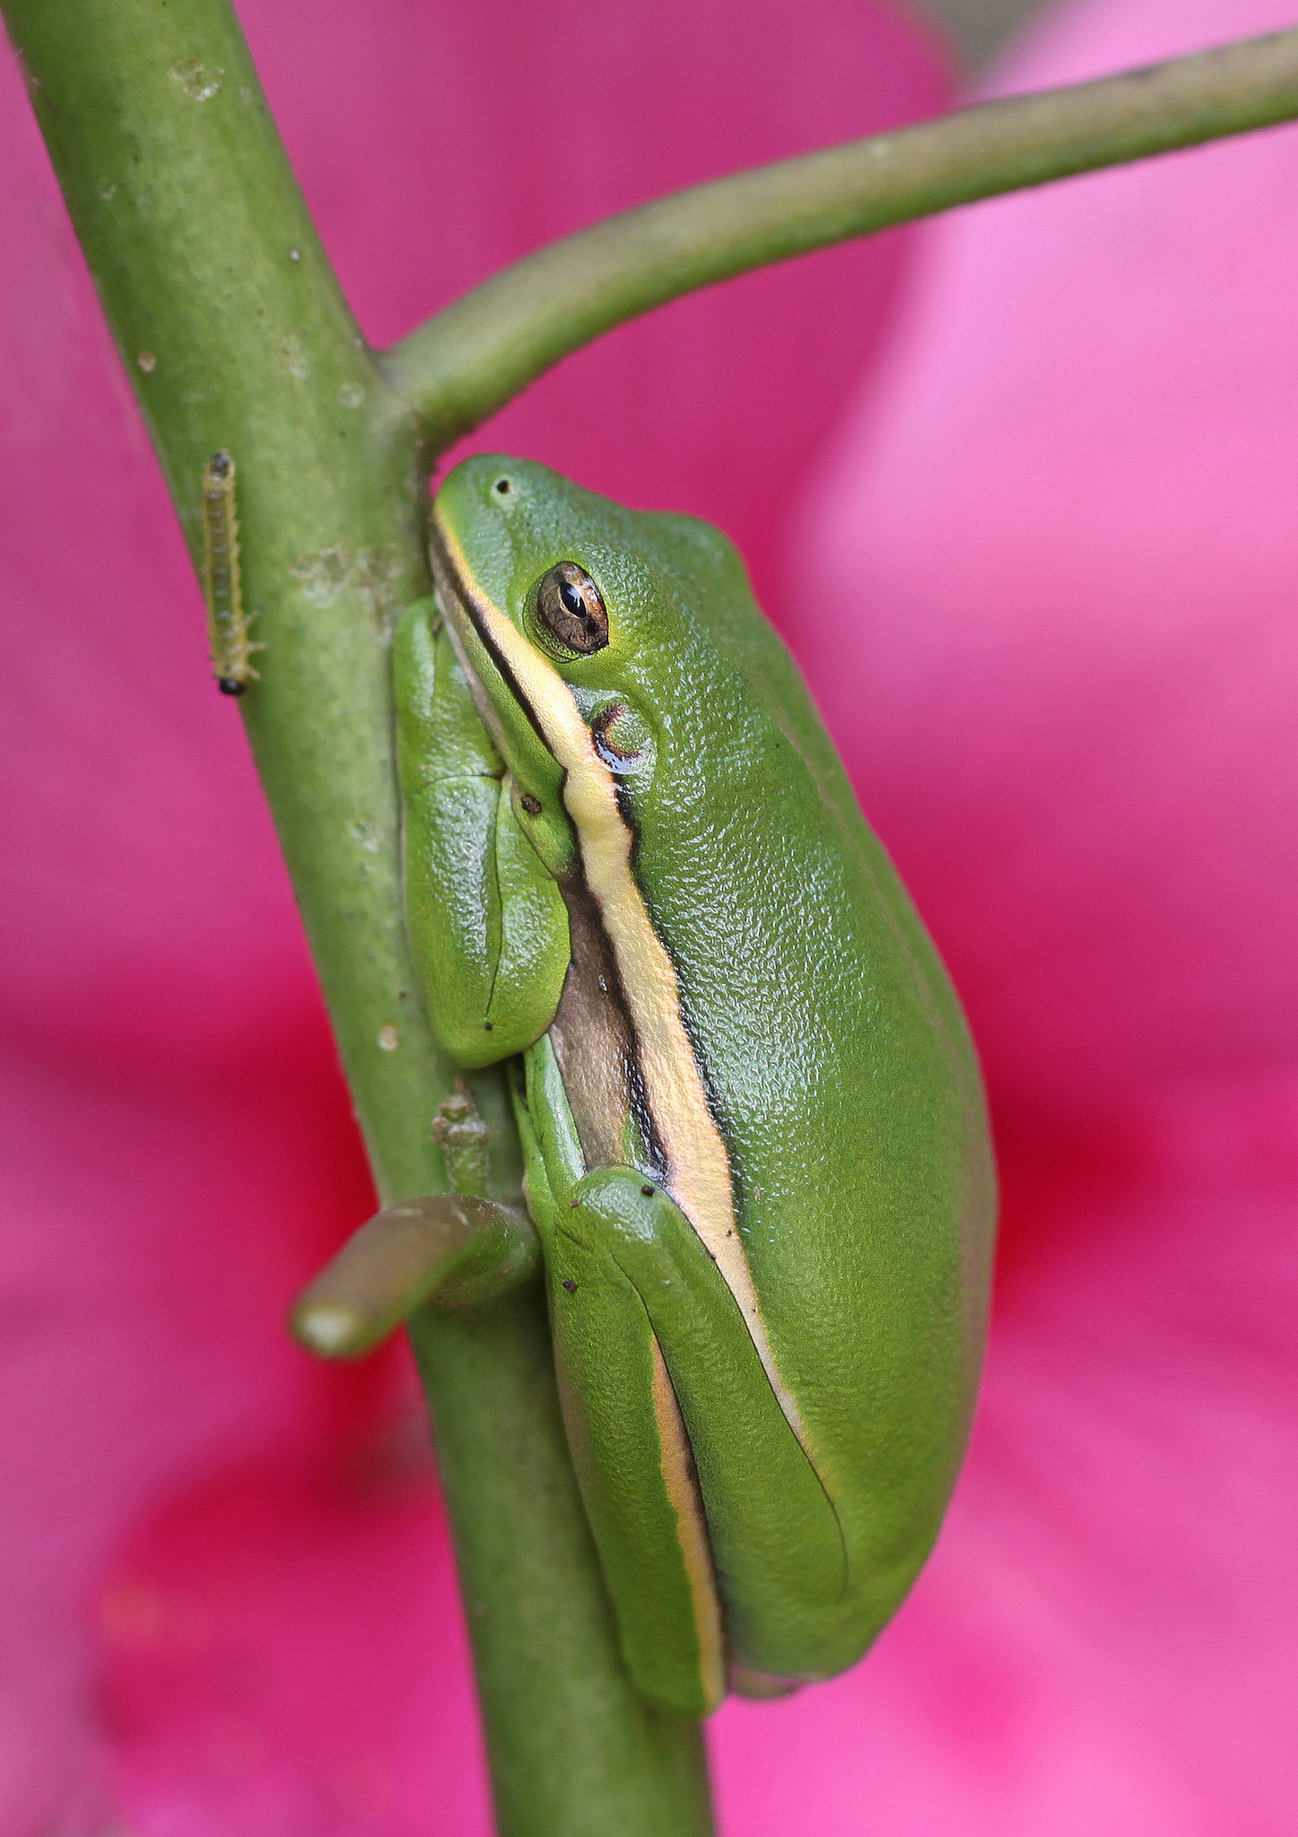
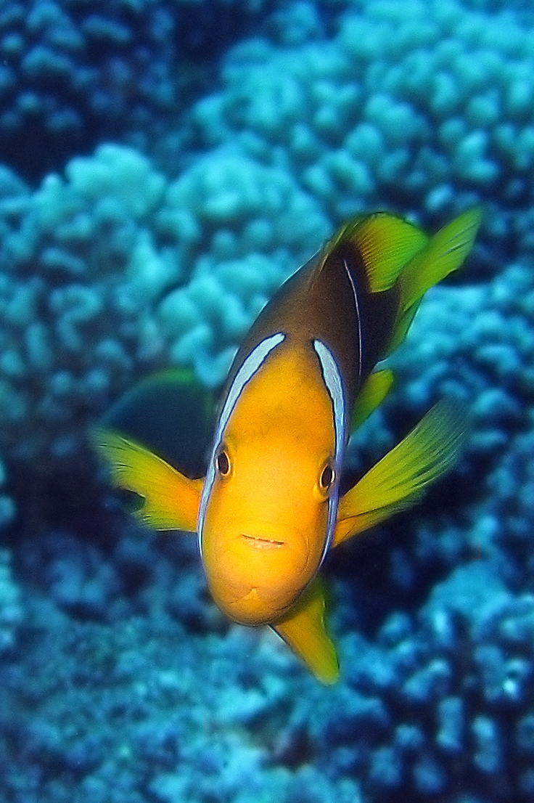
Vertebrates
Animals can be divided into 2 groups based on the presence or absence of a backbone.
Vertebrates are animals with a backbone
Photo: Valerie
Photo: Berit Watkin
Photo: Tambako The Jaguar
Photo: Vicki DeLoach
Photo: SF Brit
Mammals
Birds
Reptiles
Amphibians
Fish
Vertebrates can be further divided into 5 groups. Animals in each of these groups share certain features.
What can you find out about these 5 groups?

Slide 4
TASK 2
Tuesday

Slide 5
Invertebrates
About 97% of animals are invertebrates.
There are about 30 million species in the world!
Invertebrates
Arthropods
Sponges
Molluscs
Worms
Cnidarians
Echinoderms
What can you find out about these groups of invertebrates?

