Slide 1
The Rocketeer

Slide 2
Monday

Slide 3
Watch the clip
https://www.literacyshed.com/the-rocketeer.html#

Slide 4
The 5 W’s
As you are watching can you answer:
Where is it set?
Who is that character?
What has just happened?
What might happen next?
Write down your answers in full sentences.

Slide 5
Tuesday
On the following slide there are 8 screenshot images, in chronological order. Underneath each picture write a caption explaining what is happening in each (just like a comic strip.)
In each caption use either a conjunction or adverb to show how the story moves on.
Conjunctions – When, after, before, while, whilst
Adverbs of time – Yesterday, soon, later, now
Prepositions of time – Since, before, until

Slide 6
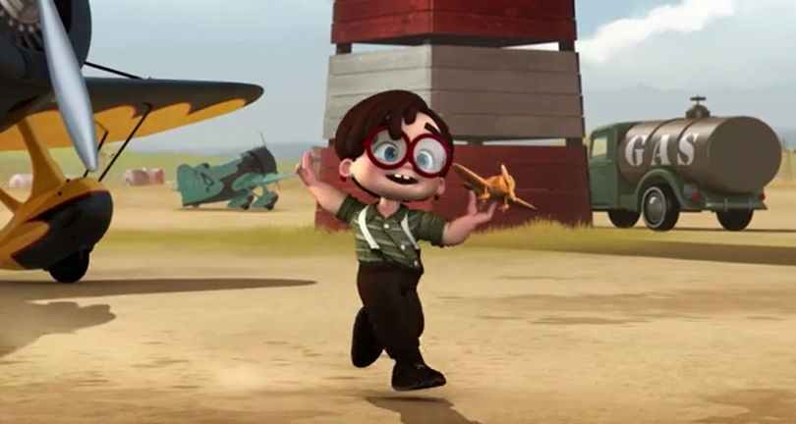
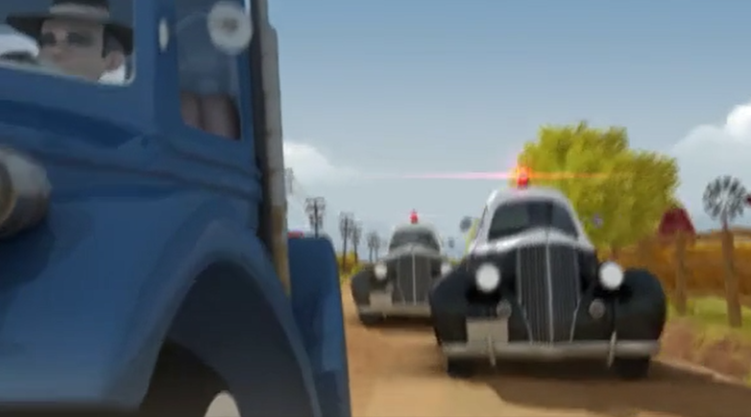
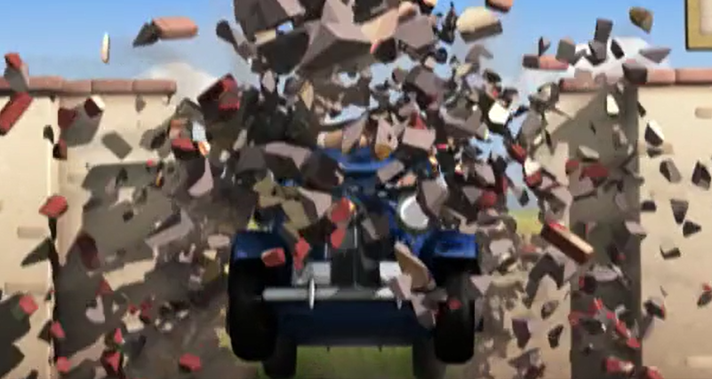
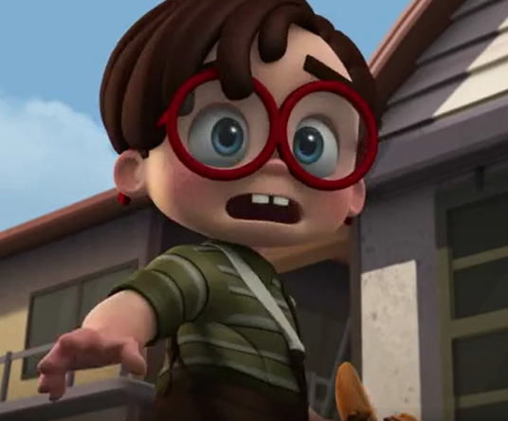
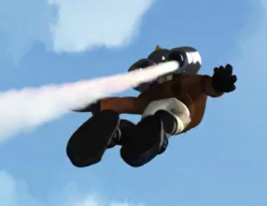
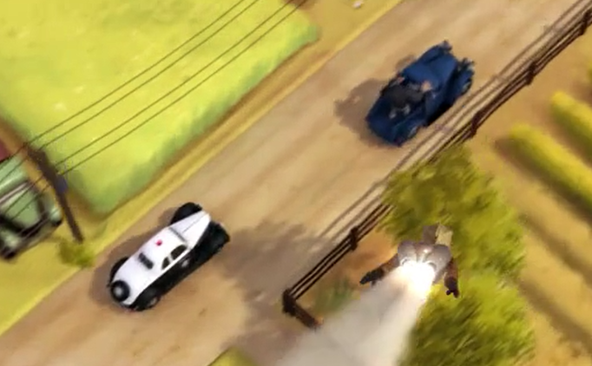
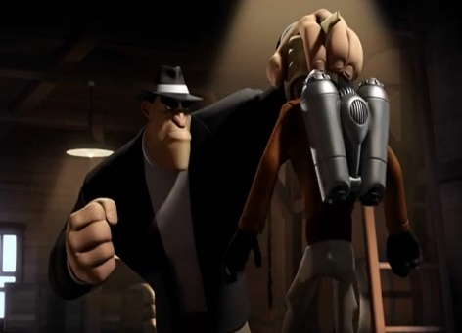
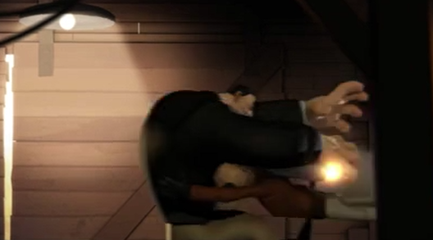

Slide 7
Wednesday
Look at the image of the hanger. You can find this if you pause the clip at 0:12
Where is this scene set?
What might it look like in the inside of the aeroplane hanger?
Use your five senses to describe the hanger in the film. Remember to use different openers. Do not keep writing I can see, I can hear.
Try using :
From the open door of the hangar the boy could see…..
Around him, the scent of………
In the distance, ………………

Slide 8
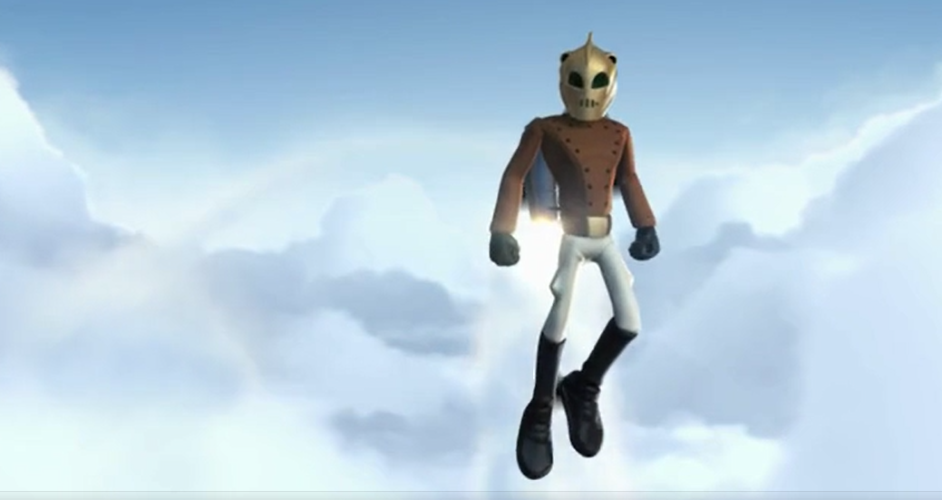
Thursday
Write a paragraph to describe the Rocketeer. Use an expanded noun phrase.

