Slide 2
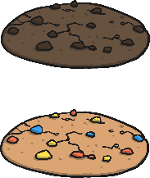
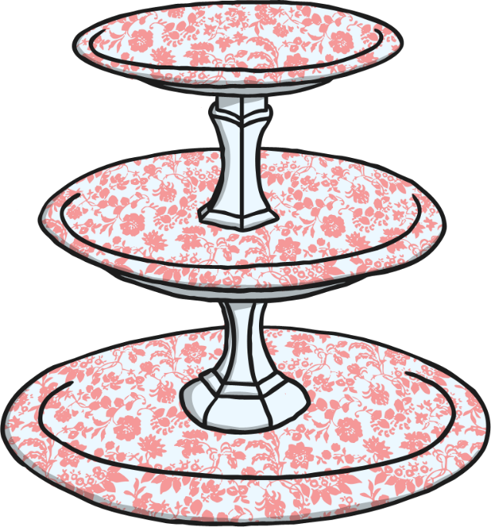


Division
Share the cookies equally between the children.
?
How many cookies do Bobby and Serena get each?
Bobby
Serena

Slide 3


Division
Share the slices of pizza equally between the plates.
?
How many slices of pizza per plate?
Plate 1
Plate 2

Slide 4
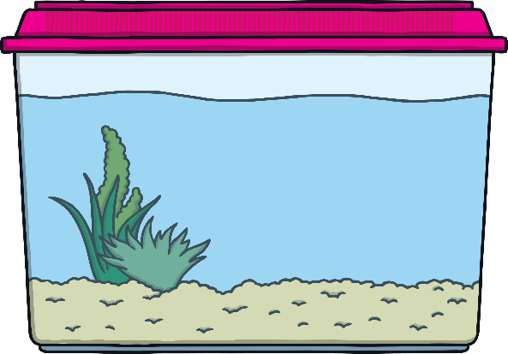

Division
Share the fish equally between the tanks.
?
How many fish per tank?

Slide 5
Division
Share the fish equally between the tanks.
?
How many fish per tank now?

Slide 6




Division
Share the strawberries equally between Anne and Sanjeev.
?
How many strawberries per person?
Anne
Sanjeev

Slide 7



Division
Share the worms between the birds.
?
How many worms does each bird get?
Bird 1
Bird 2

Slide 8


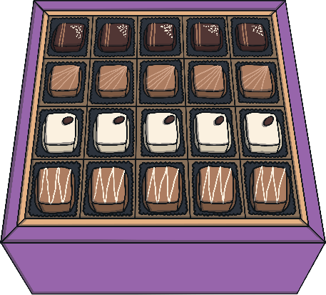
Division
There are 40 chocolates in the box.
?
How many chocolates would Mr and Mrs Gadhi each get if they are shared out equally?
Can you write the calculation?
÷
=
40 chocolates

Slide 9
Sharing Equally
The following slides need to be shown when not in slideshow mode.

Slide 10

Sharing Equally
Share the counters equally into two groups.
÷
=

Slide 11

Sharing Equally
Share the counters equally into three groups.
÷
=

Slide 12

Sharing Equally
Share the counters equally into four groups.
÷
=

Slide 13

Sharing Equally
Share 12 counters into equal amounts.
2 Equal Amounts:
3 Equal Amounts:
4 Equal Amounts:
6 Equal Amounts:
÷
=

Slide 14

Sharing Equally
Share 24 counters into equal amounts.
2 Equal Amounts:
3 Equal Amounts:
4 Equal Amounts:
6 Equal Amounts:
÷
=

Slide 15

Grouping for Division
Group the balls in 3s to find out how many nets are needed.
(9 groups into 3s).
Football nets hold 3 balls.
÷
=

Slide 16


Grouping for Division
How many baskets can be filled using the apples from the tree?
(16 grouped into 4s).
Each basket can hold 4 apples.
÷
=

Slide 17

Grouping for Division
How many packs of pencils would these pencils fill?
(15 grouped into 5s).
Pencils are sold in packs of 5.
÷
=

Slide 18

Grouping for Division
The bakery sells gingerbread people in packs of 2.
?
How many packs can be made from these gingerbread people?
÷
=

Slide 19

Grouping for Division
Mince pies are sold in boxes of 6.
?
How many boxes can be filled using these mince pies?
÷
=

Slide 20

Grouping for Division
Peppers are sold in packs of 2.
?
How many packs can be filled using these peppers?
÷
=

Slide 21

Grouping for Division
Bananas are sold in packs of 5.
?
How many packs can be filled using these bananas?
÷
=

Slide 22
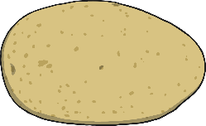
Grouping for Division
Potatoes are sold in sacks of 8.
?
How many sacks can we fill using these potatoes?
÷
=

Slide 23

Grouping for Division
Sweets are sold in packs of 9.
?
How many packs can be filled using these sweets?
÷
=

Slide 24

Grouping for Division
Circle in twos and count the groups.
How many buns?
How many groups?
2
÷
=

Slide 25

Grouping for Division
Circle in twos and count the groups.
How many socks?
How many groups?
2
÷
=

Slide 26

Grouping for Division
Circle in threes and count the groups.
How many acorns?
How many groups?
3
÷
=

Slide 27

Grouping for Division
Circle in threes and count the groups.
How many acorns?
How many groups?
3
÷
=

Slide 28

Grouping for Division
Mrs Robertson has 30 glue sticks.
She groups them into fives.
?
How many groups of glue sticks can be made?

