Slide 1
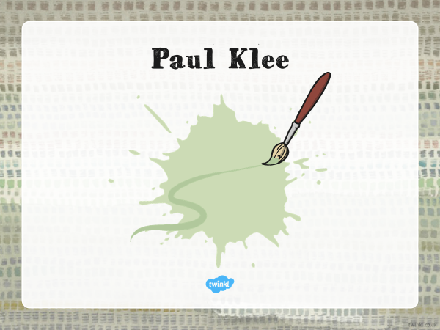

Slide 2


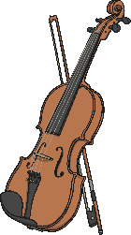
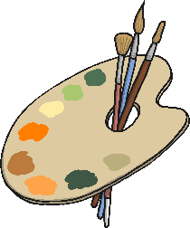
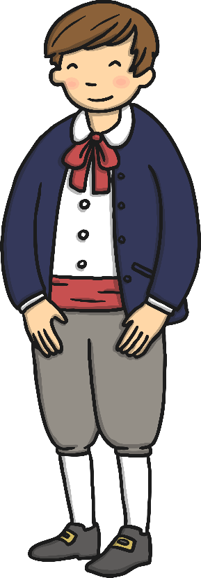
All About Paul Klee
(1879 - 1940)
Swiss German
Paul Klee was born in Switzerland in 1879. His father was a music teacher and his mother was a singer. As a child, Paul Klee was a talented violin player.
When he was 17 he decided he wanted to be an artist. But he was worried that he wasn’t good enough at painting because he couldn’t make his pictures look realistic.

Slide 3
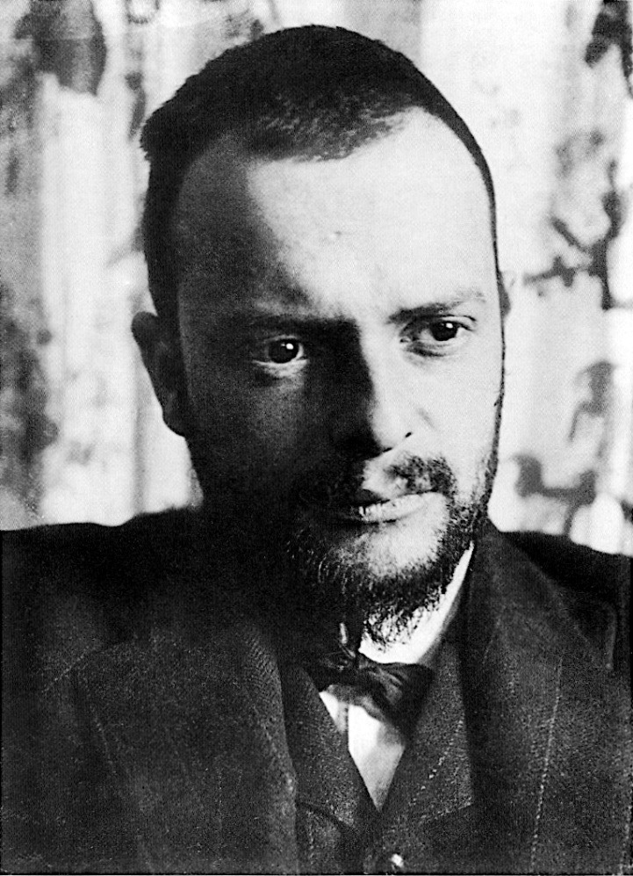
All About Paul Klee
(1879 - 1940)
Swiss German
Eventually Paul Klee realised that if he painted in a more abstract style he could express complicated feelings through simple shapes and colours.
Photo courtesy of Alexander Eliasberg (Wikimedia Commons) - granted under creative commons licence – attribution

Slide 4
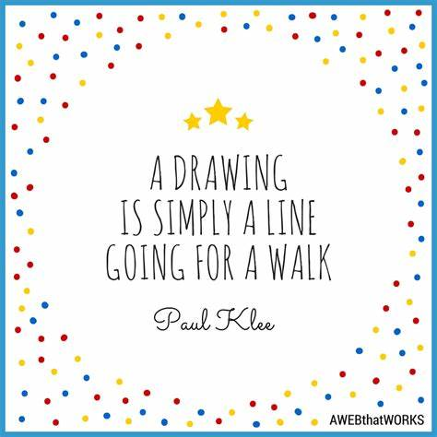
ACTIVITY 1
Take a line for a walk.
Create your own pattern or picture following this rule.
You are not allowed to take your pen or pencil off the page.
Look at the examples on the next slides.

Slide 5
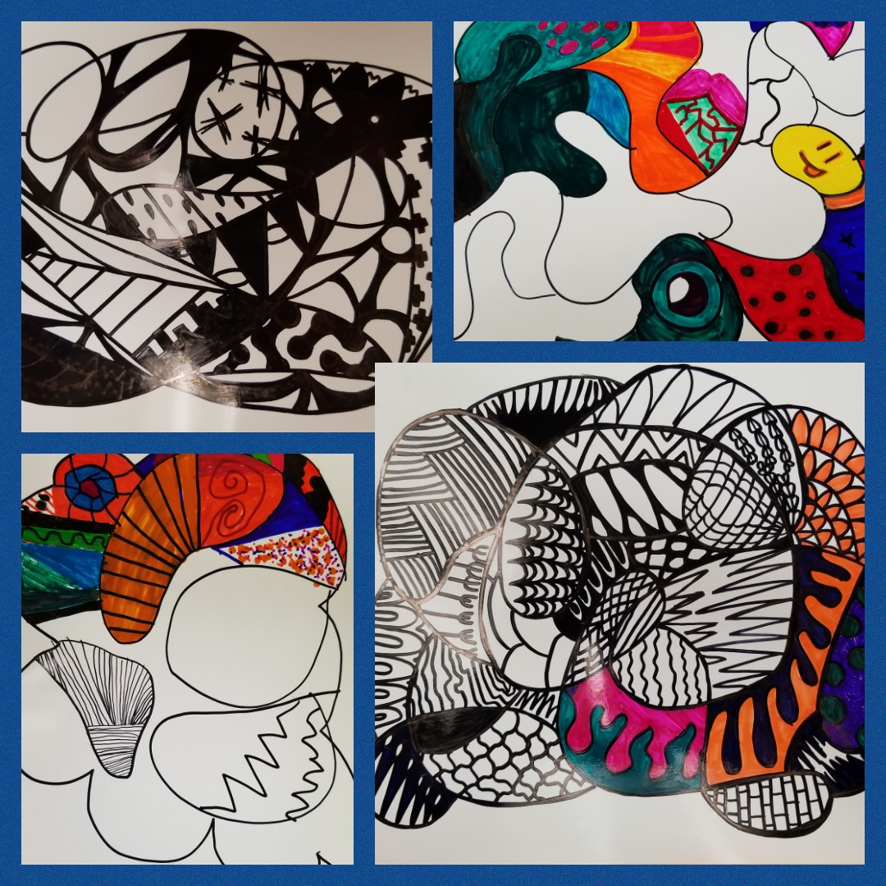

Slide 6
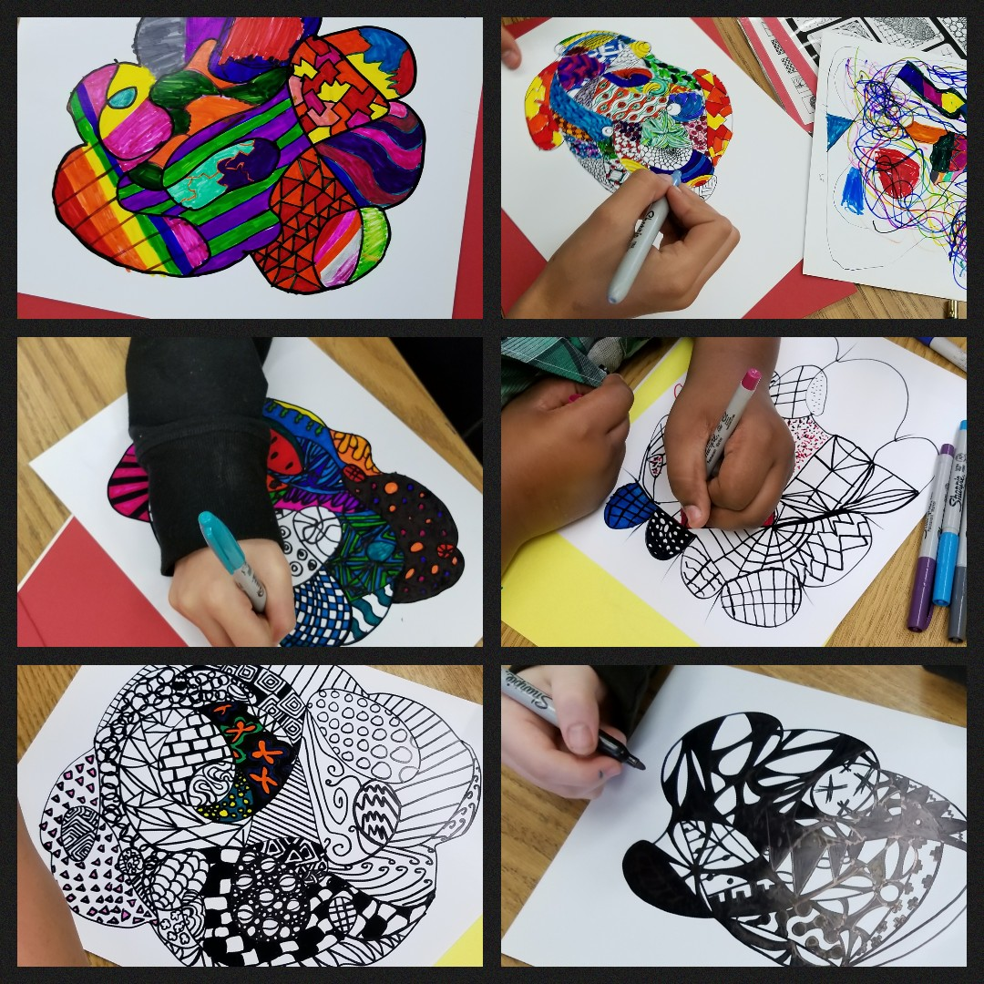

Slide 7
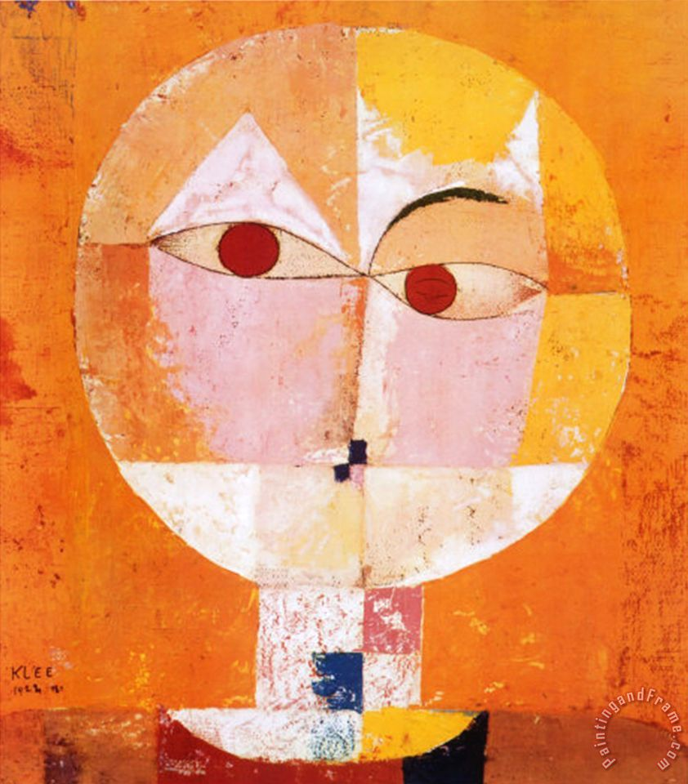
ACTIVITY 2
Head of A Man
Create a face using shapes.
Look at the examples on the next slides.

Slide 8
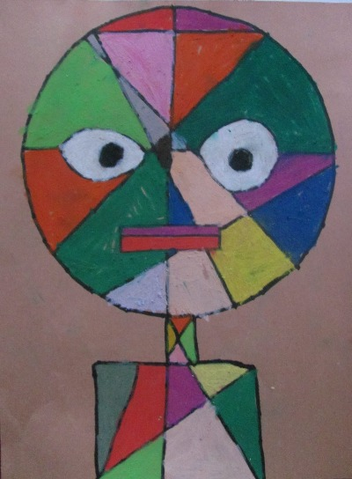
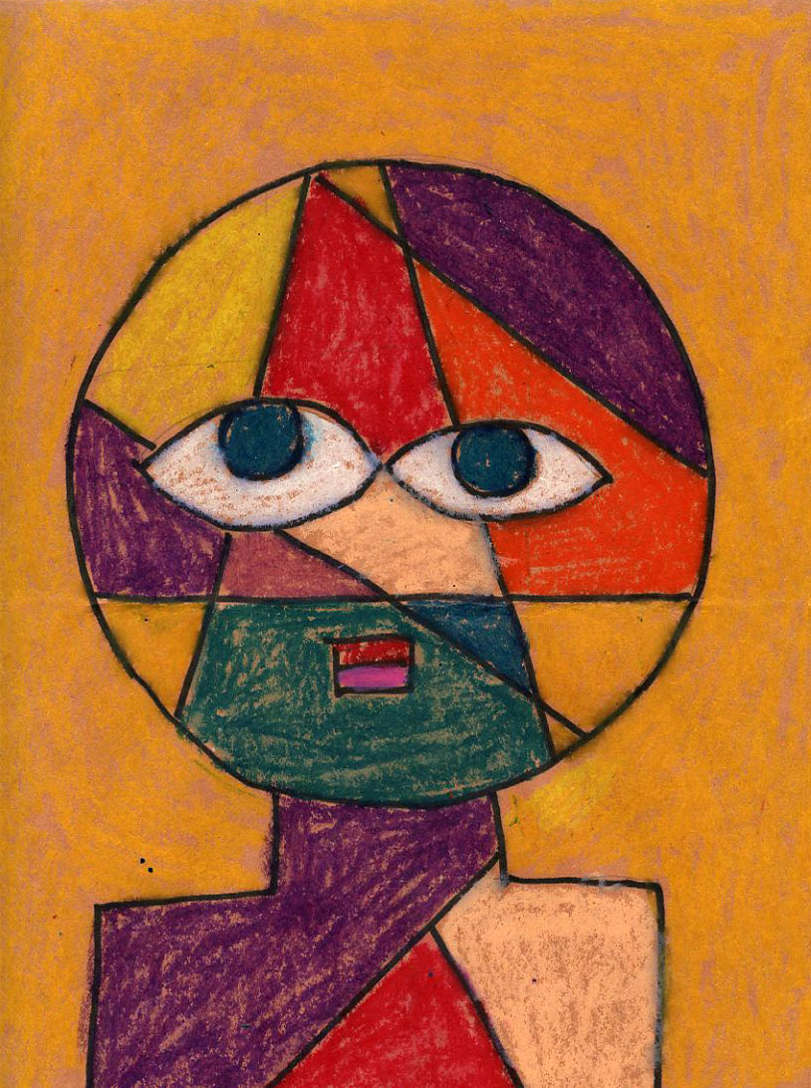

Slide 9
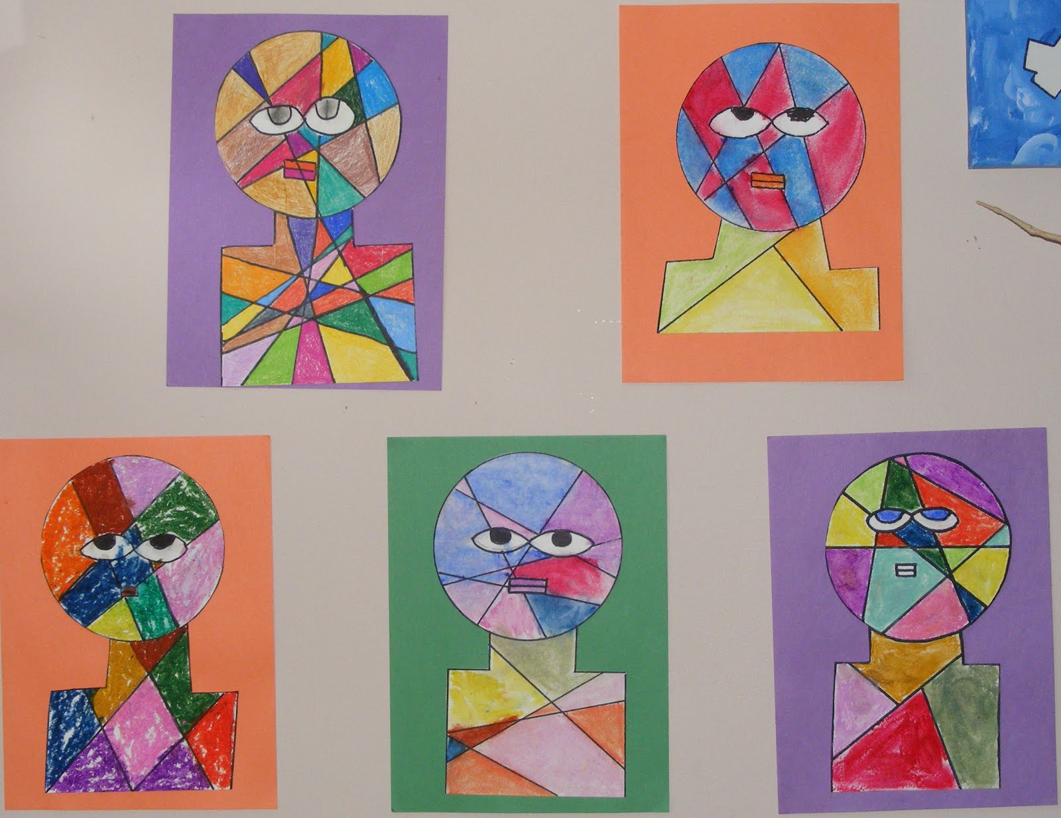

Slide 11
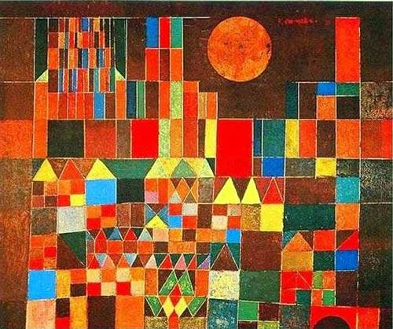
ACTIVITY 3
Cityscape
Klee often built up drawings from small repeated patterns.
Create your own cityscape.
Look at the examples on the next slides.

Slide 12
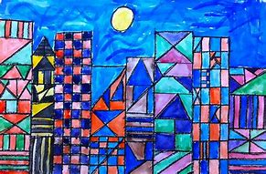

Slide 13
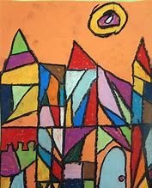
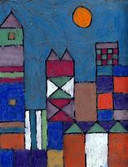

Slide 14
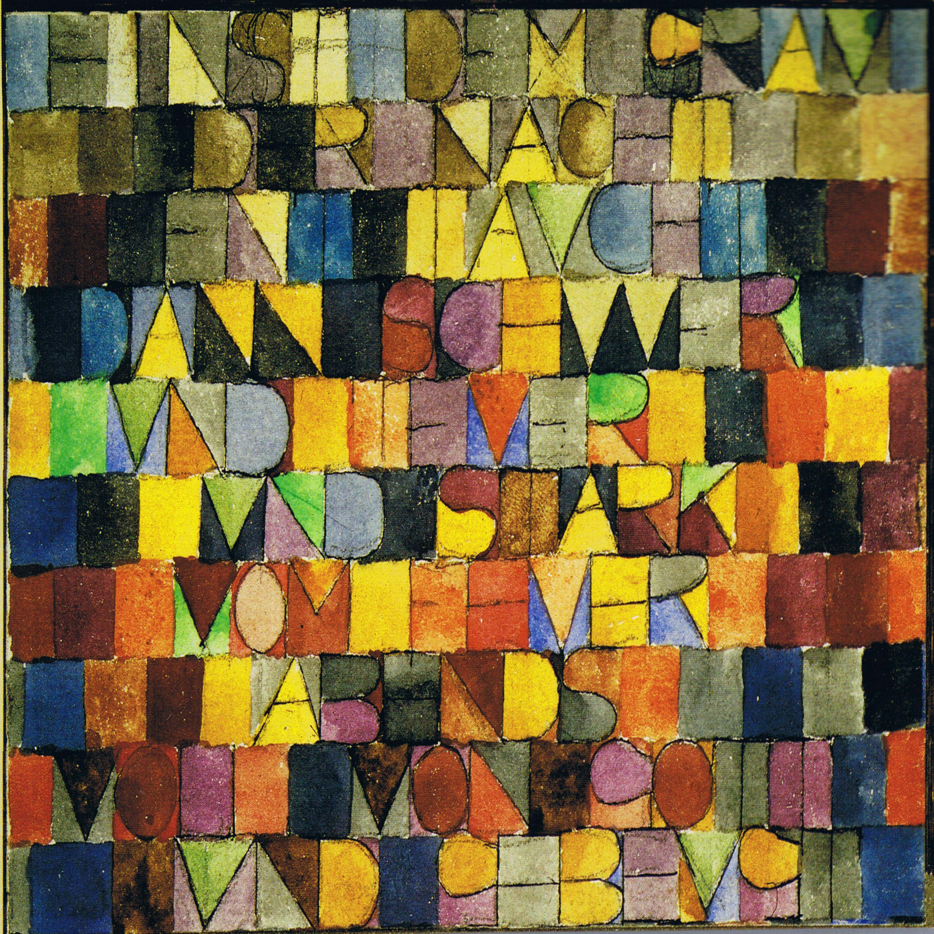
ACTIVITY 4
Song Lyrics
Klee loved music and he would often include musical symbols in his artwork.
He has used the lyrics from a German song in this picture.
Create your own song lyrics design.
Look at the examples on the next slides.

Slide 15
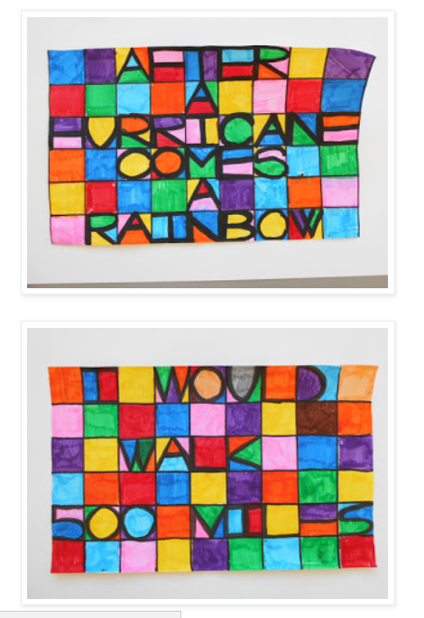
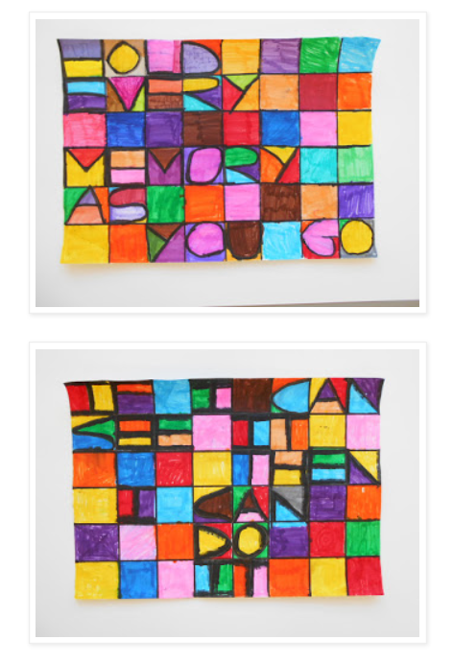

Slide 16
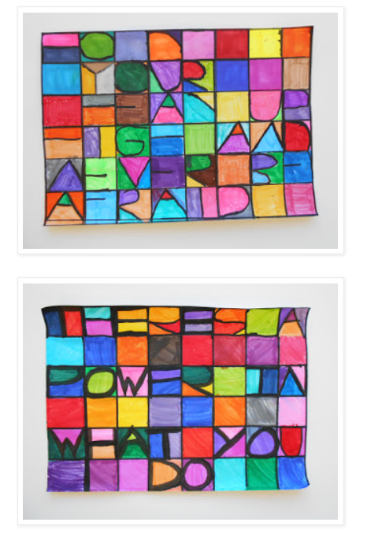
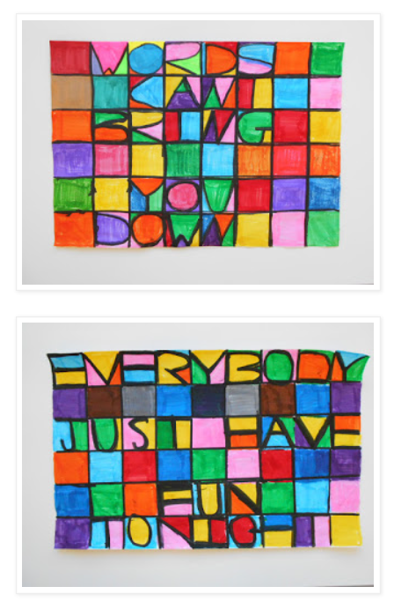

Slide 17
