Slide 1

Computing Curriculum Impact at Lyme Community Primary School

Slide 2
Introduction
The impact of our computing curriculum at Lyme is to:
Give children a wealth of experience around all aspects of computing from online safety, to creating spreadsheets and coding.
Create opportunities to build on previous learning; using pre-learning assessments -in particular around vocabulary – to ensure their learning builds appropriately.
Enable children to apply computing skills throughout the whole of the curriculum.
Ensure progression through The Purple Mas scheme of work to ensures it is consistent through all year groups from Nursery to Year 6.
To understand the value of computing in all walks of life.

Slide 3
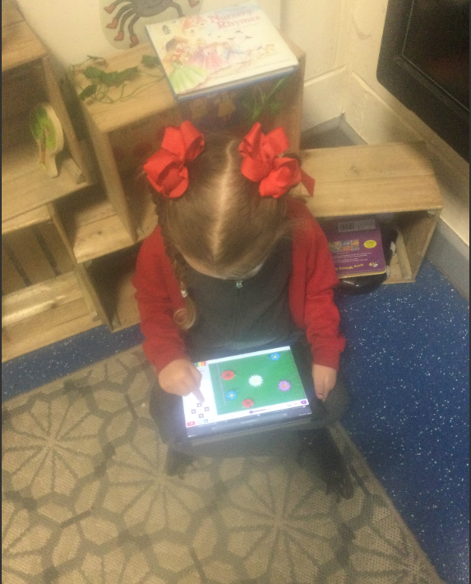
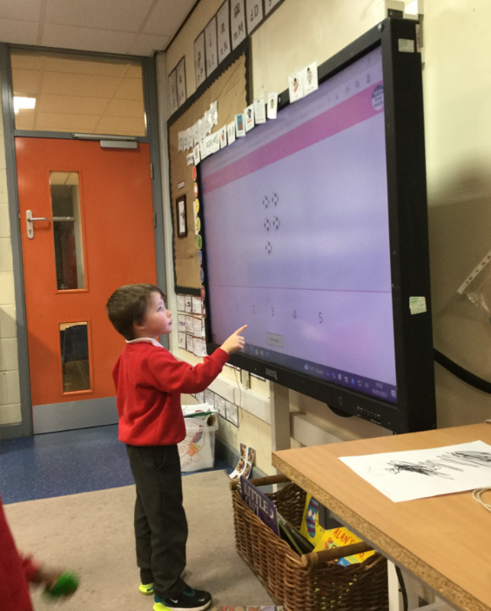
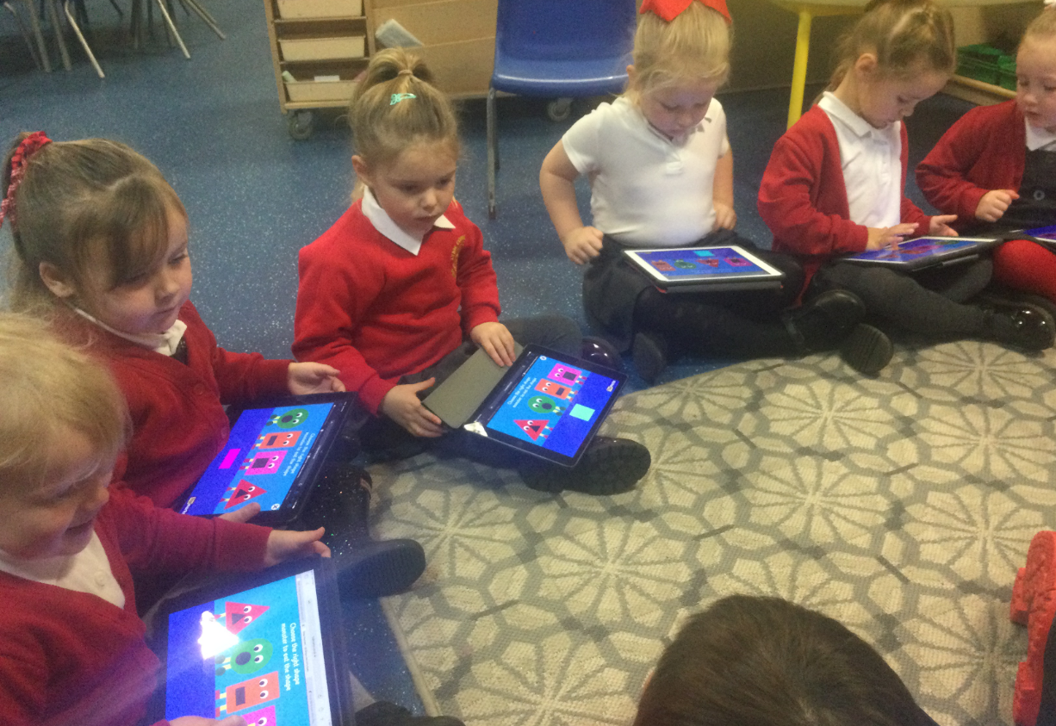
Nursery
Children use iPads to develop computing skills and support early years the curriculum as a whole. ICT is also used on the class screen in whole class teaching input.

Slide 4
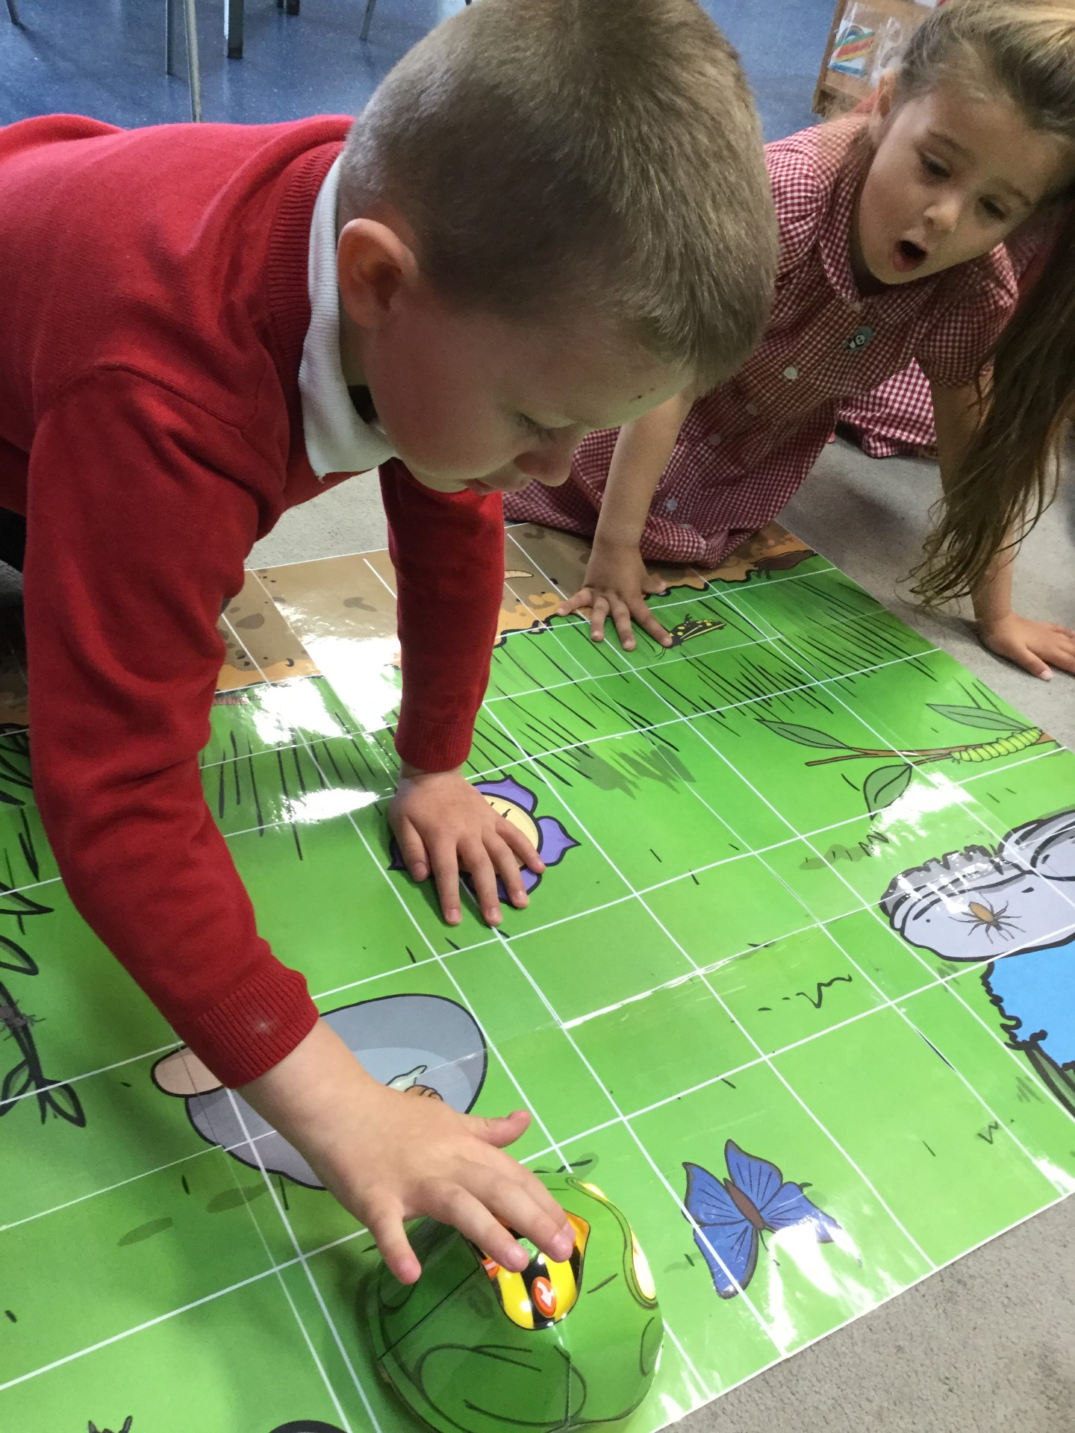
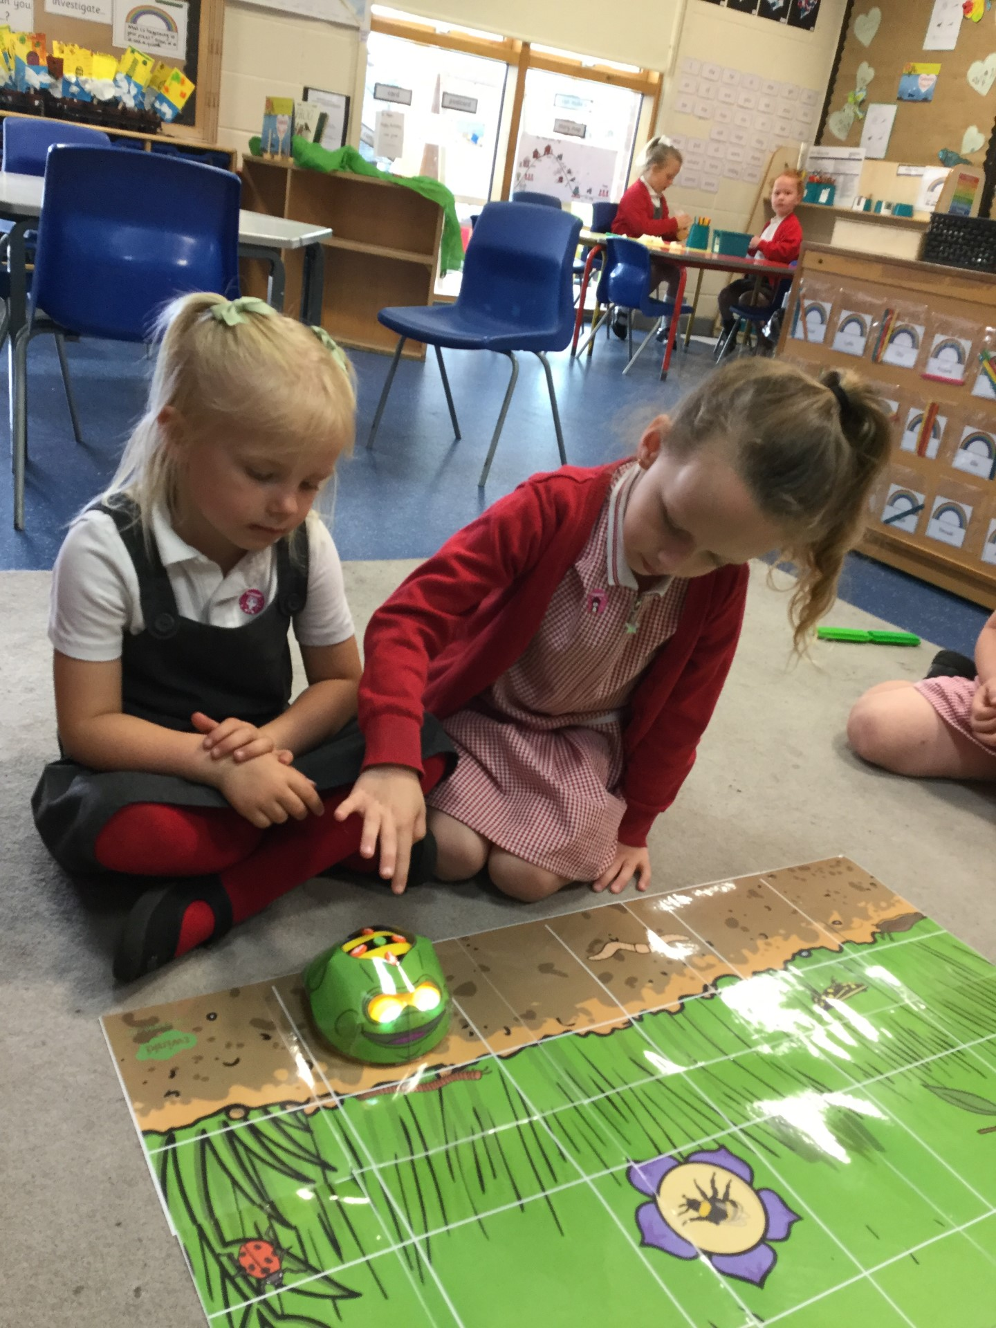
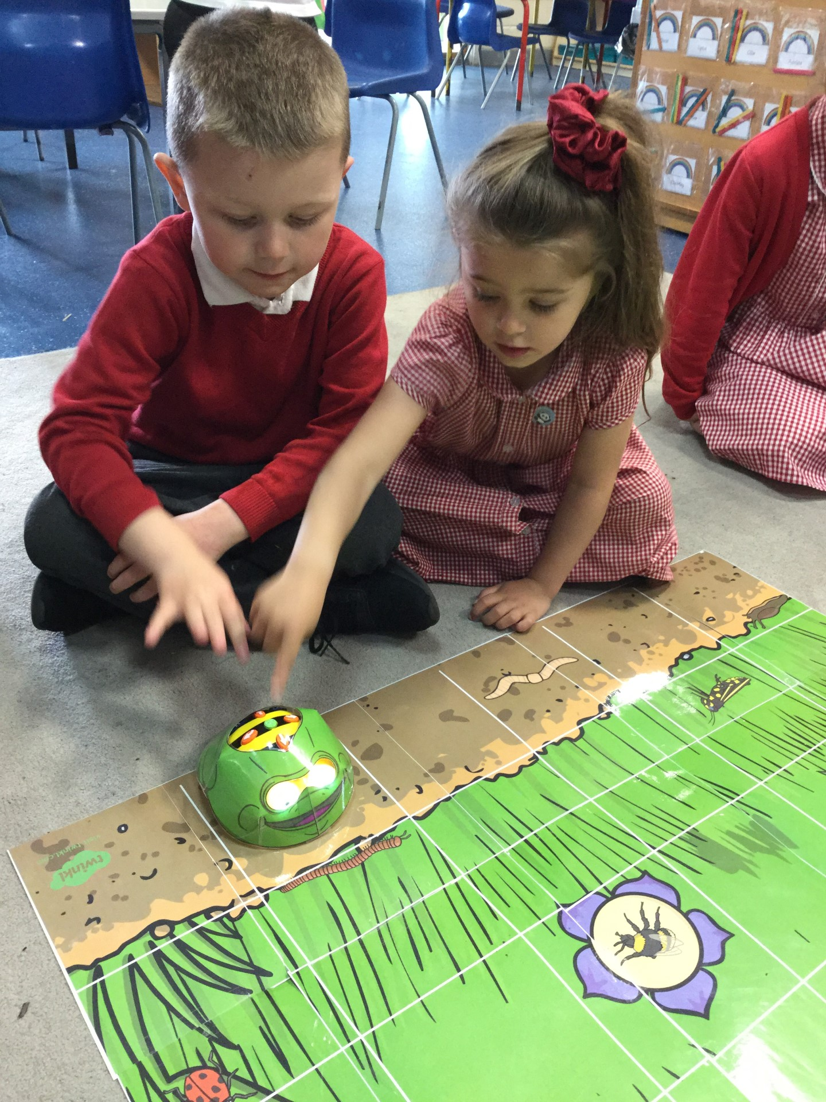
Reception

Slide 5



Year 1

Slide 6
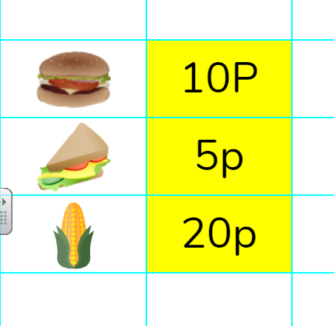
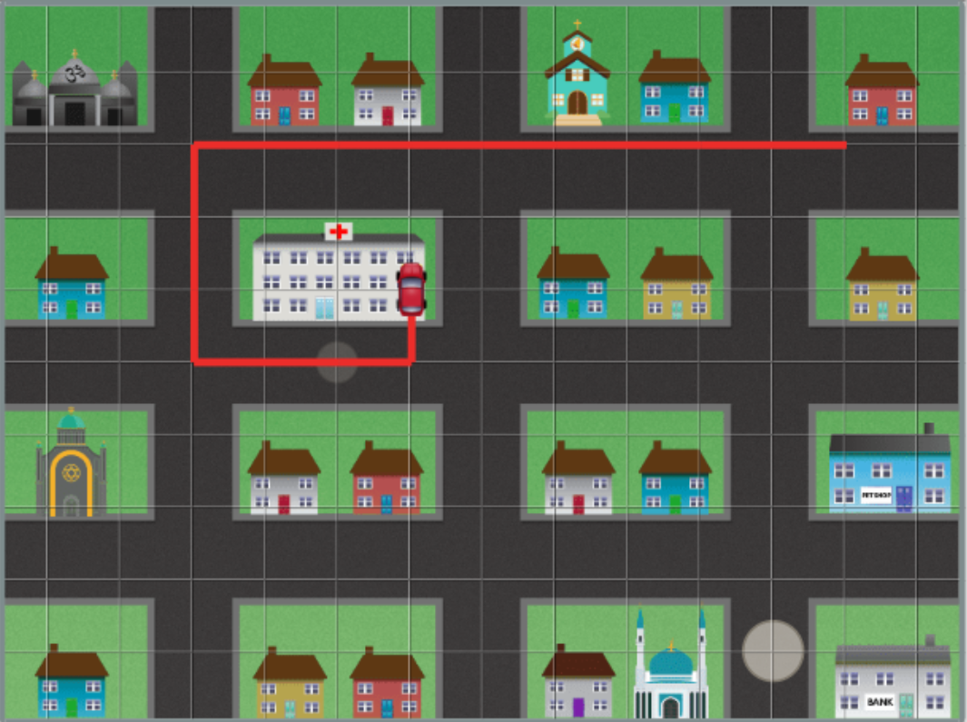
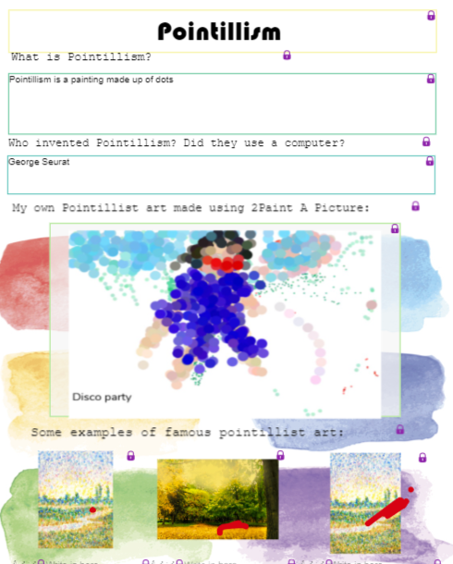
Year 2
Children can use computing to support learning in both maths and art.
Basic instructions through a maze begins the children’s understanding of algorithms.

Slide 7
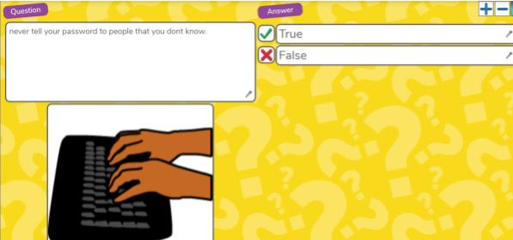
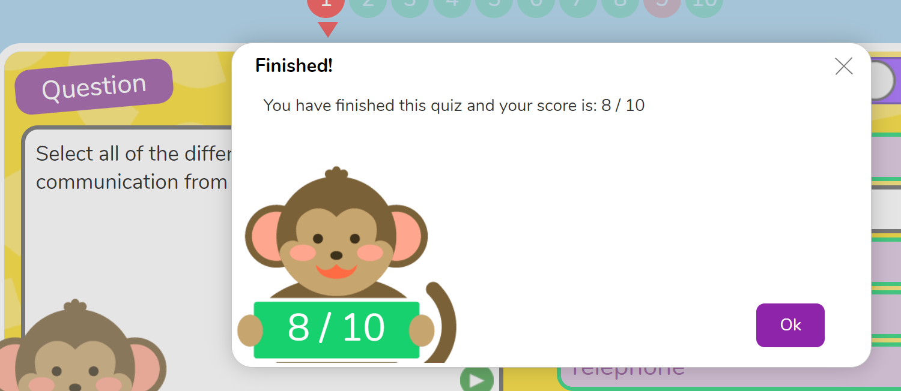
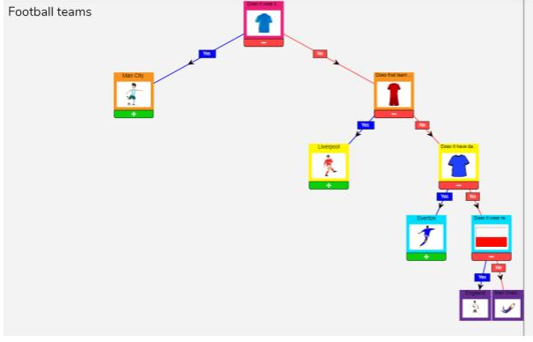
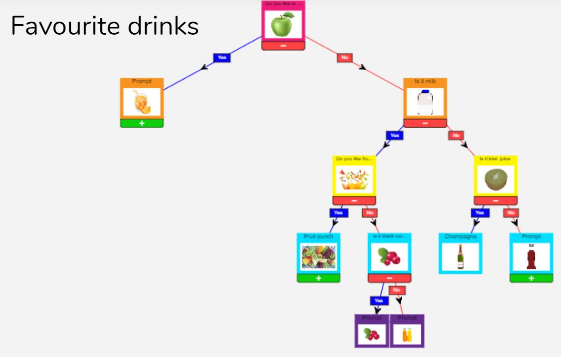
Year 3
Children can link their work to their own hobbies and interests. Quizzes are used to test previous knowledge.

Slide 8
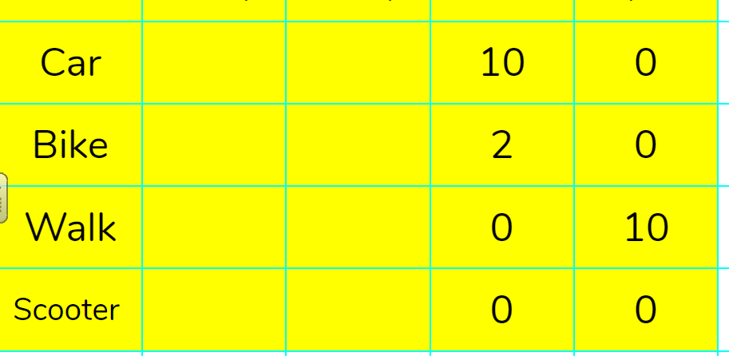
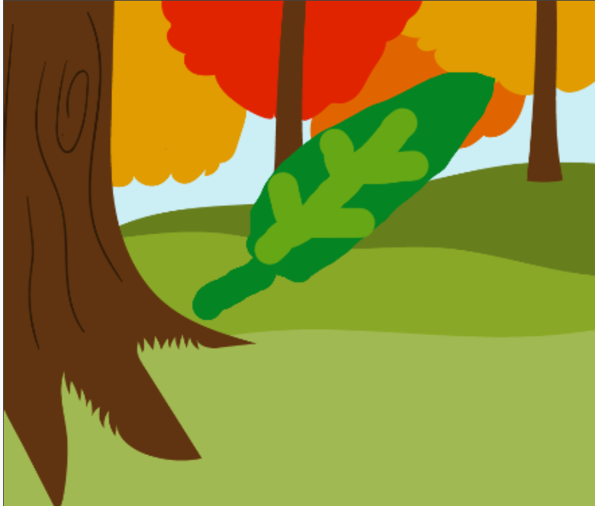
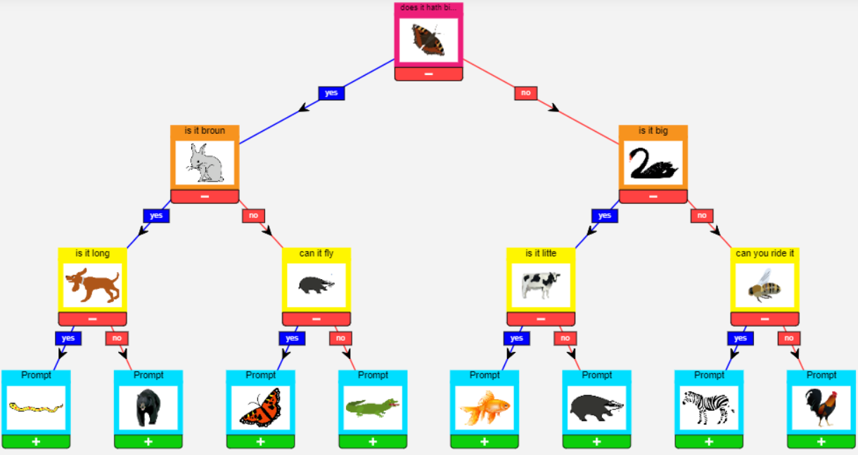
Year 4
Branching diagrams link computing data handling skills to the science curriculum.

Slide 9
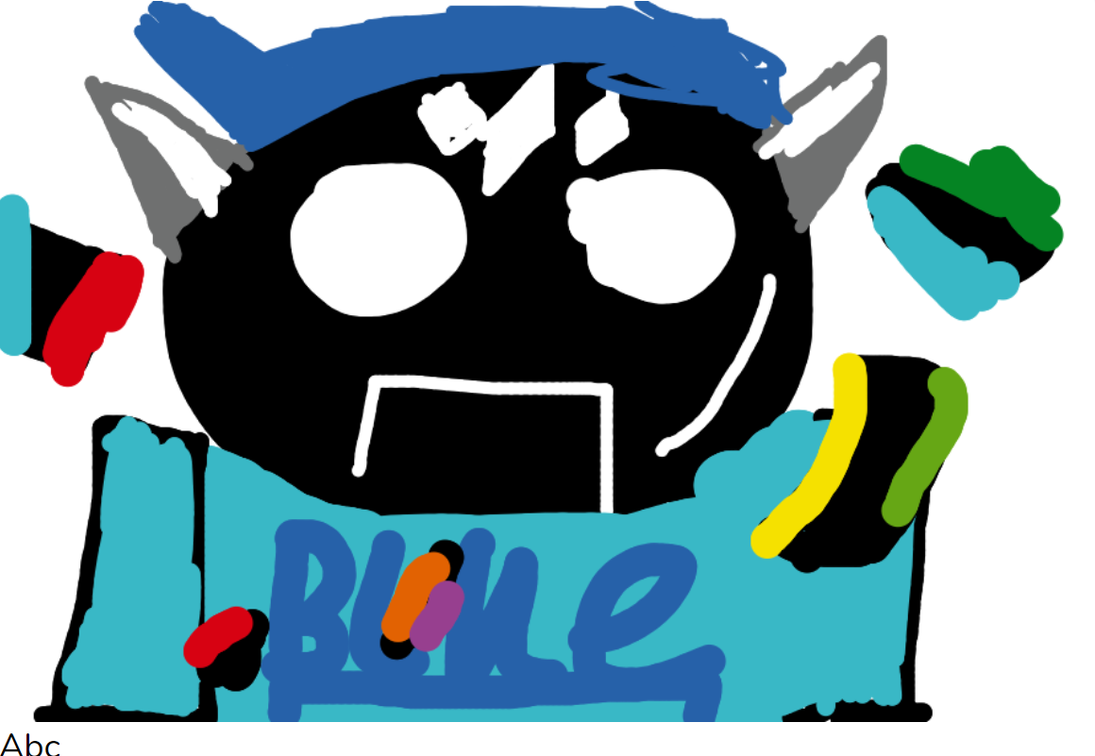
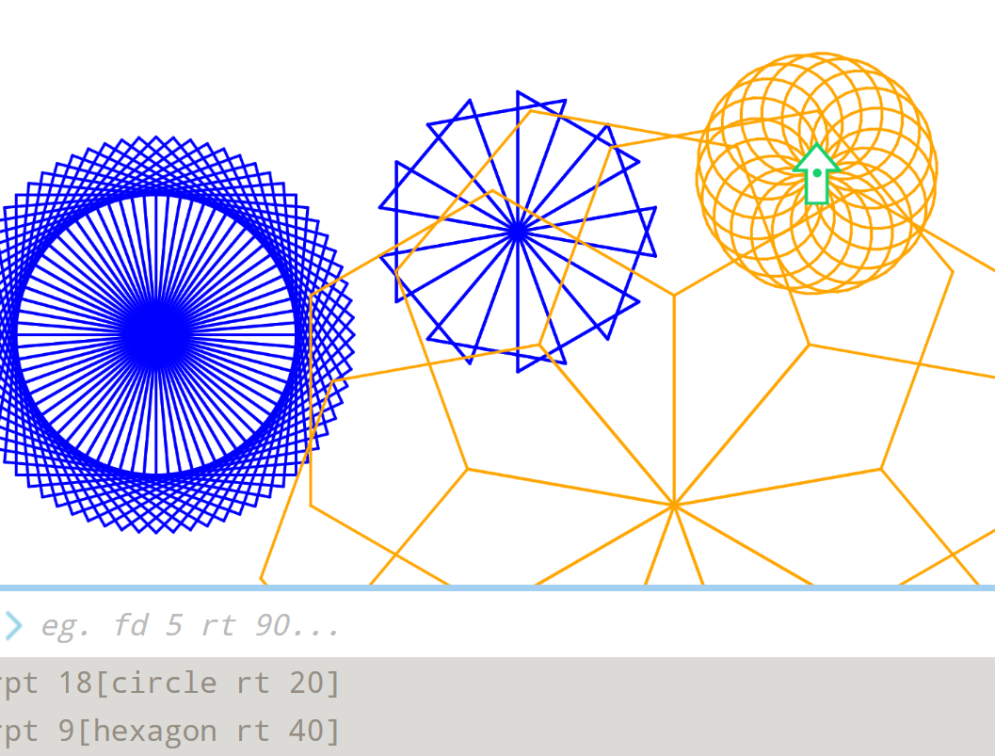
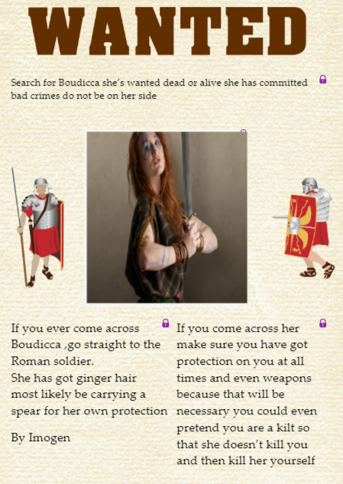
Year 5
English and maths skills are supported through computing platforms.

Slide 10
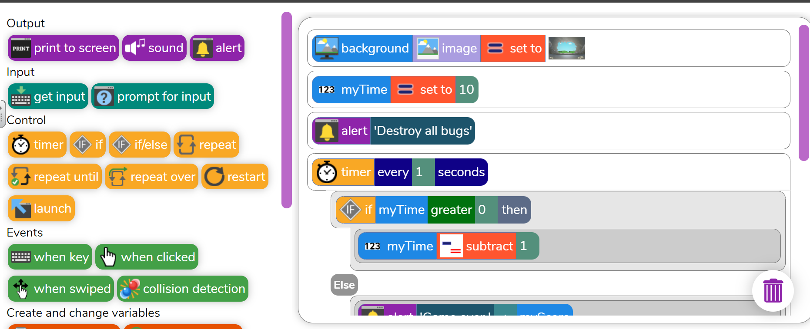
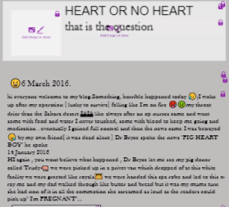
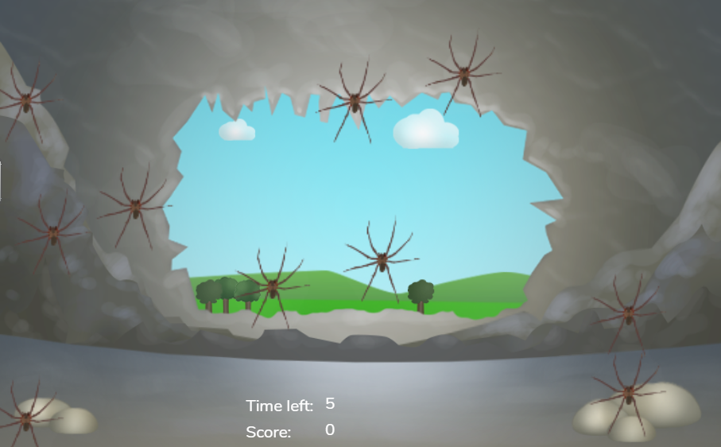
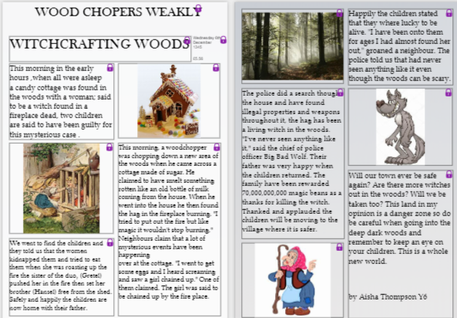
Year 6
Creating games with a complex algorithm (list of instructions) as well as supporting writing.

