Slide 1
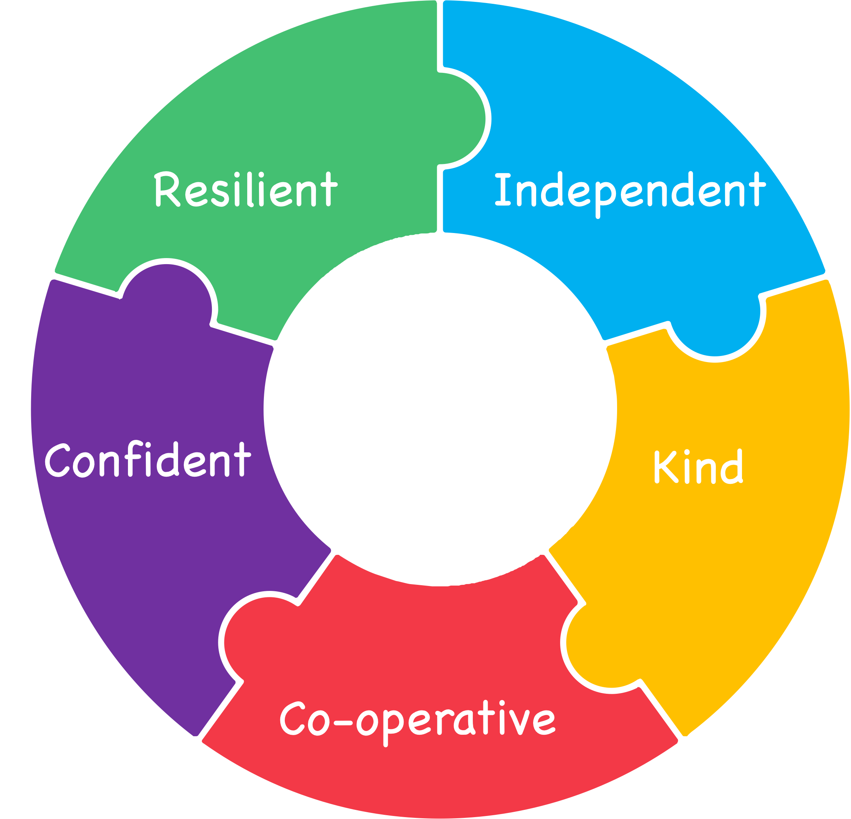
Y6 Meeting: September 2026
"Have the courage to succeed"​

Slide 2
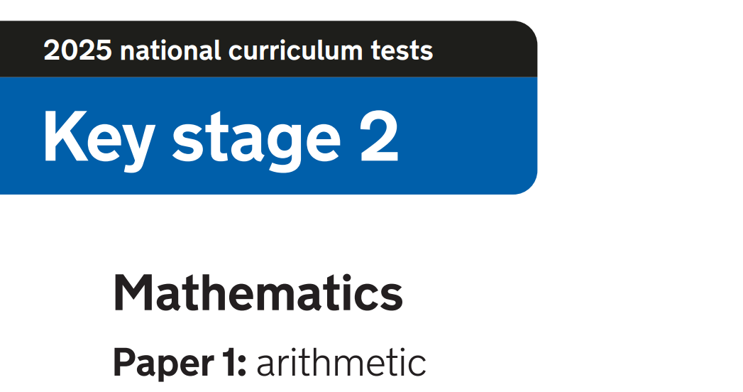


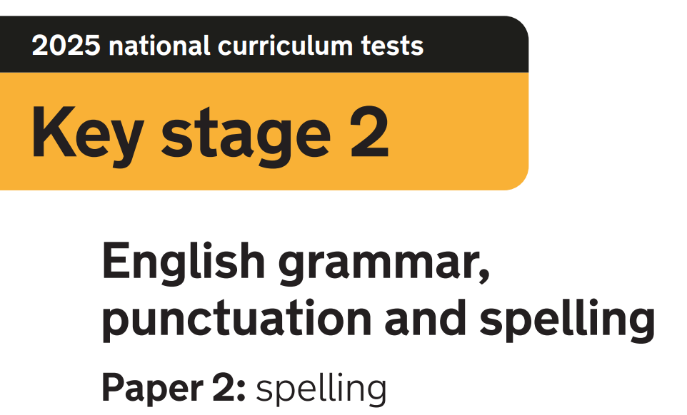
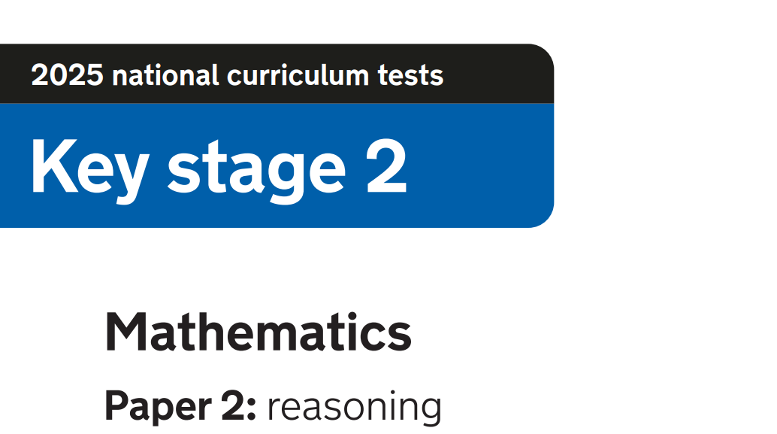
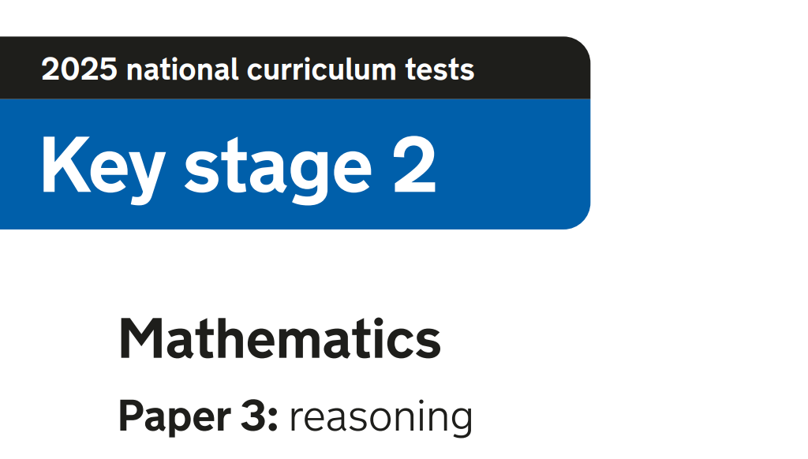
SATs tests
Your child will take SATs tests in reading, SPAG (spelling, punctuation and grammar) and mathematics.
These tests will be completed in the week starting Monday 10th May - it is crucial that your child is in school every day that week.

Slide 3
Monday 10th May: Spelling, punctuation and grammar (SPAG)
Tuesday 11th May: Reading test.
Wednesday 12th May: Maths arithmetic paper 1 and reasoning paper 2.
Thursday 13th May: Maths reasoning paper 3

Slide 4
Test logistics
Children will complete the SATs in their normal classroom environment where possible. Some children will be sat in other areas around school, or at different times in the day dependent on individual needs.
We will complete practice SATs in late March/early April so all children know where they will complete the actual assessments, and which adults will be there to support them. Dates will be sent home prior.
The SATs are based upon the whole KS2 programme of study.

Slide 5
Test logistics
Children with an EHCP automatically qualify for 25% extra time
Testing for additional time will take place in March and April and parents/carers will be notified if their child qualifies - the DfE decide, not us.
There are other access arrangements that may be beneficial for individual children rest breaks, translators, and readers, which do not need to be tested/applied for through the DfE.

Slide 6
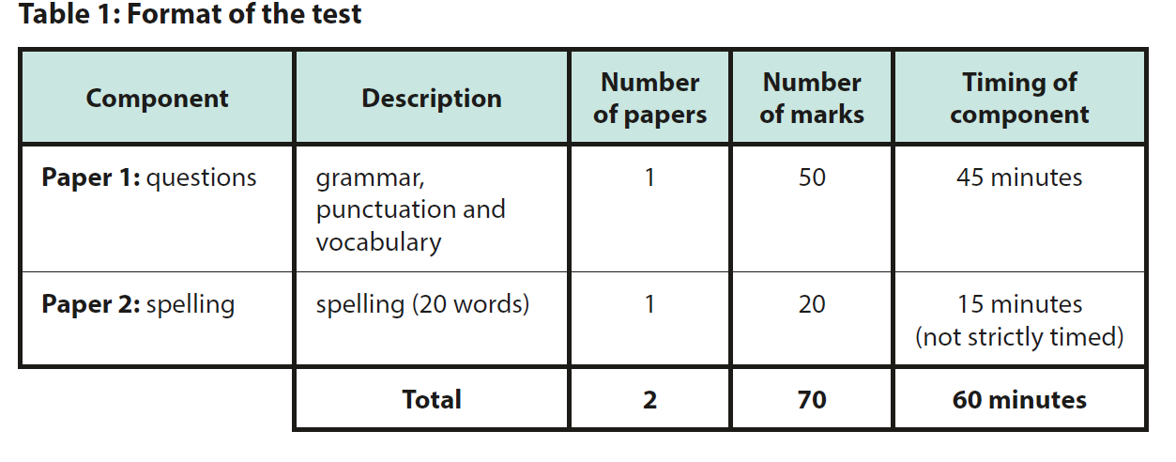
SPAG test content…
Children are expected to complete approximately 50 questions in 45 minutes.
The test is based on the relevant sections of the national curriculum statutory for English at Key Stage 2.
To meet the expected standard in 2026, pupils needed to score 36+ in total, and 55+ to achieve ‘greater depth.’

Slide 7
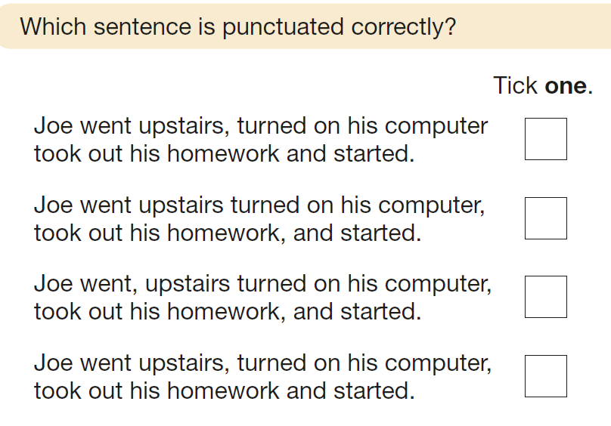
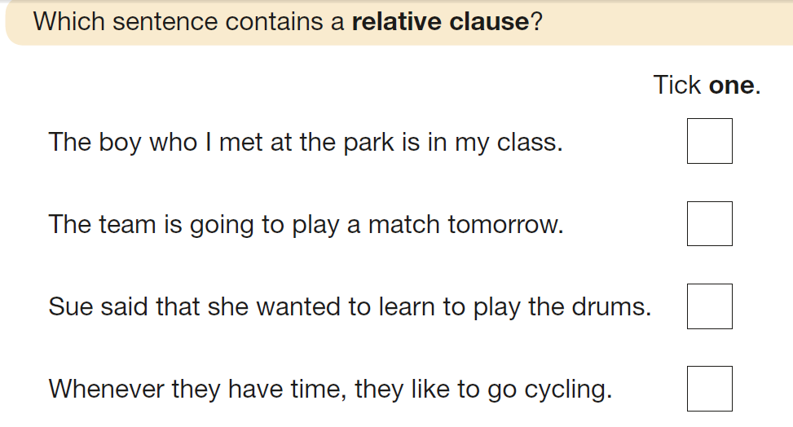
Year 3/4
Year 5

Slide 8
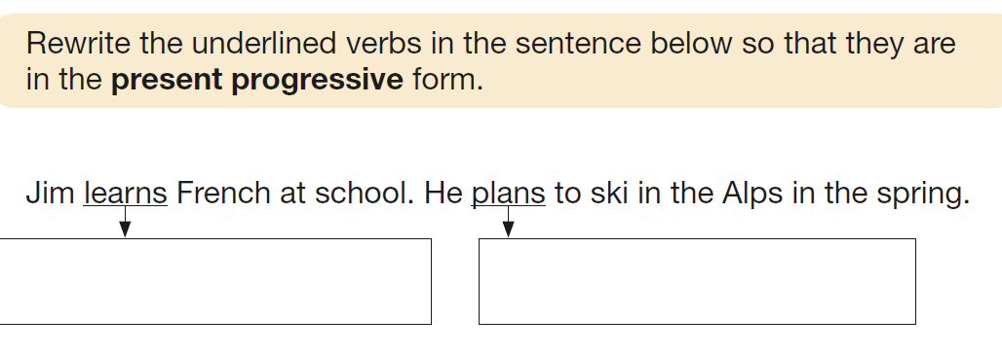
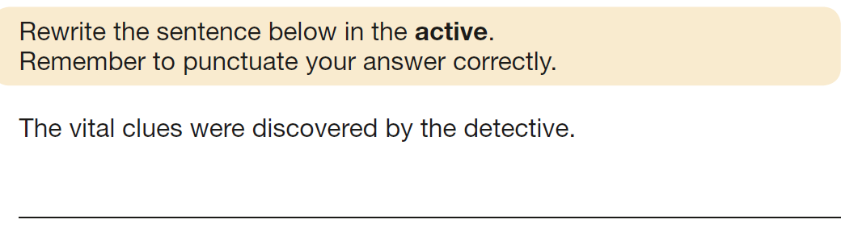
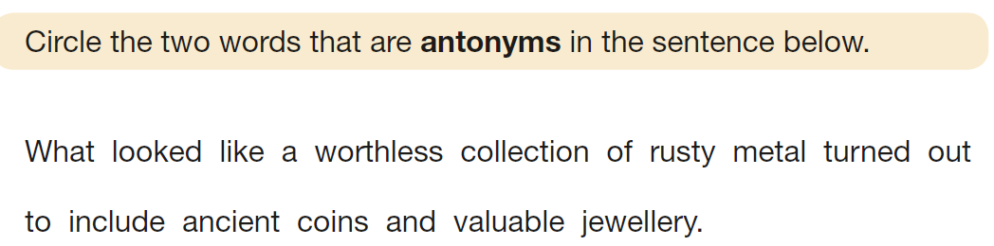
Year 3/4
Year 6
Year 3/4/5

Slide 9
Words that have previously been included in the test:
Straight
Pyramid
Deceive
Sympathetic
Originally
Descendant
Coarse
Inconceivable

Slide 10
How you can help your child…
Encourage them to complete additional activities on Purple Mash or SATs Boot Camp (logins will be provided at Parents’ Evening
Take home a copy of the SATs Grammar Terminology document.
Practise words from the Y5/6 statutory spellings list - a copy is available to take home at parents’ evening
- At least 2-3 of these will be assessed in the test, plus children have to show evidence of spelling them correctly in their writing (or in class tests) to meet the expected standard.

Slide 11
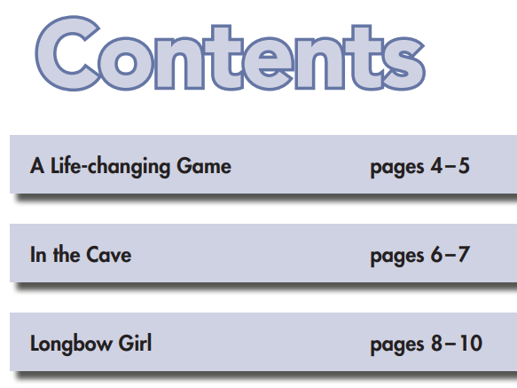
Reading test
Pupils have 1 hour to read the text (usually about 10 pages covering different topics) and about 40 questions.

Slide 12
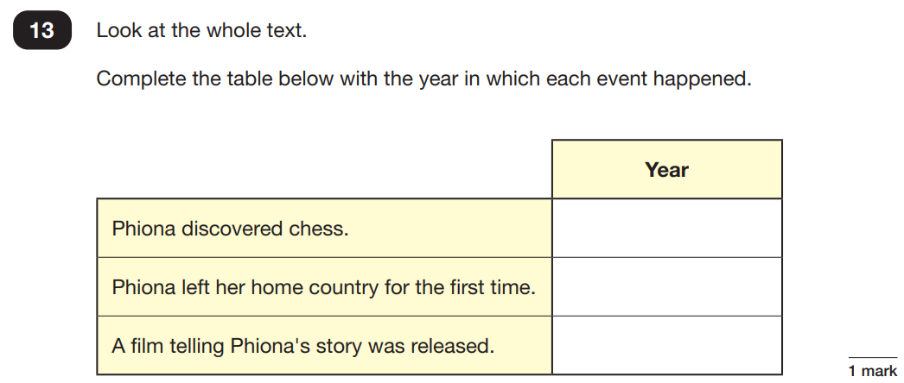
Reading test
Pupils have 1 hour to read the text (usually about 10 pages covering different topics) and about 40 questions.
The test is out of 50 marks, and gradually gets harder, with a range of 1,2 and 3 mark questions.

Slide 13
Reading test
Pupils have 1 hour to read the text (usually about 10 pages covering different topics) and about 40 questions.
The test is out of 50 marks, and gradually gets harder, with a range of 1,2 and 3 mark questions.
The children are assessed against eight content domains.
To meet the expected standard in 2026, pupils needed to score 25+ marks.
To achieve ‘greater depth,’ pupils needed 39+ marks.

Slide 14
How you can help prepare your child for the reading test…
Please make sure they read at home every evening - this will make a huge difference!
Encourage them to read a range of fiction and non-fiction texts so they are exposed to different vocabulary and text layouts.
Ask questions about their reading to develop comprehension skills
Encourage your child to complete the activities on SATs Boot Camp and use the CGP books to support revision and homework.

Slide 15
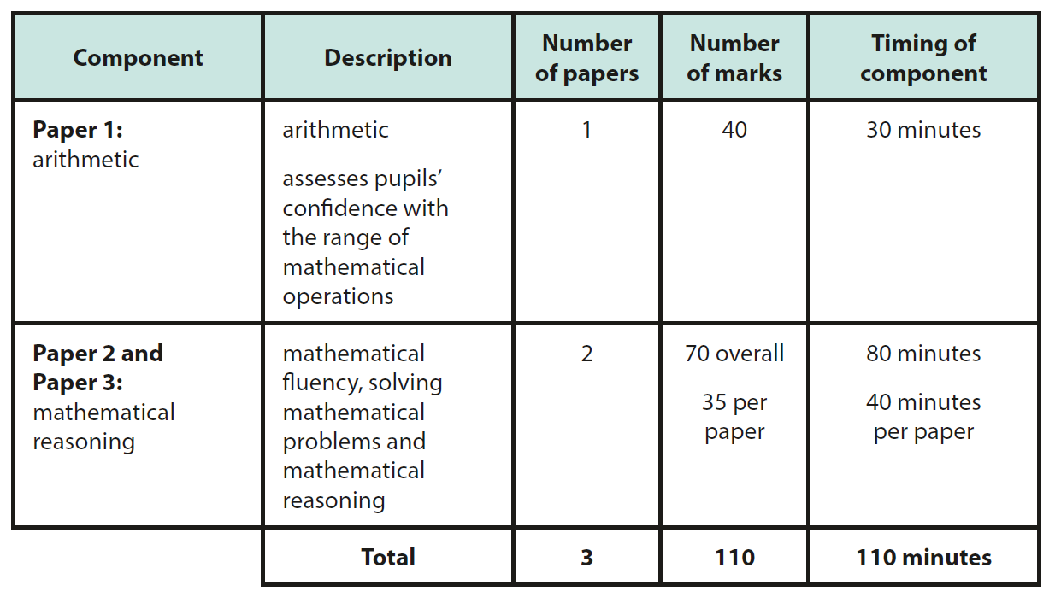
Maths test
Your child will complete 3 maths papers which assess their fluency, arithmetic and reasoning skills.
To meet the expected standard in 2026, children needed to score 56+ marks in total, and 94+ to achieve ‘greater depth.’

Slide 16






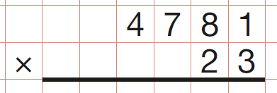

Arithmetic questions
1 mark per question
Previous cohorts’ results have shown us that pupils must succeed on the arithmetic test if they are to meet the expected standard (30+ marks out of 40).

Slide 17
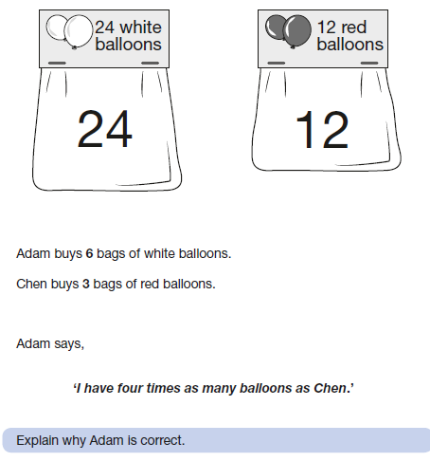
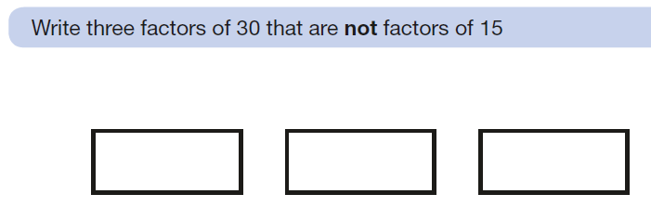
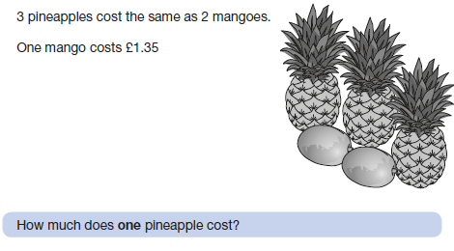
Reasoning questions
1, 2 or 3 marks per question
LK

Slide 18

How you can help your child prepare for the maths test…
Check they have completed their weekly arithmetic homework and support with any errors
Ask questions to help develop their speed of recall of times tables. Use TTRS regularly.
Encourage your child to complete the tasks on SATs Boot Camp
LK

Slide 19
Note on writing
Writing is teacher assessed, rather than done externally
.
Your child will achieve a judgement of greater depth, expected standard, working towards the expected standard or pre-key stage standard.
Teachers will make the final judgement by the end of June, based upon the work that your child has independently produced in class.
Writing assessments are moderated by the Local Authority to ensure fair and accurate judgements across schools.
Please feel free to take home the examples so you have an understanding of what is required to achieve each standard.

Slide 20
What we’re doing to help your child...
We have purchased textbooks to help your child revise key learning in reading and maths.
Child Wellbeing:
It is important that all children feel confident and happy in school during and leading up to their exams. We will not be administering numerous tests prior to exams that put undue pressure on children.
In the SATs week, children will be able to come into school slightly earlier than normal for a free SATs breakfast and to feel confident and stress-free before their exams.
We will be giving advice and having lessons/discussions about managing time, revision and sleep in the time leading up to SATs

Slide 21
Useful resources
Maths:
My Mini Maths
https://myminimaths.co.uk/arithmetic-16-practice-question-1/
Genius SATs KS2 Maths
updated-MAIN-FILE-2020.pdf (barhamprimary.co.uk)
Corbett Maths
https://corbettmathsprimary.com/
For all subjects:
SATs Boot Camp
SATs Boot Camp - Year 6 SATs Revision, Practice Papers & SATs Questions Online (yearsix.co.uk)
BBC Bitesize
https://www.bbc.co.uk/bitesize/primary
Purple Mash
https://www.purplemash.com/login/
CGP books
https://www.cgpbooks.co.uk/primary-books/bestselling-sat-busters

Slide 22
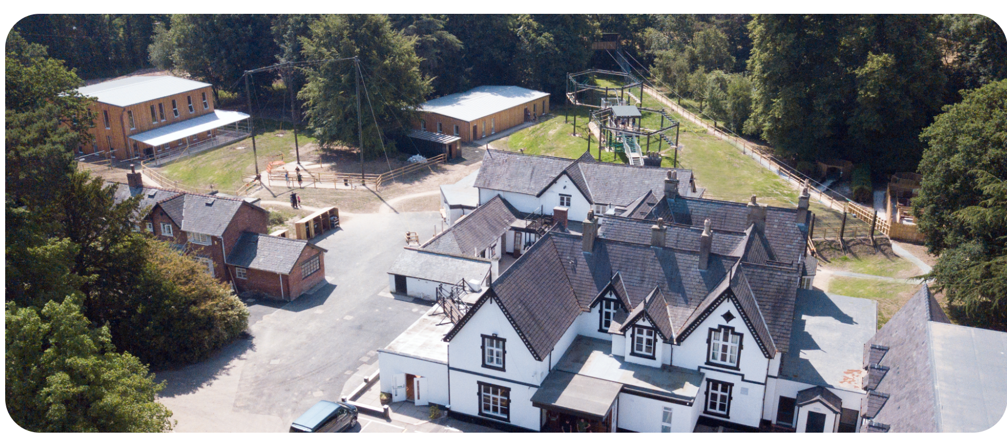

Robinwood 2026

Slide 23
Aims:
To develop your child’s independence, resilience, confidence and cooperation skills.
To ensure your child can be bold and challenge themselves.
To have fun!

Slide 24
Key information:
We will visit Robinwood’s new centre, Maes-y-Nant, in Wrexham from Wednesday 7th to Friday 9th July.
The school hall will be open from 8:30am for you to drop children and bags off.
We’ll aim to leave around 9.15am.
We’ll return to school about 3.30pm on 9th July, but will keep you updated about any potential delays.
Children not attending RW will still be required to attend school as normal - year 6 teachers will plan activities for them to take part in during the week which will be led by a familiar TA.

Slide 25
Staff attending:
Ms Rogers / Mr Taylor
Mr Mann
Miss Doyle
Miss Healy
Miss Butler
Mrs Derbyshire
Familiar TAs will also attend

Slide 26
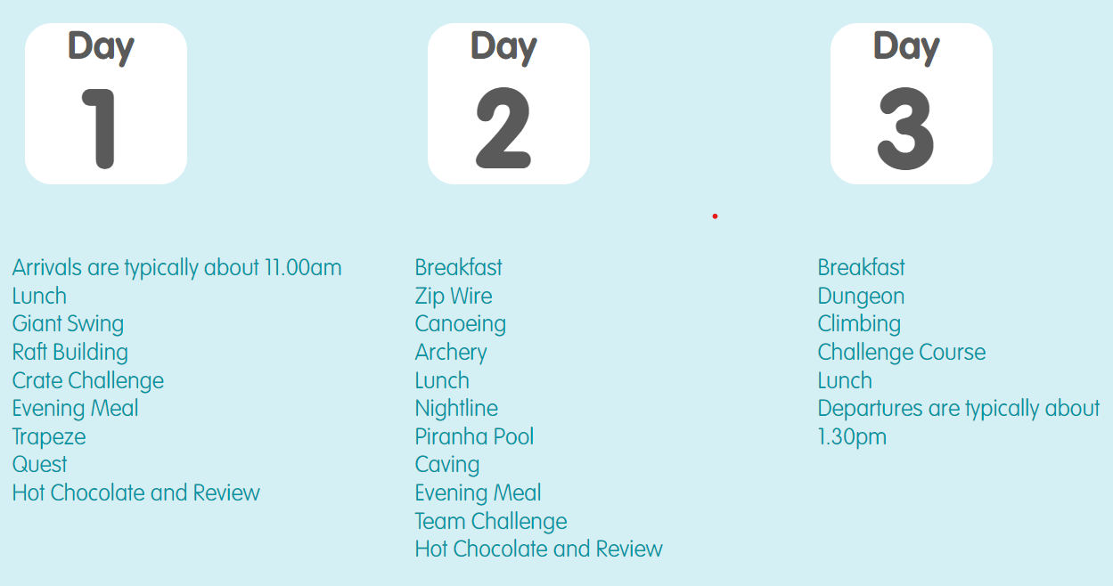
Activities: a potential timetable

Slide 27
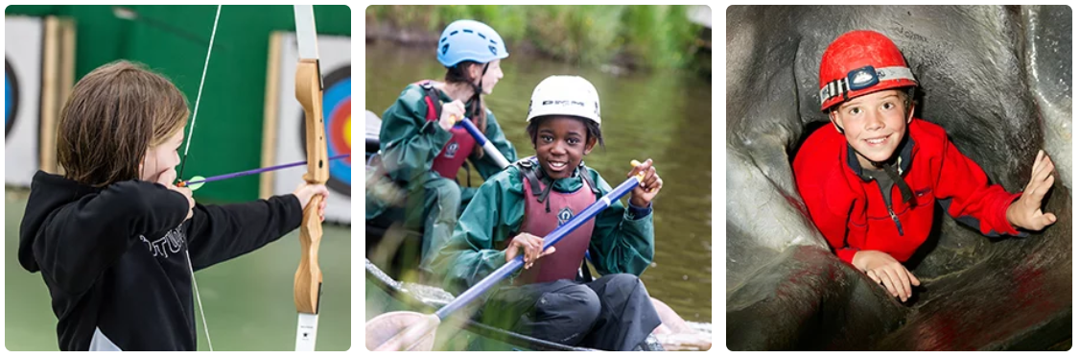
Activities
Raft Building and Canoeing takes place on a purpose-built lake, shallow enough to be perfect for Key Stage 2
Maes-y-Nant features a brand new Giant Swing and a Zip Wire of around 80 metres in length.
Purpose-built brand new buildings house archery and the specially designed indoor caving system.
Children will be split into 5 groups of approx 12-13.
Each group will have members of staff from Broadstone allocated to them, along with the Robinwood staff.

Slide 28
Dorms:
Children will be allocated a single-sex dorm which will sleep between 4-12 pupils (only from our school).
Teachers’ rooms are also nearby.
Rooms are en-suite and doors are alarmed.
Robinwood staff and Broadstone staff are on call throughout the night.
Staff will ensure your child is with a close friend in the activity group or in the dorms.
Children will be told their activity groups and dorms when we arrive at Robinwood.

Slide 29
Do not bring:
Any electrical devices, including phones, tablets, kindles and cameras.
Valuables, including smart watches or jewellery
Aerosols - they can set the fire alarm off
Chewing gum
Food (including sweets)
Any nice clothes - they won’t return ‘nice’ or clothes that cannot be tumble dried.

Slide 30
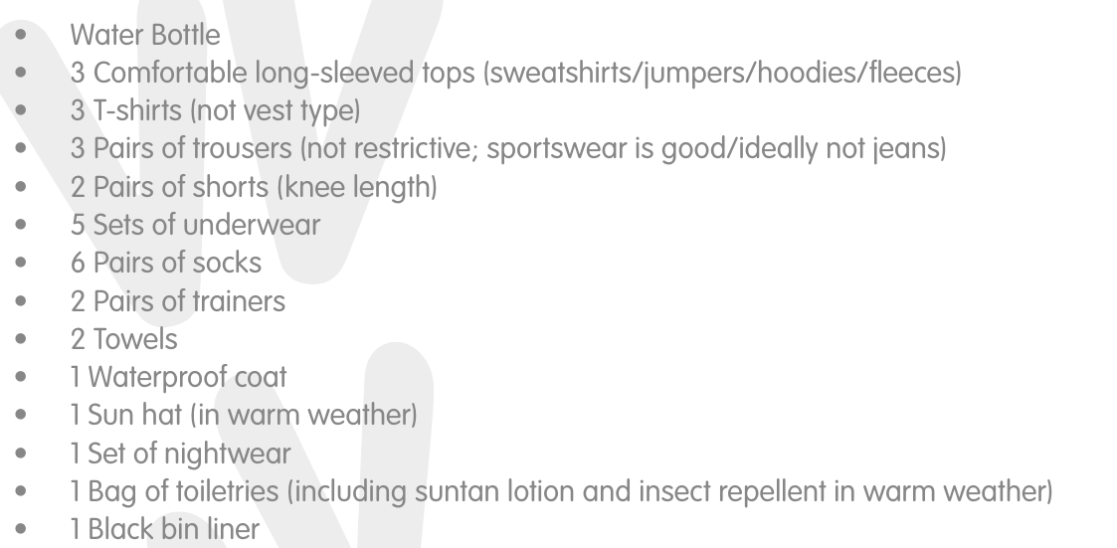
Kit List: label all clothing

Slide 31
Food:
Children choose each meal.
Vegetarian or Halal where necessary.
Menu varied but child friendly.
Hungry so tend to eat.
Allergies noted - please make sure any are included on the Robinwood medical forms as their staff will use these.

Slide 32
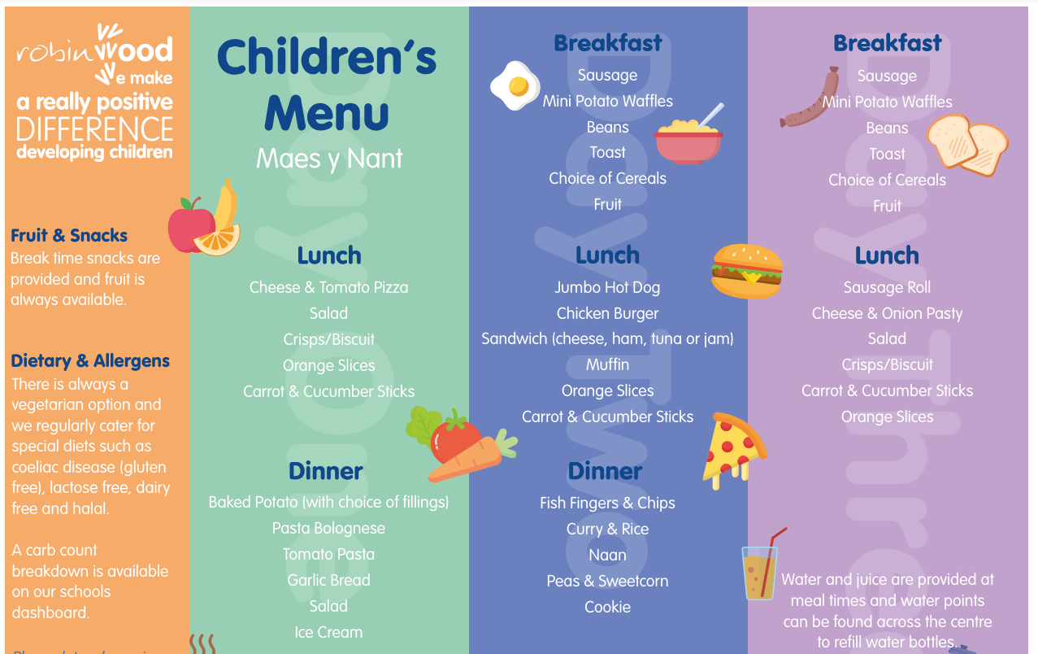

Slide 33
Medical:
Organised by Mrs Derbyshire.
Labelled clearly in original packaging name/dosage on packet.
Must be handed in on day of departure.
Travel sickness for return journey.
Last year, we ran drop-in meetings before and after school leading up to RW where you can discuss your child’s medication with Mrs Derbyshire - medication not previously discussed that is brought on the day of departure may not be allowed to be taken
Souvenirs:
Please return the order form to the school office before departure day

Slide 34
High School Transition

Slide 35



Important Dates:
Reddish Vale
Open evening on Thursday 15th October 2026
4 - 7pm
Priestnall School
Open evening on Thursday 22nd October 2026
5 - 7:30pm
St Anne’s
Open evening on Thursday 8th October 2026
5 - 8:00pm

Slide 36
Conception
A guide to what we will be teaching

Slide 37

“Older pupils explore pertinent issues such as consent, online behaviours and their changing bodies.” – Ofsted 2026
“Leaders have developed a curriculum that includes relationships education at an age-appropriate level.” – Ofsted 2026

Slide 38



Slide 39

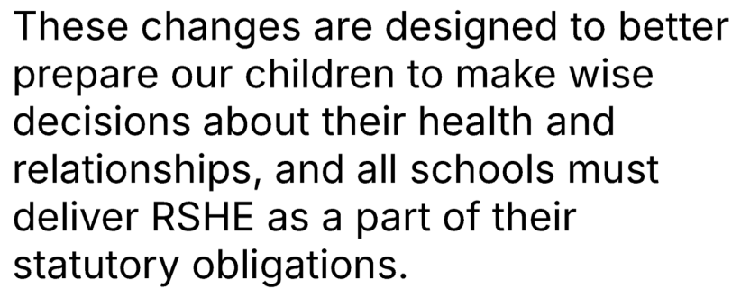


Slide 40
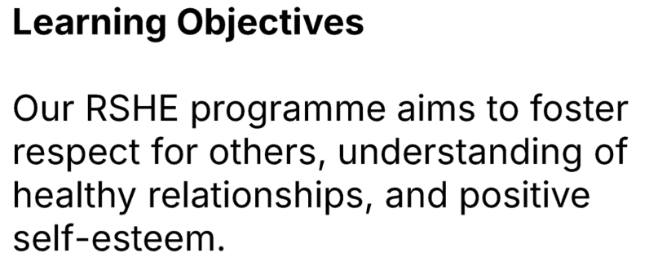
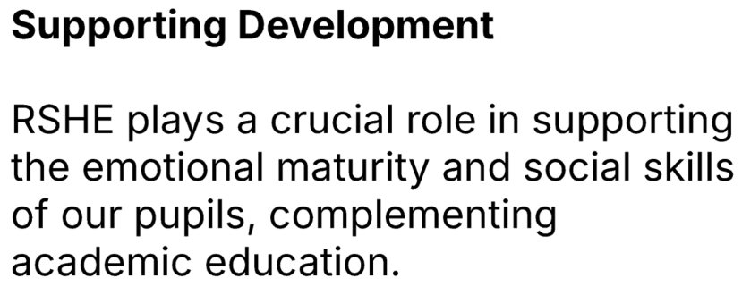
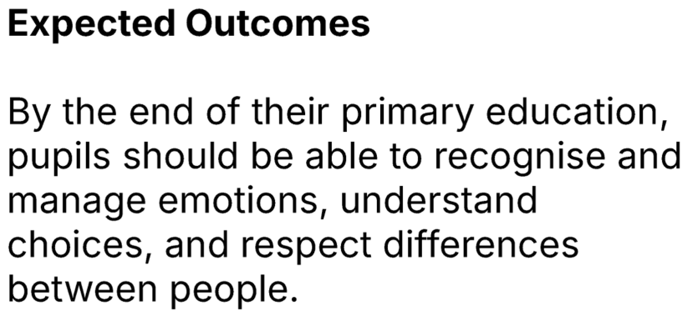

Slide 41

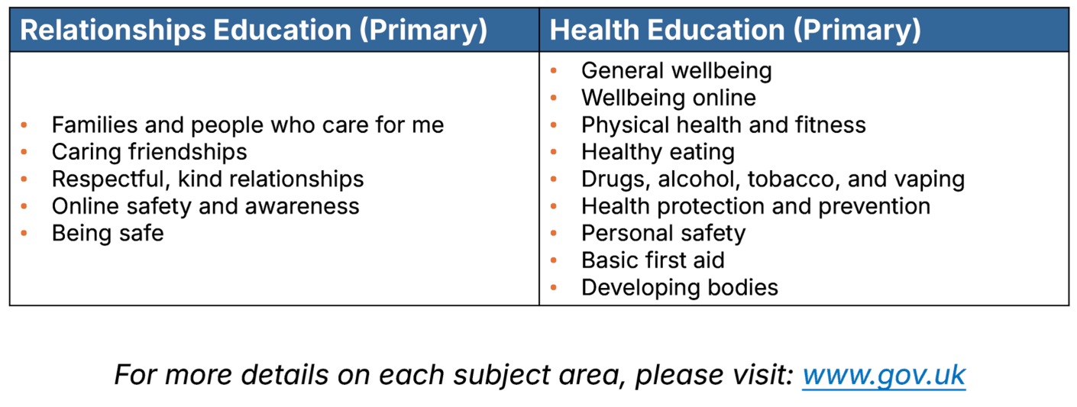

Slide 42
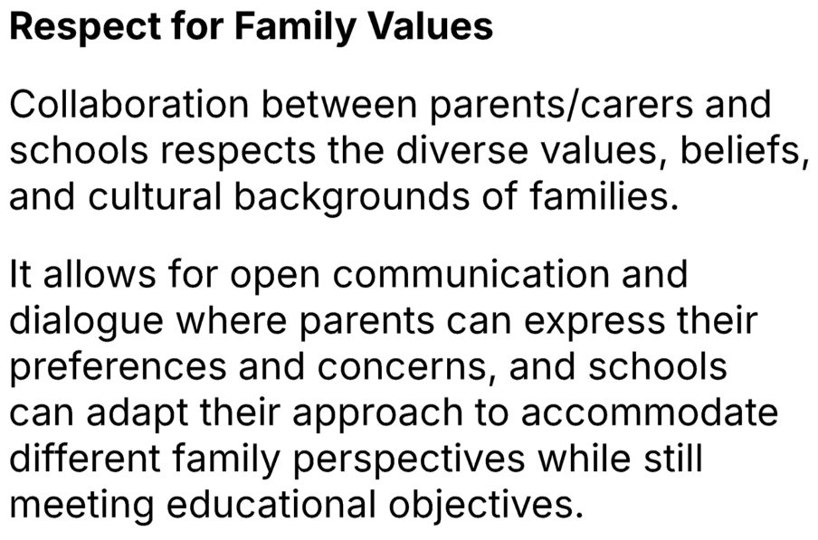
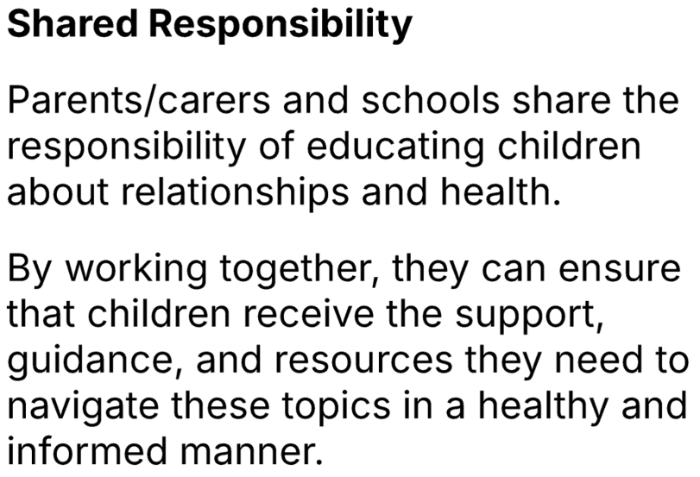
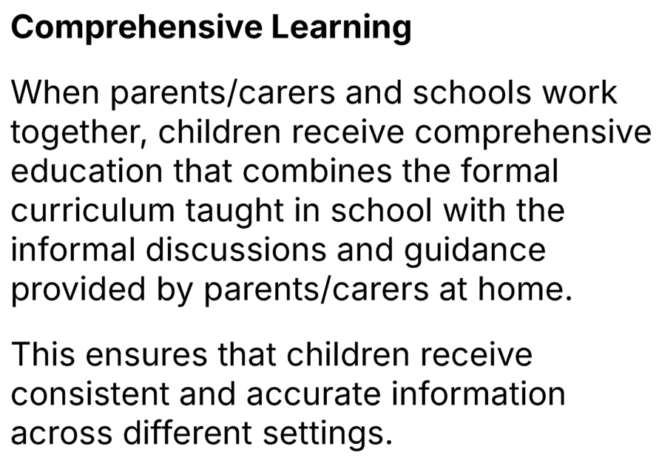
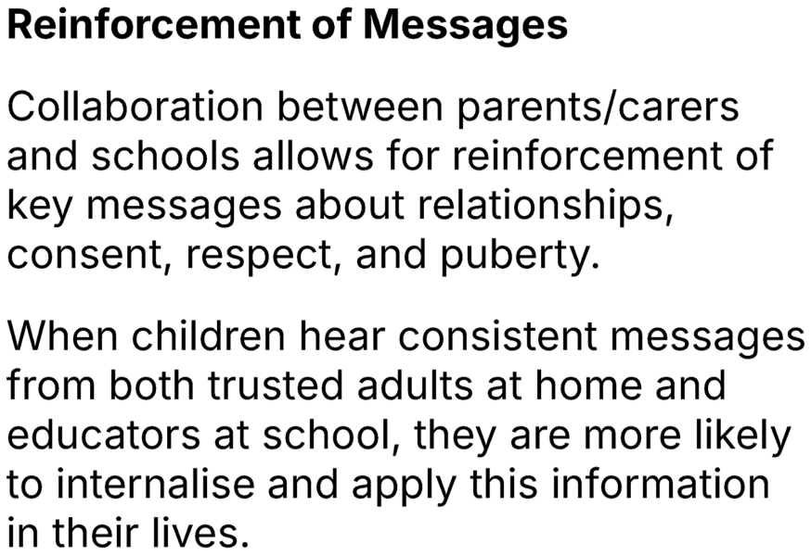

Slide 43
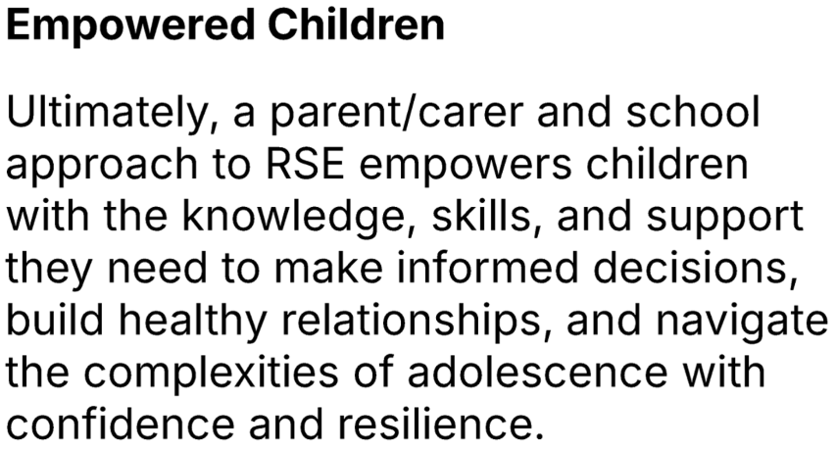
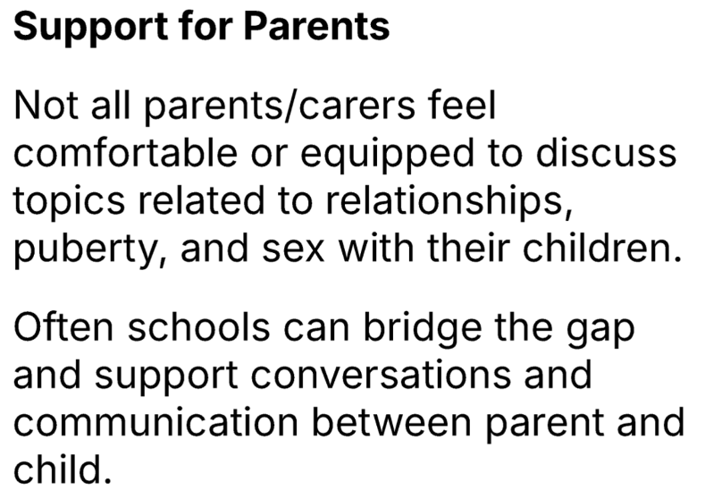
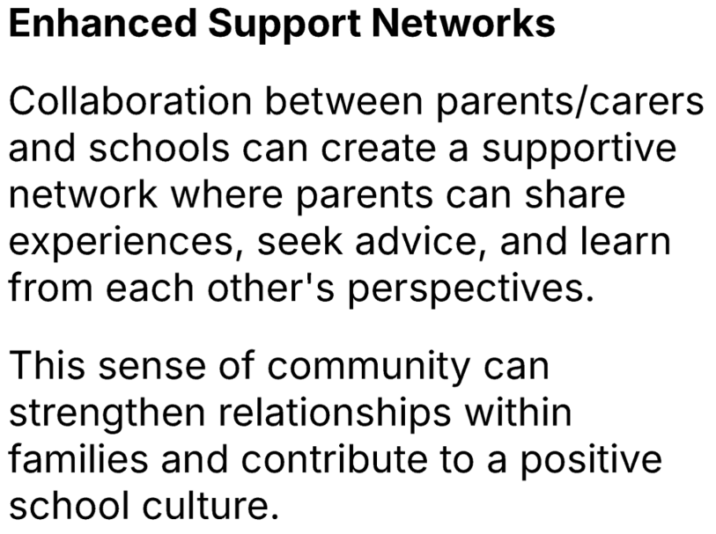
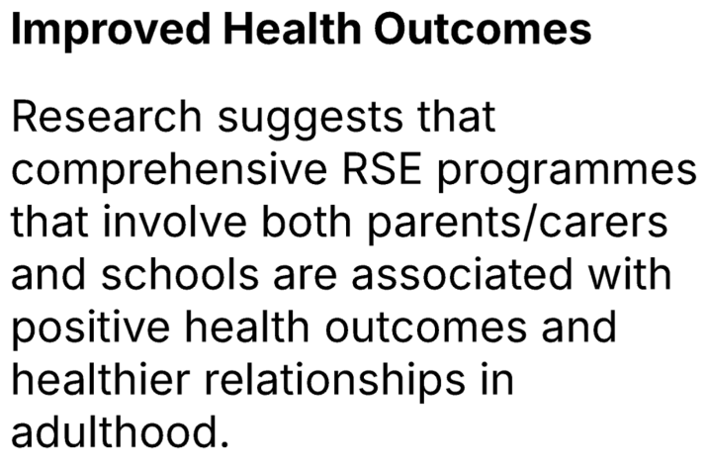

Slide 44
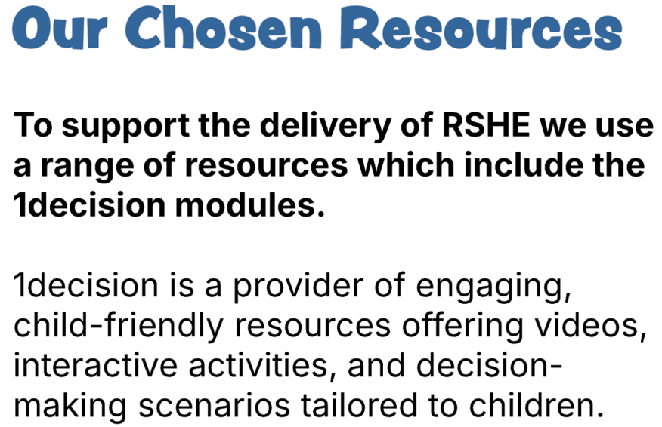
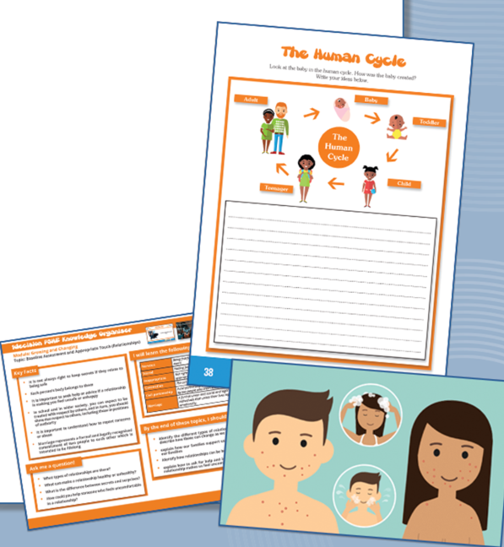
For this particular topic, we have also used resources from The PSHE Association and Twinkl. These have been used in place of some of the 1Decision materials, as well as alongside it. We have made this decision to ensure the content is age appropriate and right for our children.

Slide 45

“Leaders have designed a programme that prepares pupils well for their life beyond school.” – Ofsted 2026

Slide 46
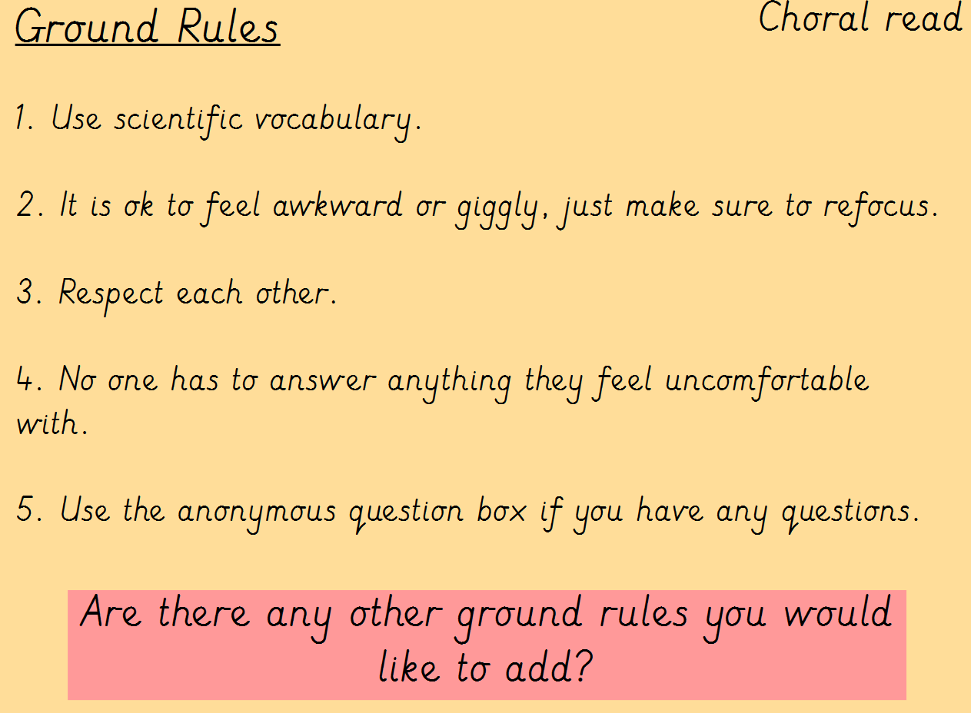
To help alleviate any fears around lesson content, we will be sharing our conception flipchart slides and activities.
All classes will begin with ground rules. The children can add to these if necessary.

Slide 47
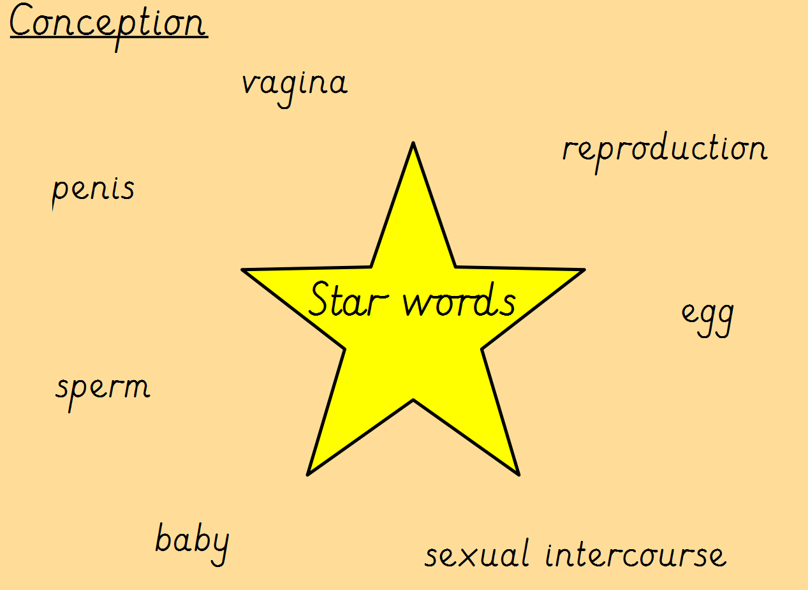
Vocabulary will be shared and read aloud at the beginning of the lesson to try and ease any embarrassment around them. Getting the ‘giggles’ out of the way, often helps the children to feel more comfortable.
The correct scientific terminologies are used for very important reasons – we will talk about this in more detail, later on in the presentation.

Slide 48
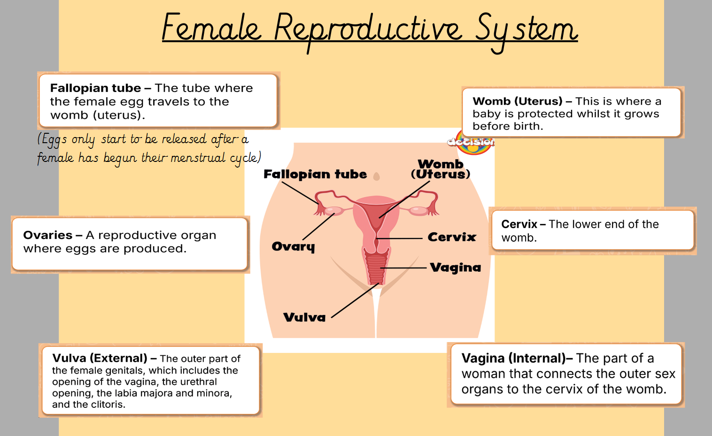
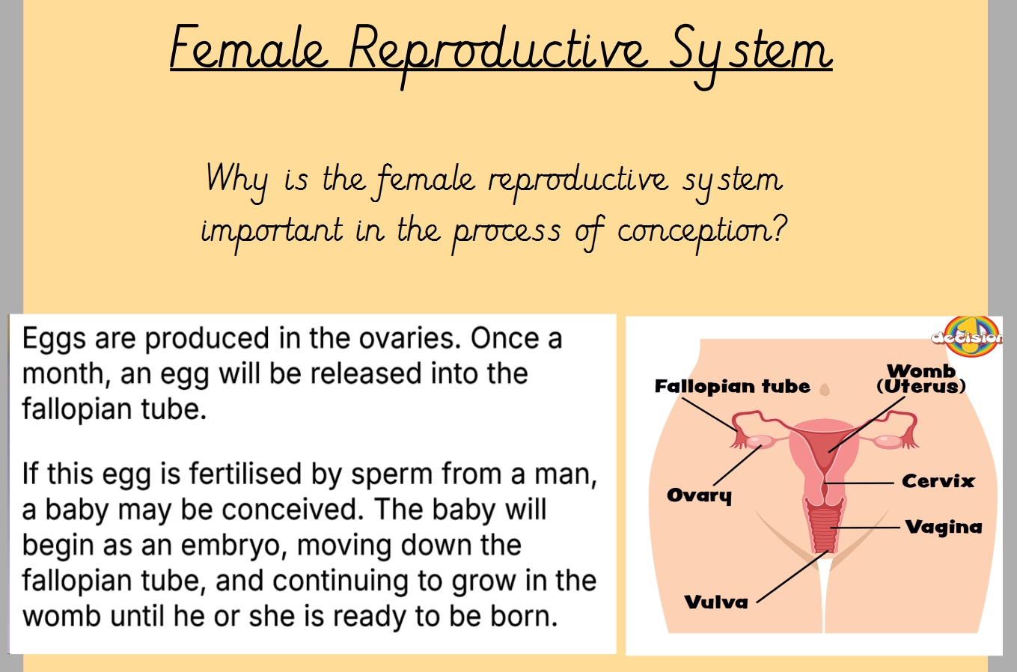
We will discuss the female reproductive system and think about why it is important in the process of conception.
Have a look at the diagrams, these are exactly what we will show the children. If you want to, you could talk to them about this before the lesson.

Slide 49
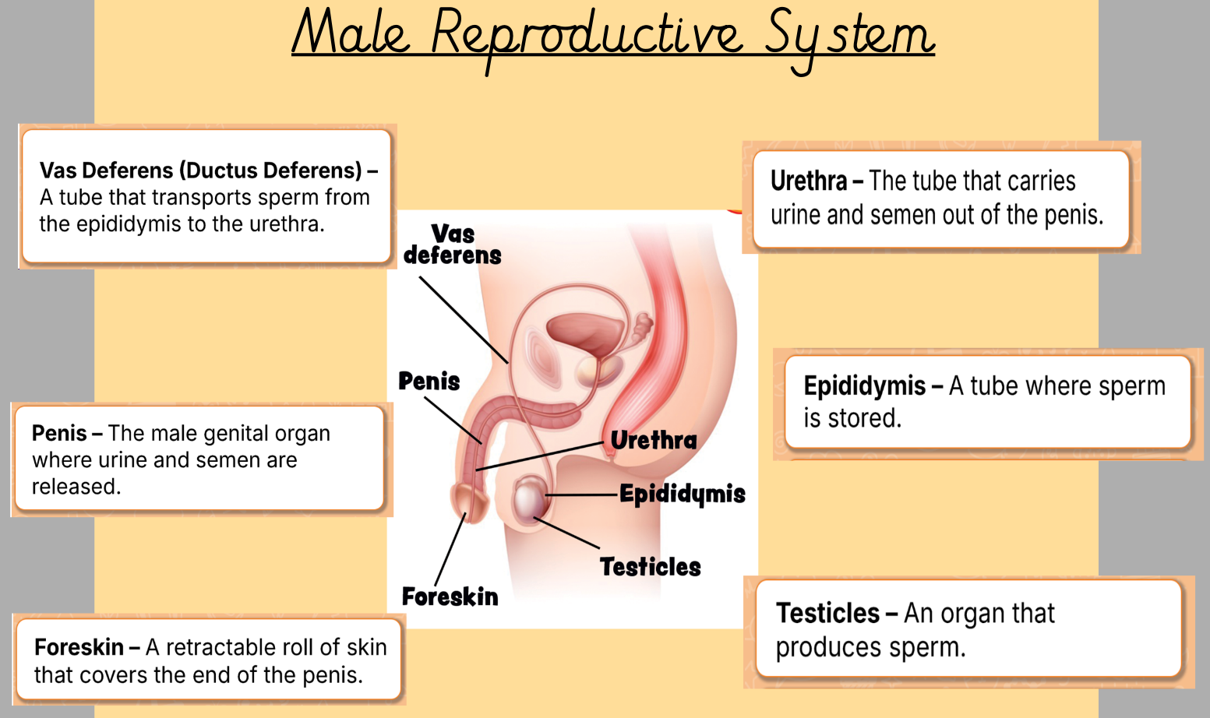
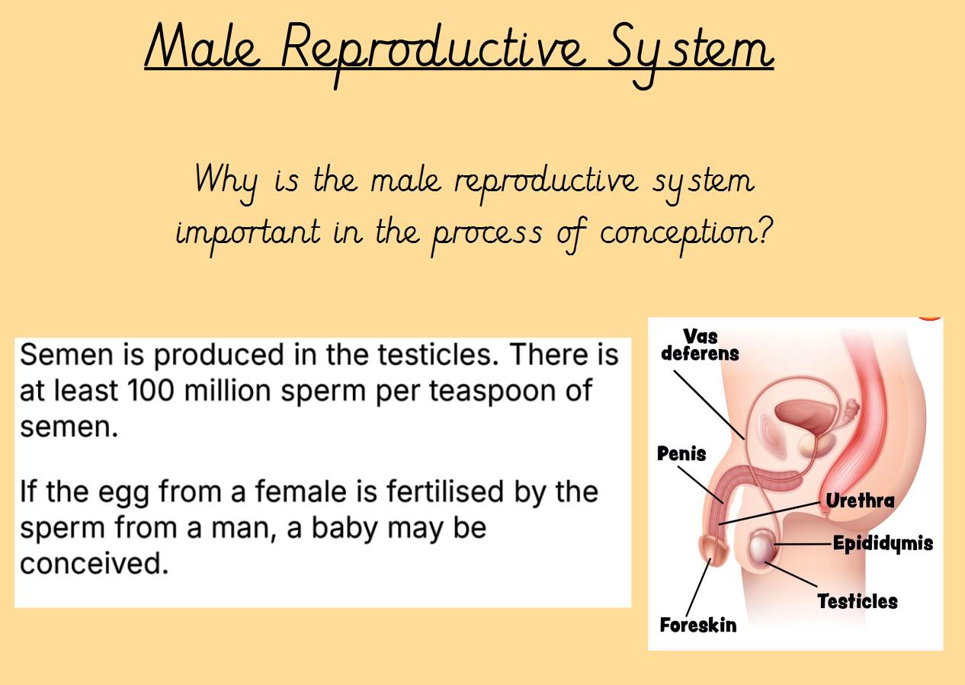
We will discuss the male reproductive system and think about why it is important in the process of conception.
Have a look at the diagrams, these are exactly what we will show the children. If you want to, you could talk to them about this before the lesson.

Slide 50
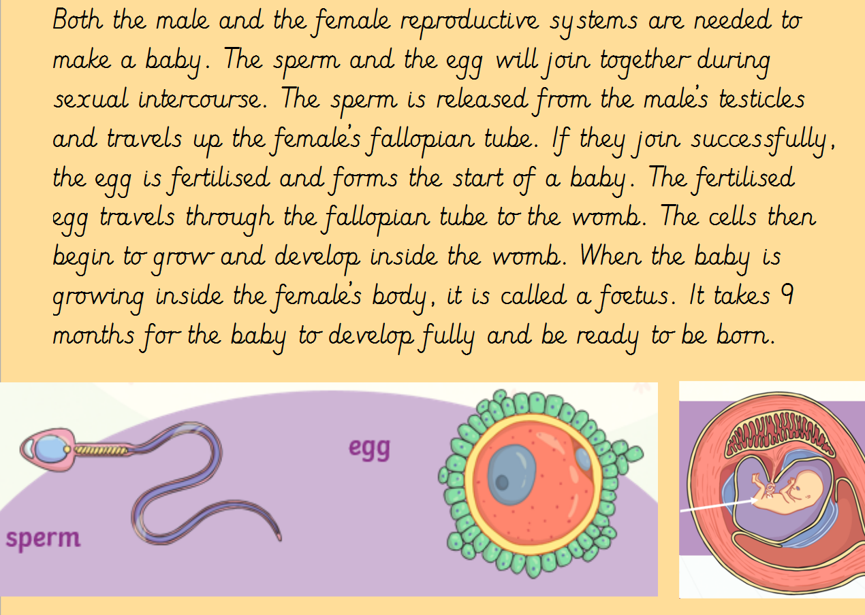
We will then give a basic overview of how the male and female sexual organs work together to conceive a baby.

Slide 51
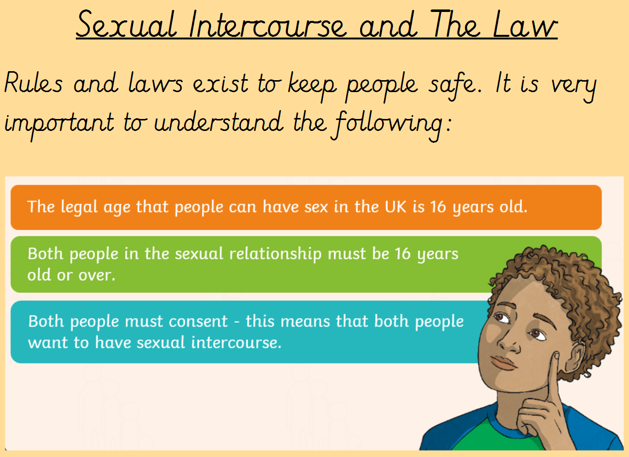

Slide 52
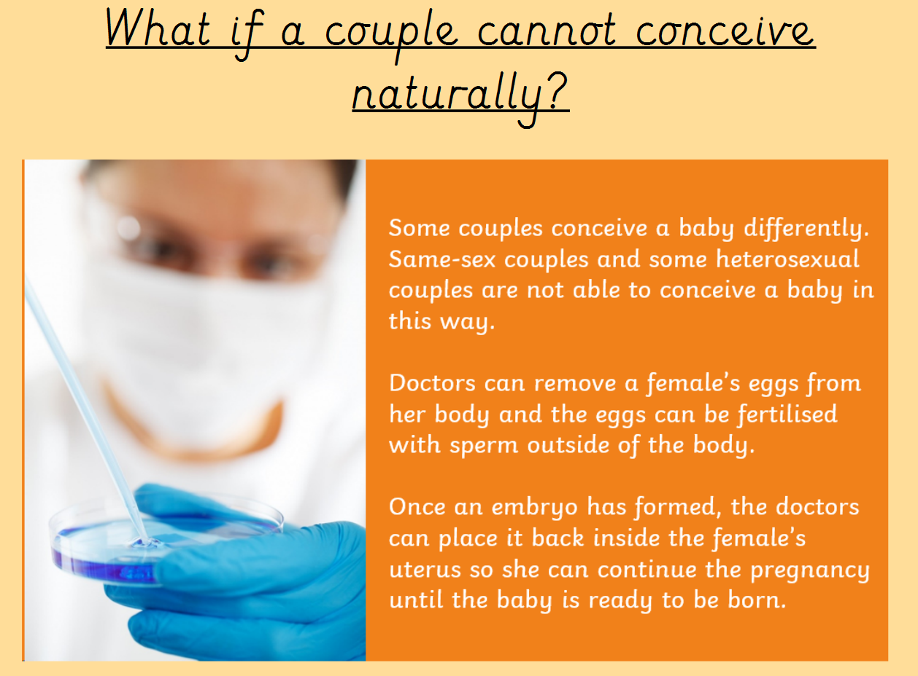
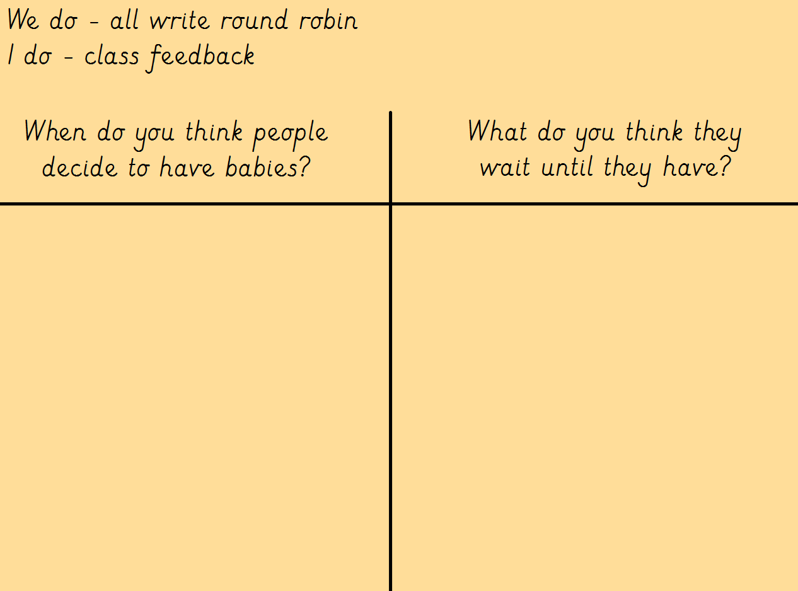
Finally, we will talk about: when people decide to have children and why they might wait; what happens if a couple cannot conceive naturally; what healthy relationships look like (what we’ve learnt throughout primary school).

Slide 53
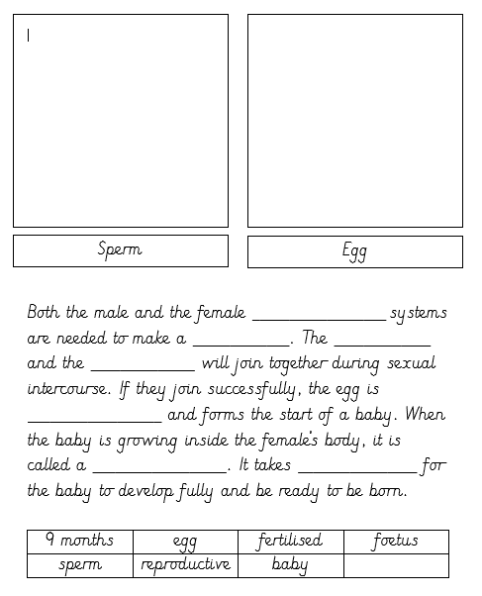
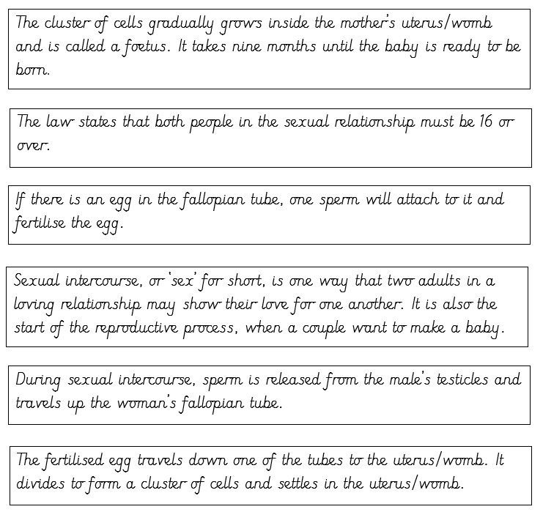
The children will complete the following activities based purely on the information we have shown you today.
Draw a diagram and fill in the missing words:
Put the cards in order:

Slide 54
Child Questions
A box will be set up for the end of the lesson for children to ask any questions they may have - we will not do a live Q&A session. This ensures we are not caught off guard and that we are answering everything with the correct level of appropriateness for our children. It also ensures everyone feels comfortable to ask any questions they have, as these can be done anonymously and then addressed as a whole class at a later date.

Slide 55

Please note that the delivery of the conception topic will happen at the end of the summer term. Therefore, there is plenty of time should you want to talk to your child about it before the lesson. You will be informed of a more accurate date closer to the time.
We hope that this information will have reassured you that we are teaching this topic in a sensitive, reassuring and age-appropriate manner. However, …

Slide 56
FAQ
It is completely natural to feel protective of your children and to wonder if they are ready for these conversations. The goal of the Year 6 curriculum is not to rush children into adulthood, but to prepare them safely and accurately for the changes they are already beginning to experience.
Preparation, Not Acceleration: Many children begin going through puberty before they leave primary school. Providing them with accurate, reassurance-based information before these changes happen prevents confusion, anxiety, and misinformation picked up from the playground or the internet.
By teaching this in a structured, safe classroom environment, we ensure that children learn about boundaries, consent (in an age-appropriate context, such as respecting personal space), and where to go for help if they feel unsafe. It empowers them to navigate the move to secondary school with confidence.

Slide 57

FAQ
understood.

Slide 58
Questions
We hope that you feel reassured that your children are going to be taught at an age appropriate level. However, if you do have any questions, please ask!
Take home the handouts and have a look through. If we can assist you further, feel free to reach out to us at the end of the day or via a phone call.
We really appreciate your support in this – it can be just as ‘embarrassing and awkward’ for us, as it is for the children!!

Slide 59
Thank you for your continued support!

