Slide 1
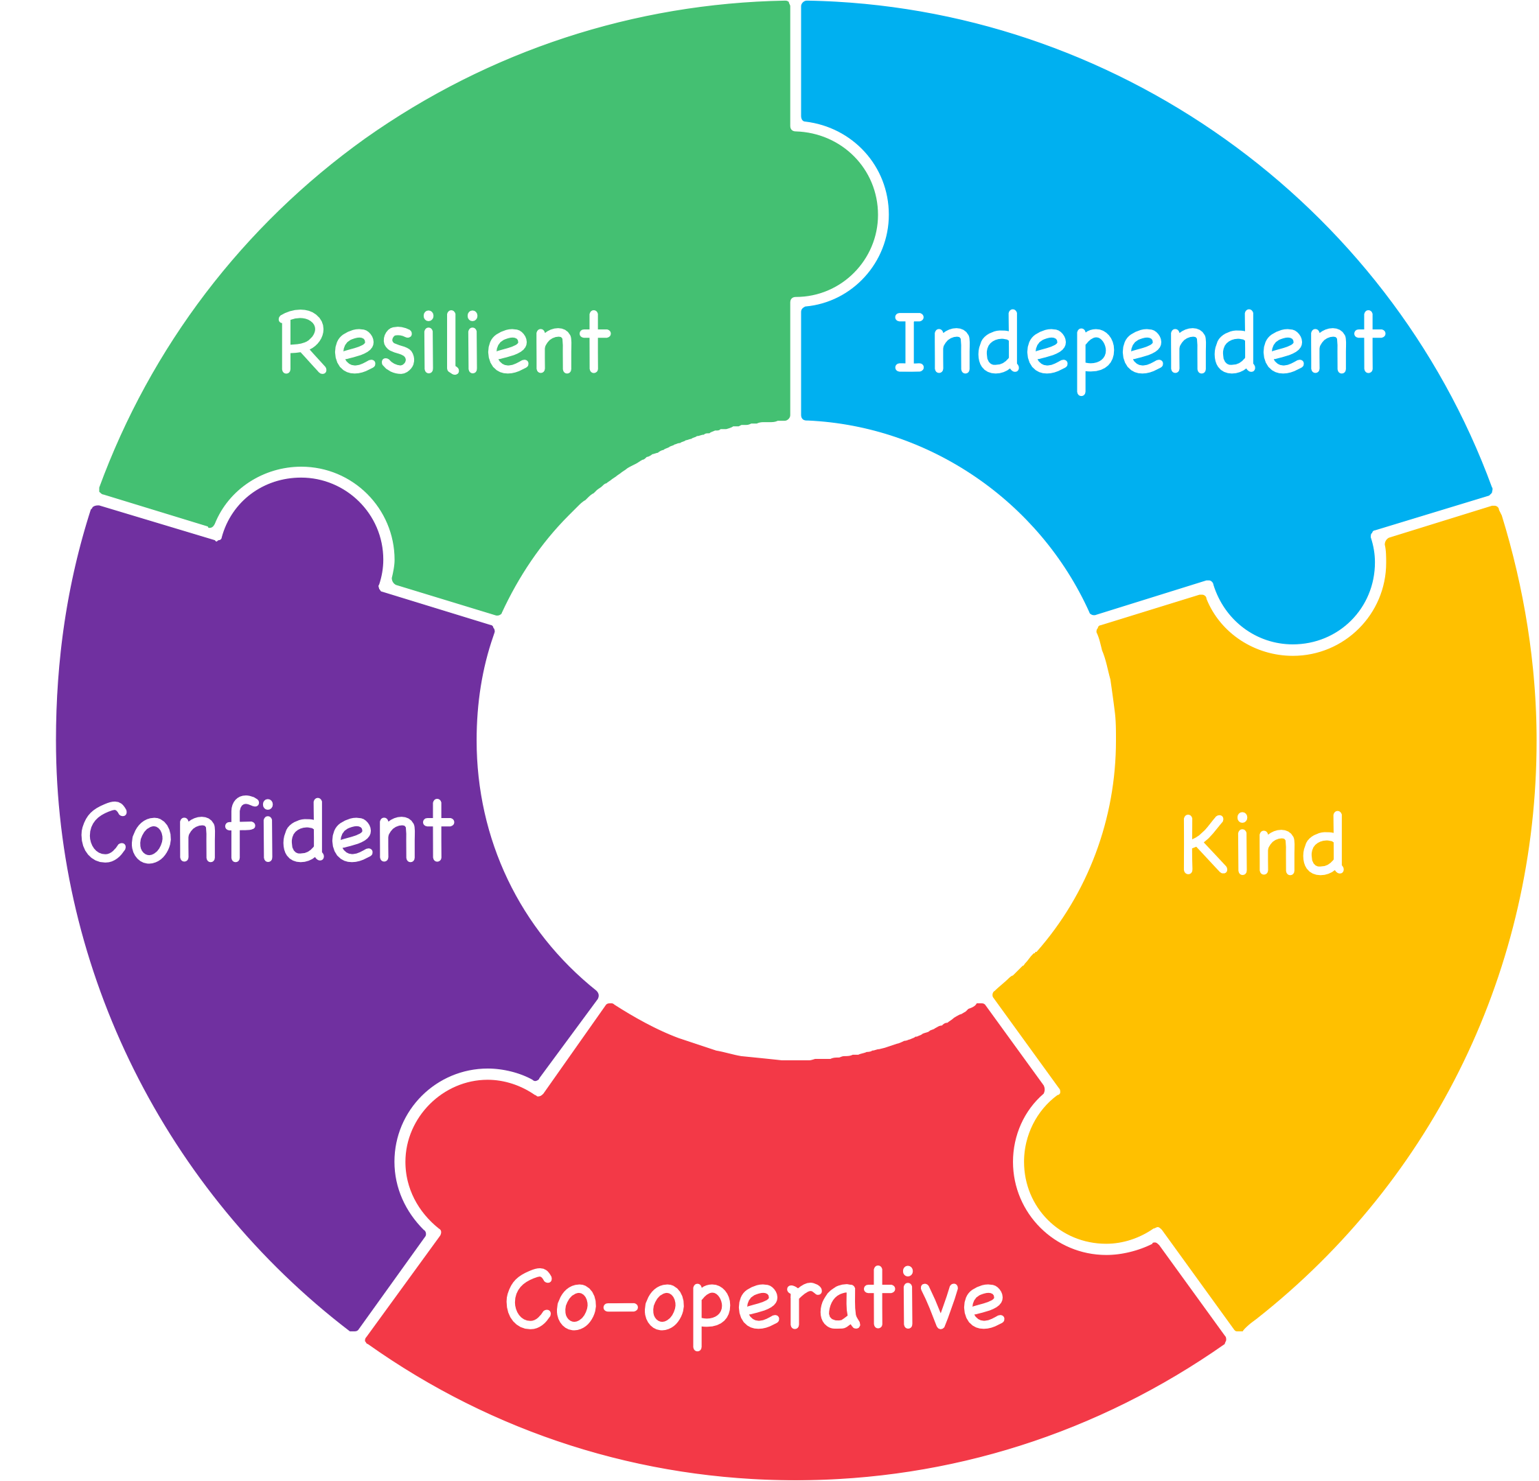
Y6 SATs Meeting – September 2024
"Have the courage to succeed"​

Slide 2
SATs tests
Your child will take SATs tests in reading, SPAG (spelling, punctuation and grammar) and mathematics.
These tests will be completed in the week starting Monday 12th May - it is crucial that your child is in school every day that week.

Slide 3
Monday 12th May: Spelling, punctuation and grammar (SPAG).
Tuesday 13th May: Reading test.
Wednesday 14th May: Maths arithmetic paper 1 and reasoning paper 2.
Thursday 15th May: Maths reasoning paper 3

Slide 4
Test logistics
Children will complete the SATs in their normal classroom environment where possible. Some children will be sat in other areas around school, or at different times in the day dependent on individual needs.
We will complete practice SATs in late April/early May so all children know where they will complete the actual assessments, and which adults will be there to support them.
The SATs are based upon the KS2 programme of study.

Slide 5
Test logistics
Children with an EHCP automatically qualify for 25% extra time
Testing for additional time will take place in April and parents/carers will be notified if their child qualifies
There are other access arrangements that may be beneficial for individual children rest breaks, translators, and readers, which do not need to be tested/applied for through the DfE.

Slide 6
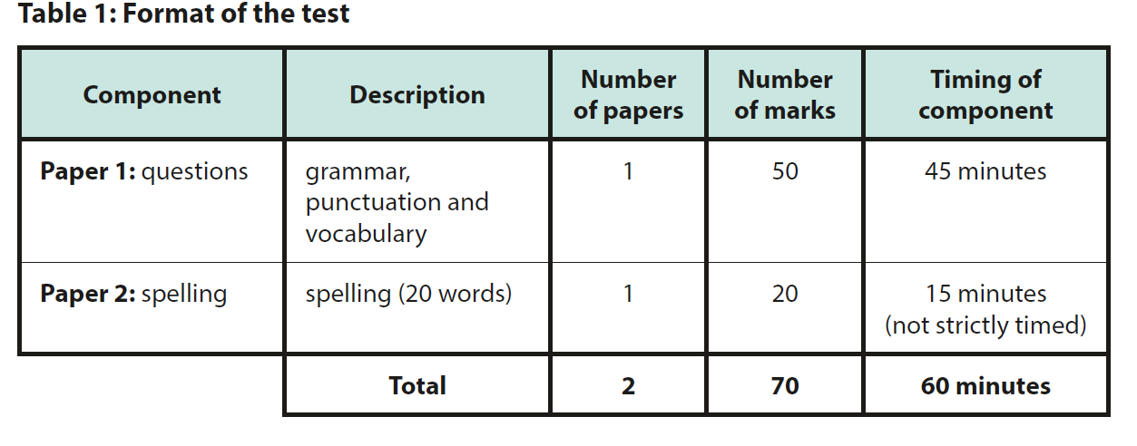
SPAG test content…
Children are expected to complete approximately 50 questions in 45 minutes.
The test is based on the relevant sections of the national curriculum statutory for English at Key Stage 2.
To meet the expected standard in 2023, pupils needed to score 36+ in total, and 55+ to achieve ‘greater depth.’

Slide 7
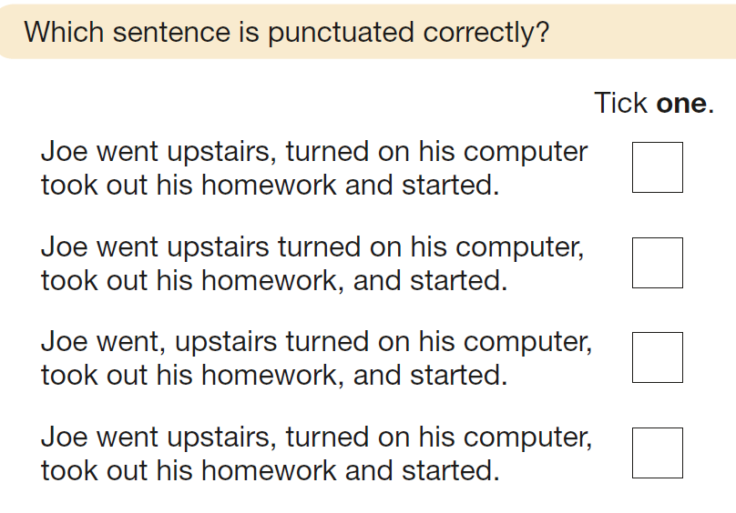
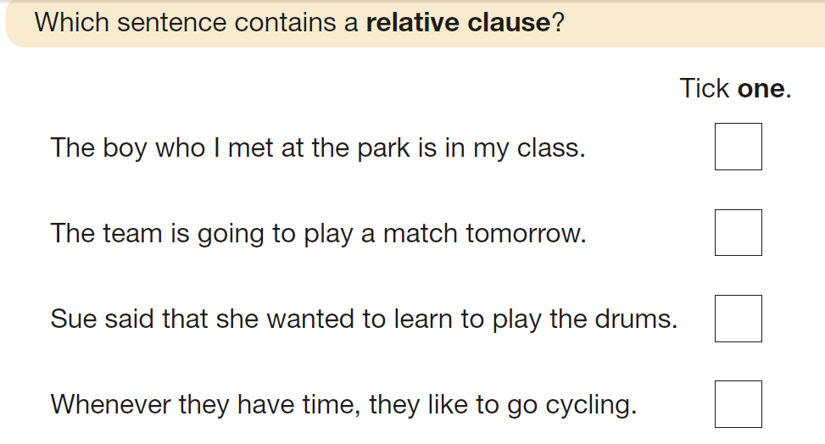
Year 3/4
Year 5

Slide 8
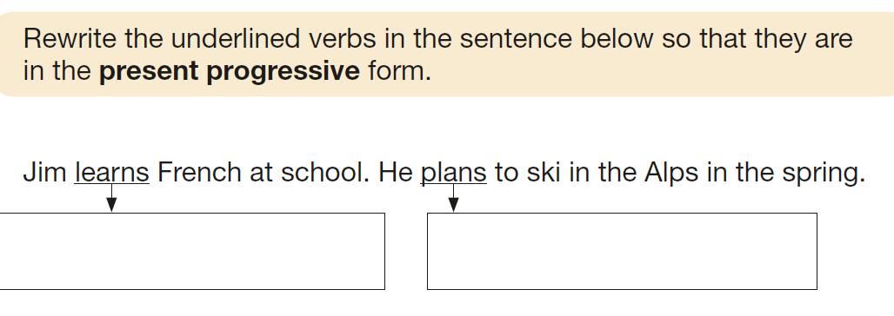
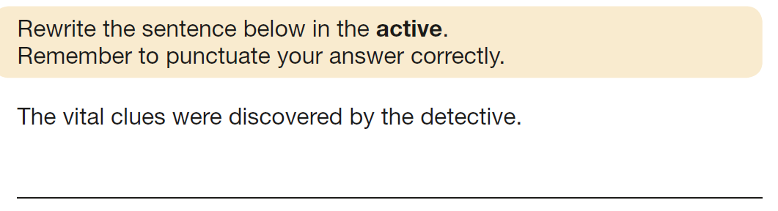
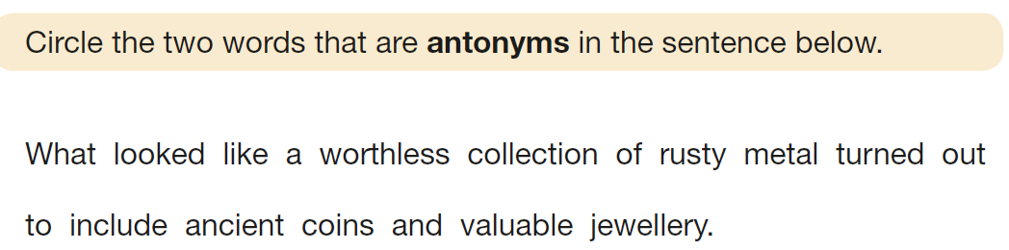
Year 3/4
Year 6
Year 3/4/5

Slide 9
Words that have previously been included in the test:
Straight
Pyramid
Deceive
Sympathetic
Originally
Descendant
Coarse
Inconceivable

Slide 10
How you can help your child with SPAG…
Make sure they complete their weekly homework, which usually has a spelling/grammar focus.
Encourage them to complete additional activities on Purple Mash or SATs Boot Camp (logins will be provided when it is up-and-running)
Take home a copy of the SATs Grammar Terminology document.
Practise words from the Y5/6 statutory spellings list - a copy is available to take home at parents’ evening
At least 2-3 of these will be assessed in the test, plus children have to show evidence of spelling them correctly in their writing (or in class tests) to meet the expected standard.

Slide 11
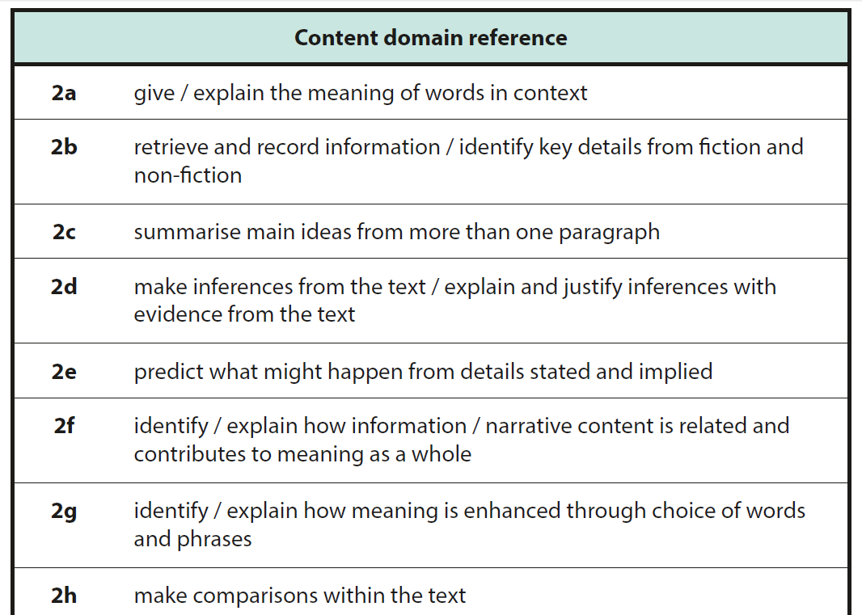
Reading test
Pupils have 1 hour to read the text (usually about 10 pages covering different topics) and about 40 questions.
The test is out of 50 marks, and gradually gets harder, with a range of 1,2 and 3 mark questions.
The children are assessed against eight content domains.
To meet the expected standard in 2023, pupils needed to score 24+ marks.
To achieve ‘greater depth,’ pupils needed 38+ marks.

Slide 12
How you can help prepare your child for the reading test…
Please make sure they read at home every evening - this will make a huge difference!
Encourage them to read a range of fiction and non-fiction texts so they are exposed to different vocabulary and text layouts.
Ask questions about their reading to develop comprehension skills linked to specific content domains (see example questions).
Encourage your child to complete the activities on SATs Boot Camp and use the CGP books to support revision and homework.

Slide 13
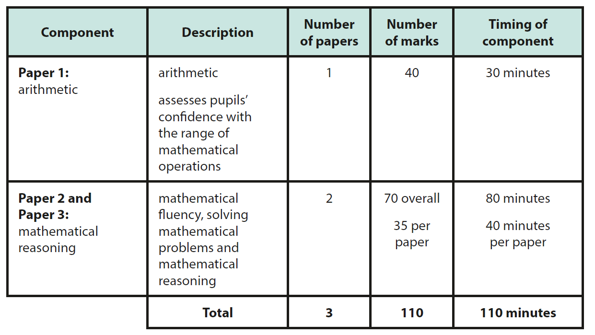
Maths test
Your child will complete 3 maths papers which assess their fluency, arithmetic and reasoning skills.
To meet the expected standard in 2023, children needed to score 56+ marks in total, and 94+ to achieve ‘greater depth.’

Slide 14








Arithmetic questions
1 mark per question
Previous cohorts’ results have shown us that pupils must succeed on the arithmetic test if they are to meet the expected standard (30+ marks out of 40).

Slide 15
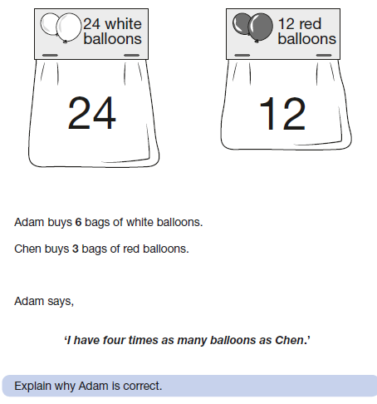
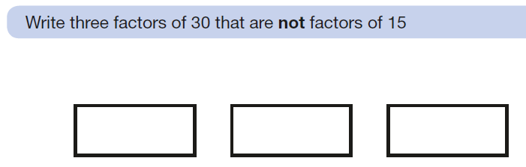
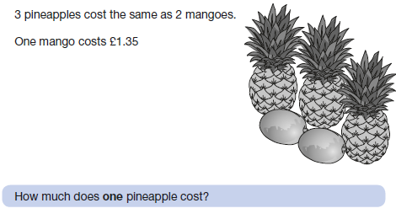
Reasoning questions
1, 2 or 3 marks per question

Slide 16
How you can help your child prepare for the maths test…
Check they have completed their weekly homework.
Ask questions to help develop their speed of recall of times tables.
Encourage your child to complete the tasks on SATs Boot Camp and the homework set using the CGP books.

Slide 17
Note on writing
Writing is teacher assessed, rather than done externally
.
Your child will achieve a judgement of greater depth, expected standard, working towards the expected standard or pre-key stage standard.
Teachers will make the final judgement by the end of June, based upon the work that your child has independently produced in class.
Writing assessments are moderated by the Local Authority to ensure fair and accurate judgements across schools.
Please feel free to take home the examples so you have an understanding of what is required to achieve each standard.

Slide 18
What we’re doing to help your child...
In maths, extra TA or HLTA support is available across year 6
Teachers will be leading additional maths booster sessions each week, supporting with arithmetic
We will purchase textbooks to help your child revise key learning in reading and maths.
In the SATs week, children will be able to come into school slightly earlier than normal for a SATs breakfast and to feel confident and stress-free before their exams.

Slide 19
Useful resources
Maths:
My Mini Maths
https://myminimaths.co.uk/arithmetic-16-practice-question-1/
Genius SATs KS2 Maths
updated-MAIN-FILE-2020.pdf (barhamprimary.co.uk)
Corbett Maths
https://corbettmathsprimary.com/
For all subjects:
SATs Boot Camp
SATs Boot Camp - Year 6 SATs Revision, Practice Papers & SATs Questions Online (yearsix.co.uk)
BBC Bitesize
https://www.bbc.co.uk/bitesize/primary
Purple Mash
https://www.purplemash.com/login/
CGP books
https://www.cgpbooks.co.uk/primary-books/bestselling-sat-busters

Slide 20
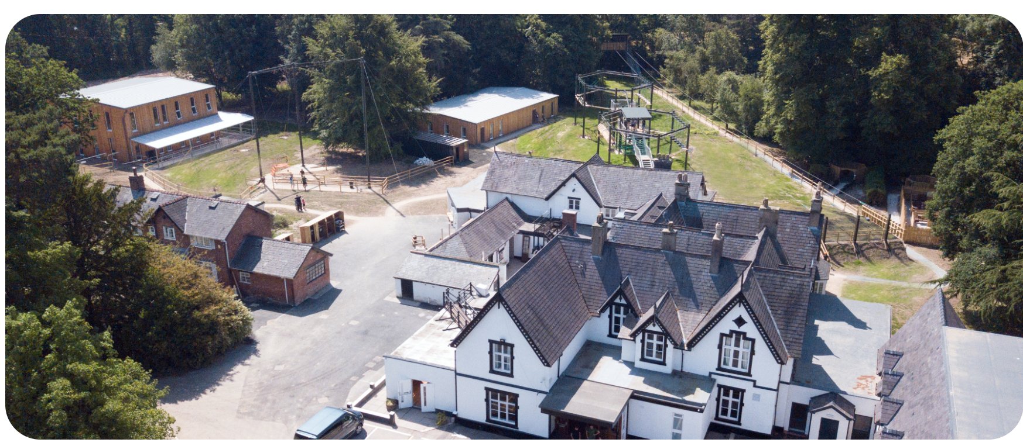

Robinwood 2025

Slide 21
Aims:
To develop your child’s independence, resilience, confidence and cooperation skills.
To ensure your child can be bold and challenge themselves.
To have fun!

Slide 22
Key information:
We will visit Robinwood’s new centre, Maes-y-Nant, in Wrexham from Wednesday 9th to Friday 11th July.
The school hall will be open from 8:30am for you to drop children and bags off.
We’ll aim to leave around 9.15am.
We’ll return to school about 3.00pm on 11th July, but will keep you updated about any potential delays.

Slide 23
Staff attending:
Ms Rogers
Mr Mann
Mrs Wager
Mrs Lampard
Miss Butler
Mrs Mc Cracken
Mrs Derbyshire

Slide 24
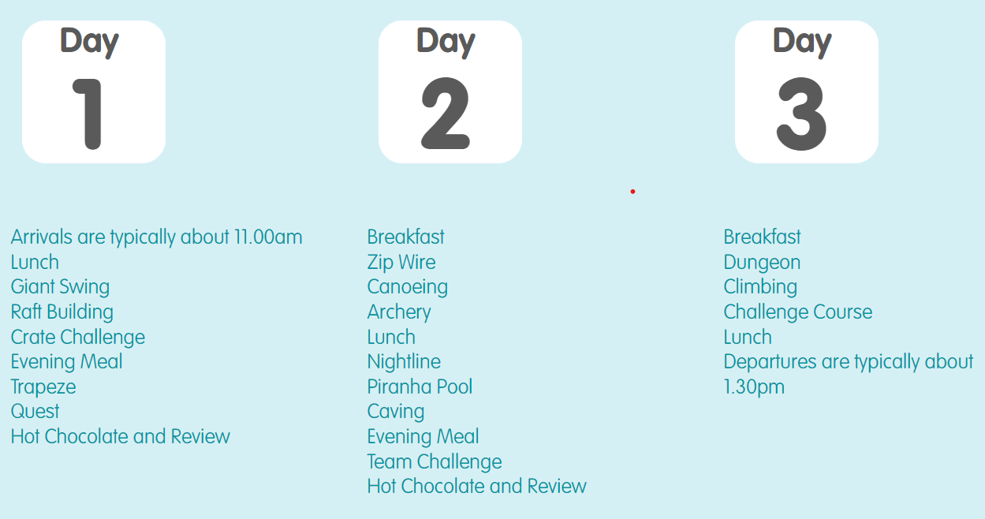
Activities: a potential timetable

Slide 25

Activities
Raft Building and Canoeing takes place on a purpose-built lake, shallow enough to be perfect for Key Stage 2
Maes-y-Nant features a brand new Giant Swing and a Zip Wire of around 80 metres in length.
Purpose-built brand new buildings house archery and the specially designed indoor caving system.
Children will be split into 5 groups of approx 12-13.
Each group will have members of staff from Broadstone allocated to them, along with the Robinwood staff.

Slide 26
Dorms:
Children will be allocated a single-sex dorm which will sleep between 4-12 pupils (only from our school).
Teachers’ rooms are also nearby.
Rooms are en-suite and doors are alarmed.
Robinwood staff and Broadstone staff are on call throughout the night.
Staff will ensure your child is with a close friend in the activity group or in the dorms.
Children will be told their activity groups and dorms when we arrive at Robinwood.

Slide 27
Do not bring:
Any electrical devices, including phones, tablets, kindles and cameras.
Valuables, including smart watches or jewellery
Aerosols - they can set the fire alarm off
Chewing gum
Food (including sweets)
Any nice clothes - they won’t return ‘nice’

Slide 28
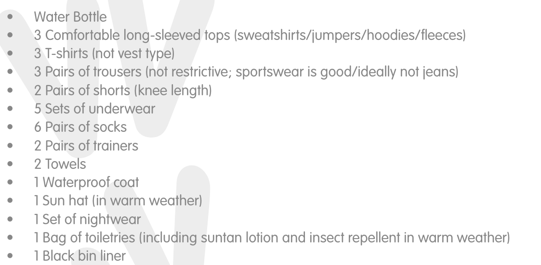
Kit List: label all clothing

Slide 29
Food:
Children choose each meal.
Vegetarian or Halal where necessary.
Menu varied but child friendly.
Hungry so tend to eat.
Allergies noted – please make sure any are included on the Robinwood medical forms as their staff will use these.

Slide 30
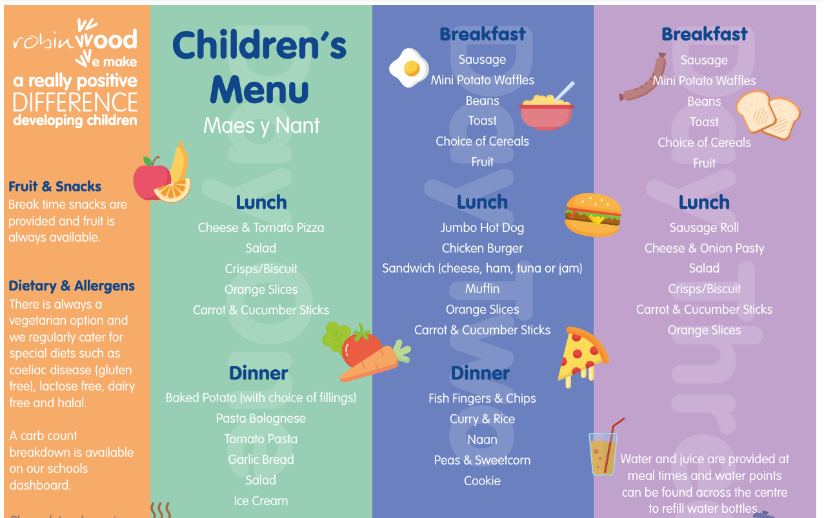

Slide 31
Medical:
Organised by Mrs Derbyshire.
Labelled clearly with in original packaging name/dosage on packet.
Must be handed in on day of departure.
Travel sickness for return journey.
Souvenirs:
Please return the order form to the school office.

Slide 32
Thank you for your continued support!

