Slide 1

Step back in time to World War One!
By Will Crofts
Read this PowerPoint to learn lots of WW1 facts!

Slide 2
The Great War begins!
The Great War (WW1) all began in 1914 because the Archduke of Austria-Hungry, Franz Ferdinand’s taxi driver, took a wrong turn. Gavrilo Prinup (of Serbia) shot Franz Ferdinand and Austria-Hungry declared war on Serbia. Soon Russia started to support Serbia then Germany declared war on Russia . It was not long before Germany attacked France but instead of marching straight to France Germany marched through Belgium. Because Belgium is a small country Britain and it’s huge empire helped Belgium fight the Germans. Thus beginning World War One!

Slide 3
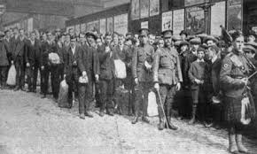
Recruitment in World War One!
The devastating first World War devoured the lives of more than ten million British men. Millions of men signed up for WW1 and millions were killed in it.
In 1914 men were eager to join the army but when word got back about the terrible conditions men were not so eager and the amount of men joining dropped drastically.

Slide 4
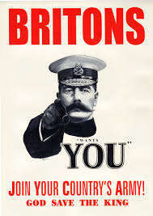
Posters and Propaganda!
There were hundreds of different posters that used propaganda to encourage men to join the army but the most famous poster was the Lord Kitchener poster. Some posters claimed the war to be fun and some said that their country needed them.

Slide 5
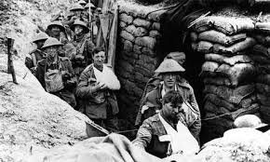
Terrible Trenches!
The Trench conditions were absolutely terrible. Some people say more soldiers died in the trenches than being shot but that’s not true. One of the reasons the trenches were so unhygienic is because the deceased were just left there to rot but there were many others too. In the trenches the soldiers had many jobs to do. It was boring!

Slide 6

The end was near!
The Great War ended, although some people say otherwise, in 1918. After four years of brutally killing Germans Britain and it’s empire emerged victorious.
A colossal amount of men died in the Great War, fortunately it ended.

