Slide 1
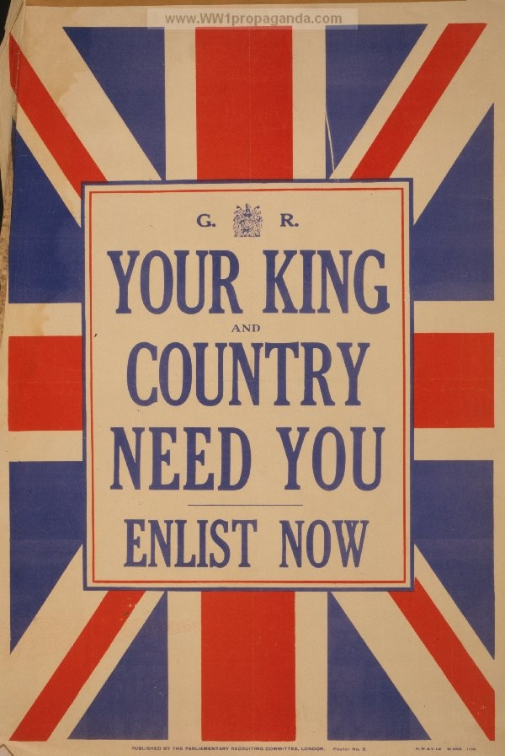
What happened IN WORLD WAR 1.
By Eleanor

Slide 2
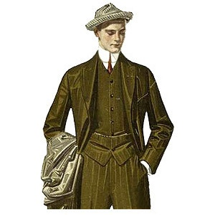
How DID IT START?
WW1 started when an Austrian man, called Franz was in a taxi, but the taxi driver took him down the wrong street. Unfortunately a group of Serbians were there. Serbians hated Franz. Unfortunately they killed him. A few months later, war was declared.
I declare war!

Slide 3
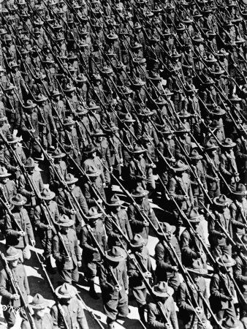
Where did they sign up?
Soldiers signed up at Whitehall Recruiting office, London. Posters were used to encourage men to sign up so we had more chance of winning. After 4 years of fighting, Britain were declared the winners. As they were waiting, the excitement rushed through the crowd.

Slide 4
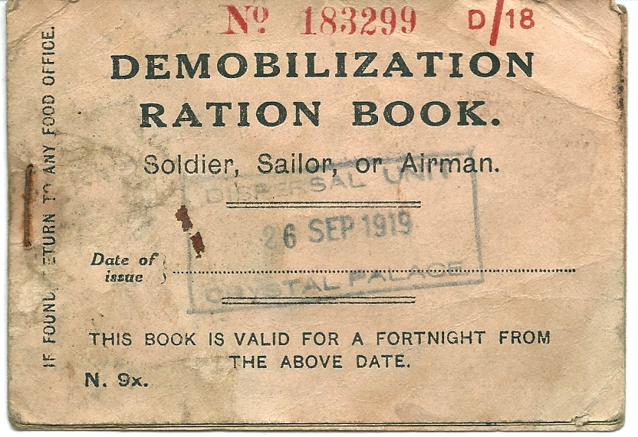
How did they get food?
At the beginning of the war, soldiers were given 200g of vegetables and 300g of meat each day. That amount of food dropped dramatically at Christmas 1916 and bread was made out of dried turnips because flour was hard to get.

Slide 5
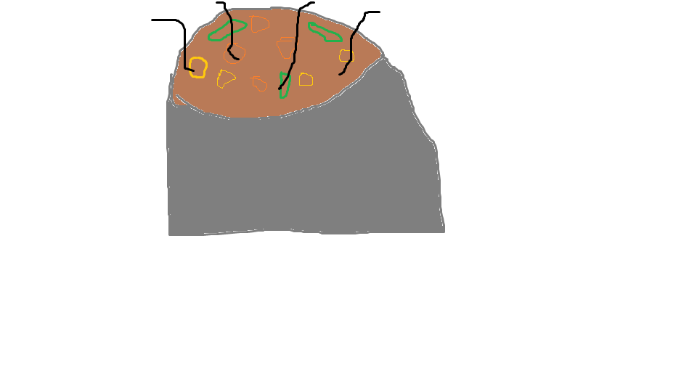
Rationing was introduced and women were only allowed to give the cooks food grown in Britain. Soldiers were also given cheese, tinned meat and army biscuits. Brown stew was also served but usually got cold. The soldiers hated the cooks.
My picture of brown stew.

Slide 6
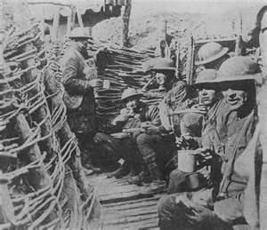
WHERE DID THEY HIDE?
Trenches were dug for soldiers to hide in and get a good shot of the enemies. Trenches were very un-hygienic as there were lice, rats and dead bodies in there. They were narrow, as it made them harder to find, but it didn’t stop rats from getting in.

Slide 7
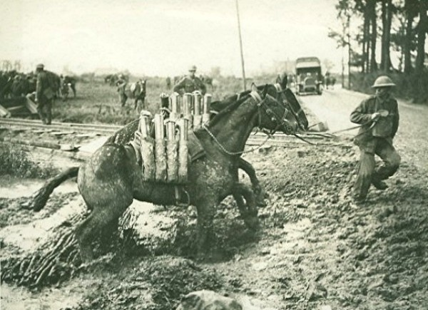
HORSES
Horses were used to pull carriages like ambulances and wagons. They played a very important role in the war.

Slide 8
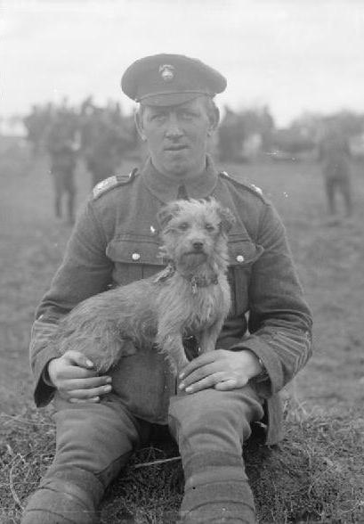
DOGS
Dogs were also used to pull the wounded on little sleighs. Sadly around 1 million dogs died during the ferocious war.

Slide 9
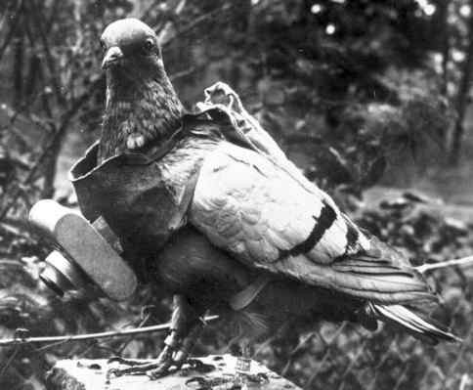
PIGEONS
Pigeons were used to carry secret messages to the soldiers. The most heroic pigeon was defiantly Cher Ami who still managed to deliver a message while being shot badly!

Slide 10
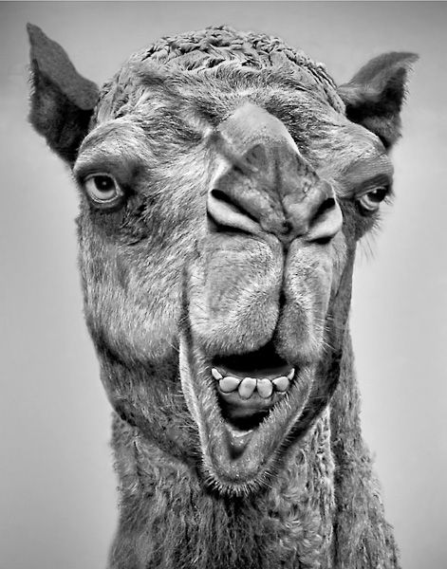
CAMELS
Camels were used to send equipment and food supplies to the soldiers.

Slide 11
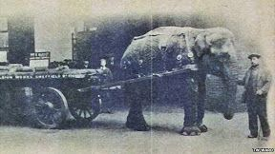
ELEPHANTS
Elephants were used to make the harvesting a lot quicker and easier.

Slide 12
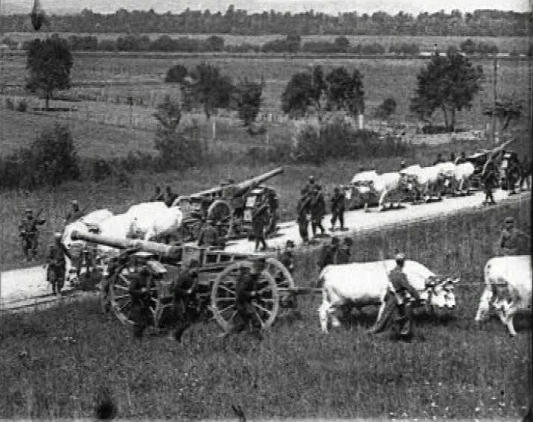
OXEN
Oxen were used to carry heavy equipment that the Elephants couldn’t carry.

Slide 13
The End

