Slide 1


Slide 2
Introduction
The war lasted for 4 long years, 1914 - 1918. Lots of countries were on Britain’s side for example France, Belgium and USA.

Slide 3
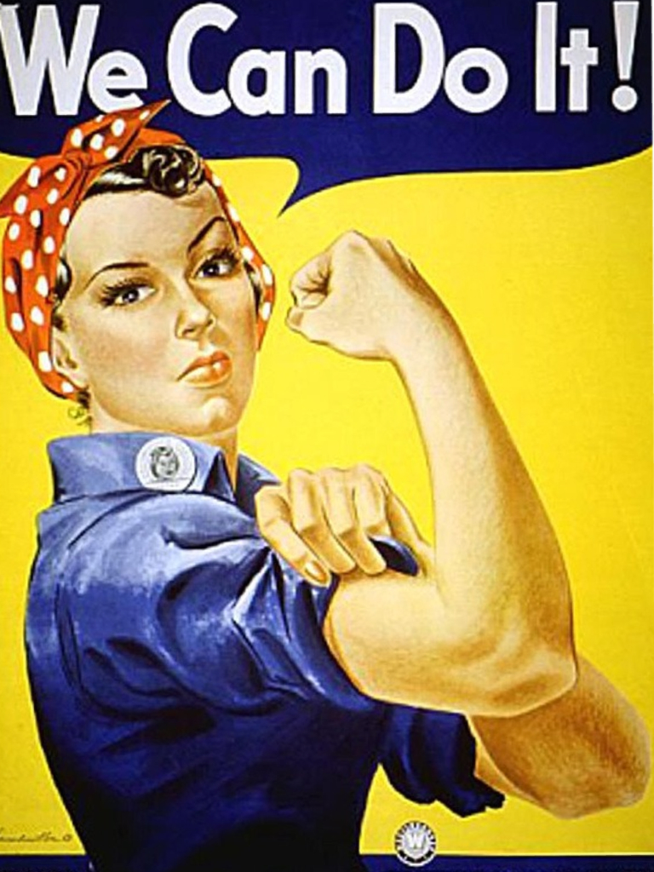
Women in the war
Women in the war worked as nurses in case any of the British soldiers got injured. They would also do other men’s work.

Slide 4
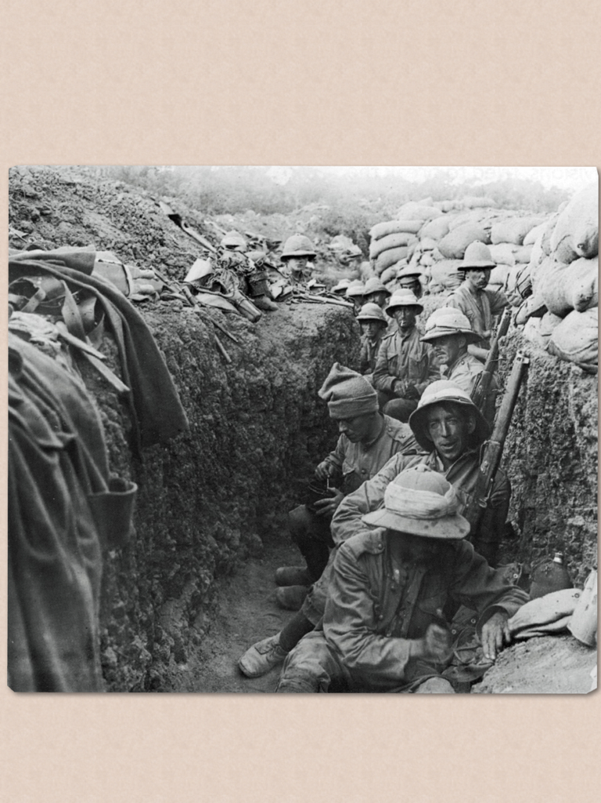
Trenches
Trenches were quite deep and kept the men a bit safer than normal.

Slide 5
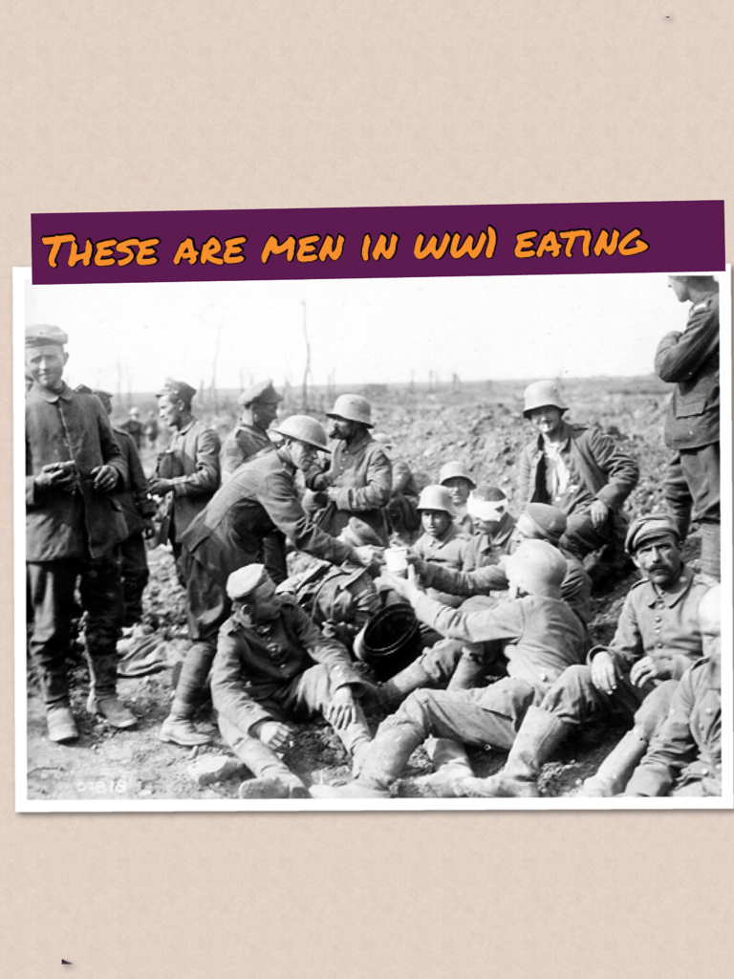

Slide 6
Food
The soldiers were fed 300g of meat and 200g of vegetables but this didn’t last.
They were lucky when their delicious brown stew didn’t have mud in it!

Slide 7
