Slide 1
Facts in World War One
By Charlie-Rose Murrell
Age 7
Mrs Williams Class

Slide 2
Facts
In World War One
The War
Women at War
Women in War Pictures
Trenches
Pictures of Trenches

Slide 3
The War
World War 1 was a war lasting from 1914 to 1918 which involved nearly all the biggest powerful countries of the world.
8 million soldiers died
21 million soldiers were wounded
Over 200,000 men died in the trenches of World War One.
Trenches were infested with millions of rats, frogs and lice

Slide 4
Women at War
Men were only allowed to fight in the war.
More than 50.000 women joined in supporting the war by working in the factories making ammunition. Before the war, women mainly stayed at home looking after their family’s.
Women also trained with the Red Cross and St. John’s Ambulance to become nurses to look after the men injured in war.
People in World War One travelled to different countries.

Slide 5

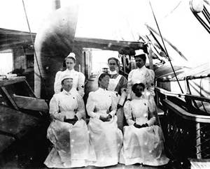
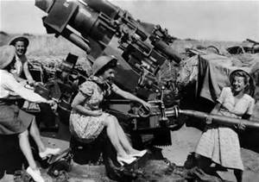
Women at War Pictures

Slide 6
The Trenches
It was boring in the trenches because the soldiers had to wait for long periods of time.
When people were killed in the trenches they left the bodies as there was no where safe to bury them in war time.
After 4 days the soldiers could go on a break.
When it rained the water would go up to their knees, because of this they often got trench foot.

Slide 7
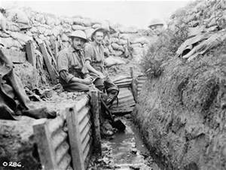
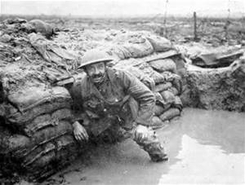
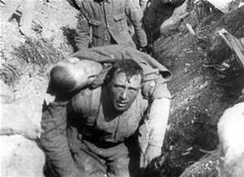
Pictures of Trenches

Slide 8
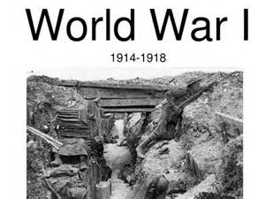
The End

