Slide 1
Keeping your child safe online.

Slide 2




Talk to your child
Find a good time and place
Think about how you are going to introduce the subject
Explain any worries you may have
Where do they go online?
What do they like?
What don’t they like?
Make sure they know they can come to you
Listen. Don’t judge. Learn…
Notes:
Talk to your child
The best way you can protect your child is to establish a positive relationship with them around their life online. Talk to them – not just once, but have ongoing conversations as part of your family life.
Find a good time and place. Pick an opportunity when you know you’re not going to be interrupted and you are both going to feel comfortable and have enough time – without turning it into one of those ‘special talks’ moments.
Think about how you are going to introduce the subject. You could mention a recent story that they might have heard about or just explain why you would like to talk to them about something.
Explain to them any worries you have. Your child might think that you are getting worried for no good reason, but if you explain why something is troubling you they will understand why you want to talk to them. Tell them if it is something you have read about or seen their friends doing.
Listen. Don’t judge. Learn. Find out more about what they encounter online; what they are doing, where they go, what they like and don’t like. Parental engagement in the positive aspect of being online and not just the risky things will help your child to talk more openly about their internet use, including anything that worries them.
The most difficult conversations can be made easier if your child understands that you care about them and whatever the outcome you will love them just as much. One of the biggest barriers to young people seeking help if something goes wrong online is the fear of being blamed, getting into trouble, and suffering repercussions (such as tech being taken away). Make sure your child knows that they can come to you for help if they are ever worried and that they won’t get into trouble. Young people who are banned from going online, or who feel that what they are doing is wrong, are less likely to ask for help and that makes them less safe.
This is not on the slide but an important point to raise. Parental controls - Controls are an important first step to helping to protect your child online, but they are not a single solution to staying safe; talking to your children and encouraging responsible behaviour is critical. For detailed guidance on all the different types of control, you can use this online tool from Internet Matters. This gives you the chance to set up a personalised list of the controls used in your home on all your different devices. There is also advice on how to use all the various controls, with videos and step-by-step instructions.

Slide 3
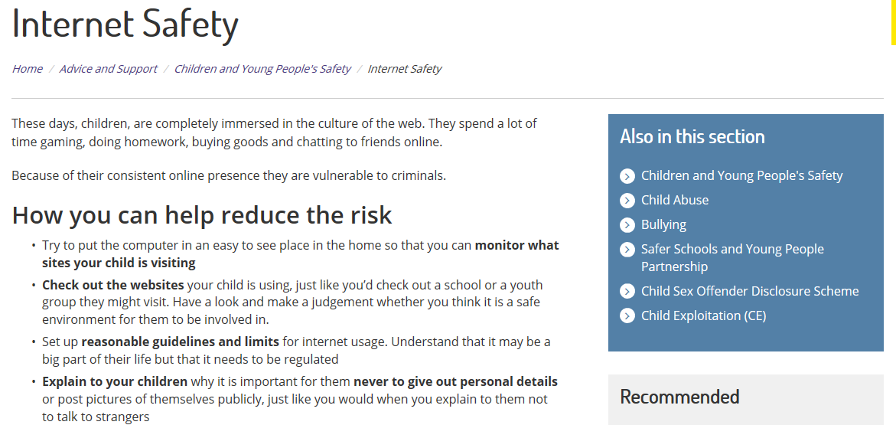
Cheshire Police Support Pages https://www.cheshire.police.uk/advice-and-support/children-and-young-peoples-safety/ https://www.cheshire.police.uk/advice-and-support/internet-safety-and-security/our-5cs-guide-to-staying-safe-online/
https://www.cheshire.police.uk/
Notes:
These days, children, are completely immersed in the culture of the web. They spend a lot of time gaming, doing homework, buying goods and chatting to friends online.
Because of their consistent online presence they are vulnerable to criminals.
How you can help reduce the risk
•Try to put the computer in an easy to see place in the home so that you can monitor what sites your child is visiting
•Check out the websites your child is using, just like you’d check out a school or a youth group they might visit. Have a look and make a judgement whether you think it is a safe environment for them to be involved in.
•Set up reasonable guidelines and limits for internet usage. Understand that it may be a big part of their life but that it needs to be regulated
•Explain to your children why it is important for them never to give out personal details or post pictures of themselves publicly, just like you would when you explain to them not to talk to strangers
•Install internet filtering software showing a Child Safety Online Kitemark, on your computer. Filtering products with a Kitemark have been independently tested to provide a simple and effective means of support to parents, helping to ensure that a child’s online experience is a safe one. The Kitemark scheme is sponsored by the  Home Office and  Ofcom.
Follow Ashleigh's rules
Ashleigh Hall was a young girl who was murdered by a man who created a fake Facebook account and arranged to meet her. Her friends have launched a campaign highlighting the potential dangers of the internet. They have created a set of rules in the hope that they will keep young people safe in the future.
https://www.cheshire.police.uk/advice-and-support/children-and-young-peoples-safety/internet-safety/ashleigh-s-rules/
https://leics.police.uk/categories/kayleighs-love-story-film
https://www.cheshire.police.uk/advice-and-support/children-and-young-peoples-safety/
https://www.cheshire.police.uk/advice-and-support/internet-safety-and-security/our-5cs-guide-to-staying-safe-online/
https://www.cheshire.police.uk/

Slide 4
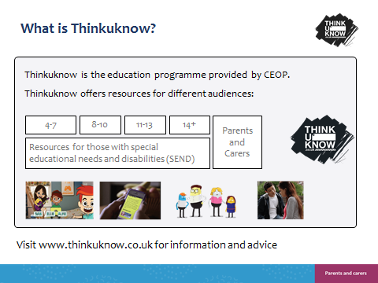

Slide 5
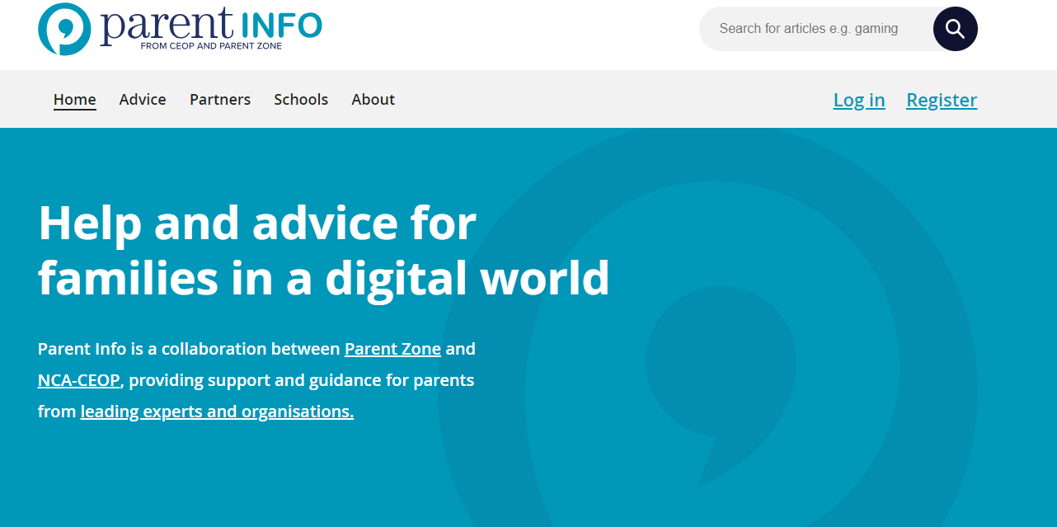
www.parentinfo.org
www.parentinfo.org
Notes:
Parent Info (www.parentinfo.org) is a partnership project between NCA-CEOP and the parent organisation Parent Zone. It’s a website and advice service for parents and carers, which aims to build the resilience of their children through articles, tips and advice. Articles are written by expert organisations on a range of different topics, covering all issues amplified by the internet. The website is divided into the following categories:
Games, apps and tech
Parenting
Safety and settings
Relationships and sex
Education and the future
Health and wellbeing

Slide 6



What can you do?
Talk to your child about their life online
Make sure your child knows they can always come to you for help and they won’t be blamed
Don’t threaten to ban technology
Practical steps you can take
Create a family agreement and regularly review
Primary aged children should only be live streaming and gaming in public rooms
Use parental controls
Report any concerns to local police, CEOP or the NSPCC
Notes:
What can you do? There are a lot of practical things you can do to support your child to stay safe online.
Talk to your child about their life online – When opening the conversation with your child start with positives, finding out as much as you can about what your child does online and what it means to them. Have ongoing conversations with your child about who they are talking to online. Questions about whether they know them in real life and what they share are vital to support your child to be safer online. Be non-judgemental and supportive in these conversations.
Make sure your child knows where to go for support - Help your child to identify adults that are there to help them. Children can sometimes feel they are to blame if something goes wrong online. Remind your child that they can always speak to an you or another adult they trust if they are worried, no matter what may have happened.
Don’t threaten to ban technology – It can help to suggest taking a break from an app for a period of time. This can help children learn from what happened, rather than banning them from the internet all together. Technology can provide sources of support to children and it is important not to ban them from this, which could lead to them taking greater risks by accessing tech somewhere else.
Practical steps
Create a family agreement - Before giving your child a device establish boundaries and rules. This is much easier to do before a device is given rather than after. Parents should research and review the apps/tech they are allowing their child to use, and set clear rules of use at the start and reiterate and review as the child uses it.
Use devices in public spaces - We understand that you can’t always be there with them, although if your child is primary school aged they should not access the internet unsupervised in private spaces, such as alone in a bedroom or bathroom. As young people develop, they often seek more privacy and autonomy in both their online and offline world but it’s important to consider whether your child is developmentally ready to be left unsupervised using devices. Young children do not have reasoning skills to keep themselves safe independently, if they are faced with experienced offenders who know how to manipulate and overpower children.
Parental controls – For detailed guidance on all the different types of parental controls, you can use an online tool from Internet Matters . This gives you the chance to set up a personalised list of the controls used in your home on all your different devices. There is also advice on how to use all the various controls, with videos and step-by-step instructions.
Report any concerns – if you have any concerns about online sexual abuse, report these immediately to local police, NCA-CEOP or the NSPCC.

Slide 7


Inappropriate images online.
https://www.lucyfaithfull.org.uk/stop-it-now-helpline-campaign.htm
https://www.iwf.org.uk/
Our vision
Our vision is to eliminate child sexual abuse imagery online.
Our remit is to remove:
Child sexual abuse content* hosted anywhere in the world.
Non-photographic child sexual abuse images hosted in the UK.
Notes:
Taking, making, sharing and possessing indecent images and pseudo-photographs of people under 18 is illegal.
This includes consensually shared images
https://www.gov.uk/government/publications/indecent-images-of-children-guidance-for-young-people/indecent-images-of-children-guidance-for-young-people

Slide 8


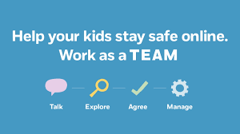



Staying up to date
https://www.internetmatters.org/
https://www.nspcc.org.uk/preventing-abuse/keeping-children-safe/share-aware/
/https://www.net-aware.org.uk
@CheshireSSYP
Notes:
https://www.internetmatters.org/advice/6-10/
https://www.nspcc.org.uk/preventing-abuse/keeping-children-safe/underwear-rule/
https://www.net-aware.org.uk

