Slide 1
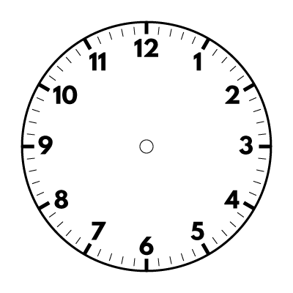
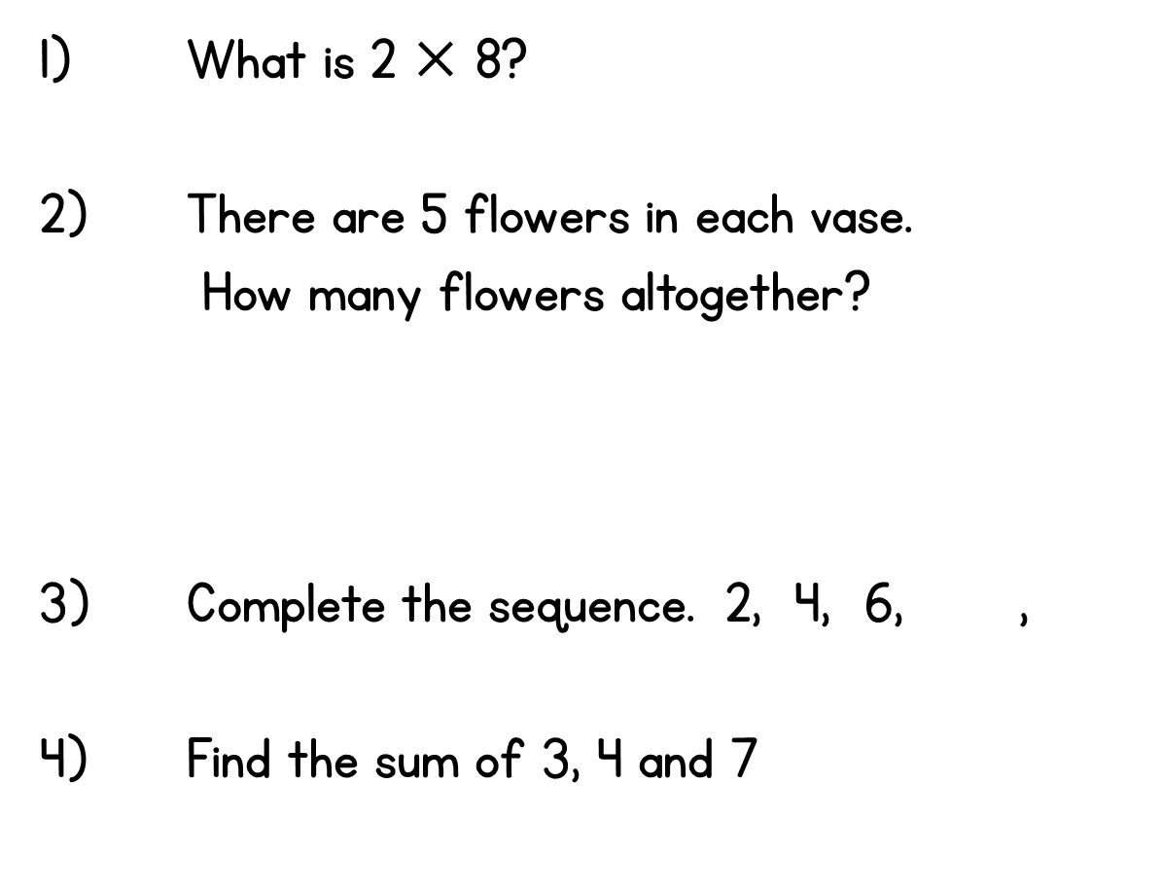

Year 2 | Week 1 | Day 1

Slide 2
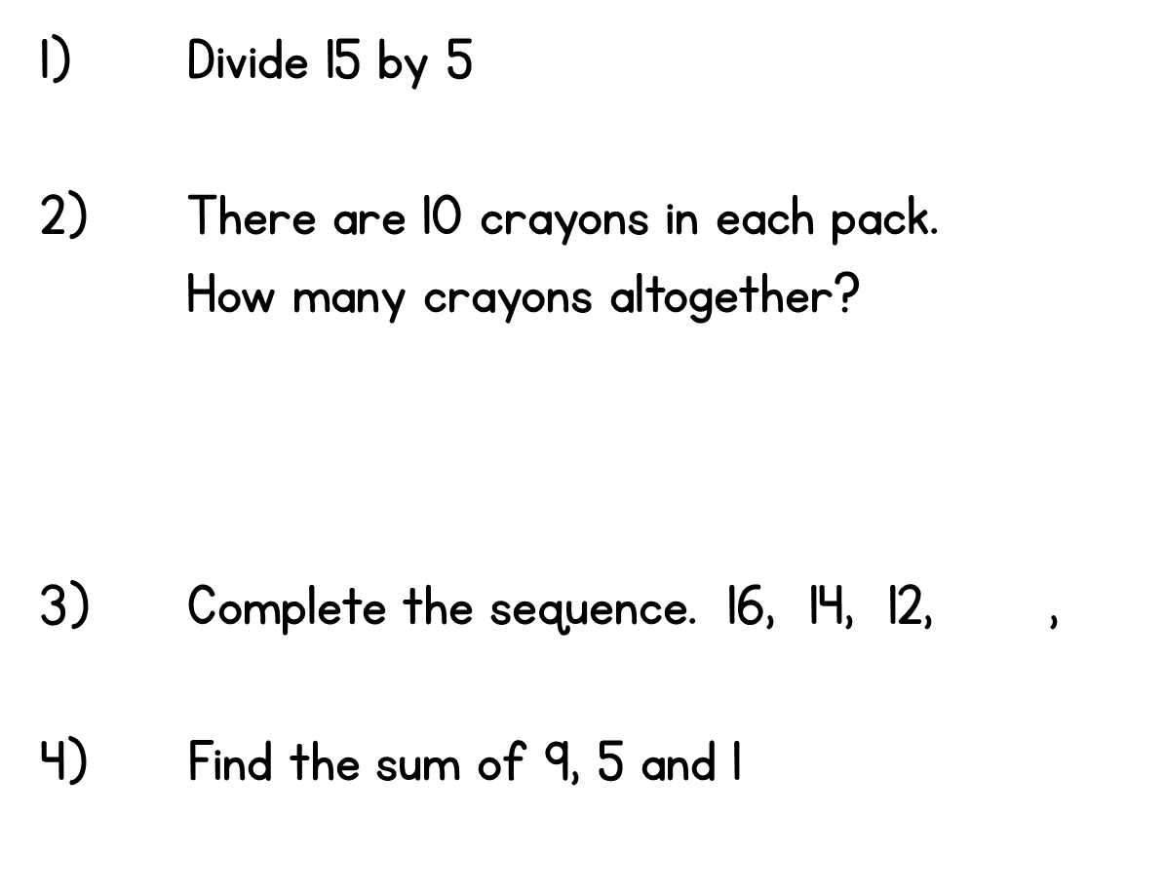
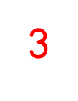

Year 2 | Week 1 | Day 2

Slide 3
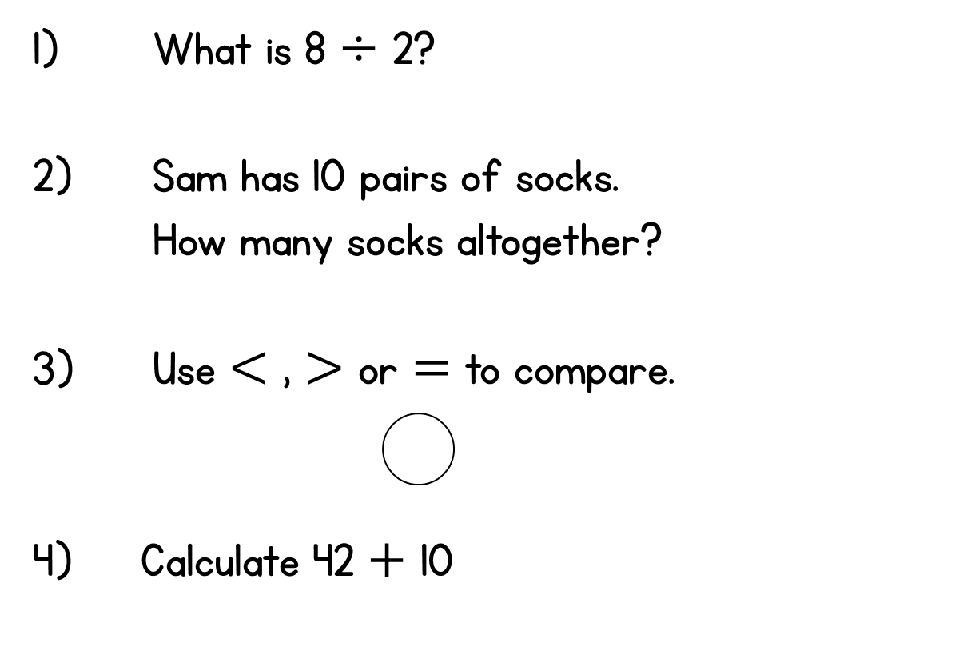


Year 2 | Week 1 | Day 3

Slide 4
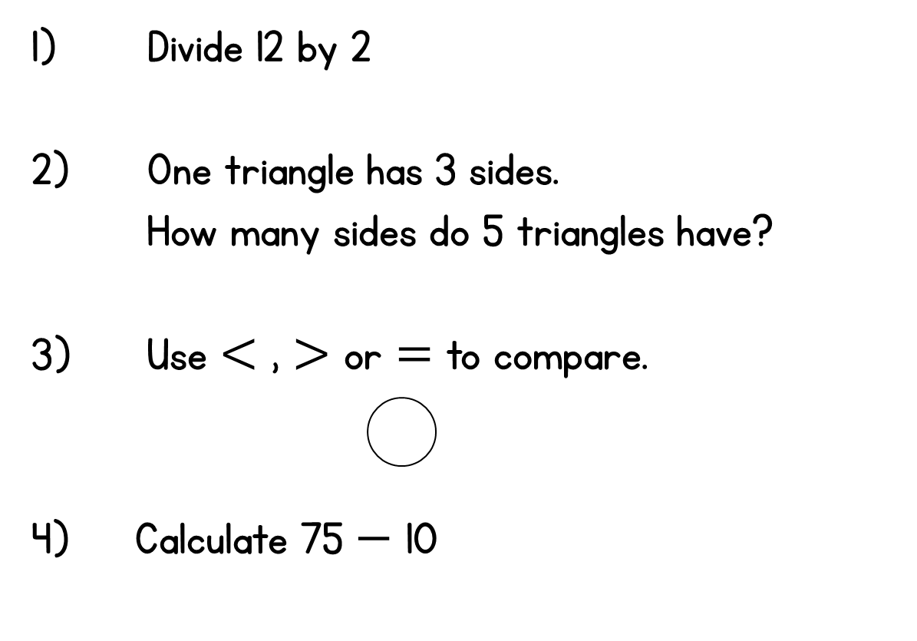

Year 2 | Week 1 | Day 4

Slide 5
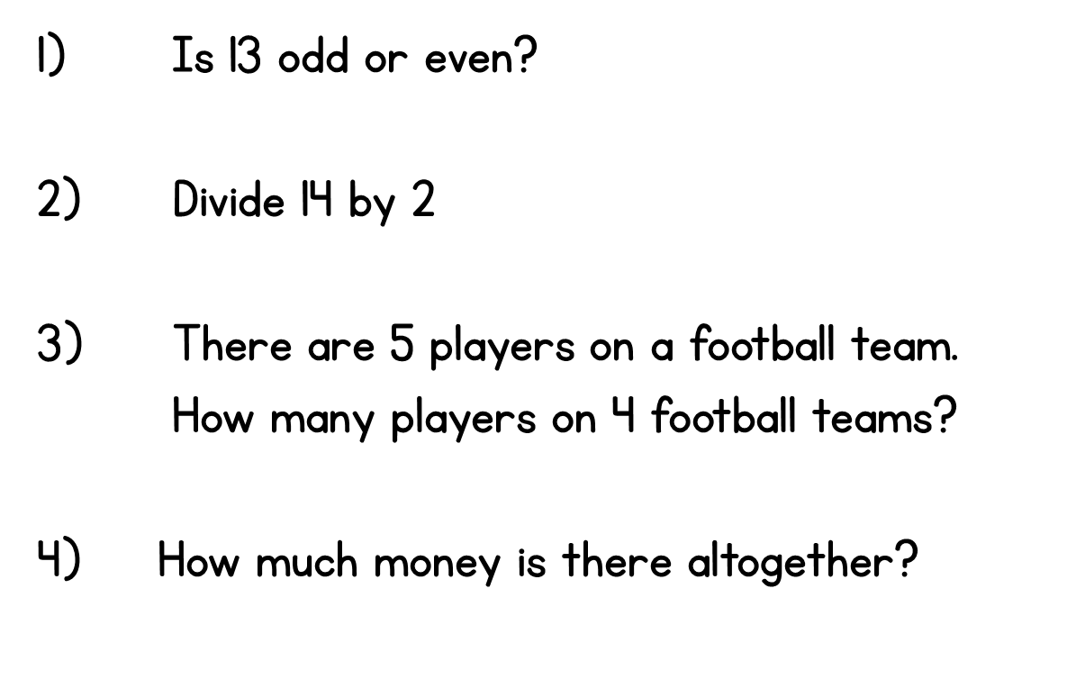
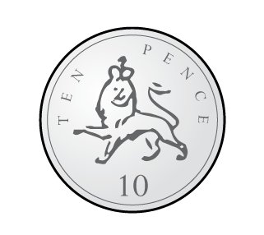
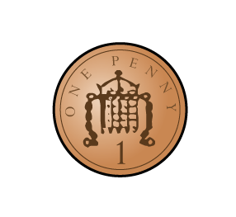
Year 2 | Week 1 | Day 5

Slide 6
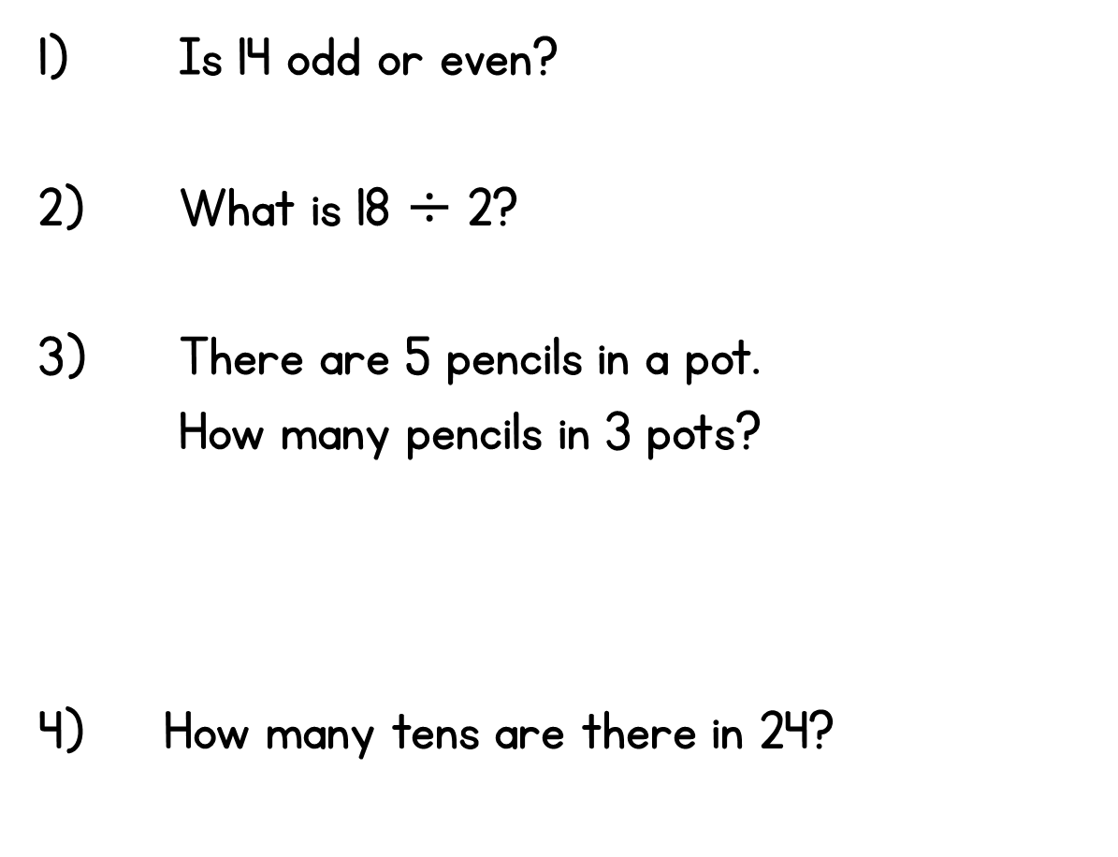

Year 2 | Week 2 | Day 1

Slide 7
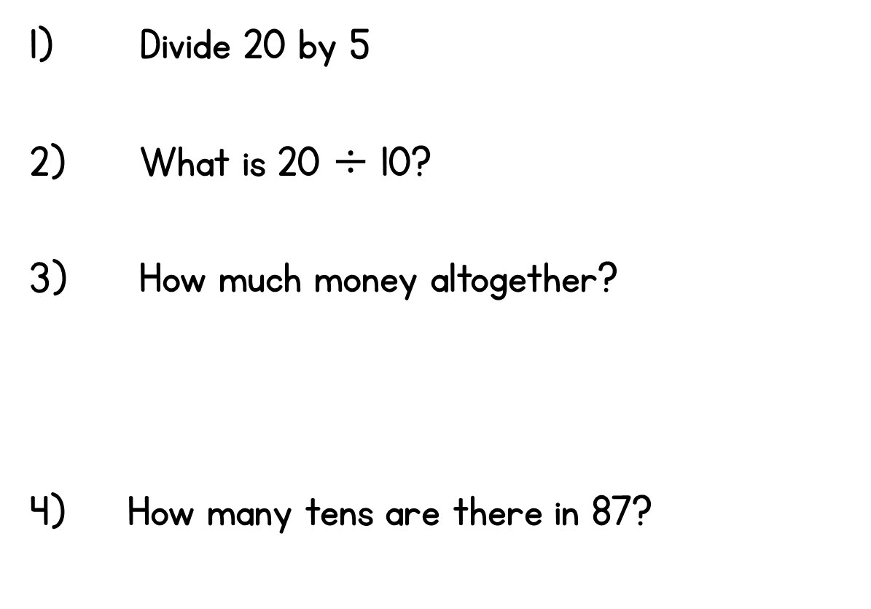
Year 2 | Week 2 | Day 2

Slide 8
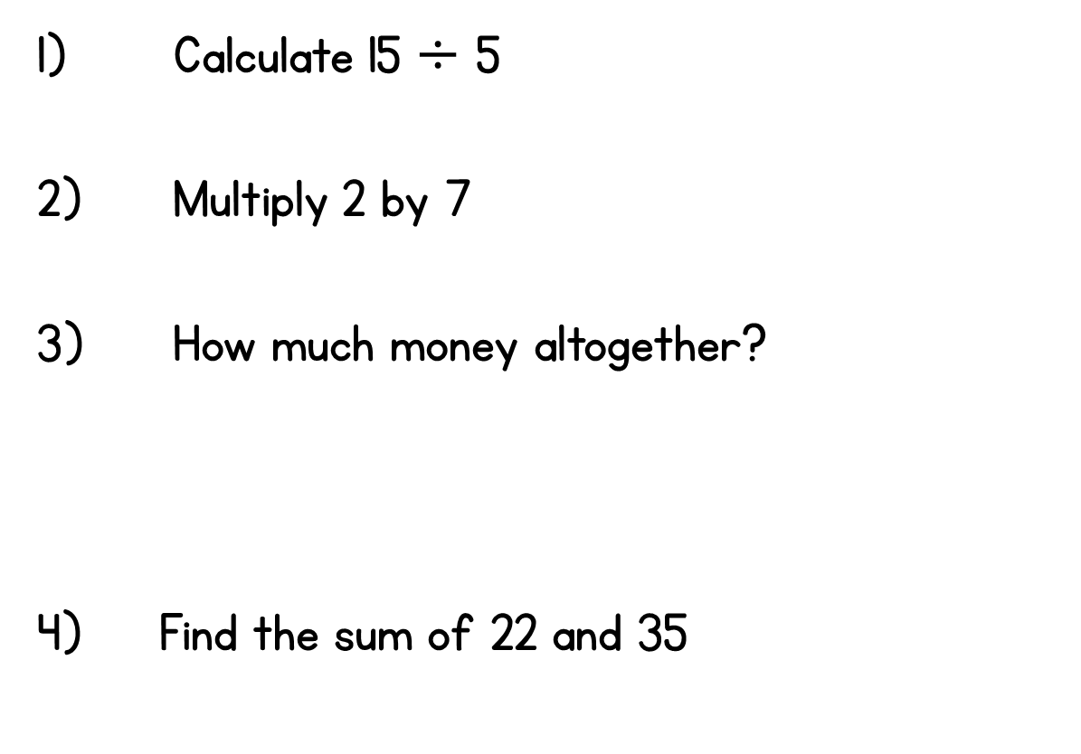
Year 2 | Week 2 | Day 3

Slide 9
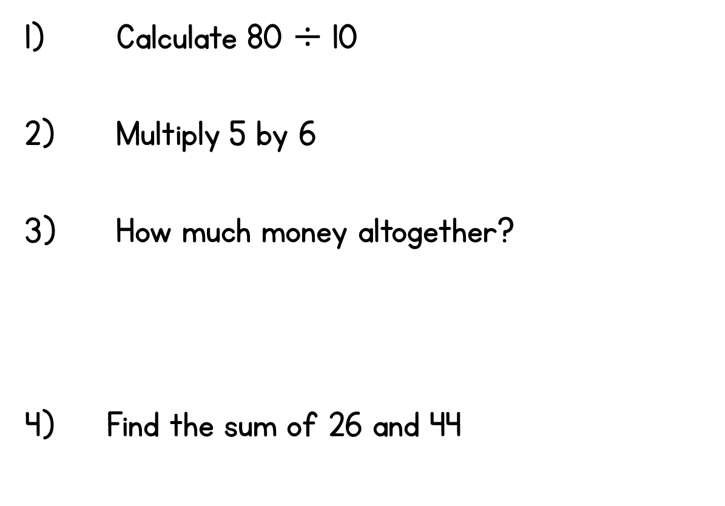

Year 2 | Week 2 | Day 4

Slide 10
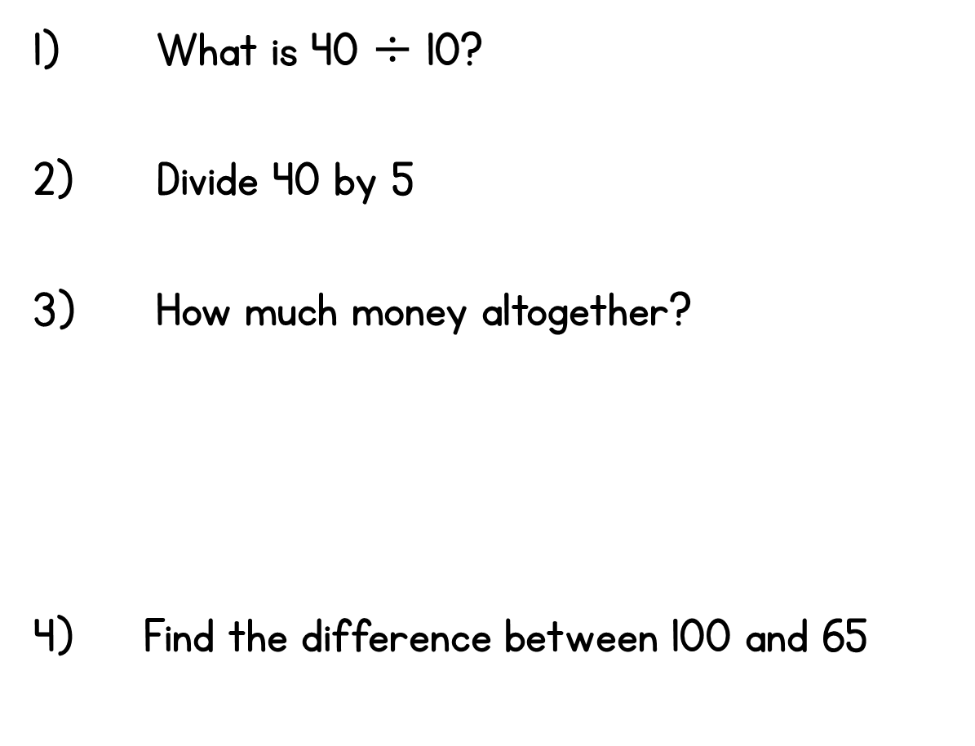
Year 2 | Week 2 | Day 5

