Slide 1
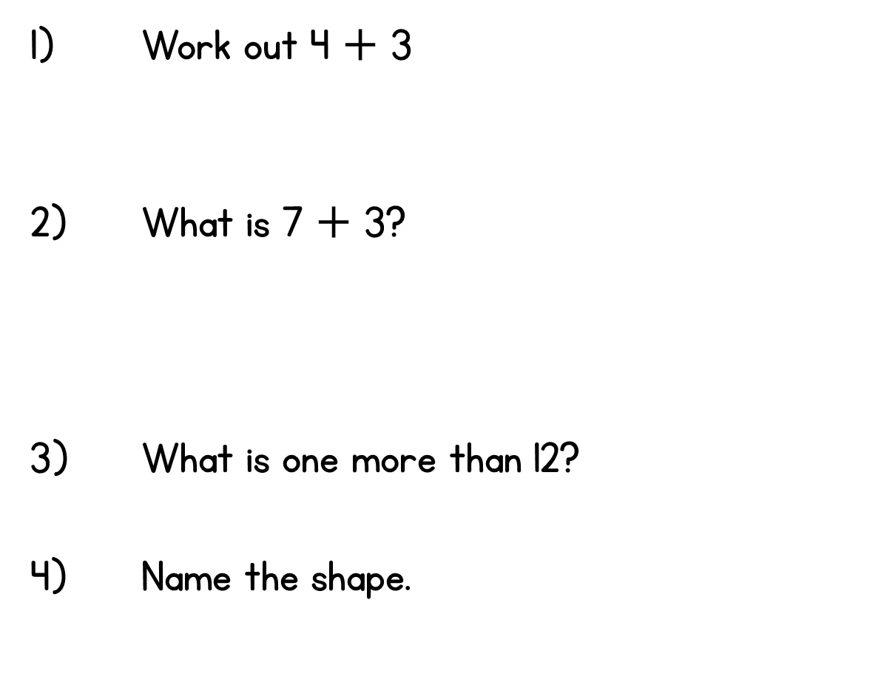


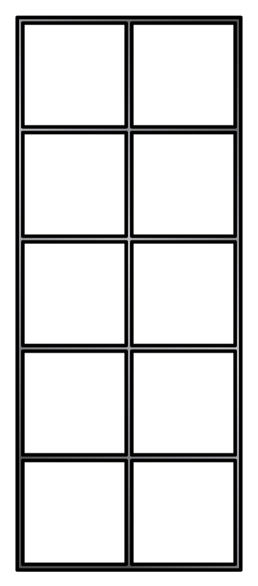
Year 1 | Week 1 | Day 1

Slide 2
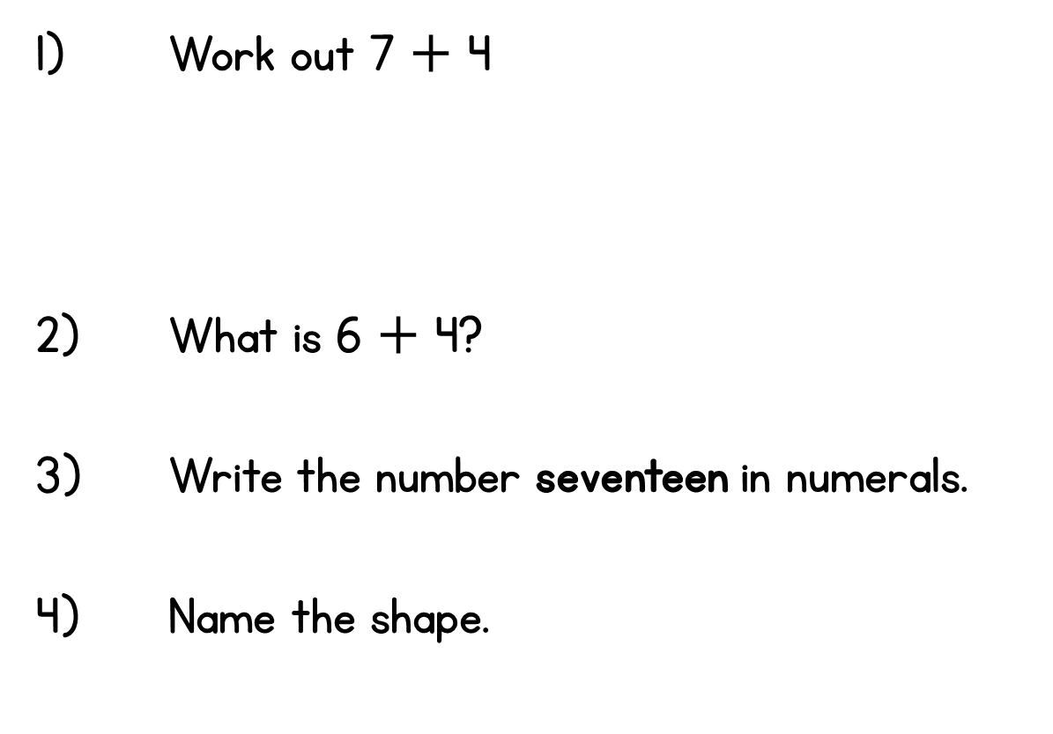
Year 1 | Week 1 | Day 2

Slide 3
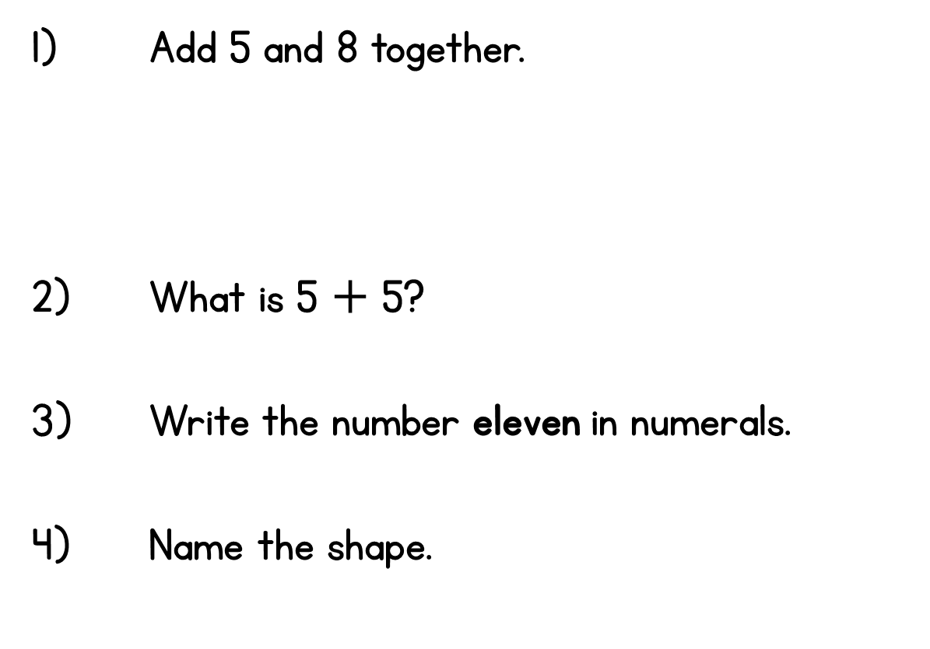
Year 1 | Week 1 | Day 3

Slide 4
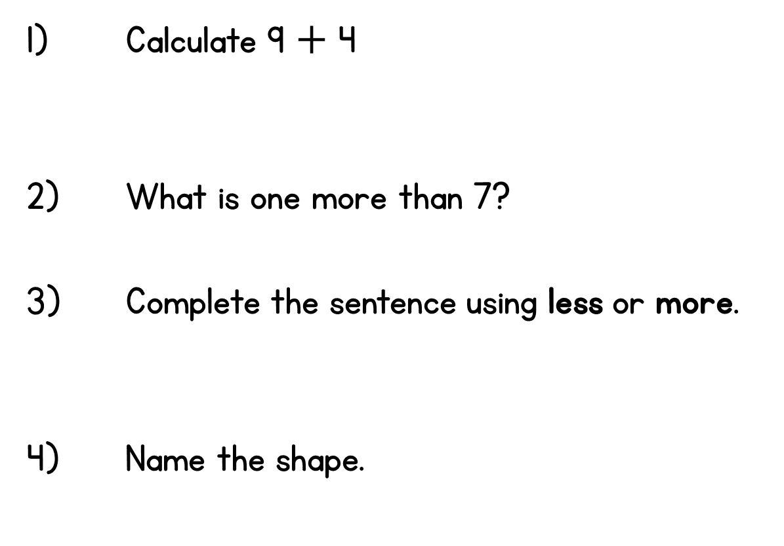
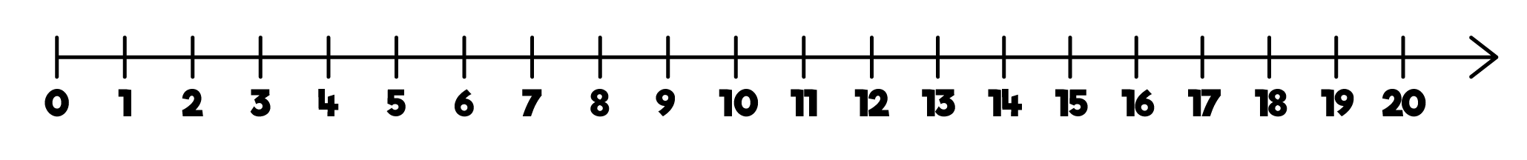
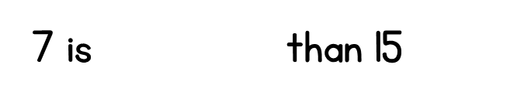
Year 1 | Week 1 | Day 4

Slide 5
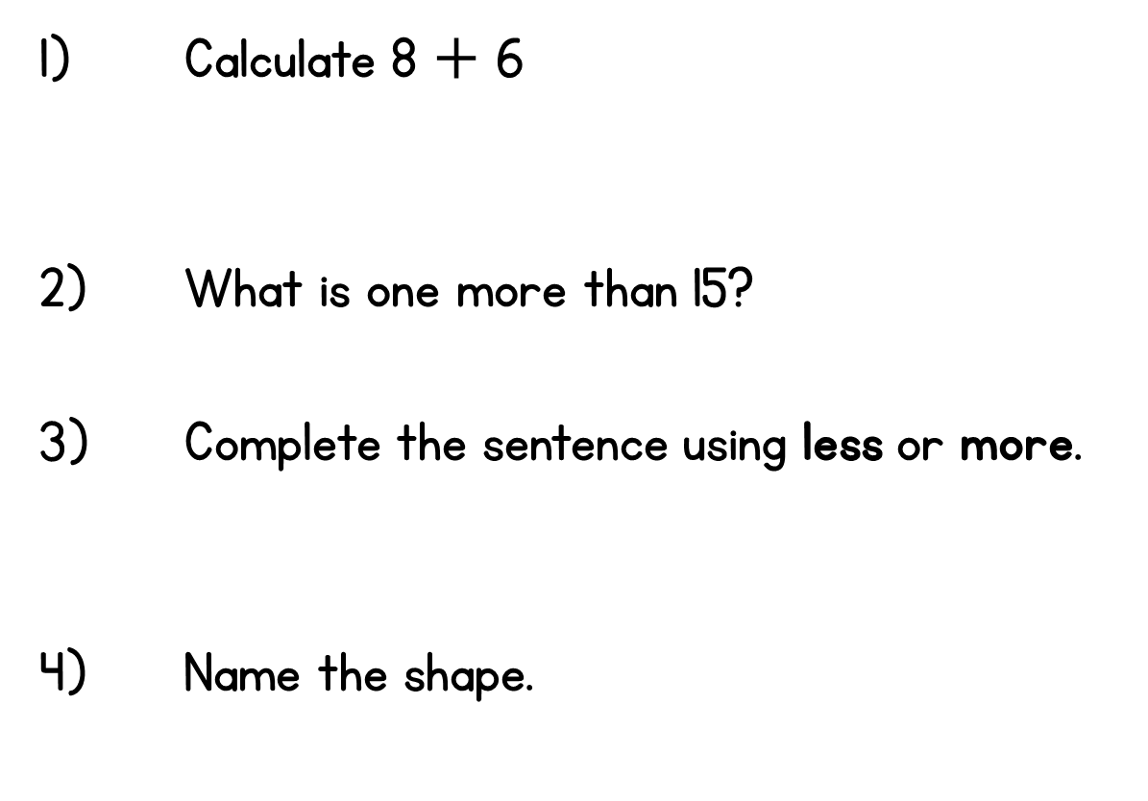
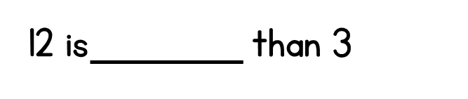
Year 1 | Week 1 | Day 5

Slide 6
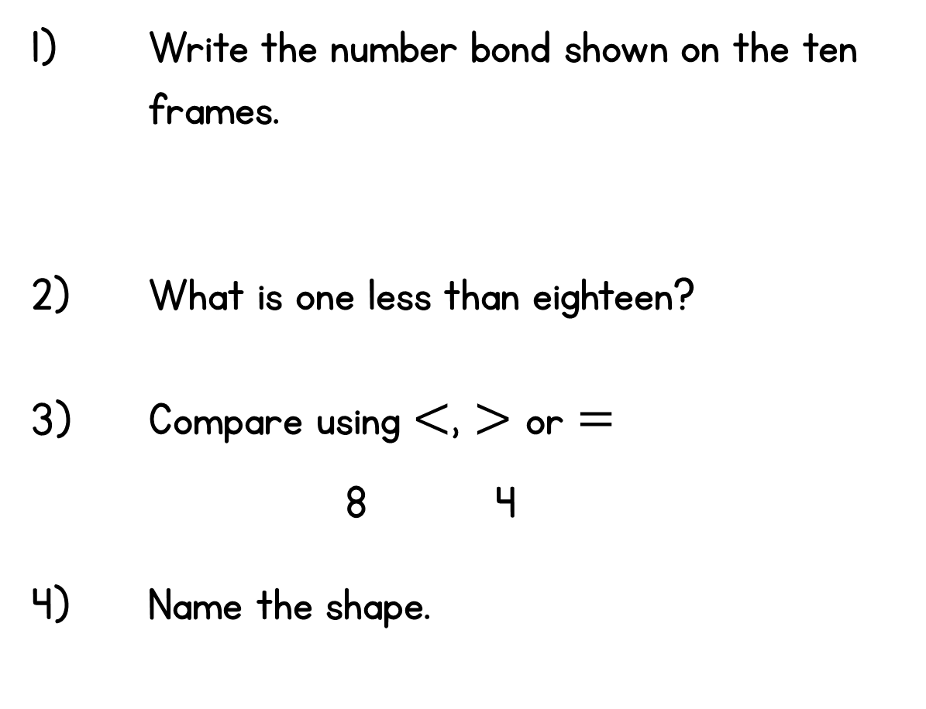

Year 1 | Week 2 | Day 1

Slide 7
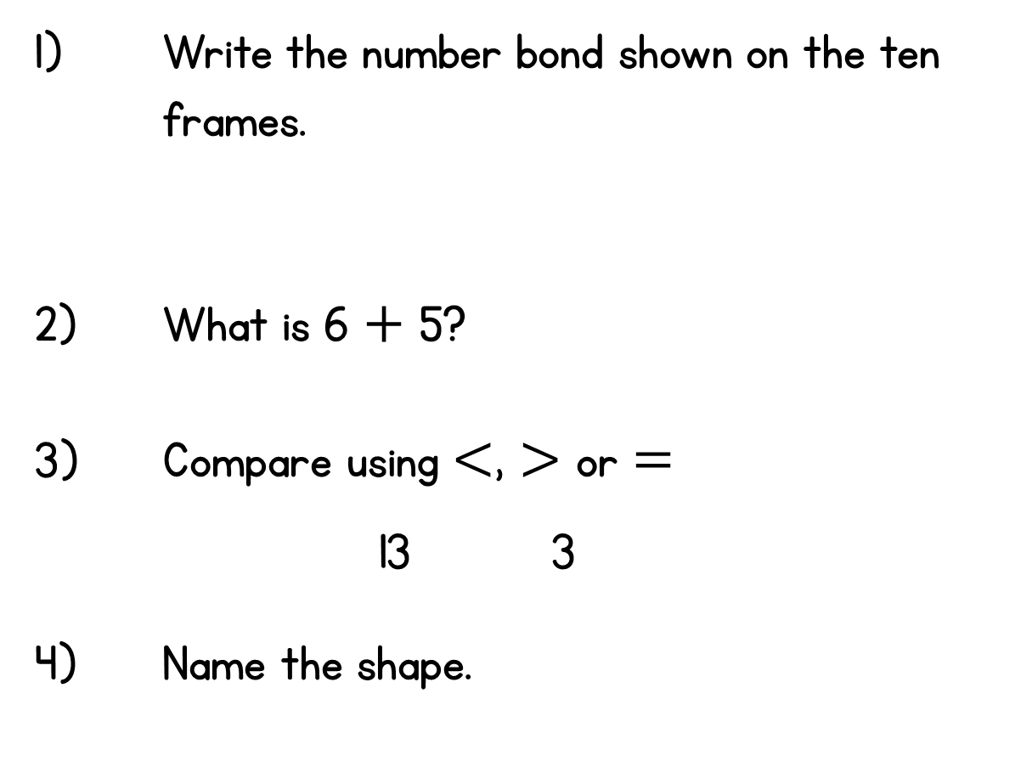
Year 1 | Week 2 | Day 2

Slide 8
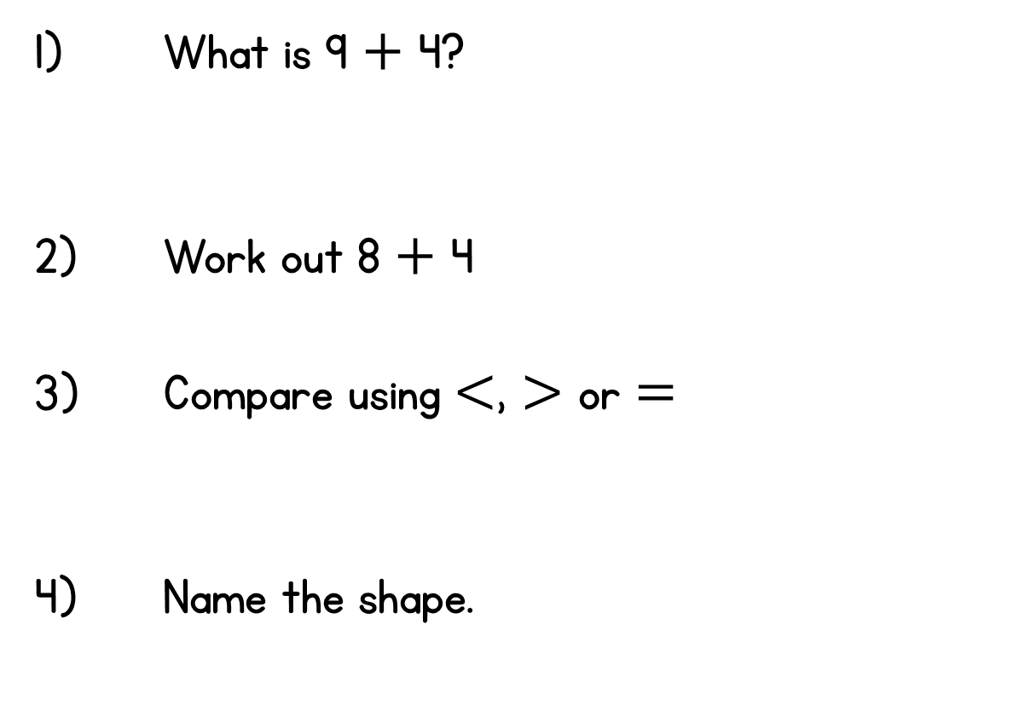
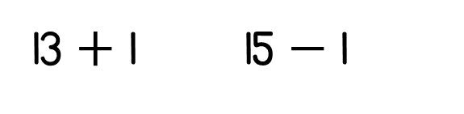

Year 1 | Week 2 | Day 3

Slide 9
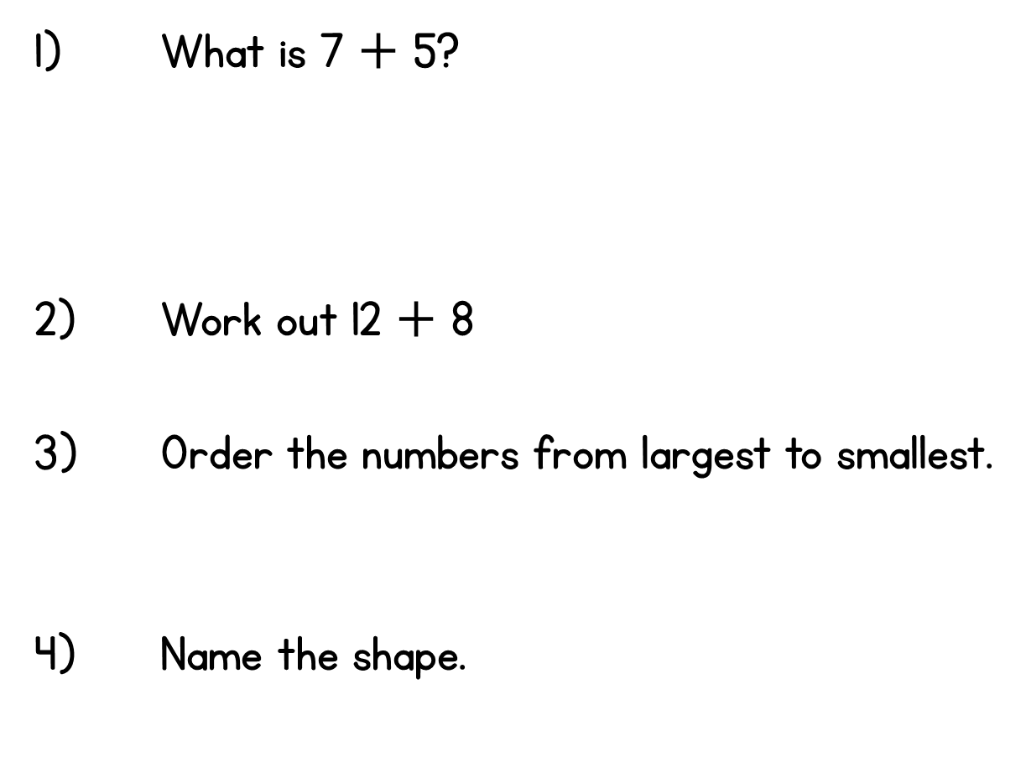

Year 1 | Week 2 | Day 4
17 , 9 , 14

Slide 10
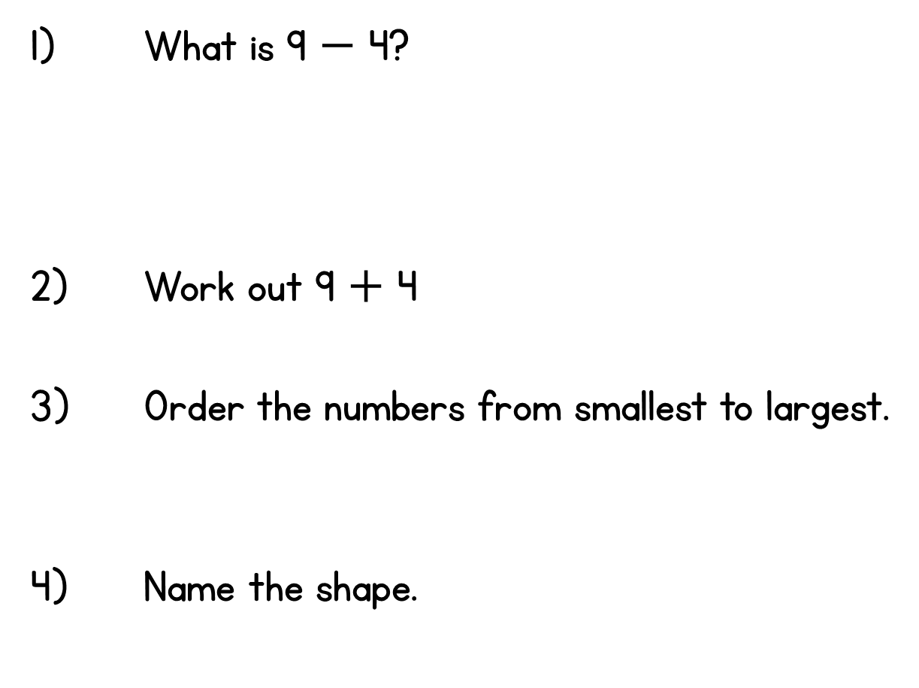

Year 1 | Week 2 | Day 5
7 , 12 , 10

