Slide 1
Reading at St Oswald’s CE Primary School
A Parent’s Guide

Slide 2

“When you read with your child, you not only show them that reading is important, but also that they are important.”

Slide 3
Aoccdrnig to a rscheearch at Cmabrigde Uinervtisy, it deosn't mttaer in waht oredr the ltteers in a wrod are, the olny iprmoetnt tihng is taht the frist and lsat ltteer be at the rghit pclae. The rset can be a toatl mses and you can sitll raed it wouthit porbelm. Tihs is bcuseae the huamn mnid deos not raed ervey lteter by istlef, but the wrod as a wlohe.
Or rather:
According to a research at Cambridge University, it doesn't matter in what order the letters in a word are, the only important thing is that the first and last letter be at the right place. The rest can be a total mess and you can still read it without problem. This is because the human mind does not read every letter by itself but the word as a whole.

Slide 4
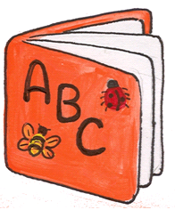
Reading in KS1
The early reading process has distinct stages:
  discussion books that develop understanding – What is happening in the story?
  In the meantime building up :-
  Phoneme knowledge (sound that letters/strings of letters make)
  Phonics – learn to segment and blend words
  Word recognition – tricky words – the shape of words
  Flashcards
  This gives children resources to tackle simple texts.

Slide 5
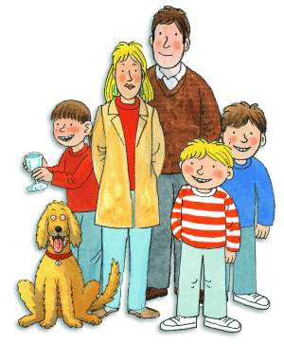
Simple texts
Early reading skills of segmenting and blending, tricky word recognition, using picture cues and discussion skills will all fit together to enable children to access simple texts
For example the sentence
“Dad was mad at Floppy”
  black – blended words
  blue – tricky words learnt by sight.

Slide 6

Developing reading
All children develop at different rates
  children flourish when they are praised and believe in themselves
  we want to develop fluent and confident readers who read for enjoyment
We teach a variety of other strategies so they can continue to work out words they don’t know…

Slide 7
Reading strategies
Children need to build up and use a range of strategies to support themselves.
Develop using phonic knowledge to blend - sheep
Recognise patterns – ing, ed
Chunk it – look for smaller words hiding inside larger ones
Picture cues
Read to the end of the sentence – what fits?
Re-read the sentence – run up – does it look right, sound right, make sense?
Skip hard words and then go back – Read, skip, go back and read
Think about the story

Slide 8
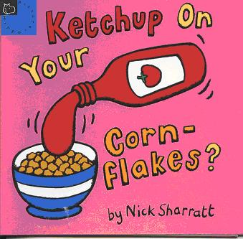
Benefit of Using Reading Strategies
Using these strategies will help your child to read accurately.
  They will also learn to ‘self correct’.
  Children need to be taught these strategies and be reminded to use them!
  Children are encouraged to read a wide range of fiction and non-fiction books
  Alongside the ‘reading’ of the text it is vital that children develop their comprehension skills.

Slide 9

How we develop comprehension skills
Asking them questions about the text to show their understanding
  describe, select or retrieve information
  Who… What…Find… List…
  Select a word that shows…
Deducing, inferring or interpreting information
  How did __ feel? Why did __ think?
  Explain why…
Identify and comment on the structure and organisation of text
  What is the purpose of…?
  Why is that word in bold/italics?
Explain and comment on writer’s use of language
  Why is that word used?
  Find words or phrases that make the passage seem…
Identify and comment on writers’ purpose and viewpoints
  How does the author make you think…?
  How does the writer make it interesting, engaging, exciting?

Slide 10
Children need to develop their ‘word recognition’ and ‘language comprehension’ skills together:
Language
Comprehension
skills
good
Word
recognition
skills
Word
recognition
skills
poor
good
poor
Language
Comprehension
skills

Slide 11
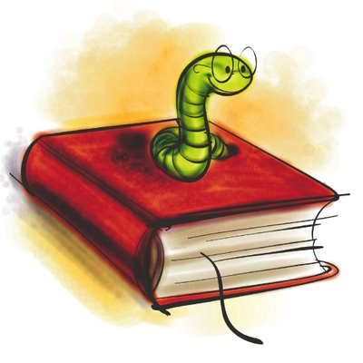
How you can help…
Read a variety of books from school and home
Create a ‘reading time’ together
Encourage your child to use different strategies to decode unknown words
Spend some time at the end of a book to discuss what has been read

Slide 12
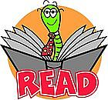
How we assess reading
It is important that your child is reading at a level that will develop their word recognition and language comprehension skills.
Books are ‘banded’ into different levels and are placed along the corridor in ‘book boxes’
Each level has a colour starting with ‘pink’ and children work up through the colours as their reading develops.

Slide 13
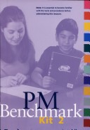
How we assess reading
We formally assess reading using the Benchmark Assessment Kits:
  Children individually read an unknown text and a running record is used to record words read accurately. A note is also made of any decoding strategies they are using.
  They are then asked to ‘re-tell’ the story and a range of comprehension questions are asked.
  From their reading a percentage score is reached depending on the amount of errors they have made.
    95 – 100% correct - Easy
    90 – 94% correct - Instructional (Guided Reading)
    Below 90% correct - Hard
  Children do not move up to the next level of reading until their word recognition and language comprehension capabilities are equal.

Slide 14
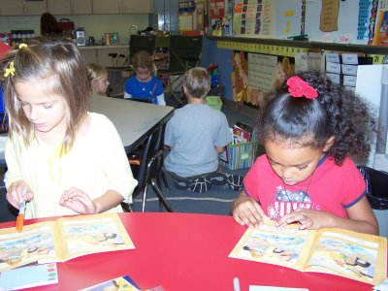
Guided Reading
Guided Reading is used to teach children the reading strategies described earlier
  Guided Reading is taught in groups of up to 6 children who are at the same level with the same book
  The book used is one level higher than their independent reading book in the child’s book bag
  Once children are free readers the teacher chooses sets of books at a challenging level which gives the children an opportunity to develop advanced reading and comprehension skills. Children are still grouped according to ability.

Slide 15
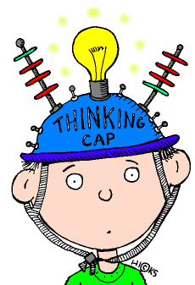
Guided Reading
Guided Reading has been proved to be the best method to use to teach children to read
  input from the other children
  the teacher will choose a range of books through the year
  most guided reading books in school have a teacher's version too, to help run the session
  Guided Reading is linked to the children’s reading targets.

Slide 16

Free Reading
When children move to ‘Free Reading’ they often need guidance to choose books
Children need to read a wide variety of books including:
  fiction
  non-fiction
  poetry
  drama
Each class has a variety of free-reading books, both longer and shorter reads
If children choose a book that they are not interested in, let the teacher know and swap it
We don’t want to put children off if they don't like the book!

Slide 17

Free Reading
Some parents think that when their children are free readers they don’t need to hear them read again!
  this is not the case!
  you must still hear your child read
  hear them read a few pages most nights
Children need to read some long reads and some shorter ones - the shorter ones are not necessarily easier
Please write in the planner so that the teacher knows that you‘ve heard your child read.

Slide 18

Comprehension Skills
Hearing your child read gives you the opportunity to enhance your child’s comprehension skills too :
  ask children questions about what they have read
  stop and talk…
  don't let them read the whole text without asking questions!
  ask the meaning of difficult words
  ensure they understand what they are reading.

Slide 19

How you can help…
Hearing your child read out loud is important because:
  spoken skills are different
  helps with voice projection
  develops clarity
  promotes intonation
  makes children stop at punctuation
  helps them understand what they are reading
Spend time reading to your children and read books together.

Slide 20
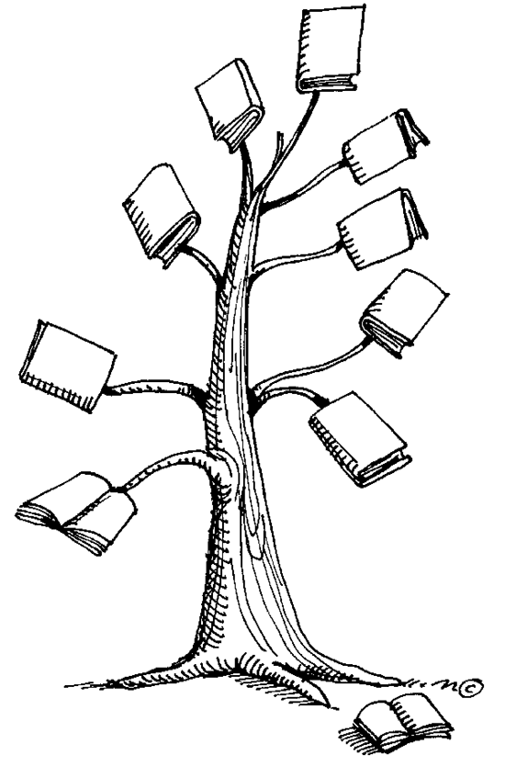
Where next?
What are children expected to be able to do?
  explain implied meaning
  pick out relevant information to back up an opinion or answer a question
  summarise a range of text, genre, plot, character
  identify styles of authors
  understand the use of language, dialects and slang.

Slide 21

Which books should they choose?
Plot
  more complex, with flashbacks and sub-plots
  character development during the story
Sentences
  mix of simple, compound and complex
  range of punctuation ; : - ( )
Vocabulary
  descriptive, challenging and ambitious
Interest
  so that they want to finish the book
Variety
  fiction and non-fiction
  newspapers, magazines and reviews
  applicable to the real world.

Slide 22
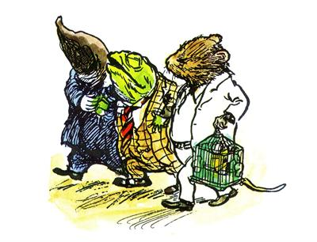
Recommended Reading
The Wolves of Willoughby Chase – Joan Aiken
Carrie’s War – Nina Bawden
The Secret Garden – Francis Hodgson-Barnett
The Midnight Fox – Betsy Byars
Over Sea, Under Stone – Susan Cooper
The Wind in the Willows – Kenneth Grahame
The Haunting – Margaret Mahy
Anne of Green Gables – L. Montgomery
Bug Muldoon – Paul Shipton
Artemis Fowl – Eoin Colfer
The Edge Chronicles – Paul Stewart and Chris Riddell
Other authors:
  Antony Horowitz, Philip Pullman, J.K. Rowling, Robert Swindells, Michael Morpurgo, J.R.R. Tolkein, Anne Fine, Paul Jennings,

Slide 23

Summary & Conclusions
We carefully deliver strategies to help every child learn to read:
  from pre-reading through to free reading
Your child also needs your help through each stage of reading:
  to support the strategies we deliver in school
  to build your child’s confidence
  to help your child enjoy reading
  to prepare them for secondary school
  and beyond.
  - to develop a lifetime love of reading

