Slide 1
Singapore Maths
Maths- No problem
KS2 Parent Workshop

Slide 2
Singapore Maths
Singapore is consistently at the top of international benchmarking studies for maths teaching
A highly effective approach to teaching maths based on research and evidence
Introduces new concepts using a ‘Concrete Pictorial Abstract’ approach
Builds student’s mathematical fluency without the need for rote learning
Pupils learn to think mathematically as opposed to reciting formulas they don’t understand
Teaches mental strategies to solve problems

Slide 3
A Singapore Maths lesson
Anchor Task - the entire class spends time on a question guided by the teacher. All children are encouraged during this time to think of as many ways as possible to solve the question, share and explain ideas and help the teacher to solve the problem.
Guided Practice - practice new ideas in groups, pairs or individually guided by the teacher.
Independent Practice - practice on your own. Once children have mastered the concept they use their reasoning and problem solving skills to develop their depth of learning.

Slide 4


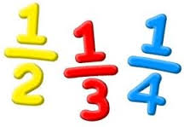
Singapore CPA model
CONCRETE ➢ PICTORIAL ➢ ABSTRACT

Slide 5
Mixed ability classes
“ … aptitude is the length of time it takes a person to learn, not how ‘bright’ a person is, that is, everyone can learn given the right circumstances.” Benjamin Bloom
Advanced learners and struggling learners are differentiated for within the same learning environment
Shared learning through talk

Slide 6
National Curriculum
Mathematics programmes of study state that:
All pupils should become fluent in the fundamentals of mathematics, including through varied and frequent practice, so that pupils develop conceptual understanding and are able to recall and apply their knowledge rapidly and accurately to problems.
The expectation is that the majority of pupils will move through the programmes of study at broadly the same pace. When to progress should always be based on the security of pupils’ understanding and their readiness to progress to the next stage.
Pupils who grasp concepts rapidly should be challenged through rich and sophisticated problems before any acceleration through new content. Those pupils who are not sufficiently fluent with earlier material should consolidate their understanding, including through additional practice, before moving on.
clip

Slide 7
How are advances learners challenged?
Advanced learners will:
make links between previous learning
think about problems in different ways
have opportunities to explain their reasoning
find and explain generalisations
use rich mathematical language when explaining ideas
solve complex problems which expand on their mathematical knowledge
work with a range of manipulatives to consolidate their understanding
work with a mix of children in groups, pairs and on their own

Slide 8
How are struggling learners supported?
Struggling learners will:
make links between previous learning
think about the way they know to solve problems
have opportunities to listen to good vocabulary from peers
be given more time to practice tricky concepts
work with a range of manipulatives to solve problems visually
work with a range of children in groups, pairs and on their own
scaffold learning- extra clues and support

Slide 9
What teachers do to support all learners:
Move individual children on at their own pace throughout the lesson
Set rich and sophisticated problem solving activities for advances learners
Give time for all children to fully grasp and master concepts
Provide visual stimuli for children to access a problem using CPA approach
Give children ownership in their learning
Model making mistakes- maths is hard!

Slide 10
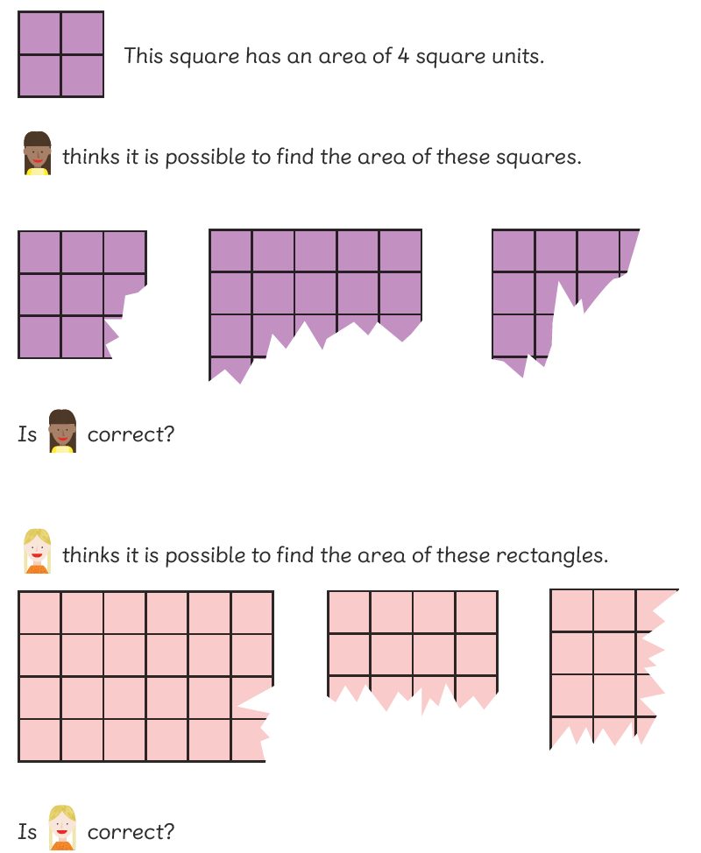



An example of differentiation in Singapore Maths
A
B
C

Slide 11

C
Clue
Are the girls correct? Explain in writing.
Is there another possible answer? Explain in writing.

Slide 12
B
Clue
What do you know about the sides of a square?
What do you know about the sides of a rectangle?
Are the girls correct? Explain in writing. Write two sentences.

Slide 13
A
Clue
They are incomplete squares. Could you imagine each of them as a complete square? Is it possible for every one?
Do the same for the rectangles. Is it possible for everyone?
If you could complete the shape, could you find the area? How?
So are the girls correct? Explain by drawing.

Slide 14
Maths workbooks
Allow children to show their understanding of a concept by solving problems displayed in different ways
The questions are set up to ensure children understand the concept forwards, backwards and inside out
For advanced learners this consolidates any previous learning before they move onto greater depth challenges
For struggling learners it highlights any gaps in understanding and they can work at their own pace through the questions

Slide 15
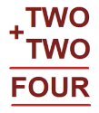
Maths journals- greater depth
Maths journals- Once children have shown they know the concepts they are given ‘greater depth’ tasks. These tasks take the children’s learning deeper into the concept and allow them the rich and challenging problem solving skills they need.
GD 1: Explaining
Explain to the math's wizard why he has made a mistake on the calculation below.
Write to your friend in Spain explaining what renaming means.
GD 2: Compare
What is the same between the 2 methods we have learnt today? What is different?
Two children have used different methods- look at their working out. Can you compare them?
GD 3: Reasoning
Bob has 234 cupcakes and Bill has 174 cupcakes. Together they think they have 308 cupcakes.
Are they correct?
Why/ why not? Explain your reasoning.
GD 4: Generalise
If we know 1 complete side of the square we can find the area.
If we know a minimum of 2 complete sides of the rectangle we can find its area .
GD 5: Open ended problem
Open ended problem to develop thinking skills and systematic working out.
Each of the different letters below stands for a different number.
How many solutions can you find to solve this?
How can you be sure you have found them all?

Slide 16
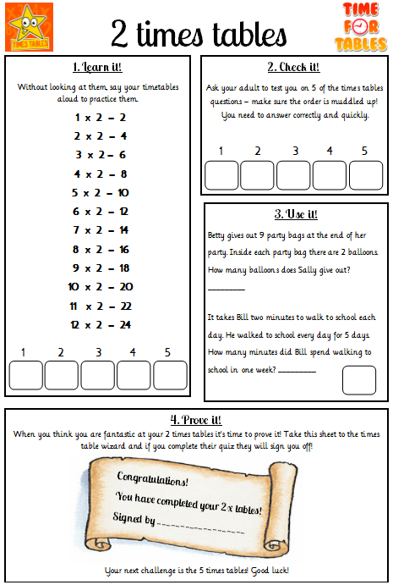
Times Table challenges
Alongside Singapore Maths we will be beginning a whole school times table challenge.
Children begin in 2x tables and work their way through the times tables
You can help at home
Sign off the boxes but not more than 1 a day
Learn it – at home
Check it – at home
Use it – at home (can tick both on same day)
Prove it – at home

