Slide 1

St Luke’s Church of England Primary School
God is good
All the time
All the time
God is good

Slide 2


Slide 3

The Holy Trinity
God the Father
God the Son
God the Holy Spirit

Slide 4
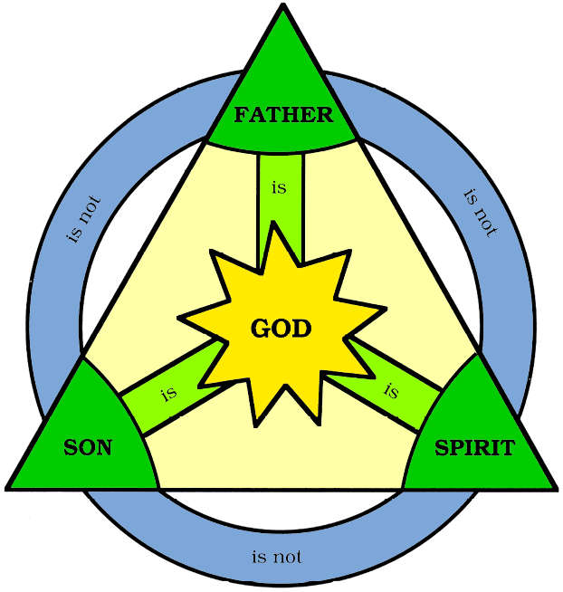
The Holy Trinity

Slide 5
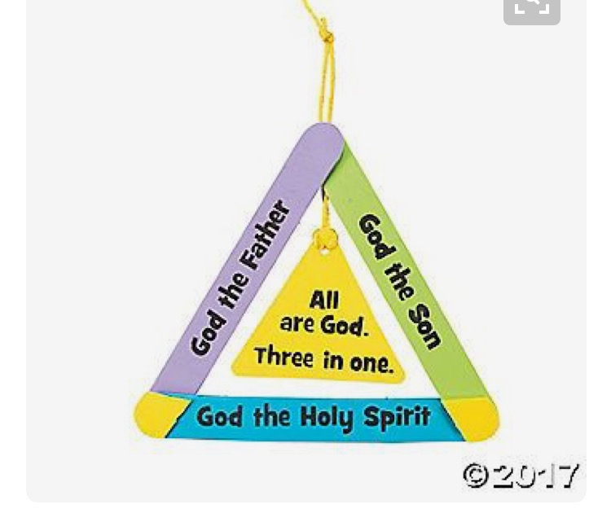

Slide 6
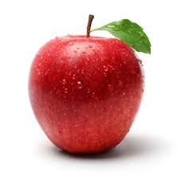

God the Father
Bible –Teaches us
Apple Skin –Protects us

Slide 7
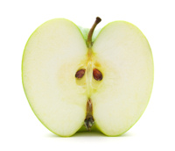

God the Son
Cross –Loves us
Apple Flesh - Goodness

Slide 8

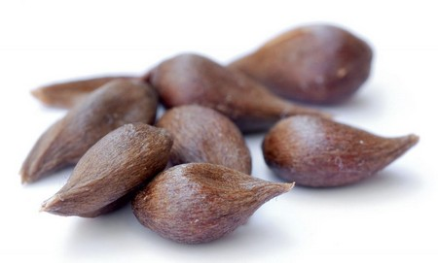
God the Holy Spirit
Candle – Guides us
Apple Seeds – Grows us

Slide 9
Time for Prayer
Dear Lord,
We thank you for all our different gifts. Help us
to see the importance of working together and
the value of using different people’s skills and
talents. Help us to co-operate, and to work well
together as a team. Through the Holy Trinity
Teach us, Love us and Guide us.
Amen

Slide 10
Time for Prayer
Dear Lord,
Thank you for revealing yourself to us as Father,
Son and Holy Spirit even though you are still
one. Help us to learn about you and the great
love you have for each one of us. We ask this in
the name of the Father, the Son and the Holy
Spirit.
Amen

