Slide 1


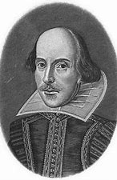
CURRICULUM PLAN: ENGLISH
“It is not in the stars to hold our destiny but in ourselves” William Shakespeare, 1545-1616.
Our intent
At Woodhouse Academy, we are passionate about inspiring a lifelong love of English through an ambitious and engaging curriculum that develops confident readers, thoughtful writers and articulate speakers. We believe that English is the foundation of learning, enabling pupils to access the wider curriculum and communicate effectively in an ever-changing world.
Through a carefully sequenced curriculum, pupils explore a diverse range of high-quality texts that broaden their knowledge, challenge their thinking and expose them to a variety of authors, cultures and perspectives. Reading lies at the heart of our curriculum, supporting pupils' academic success while nurturing their cultural, emotional, social and intellectual development.
We are committed to developing pupils' vocabulary, comprehension, writing and oracy, equipping them with the skills to communicate with confidence and purpose. Oracy is explicitly developed alongside reading and writing, enabling pupils to articulate ideas clearly, reason effectively and engage in meaningful discussion. Pupils learn to write imaginatively and creatively, while also mastering the conventions of formal and academic writing for a range of audiences and purposes.
Our aim is for every pupil to leave Woodhouse Academy as a fluent reader, an ambitious writer and a confident communicator, with the knowledge, skills and love of literature to succeed in the next stage of their education and beyond.

Slide 2
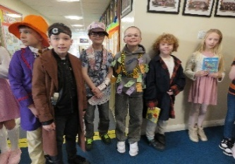
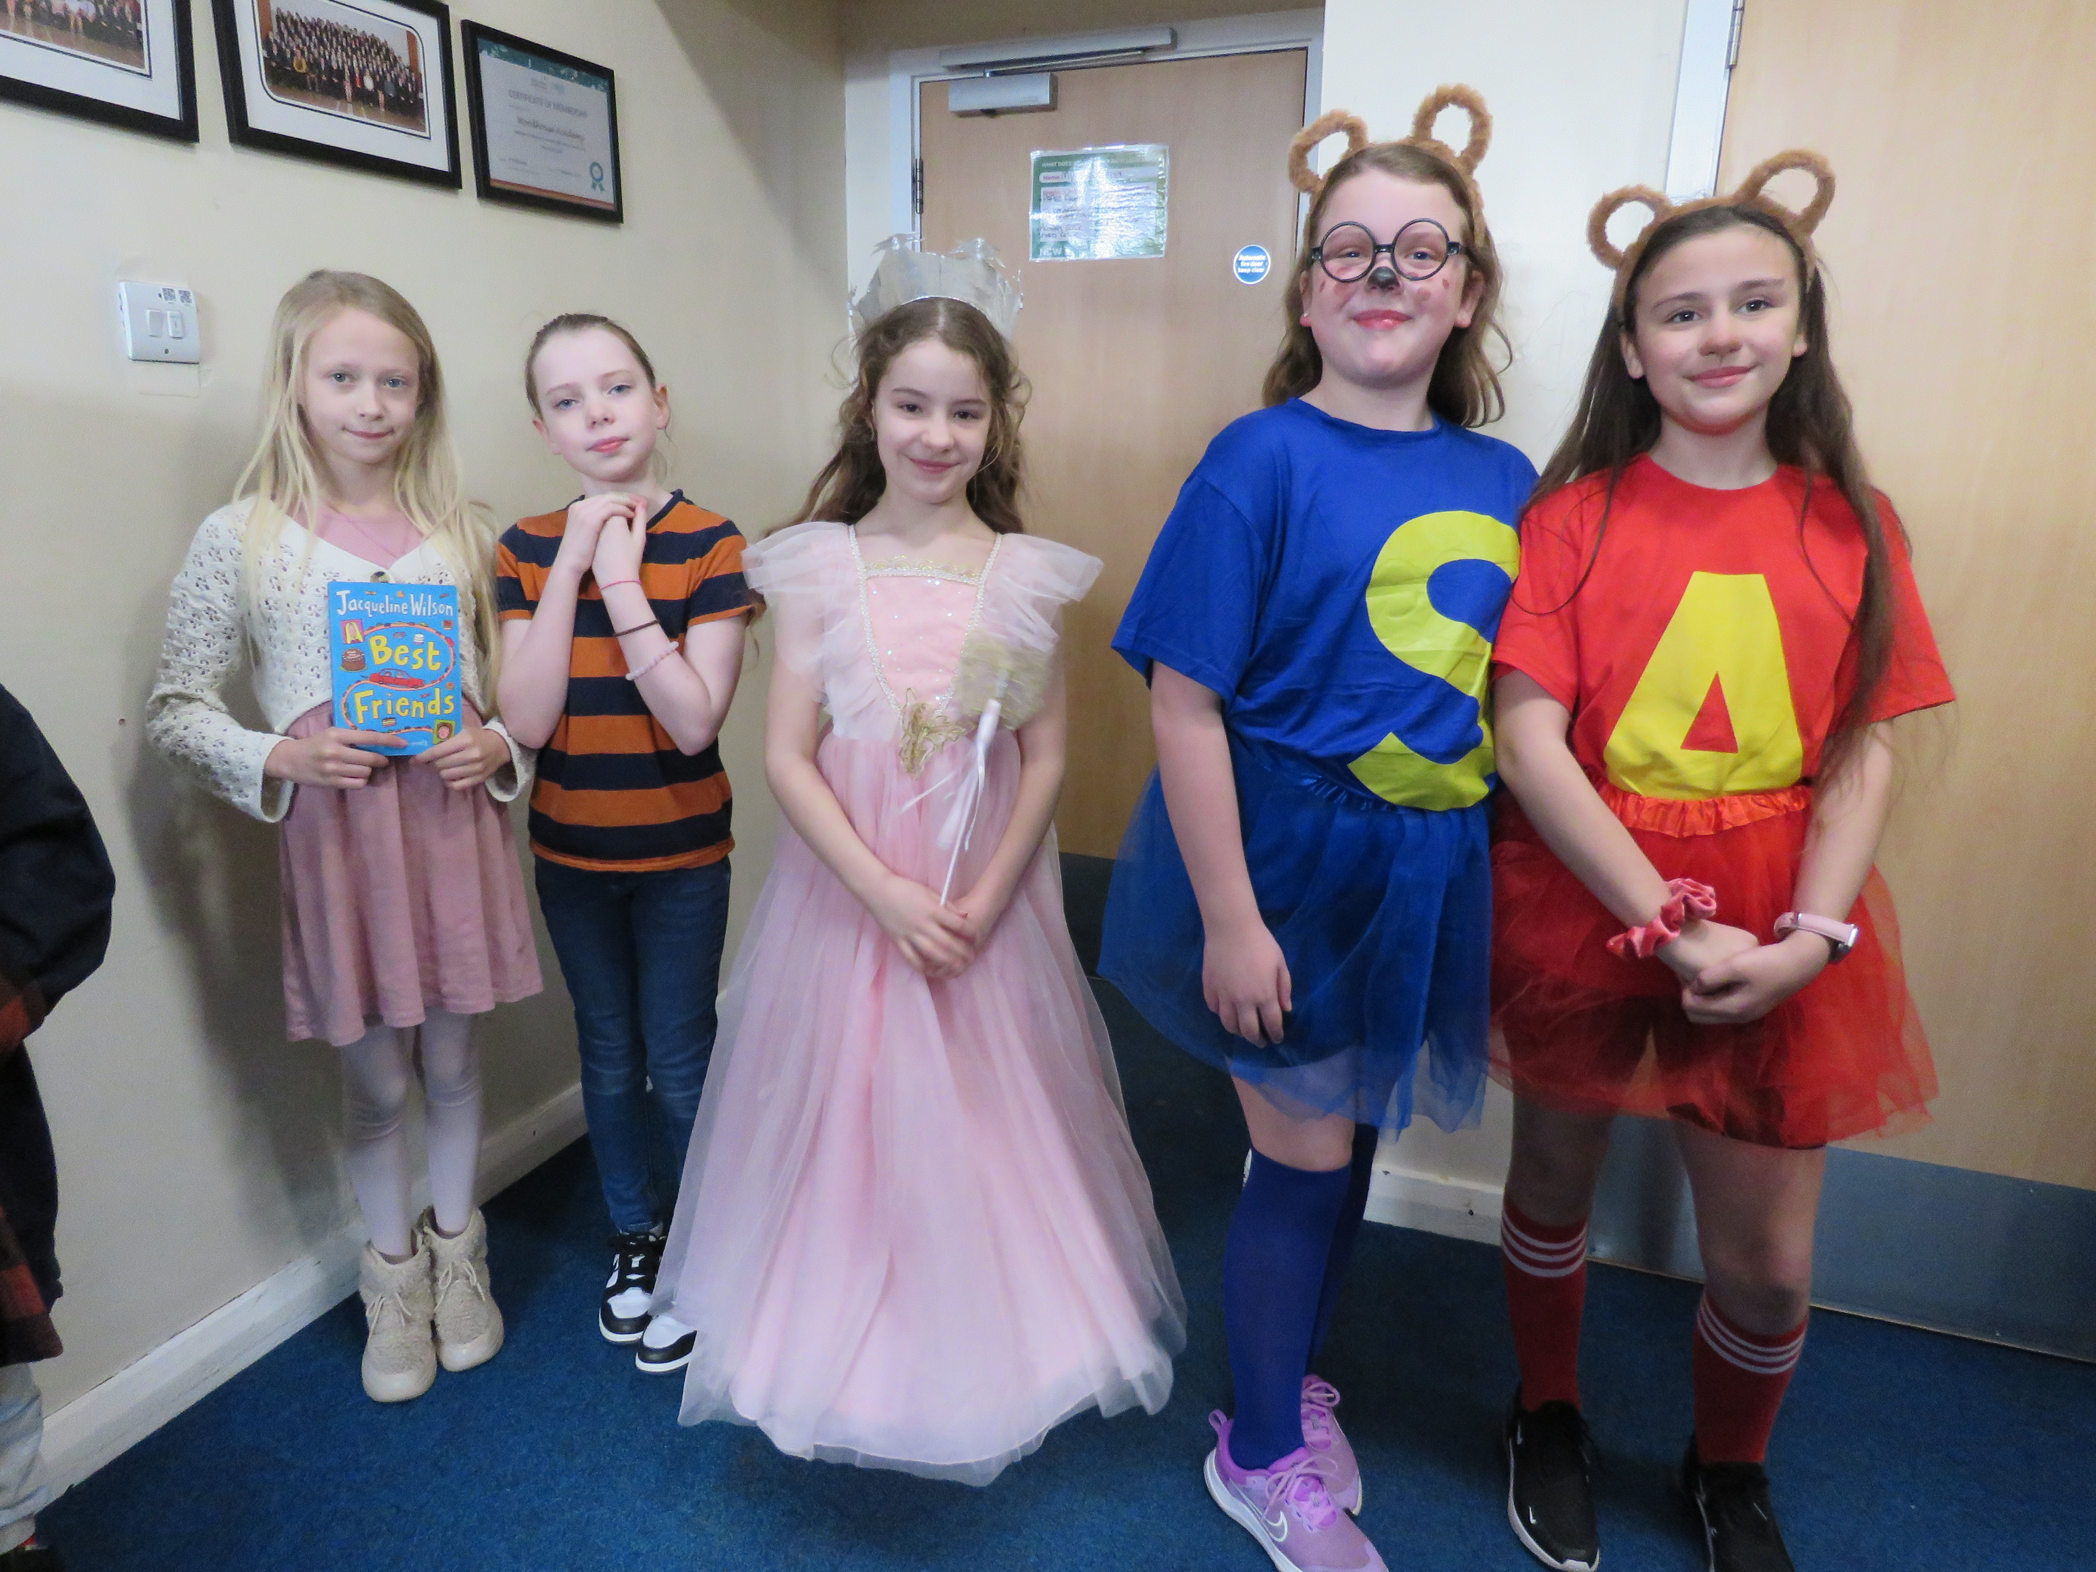
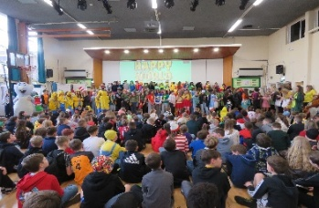
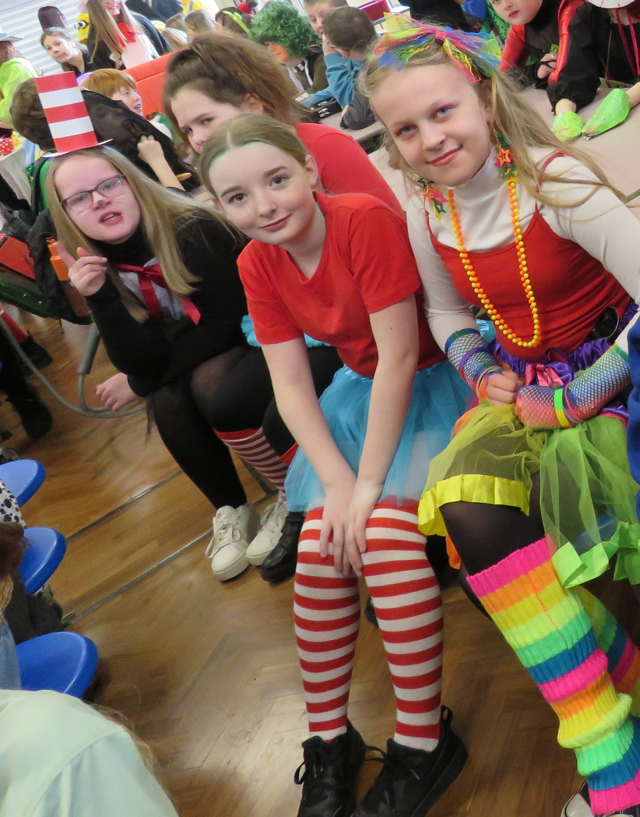

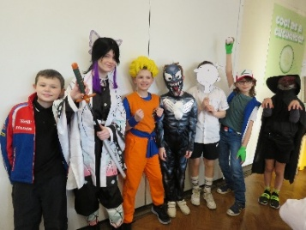
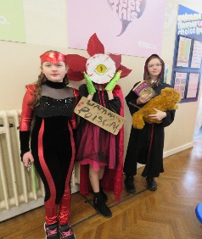
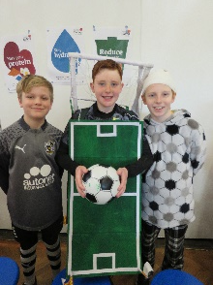
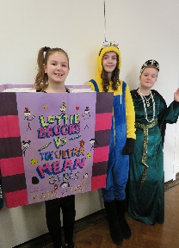
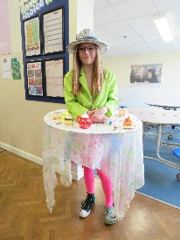
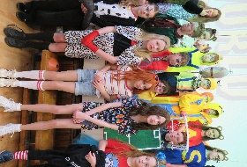
ENRICHMENT IN ENGLISH
Our Woodhouse Academy English curriculum is enriched through a wide range of carefully planned experiences that develop pupils' reading, writing, oracy and cultural understanding. Through a diverse range of high-quality texts and schemes of learning across all year groups, pupils experience an ambitious curriculum that broadens their knowledge, vocabulary and appreciation of literature. Reading and writing are further strengthened through meaningful links with subjects such as RE and History.
Enrichment is a key feature of our English curriculum. Our whole-school love of reading is celebrated through World Book Day, which remains a highlight of the school calendar. Pupils dress as their favourite book characters, take part in reading activities and have the opportunity to enter the national World Book Day competition. Visits from published authors also inspire pupils as readers and writers and we take pride in showcasing this in the local newspaper.
Drama and performance play a central role in bringing literature to life. Pupils enjoy in-house performances of Macbeth and A Midsummer Night's Dream, supporting their understanding of Shakespeare while developing oracy, confidence and communication skills. Our whole-school production, based on a popular musical, provides further opportunities for pupils to perform, collaborate and express themselves.
Pupils also experience literature beyond the classroom. As part of the Year 5 mythology unit, they enjoy a live performance in school that enriches their understanding of myths and storytelling. In KS3, pupils attend live theatre productions, broadening their cultural experiences and fostering a lifelong appreciation of literature and the arts.

Slide 3


















Y5 CURRICULUM PLAN: ENGLISH
Autumn 1 | Autumn 2 | Spring 1 | Spring 2 | Summer 1 | Summer 2
Greek Mythology Explore and understand the features, characters and themes of Greek myths. Retrieve information, make inferences and justify ideas using evidence from the text. Discuss, debate and retell mythological events using clear, confident speaking and listening skills. Plan and write a chronological recount using ambitious vocabulary and effective language features. Apply accurate punctuation, varied sentence structures and cohesive devices to improve writing. | Narrative Poetry Alfred Noyes The Highwayman Explore and understand the narrative poem The Highwayman by Alfred Noyes, focusing on plot, character and atmosphere. Develop comprehension skills by making inferences, explaining language choices and exploring how tension is built. Use oracy to rehearse, perform and interpret sections of the poem with expression, pace and tone. Analyse and use poetic language and structural features to support understanding and performance. Deliver a performance-based interpretation of the poem, using voice and movement effectively. | Non fiction: Recounts, Reports and Journalism Explore a range of newspaper reports to identify purpose, audience and key features. Develop comprehension skills by summarising information and identifying bias or viewpoint. Use oracy to discuss events, ask questions and present information clearly and confidently. Plan and write a newspaper report using appropriate structure, style and formal language. Apply accurate grammar, punctuation and cohesive devices to create a clear and engaging report. | Playscripts and Performances Explore and read a range of playscripts to understand layout, structure and stage directions. Develop comprehension skills by inferring character feelings, motives and relationships. Use oracy and drama skills to rehearse, interpret and perform dialogue with expression and clarity. Plan and write a playscript using appropriate conventions, dialogue and stage directions. Perform a scripted scene confidently, using voice, gesture and movement to engage an audience. | Classic Author Narrative- Roald Dahl Matilda Explore Matilda by Roald Dahl, focusing on characters, plot development and themes. Develop comprehension skills by making inferences and explaining language choices. Use oracy to discuss characters, justify opinions and explore key moments in the story. Plan and write a diary entry in role, using first person and appropriate tone. Apply KS2 writing skills including varied sentence structures, ambitious vocabulary and accurate grammar and punctuation. | Literary Heritage- Lewis Carroll Alice in Wonderland extracts Explore extracts from Alice’s Adventures in Wonderland by Lewis Carroll, focusing on characters, setting and themes. Develop comprehension skills by interpreting meaning, making inferences and exploring Victorian language. Use oracy to discuss interpretations, justify ideas and rehearse spoken responses to key extracts. Analyse how language, imagery and structure create meaning and impact in selected passages. Plan and deliver a performative interpretation of extracts using voice, expression and dramatic techniques.

Slide 4


















Y6 CURRICULUM PLAN: ENGLISH
Autumn 1 | Autumn 2 | Spring 1 | Spring 2 | Summer 1 | Summer 2
Extended Narrative – Michael Morpurgo Kensuke’s Kingdom Explore Kensuke’s Kingdom by Michael Morpurgo, focusing on character, setting and plot development. Develop comprehension skills by making inferences, summarising events and explaining author choices. Use oracy to discuss key moments, justify viewpoints and explore character perspectives. Plan and write a diary entry in role, using first person and appropriate tone and viewpoint. Apply KS2 writing skills including cohesive devices, ambitious vocabulary and accurate grammar and punctuation. | Short Suspense Story Writing- Alma Explore the Literacy Shed animated clip Alma, focusing on plot, character and atmosphere. Develop reading for meaning by making inferences, predicting events and explaining key moments. Use oracy to discuss interpretations, build ideas collaboratively and orally rehearse sentences for effect, producing a monologue to deliver. Create dramatic suspense through precise vocabulary, sentence structure and controlled pacing. Apply KS2 writing skills to plan, draft and edit a suspenseful narrative inspired by the clip. | Non fiction Persuasive Speech Writing Explore the history of Athens and Sparta, comparing key aspects of daily life, society and values. Develop comprehension skills by retrieving information, comparing sources and explaining historical differences. Use oracy to discuss viewpoints, justify preferences and rehearse ideas for a persuasive speech. Plan and write a persuasive speech, selecting and organising arguments to support a clear viewpoint. Apply KS2 writing techniques including persuasive language, cohesive devices, rhetorical questions and formal tone, before delivering to the class. | Extended story writing- Roger Hargreaves Mr Men Explore and comprehend a range of Roger Hargreaves’ Mr Men stories, identifying character traits, humour and narrative patterns. Develop comprehension skills by retrieving key information, sequencing events and explaining characters’ actions and motives. Use oracy to discuss characters, share interpretations and orally rehearse ideas in the style of Hargreaves’ writing. Plan and write an original Mr Men story, maintaining consistent characterisation, tone and simple narrative structure. Apply KS2 writing skills to create engaging fiction using clear sentences, repetition, dialogue and playful languages. | Multicultural Contemporary Poetry Explore a range of multicultural poetry, focusing on themes, language and cultural perspectives. Develop comprehension skills by interpreting meaning, identifying imagery and explaining poets’ language choices. Use oracy to discuss responses to poetry and rehearse lines for performance with expression and clarity. Write an original poem using figurative language, structure and rhythm to convey meaning and emotion. Perform a chosen or self-written poem, using voice, pace and gesture to engage an audience. | Modern Narrative- Jason Reynolds Ghost Explore Ghost by Jason Reynolds, focusing on character, themes and key narrative moments. Develop comprehension skills by making inferences, summarising events and exploring character motivations. Use oracy to discuss diverse themes such as identity, resilience and belonging, and to share personal responses. Plan and write a formal/informal letter in role, responding to events or a character from the text. Apply KS2 writing skills including varied sentence structures, ambitious vocabulary and accurate grammar and punctuation.

Slide 5















Y7 CURRICULUM PLAN: ENGLISH
Autumn 1 and Autumn 2 | Spring 1 | Spring 2 | Summer 1 | Summer 2
Classic Narrative- David Almond Skellig Explore Skellig by David Almond, focusing on character, themes and narrative development. Develop comprehension skills by making inferences, analysing language and explaining key moments in the text. Use oracy to discuss interpretations, justify viewpoints and explore themes such as mystery and change. Analyse how Almond uses language, symbolism and structure to create atmosphere and meaning. Plan and write a diary based on the novel, applying KS3 writing skills including clear structure thoughtful vocabulary. | Modern Playscript David Grant: Free Explore Free by David Grant, focusing on themes, characters and key dramatic moments. Develop comprehension skills by interpreting meaning, and analysing character motivation. Use oracy and drama skills to rehearse, interpret and perform selected scenes with expression and clarity. Plan and write a playscript using correct dramatic conventions, including stage directions, dialogue and layout. Perform scenes from the script, applying voice, movement and interaction to bring meaning to the audience. | Play: William Shakespeare’s A Midsummer Night’s Dream Explore A Midsummer Night’s Dream by William Shakespeare, focusing on plot, themes and characterisation. Develop comprehension skills by interpreting meaning, analysing language and tracking relationships between characters. Use oracy and drama to rehearse, perform and refine scenes, focusing on expression, tone and interaction. Explore characterisation through discussion and performance, considering how Shakespeare presents different characters and their relationships. | Argue, Persuade, Advise Non Fiction texts Explore a range of non-fiction texts, focusing on purpose, audience and persuasive techniques. Develop comprehension skills by identifying bias, retrieving information and explaining how writers influence the reader. Use oracy to discuss issues, share viewpoints and orally rehearse arguments and ideas. Plan and write a persuasive letter using persuasive language features. Apply KS3 writing skills including rhetorical questions, emotive language, cohesive devices and formal tone. | Literary Heritage-Anne Frank Diary of a Young Girl (extracts) Explore extracts from Anne Frank: The Diary of a Young Girl, developing reading fluency and comprehension. Develop comprehension, inference and vocabulary through close analysis of the text. Build oracy skills through discussion, questioning and exploration of character and themes. Explore Anne Frank's diary-writing style, considering purpose, audience and historical context. Apply reading, comprehension and oracy skills to produce a diary entry.

Slide 6











Y8 CURRICULUM PLAN: ENGLISH
 | Autumn 1 and Autumn 2 | Spring 1 | Spring 2 | Summer 1 | Summer 2
Year 8 | Classic Narrative Louis Sachar: Holes Explore Holes by Louis Sachar, developing reading fluency through the study of plot, characters and themes. Develop comprehension, inference and vocabulary by analysing language and selecting evidence from the text. Use oracy to discuss character development, key events and different interpretations. Explore the historical context and multiple timelines of Camp Green Lake, considering how they shape the narrative. Apply KS3 reading, writing and oracy skills to write a diary entry from the perspective of a character in Holes. | Gothic Horror Explore Gothic horror through Frankenstein extracts and Gothic short stories, developing reading fluency and comprehension. Develop comprehension, inference and vocabulary through close analysis of Gothic language and conventions. Build oracy through discussion, questioning and a dramatic monologue from Frankenstein. Explore plot, characterisation and atmosphere through reading and comprehension activities. Apply reading, comprehension and oracy skills to write an original Gothic horror story. | Playscript Willy Russell: Blood Brothers Explore Blood Brothers by Willy Russell, focusing on character, themes and dramatic development. Develop comprehension skills by analysing dialogue. Use oracy to discuss interpretations, justify viewpoints and explore themes such as class, fate and family. Analyse how Russell uses language, dramatic techniques and structure to create tension. Plan and write a newspaper article based on events from the play, applying KS3 writing skills including clear structure, accurate expression and effective journalistic language. Perform a key scene using appropriate vocal and physical acting skills. | Play William Shakespeare: Macbeth Explore Macbeth by William Shakespeare, focusing on character, themes and plot. Develop comprehension through inference, language analysis and key events. Use oracy to discuss ideas and explore themes such as ambition, power and guilt. Analyse Shakespeare’s use of language and dramatic techniques. Write a letter to Lady Macbeth using KS3 writing skills and perform key scenes from the play. | Poetry: Nature and Place Explore a range of poems on nature and place, focusing on themes, language and meaning. Develop comprehension through inference, comparison and analysis of poetic techniques. Use oracy to discuss interpretations and respond thoughtfully to poetry. Analyse how poets use language, imagery and structure to create effects. Write and perform an original poem on nature and place, applying KS3 writing techniques.

