Slide 1


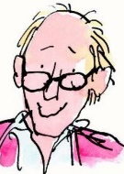
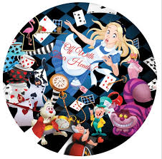



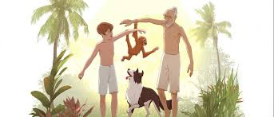
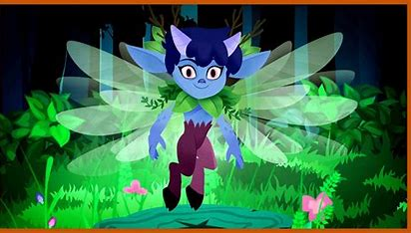


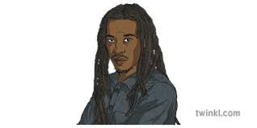


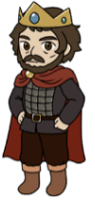



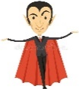

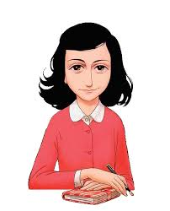
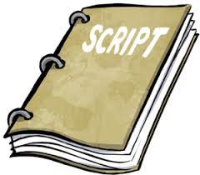

English- Learning Journey
Every year, you will complete a number of reading, writing and Speaking and Listening assessments as well as NGRT assessments in the first and final terms.
We will continue to build on literacy skills you learned from the first schools. In KS2, as well as working on reading, writing and oracy skills, every class follows a spelling programme.
Y5 Children’s Classic Literature
Matilda –Roald Dahl
You will be able to study the plot, write diary entries and take part in some dramatic performances based on Matilda.
Y5 Playscripts and Performances
You will understand what playscripts are, how they are written and performed, and even be able to create and act out your own!
Y5 Recounts, Reports and Journalism
Learn how to write your very own newspaper by being a journalist!
Y5 Narrative Poetry- Alfred Noyes
Exploring Alfred Noyes’s The Highwayman, you will be able to define the poem through story writing, analyse language and structure as well as exploring the relationship between the central characters using drama.
Y5 Myths
Delve into some classic Greek myths as well as learning how to write in the style of a myth.
Y5 Classic fiction- literacy heritage
Alice in Wonderland extracts (Lewis Carroll)
Explore themes of curiosity, identity, and growing up through a strange, imaginative world. You will also experience Carroll’s playful poetry, which uses rhyme and nonsense language to develop creativity.
Y6 Extended Narrative-Michael Morpurgo
We will continue to build on our KS2 reading, writing and oracy skills. We will also work on understanding characterisation and plot.
Year
5
Y6 Short Suspense Story
Explore tone and atmosphere. Understand how to build suspense skills in your writing to intrigue your reader.
Year
6
Y6 Persuasive Writing
Decide if you want to be an Athenian or Spartan with our cross-curricular persuasive piece!
Y7 Modern Fiction- David Almond
A wonderful book to let your imagination run wild. You will explore the key themes of the plot as well as looking at William Blake poetry and comparing the novel to the adaptation.
Y7 William Shakespeare-
A Midsummer Night’s Dream
Pupils will delve into this comedy play, exploring themes of love, magic and the supernatural as well as looking into dreams, gender and power.
Y6 Poetry- Multicultural Poetry
Explores themes of social justice, identity, inequality, and human rights, often promoting unity, empathy, and resistance against oppression from poets like Benjamin Zephaniah and many more.
Y6 Modern Extended Narrative-
Jason Reynolds Ghost
Learn about a boy who joins a track team and begins to confront his past while discovering his potential and sense of belonging.
Year
7
Y6 Modern Short Stories-
Roger Hargreaves
Become a Mr Man or Little Miss and rewrite a short story just like Mr Hargreaves does.
Y7 Non- fiction Writing to
Argue, Persuade and Advise
You will learn to debate with your classmates, showcasing new persuasive techniques you will have learned in your lessons.
The department has a wide range of resources to help you with your studies, including dictionaries and literacy key rings. Make sure you take advantage of these in your lessons!
During your time at Woodhouse, there are numerous opportunities to join one of our many clubs. We offer KS2 and KS3 Film Club, Mindfulness Club and there’s even a Drama Club in school too!
We celebrate World Book Day on an annual basis. Pupils are treated to several fun resources and a free book to enjoy. We also celebrate with a fashion runway during assembly time. Pupils who have dressed up as characters from a book get to show us who they are!
Y8 Poetry- Nature and Place
You will be exposed to poems that explore the natural world and the importance of location in shaping thoughts and feelings. Learn how poets use imagery, language, and structure to create vivid descriptions of landscapes and environments.
Y8 William Shakespeare- Macbeth
We study Macbeth before you leave us for high school. Not only do we explore the characters, plot and themes. We also analyse, critique and perform extracts from theatres online.
Year
8
Y7 Literary Heritage
Diary of a Young Gil extracts- Anne Frank
Read a number of powerful extracts which reveal Anne’s personal thoughts and emotional growth while hiding during World War II, showing her resilience, hopes, and reflections on fear, identity, and humanity.
Y8 Contemporary Play
Willy Russell- Blood Brothers
A chance to explore the iconic play by Willy Russell. We examine crucial themes in the play in the form of class debates and discussions. You will also be given several opportunities to read from the script and deploy oracy skills to communicate and perform.
Y8 Modern Extended Narrative Louis Sachar Holes
Revisit a known author from your KS2 days. This novel follows a boy on a mission to dig up the truth. You will write various pieces including a diary and a brochure advertising a summer camp.
Y8 Gothic Horror
Write your own gothic story following the conventions taught to you and also using numerous gothic extracts and some examples of gothic poetry to support.
Our Library is a wonderful place to visit. You can browse and read the books on the comfy sofas or even take out books to read at home.
Y7 Playscripts- Fast David Grant
You will be able to read as a character from the play, act out isolated scenes in groups as well as exploring script writing.
When you reach year 9, you will build on the English skills and content knowledge that you acquired in middle school.

