Slide 1
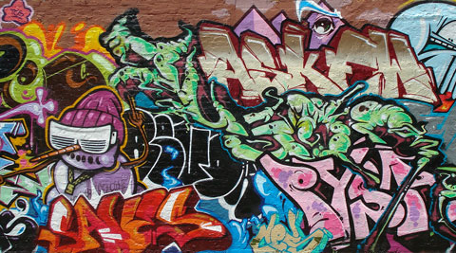
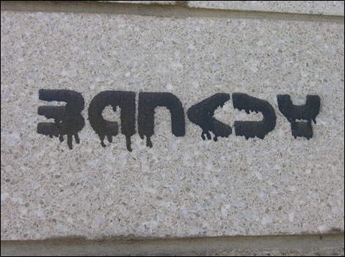
a
And Graffiti Art

Slide 2

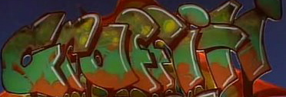
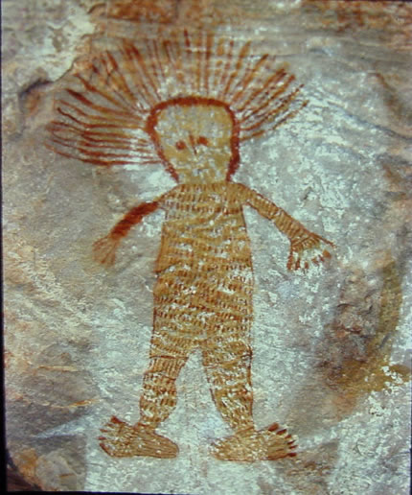
Art or Vandalism?
What do you think
Graffiti has been around for longer than you might think…..from ancient cave art of the aborigines'
To the modern day Graffiti seen in all cities and towns…

Slide 3
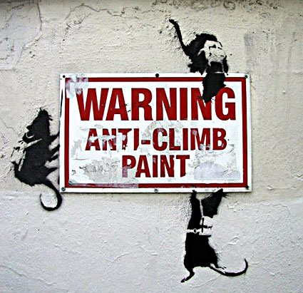
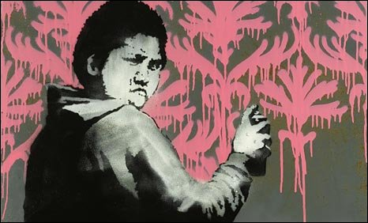
Graffiti has been viewed more as an act of vandalism than a work of art, but over recent years it has became more appreciated as public art.
Graffiti artists such as the Mysterious “Banksy” (Identity unknown) could have promoted Graffiti as art...

Slide 4
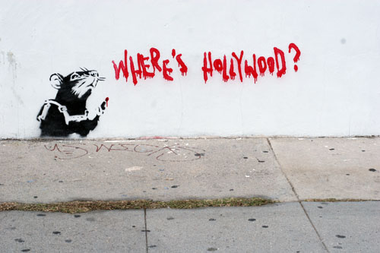
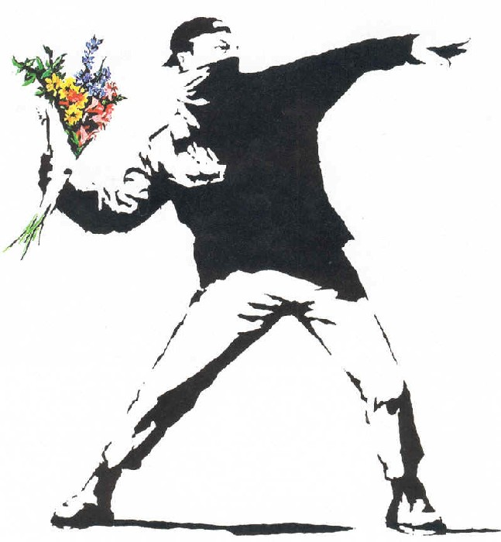
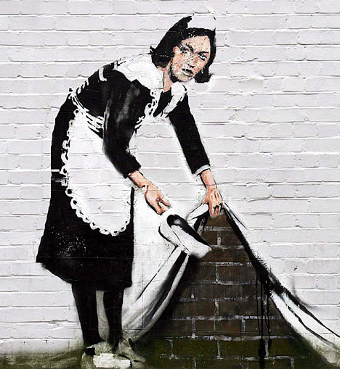
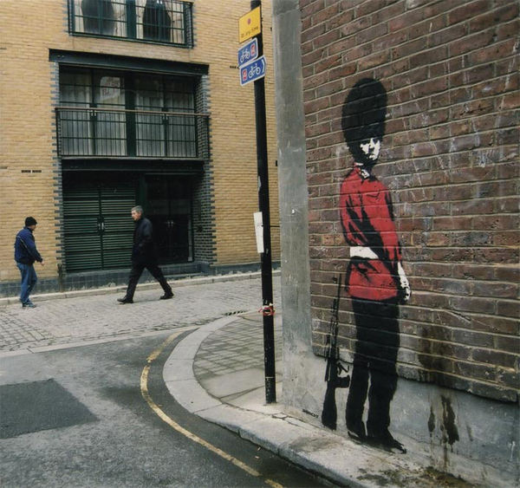
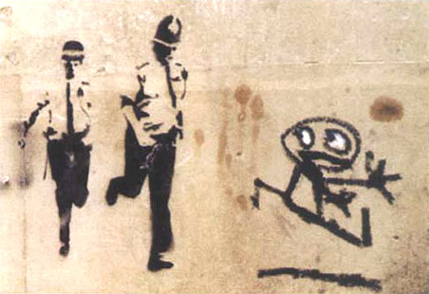
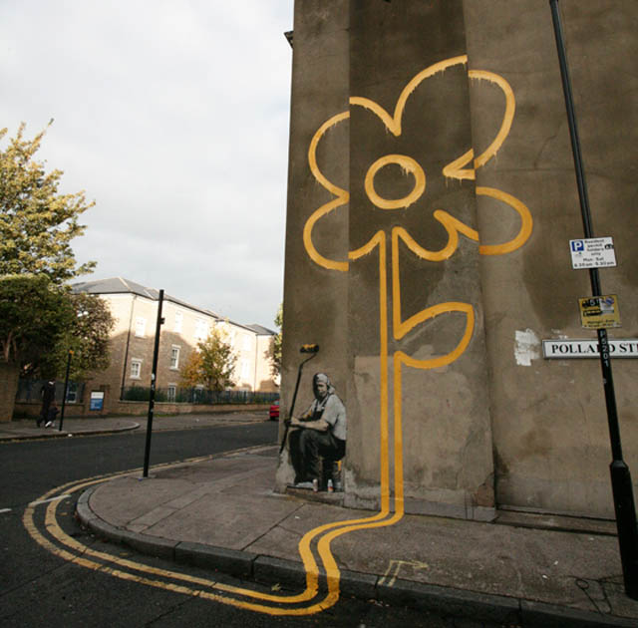
The work of

Slide 5
You are going to create your own Banksy style piece.
You will create a Graffiti “tag” of your name ( task 1 )
A back ground to add the tag and the image to ( task 2 )
An outline of your own portrait (lesson 2)
You could then have an image similar to this…….

Slide 6
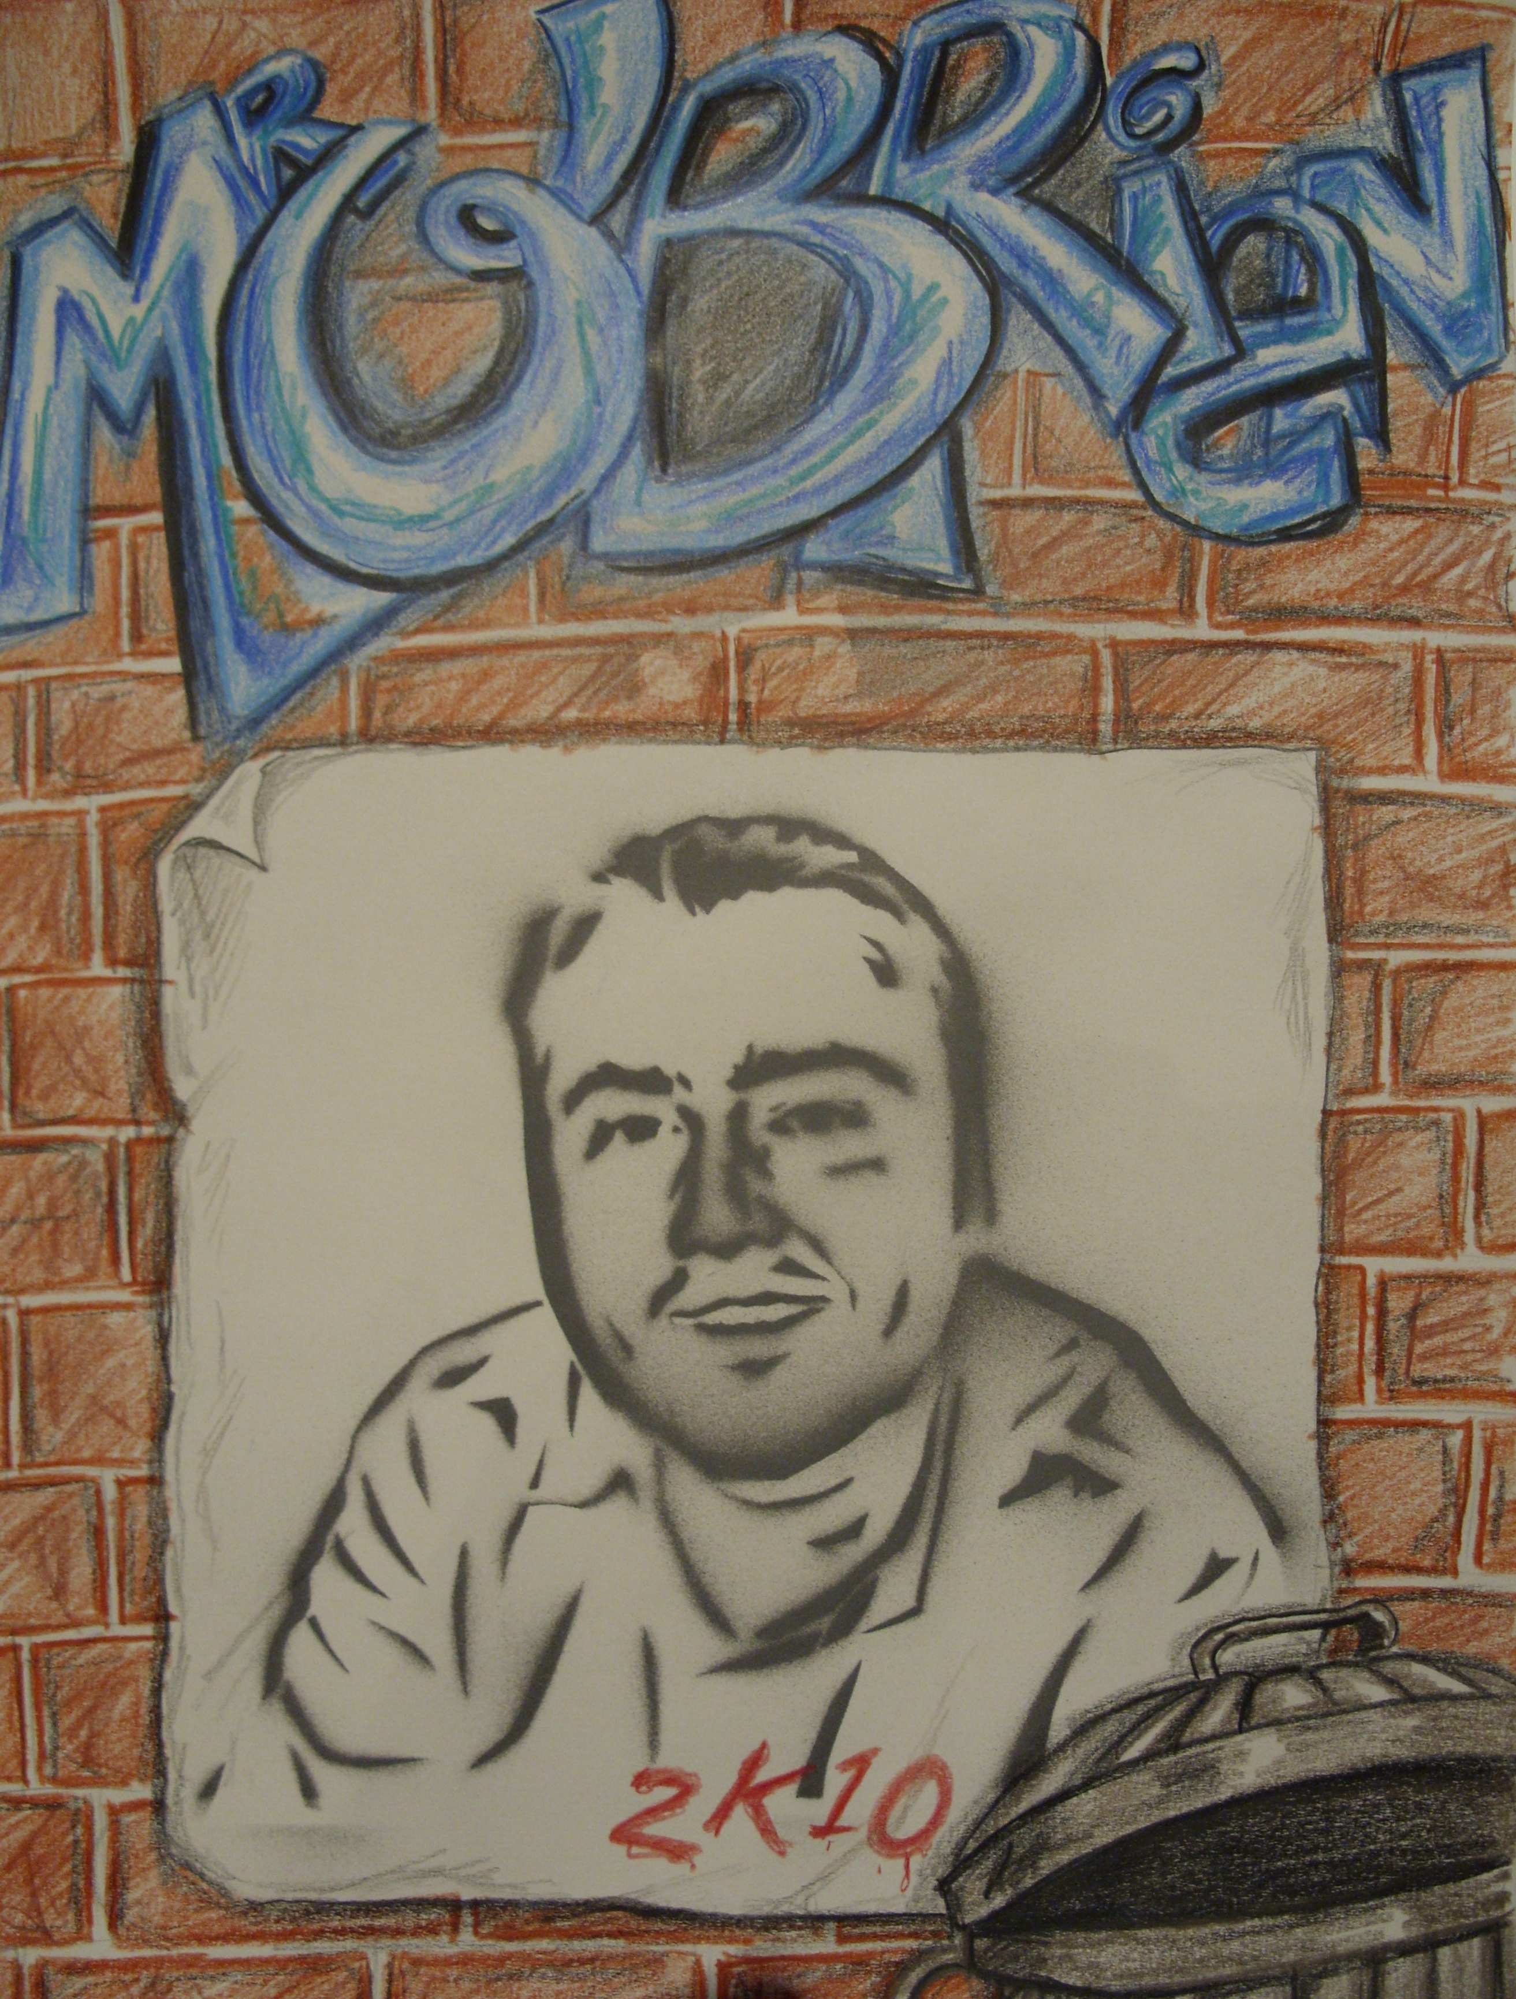
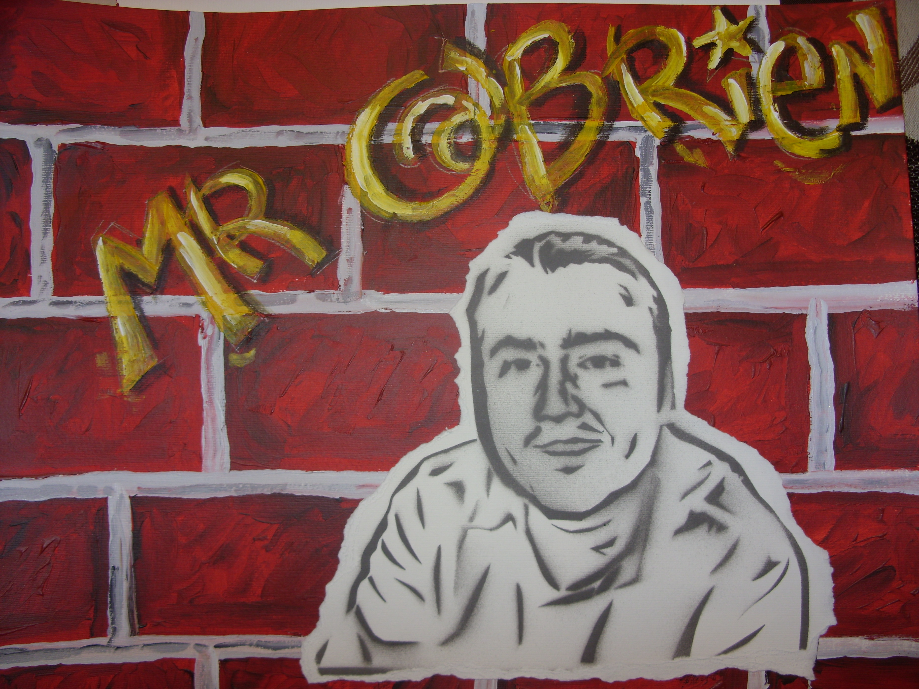
Your design can include much more detail and a better designed tag…and will obviously be a better looking subject!

Slide 7


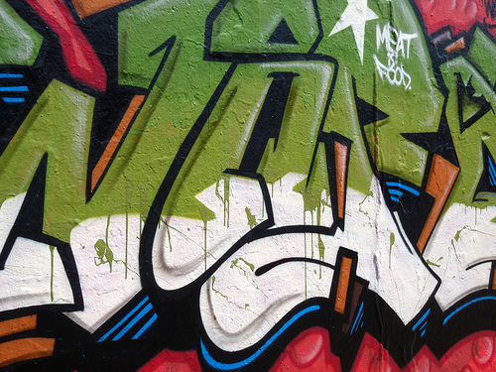
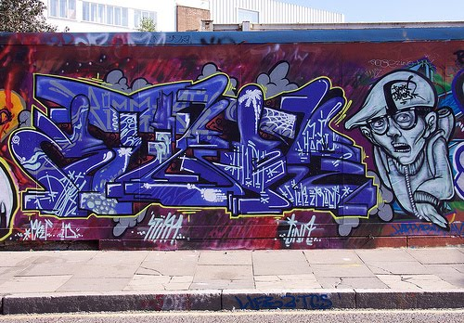


Graffiti Tag
A Graffiti Tag is your name or nickname usually drawn or sprayed on your work in a unique Graffiti style text.

Slide 8
TASK ONE -
(wb 6th July) continuing work for next week
Creating your Graffiti tag
Using your own creative skills create your own tag now. Many of you will be confident enough to have a go of this own your own – however if you would like some help of how to get started please watch this you tube clip - its only 3 minutes long and will help lots.
Do this on one piece of paper. Outline in a black crayon or biro.
Create this about A5 size
Lots of bright colours.

Slide 9

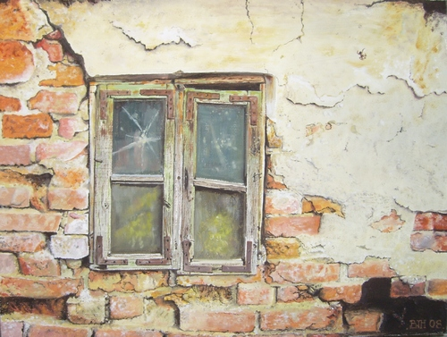
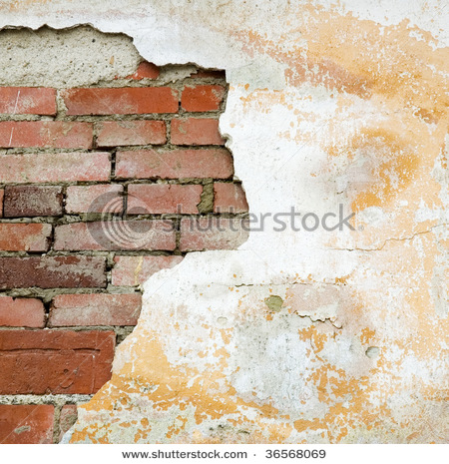
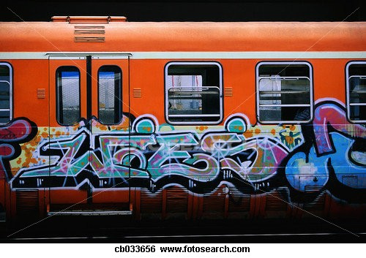
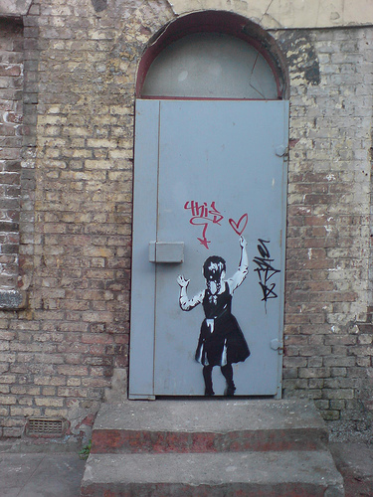
TASK TWO
TASK TWO -
Background

Slide 10
Background
You need to think of an eye catching back ground for your work….you could copy one of these if you are unsure. It need to be completed on one separate A4 sheet of paper . Happy creating .

