Slide 1



l/o: To explain the importance of different muscles in the body.
Developing
Secure
Secure +
I can: State the function of major muscle groups.
I can: Describe the function of major muscle groups.
I can: Explain how the muscle groups interact with other tissues to cause movement.

Slide 2
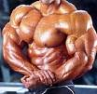
Prepare to Learn
What is the largest muscle in your body?
What is the smallest?
Why do some people have more muscle than others?
Why do we have muscles at all?
l/o: To explain the importance of different muscles in the body.

Slide 3
Muscle Facts
Smallest muscle in the body?
Stapedius: the muscle that activates the stirrup, the small bone that sends vibrations from the eardrum to the inner ear. It measures just 0.05 inch (0.13 centimeter) in length.
Largest muscle in the body?
Latissimus dorsi: the large, flat muscle pair that covers the middle and lower back.
Longest muscle in the body?
Sartorius: the straplike muscle that runs diagonally from the waist down across the front of the thigh to the knee.
l/o: To explain the importance of different muscles in the body.

Slide 4
Muscle Facts
Strongest muscle in the body?
Gluteus maximus: the muscle pair of the hip that form most of the flesh of the buttocks.
Fastest-reacting muscle in the body?
Orbicularis oculi: the muscle that encircles the eye and closes the eyelid. It contracts in less than 0.01 second.
Number of muscles used to make a smile?
Seventeen.
Number of muscles used to make a frown?
Forty-three.
l/o: To explain the importance of different muscles in the body.

Slide 5
Antagonistic pairs
Prime mover (agonistic)
This muscle determines the movement of an action – by contracting.
Antagonistic
This muscle works with the prime mover but creates an opposing action – by relaxing.
l/o: To explain the importance of different muscles in the body.

Slide 6
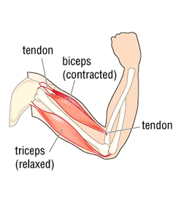
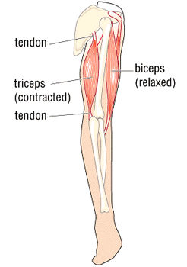
Antagonistic pairs – Bicep Curl
Biceps – Prime mover
Triceps – Antagonistic
Biceps – Antagonistic
Triceps – Prime Mover
l/o: To explain the importance of different muscles in the body.

Slide 7
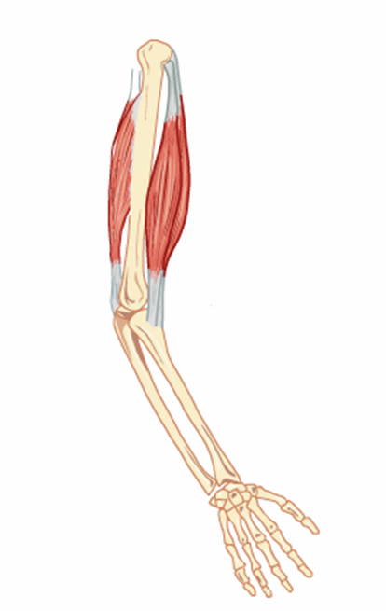
Muscle pairs
Tricep
Bicep
Which muscle causes the elbow joint to flex?
Bicep
What happens to the other muscle in the pair?
It relaxes
What do we call these pairs of muscles?
Antagonistic pairs
l/o: To explain the importance of different muscles in the body.

Slide 8
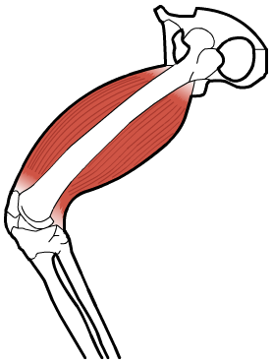
Muscle pairs
Quadriceps
Which muscle causes the knee joint to extend?
Quadriceps
Is this the agonist or antagonist?
Agonist
When does the hamstring become the agonist?
When the knee is flexed
Hamstring
l/o: To explain the importance of different muscles in the body.

Slide 9
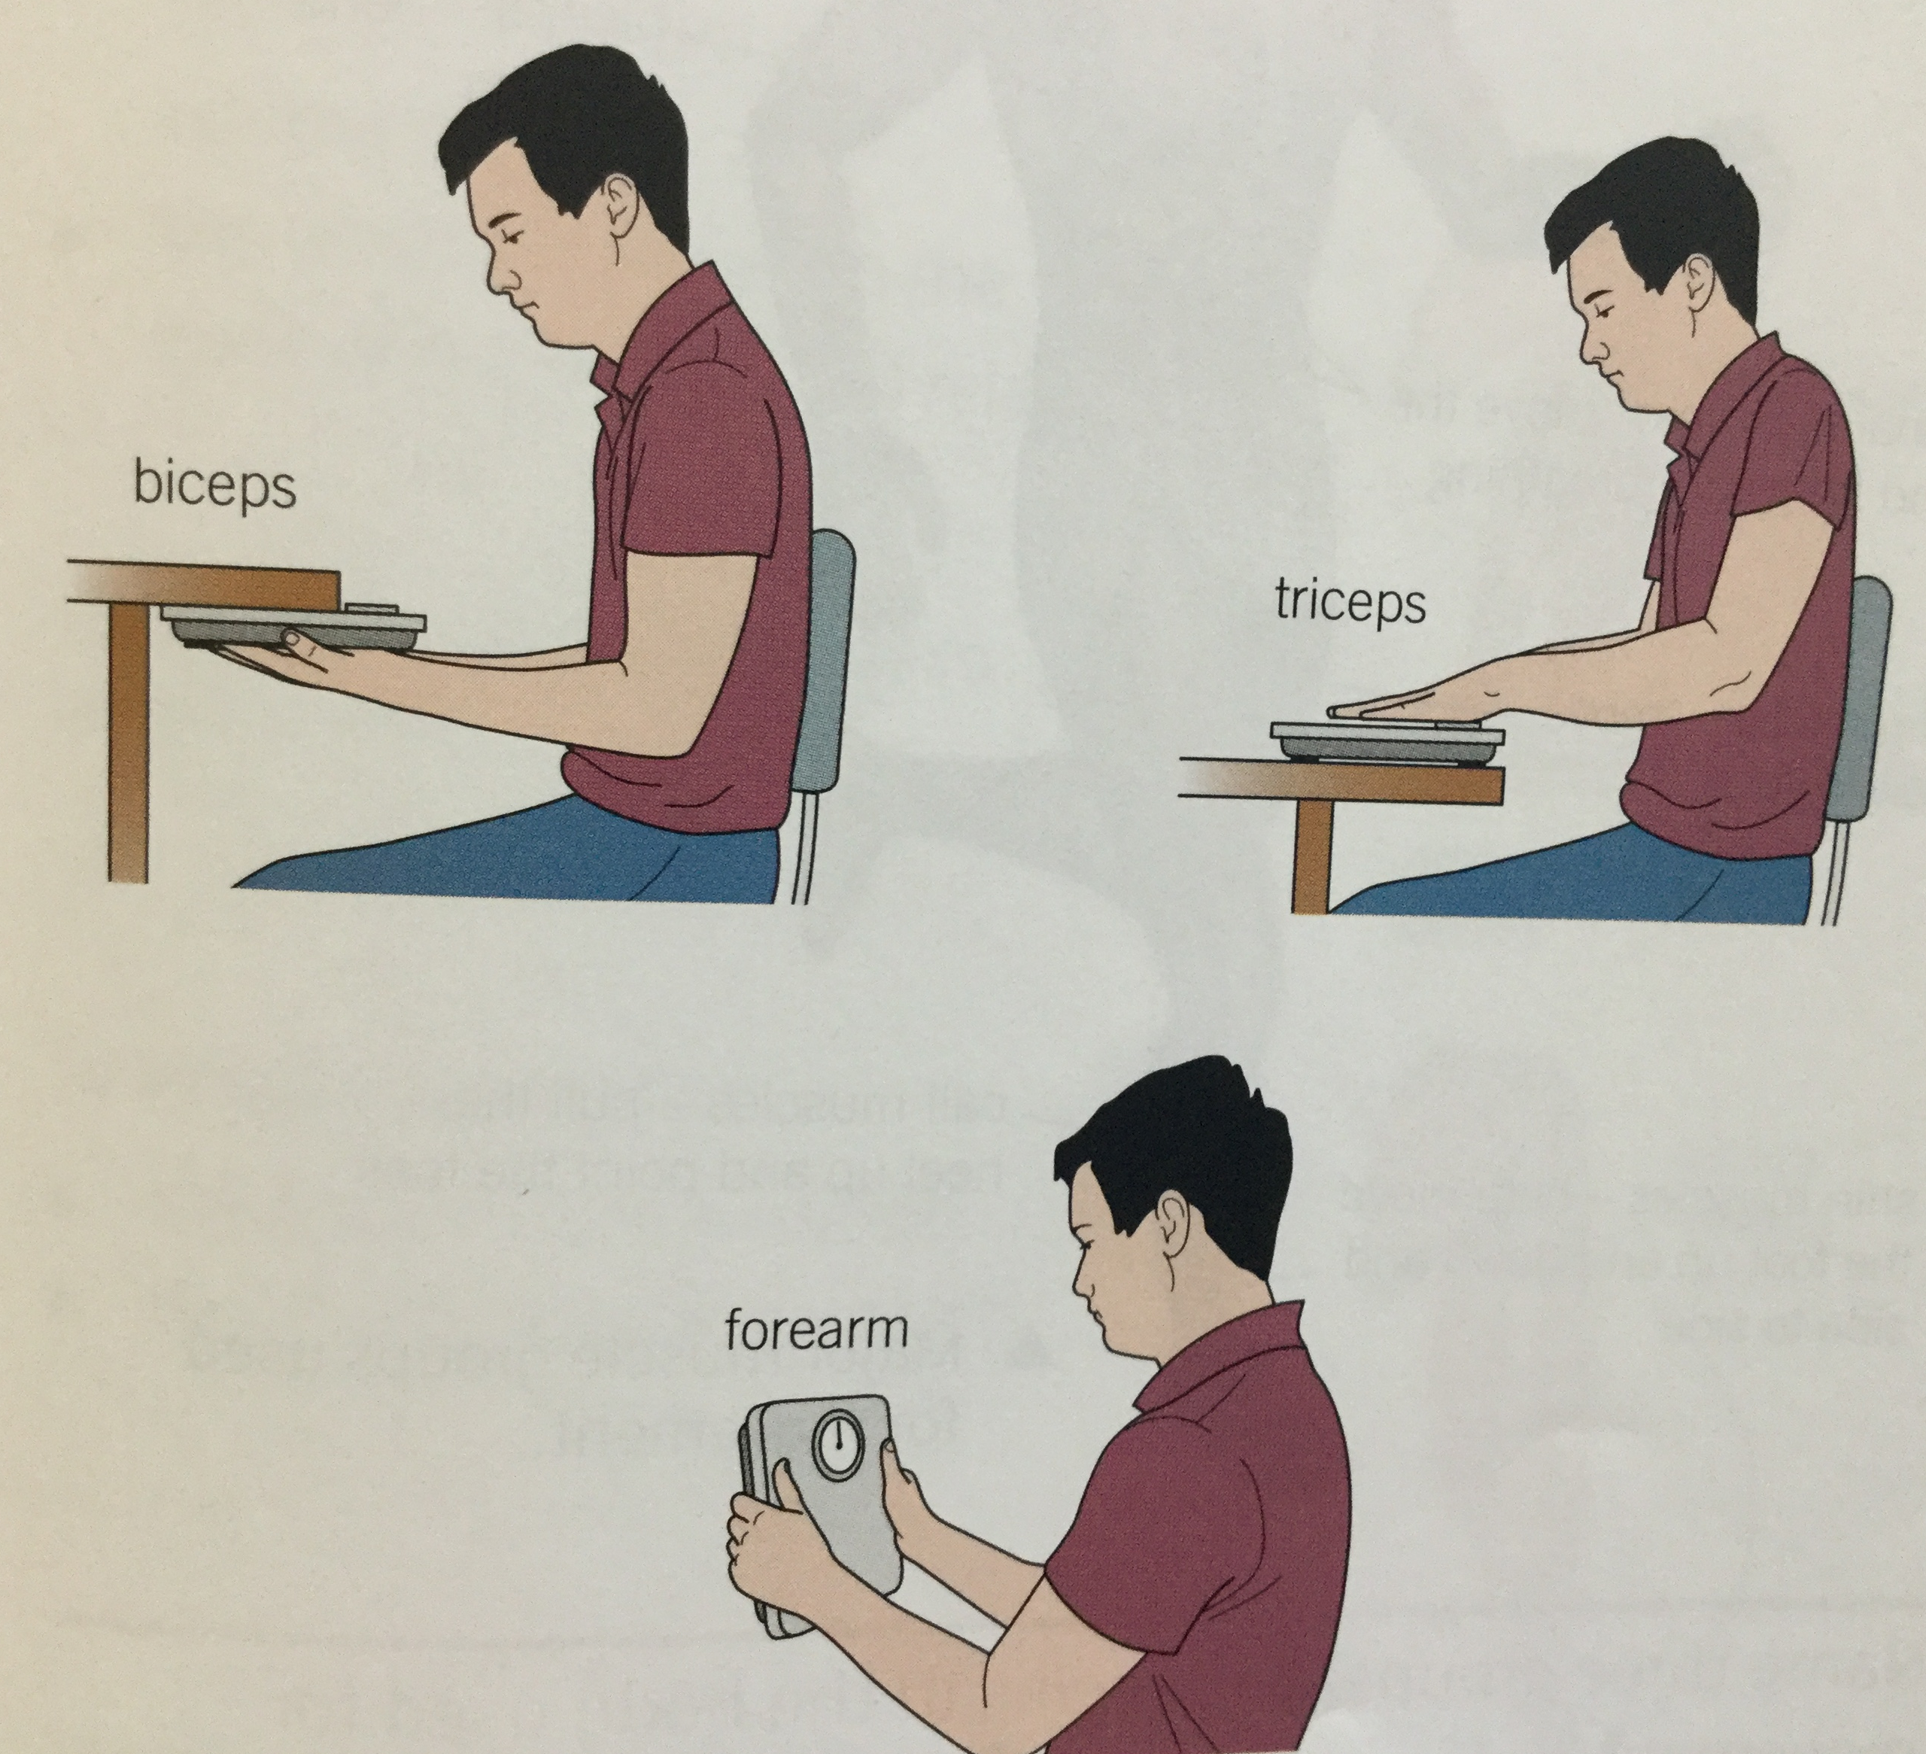
Measuring Muscle Strength
Use a force meter to test for the strength of muscles.
l/o: To explain the importance of different muscles in the body.

Slide 10
Three types of Muscle
Heart (cardiac) Muscle
Involuntary Muscle
Voluntary
Structure and function of these muscle tissues are very different
l/o: To explain the importance of different muscles in the body.

Slide 11
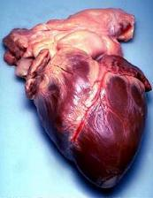
Heart/Cardiac Muscle
Built in Pacemaker – Sino-atrial node
Heartbeat is involuntary
Influenced by many factors – Such as?
These factors change the nervous system and the hormones that are released.
l/o: To explain the importance of different muscles in the body.

Slide 12
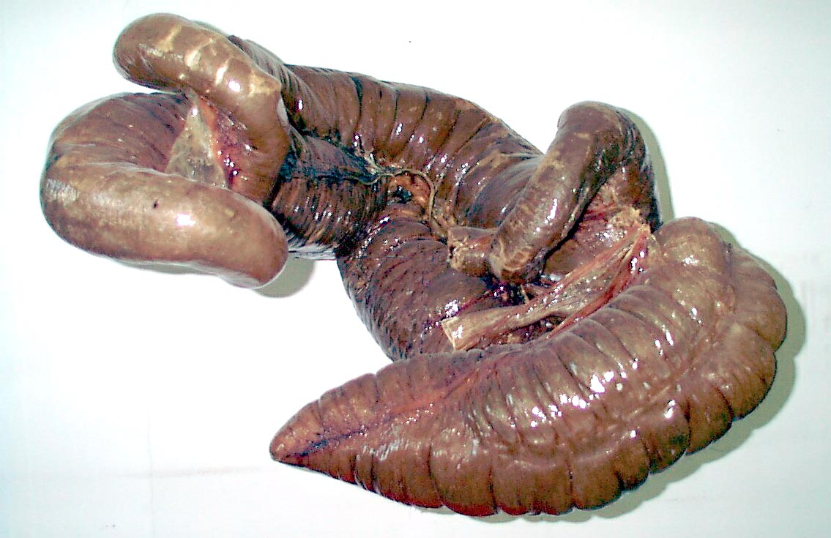
Involuntary (Smooth) Muscle
Found in visceral organs.
(Hollow organs)
Name three locations where you would find smooth muscle?
l/o: To explain the importance of different muscles in the body.

Slide 13
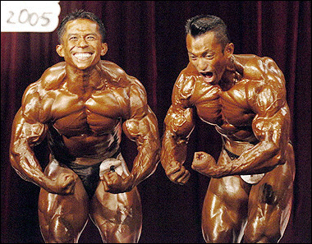
Voluntary (skeletal) Muscle
Attached to the skeleton
Provides movement and stability
Striated in appearance
l/o: To explain the importance of different muscles in the body.

Slide 14
Literacy Focus
Explain why some organs contain muscle tissue.
Use key words:
Relax
Contract
Muscle
Involuntary
Make sure you use capital letters and full stops

