Slide 1



l/o: To understand the structure and function of different types of joints.
Developing
Secure
Secure +
I can: State where joints are found in the body.
I can: Describe the role of joints in movement.
I can: Explain how the parts of a joint allow it to function.

Slide 2
Find the information to answer these questions.
State where joints are found in the body.
Describe the role of joints in movement.
Explain how the parts of a joint allow it to function

Slide 3
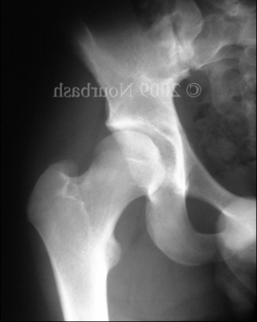
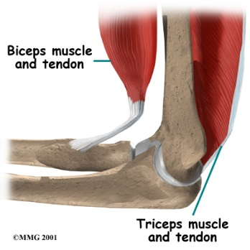
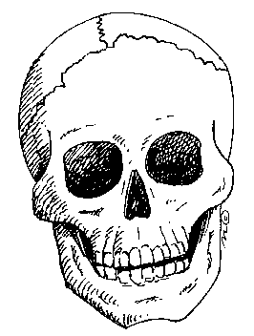
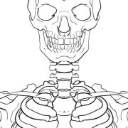
Use the slides in ‘resources’ to complete this table.
Type of joint | Diagram | Facts

Slide 4
Damage to joints
Joints can get damaged/worn
  How?
  What could this cause?
  What can be done to help?

Slide 5
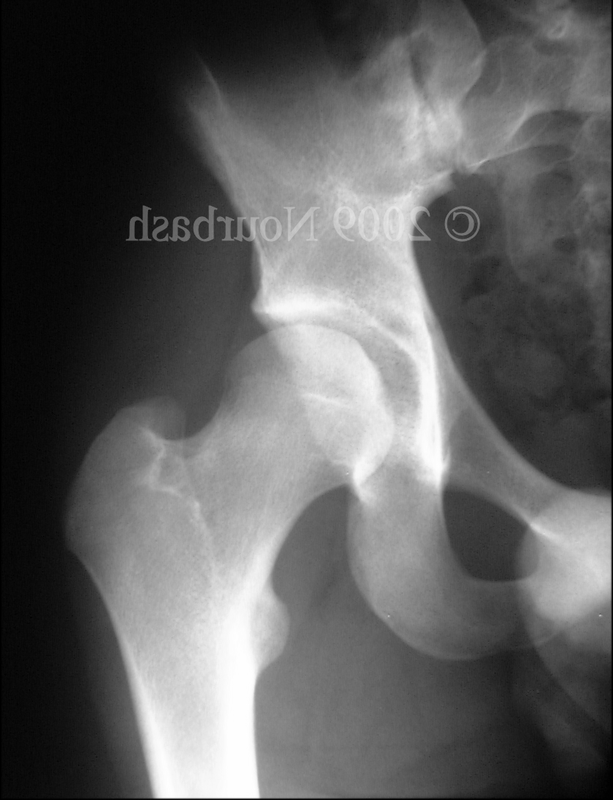
Ball and Socket Joint
Ball and socket joints allow the joint to rotate in 360º allowing a lot of flexibility.
A Typical ball and socket joint in the hip

Slide 6

Hinge Joint
Hinge joints work like a lever and allow movement of 180º.
The ends of the bones in a hinge joint are covered by cartilage.
Between the bones of the joint is a fluid called synovial fluid.
Muscles work in pairs to contract and relax to move the joint.
A Typical hinge joint in the elbow

Slide 7
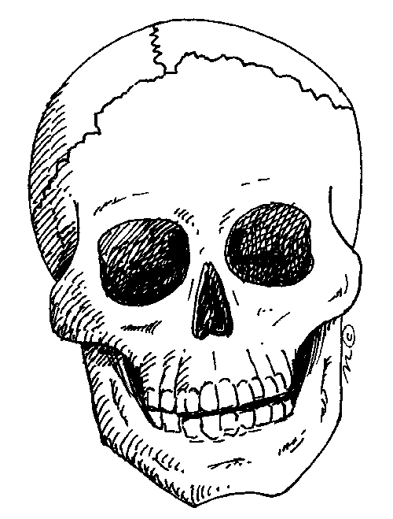
Fixed Joint
Fixed joints form between two bits of bone and they do not move.
The plates of bone that make up our skull were once separate, but during early years, they fuse to form a solid skull.
The fusion of the bone means it cannot grow and get bigger, or smaller.
The fixed joint between plates of bone in the skull

Slide 8
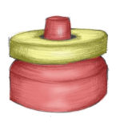
Pivot Joint
Pivot joint of the neck
Pivot joints allow bones to rotate around each other by 360º.
The reason our neck does not rotate 360º fully is because muscles limit how far it will rotate.
The ends of the bones in a pivot joint are covered by cartilage.
The joint contains synovial fluid between the bones.

Slide 9
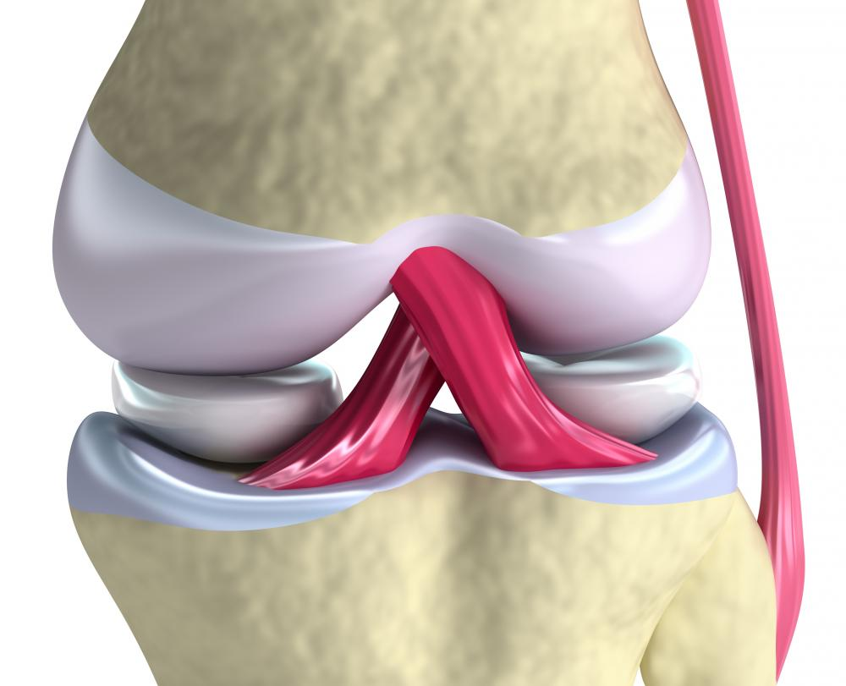
Ligaments
Ligaments are a type of connective tissue.
They connect Bone to Bone.
Ligaments are elastic and stretchy. This allows the joint to move where it needs to, but keeps the bones aligned.
When we tear a ligament, the connective tissue is damaged and causes pain when we move the joint.
If ligaments were not stretchy, they would snap every time we bent a joint!
Ligaments of the Knee in Pink

Slide 10
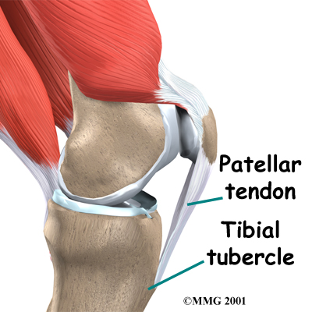
Tendon
Tendons are a type of connective tissue.
They connect Muscle to Bone.
Tendons are not elastic and not stretchy. This allows the muscles to pull up on a bone.
If tendons were stretchy, when a muscle contracted to move a joint, it would stretch the tendon and the joint would not move.
Tendons have to be very tough and strong to hold powerful muscles to strong bones.
Tendons of the Knee in White

Slide 11
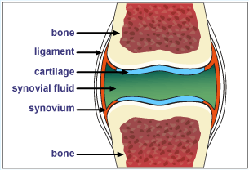
Cartilage
Cartilage is a strong and spongy tissue.
It forms round the end of ball and socket, hinge and pivot joints to protect the end of the bone.
When we move, cartilage in our joints acts to reduce friction to protect our bones.
Arthritis is when cartilage wears down and the ends of bones in a joint grind together when it is moved.
Cartilage in a joint, here in blue

Slide 12
Ball and Socket Joint
Ball and socket joints allow the joint to rotate in 360º allowing a lot of flexibility.
A Typical ball and socket joint in the hip

Slide 13
Hinge Joint
Hinge joints work like a lever and allow movement of 180º.
A Typical hinge joint in the elbow

Slide 14
Fixed Joint
Fixed joints form between two bits of bone and they do not move.
The fixed joint between plates of bone in the skull

Slide 15
Pivot Joint
Pivot joint of the neck
Pivot joints allow bones to rotate around each other by 360º.

Slide 16
Ligaments
Ligaments are a type of connective tissue.
They connect Bone to Bone.
Ligaments are elastic and stretchy. This allows the joint to move where it needs to, but keeps the bones aligned.
When we tear a ligament, the connective tissue is damaged and causes pain when we move the joint.
If ligaments were not stretchy, they would snap every time we bent a joint!
Ligaments of the Knee in Pink

Slide 17
Tendon
Tendons are a type of connective tissue.
They connect Muscle to Bone.
Tendons are not elastic and not stretchy. This allows the muscles to pull up on a bone.
If tendons were stretchy, when a muscle contracted to move a joint, it would stretch the tendon and the joint would not move.
Tendons have to be very tough and strong to hold powerful muscles to strong bones.
Tendons of the Knee in White

Slide 18
Cartilage
Cartilage is a strong and spongy tissue.
It forms round the end of ball and socket, hinge and pivot joints to protect the end of the bone.
When we move, cartilage in our joints acts to reduce friction to protect our bones.
Arthritis is when cartilage wears down and the ends of bones in a joint grind together when it is moved.
Cartilage in a joint, here in blue

