Slide 1



Organisation
Developing
Secure
Secure +
I can: Explain how the different tissues in an organ, and the different organs in an organ system function together.
I can: Define and state examples of tissues, organs, and organ systems.
I can: Describe the hierarchy of organisation in a multicellular organism.

Slide 2

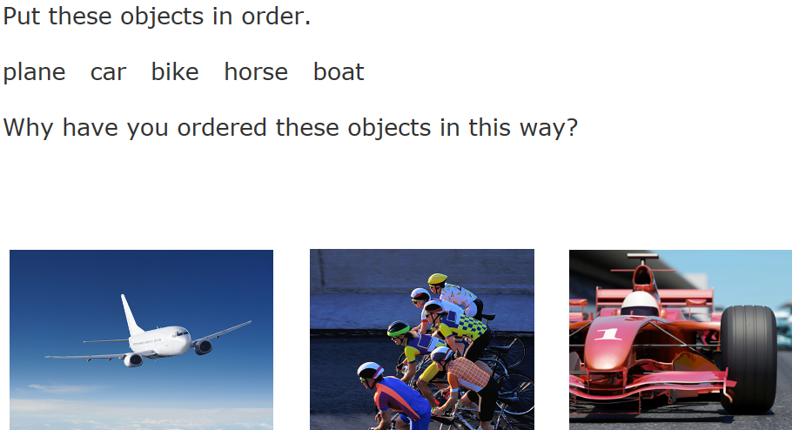
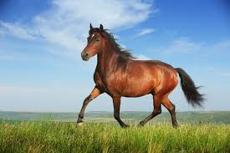
Prepare to Learn

Slide 3
Organisation in multicellular organisms
How do cells work together in the whole organism?
Watch the animation on the organisation of multicellular organisms.
https://www.youtube.com/watch?v=SzKKYYIlJ-c

Slide 4
What is a cell?
What is a tissue?
What is an organ?

Slide 5
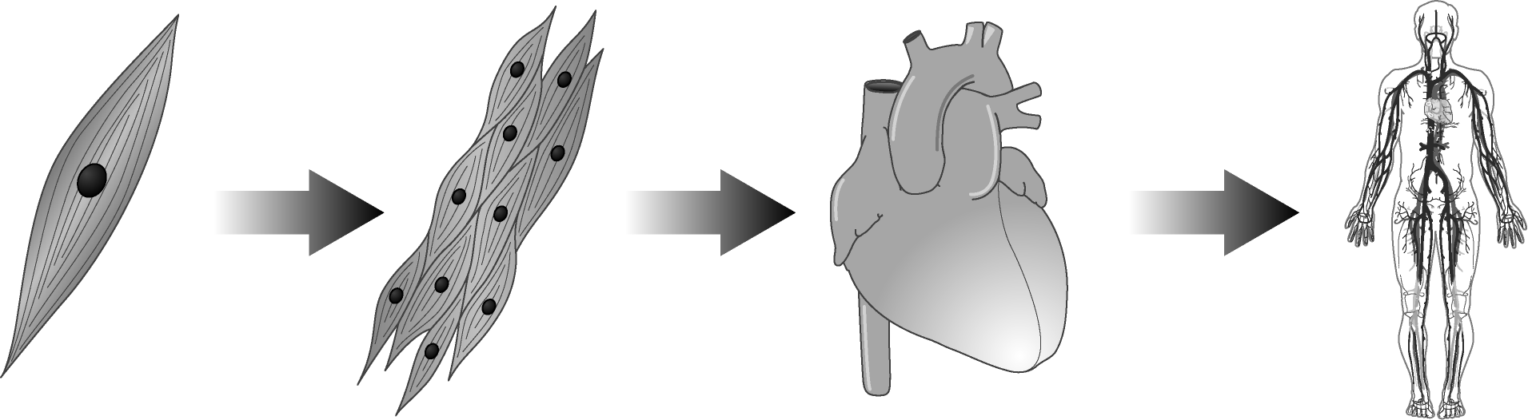
Cell –> tissue -> organ -> organ system

Slide 6
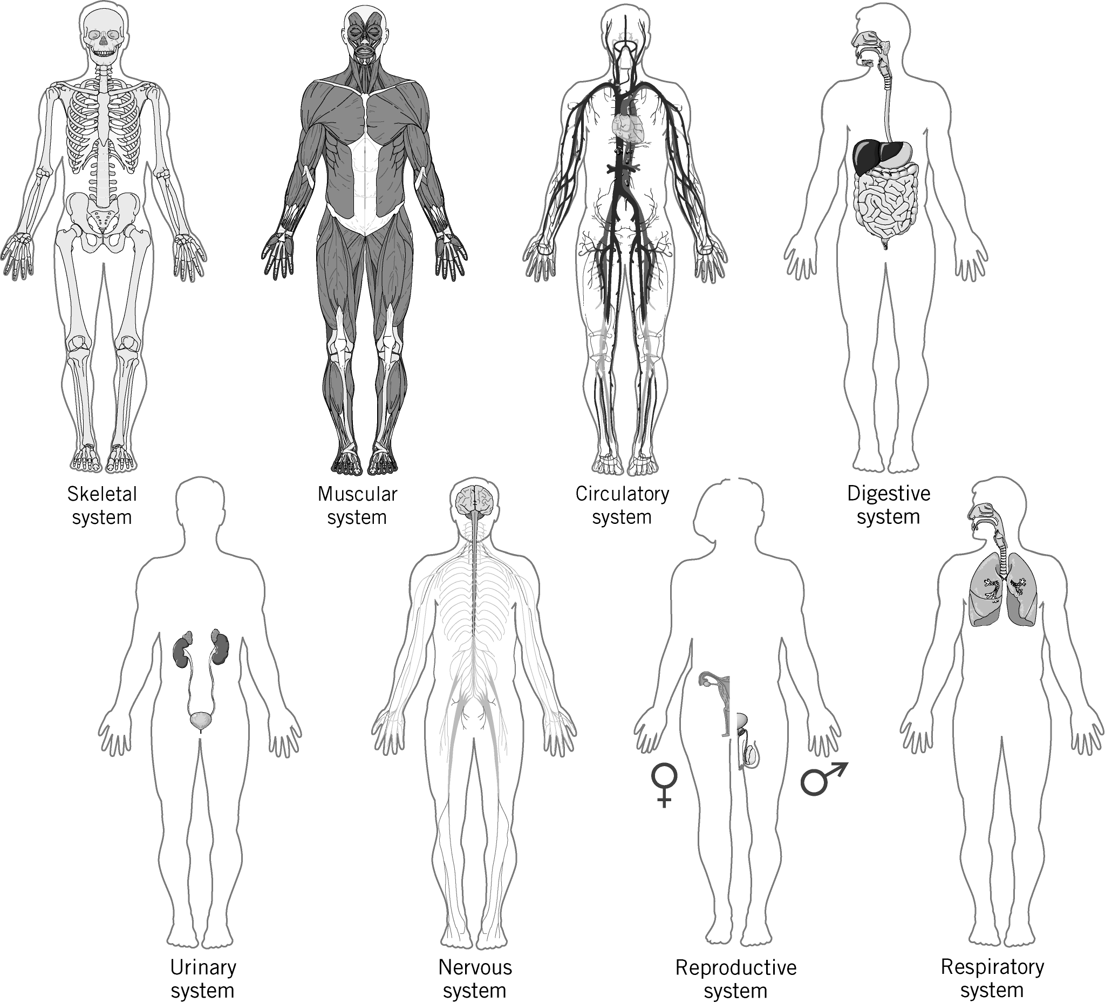

Slide 7
Research
Research the organ systems.
Find out what organs are in the system and what the system's function is.

Slide 8
Questions
State what all living things are made from.
Name three parts of all cells.
Name three specialised cells.
What is a tissue?
State the name of a group of tissues working together.
What is an organ system?

Slide 9
Extension
Explain how the organs of the digestive system function together to digest food. (6 marks)

