Slide 1
Employment in Italy
Describe the key concepts ‘primary’, ‘secondary’ and ‘tertiary’.
Analyse the spread of employment in Italy
Compare and contrast Italy’s employment with less developed countries

Slide 2


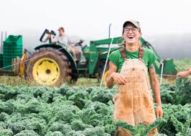
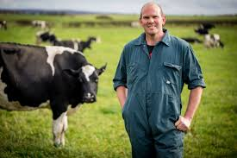
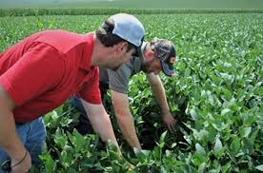
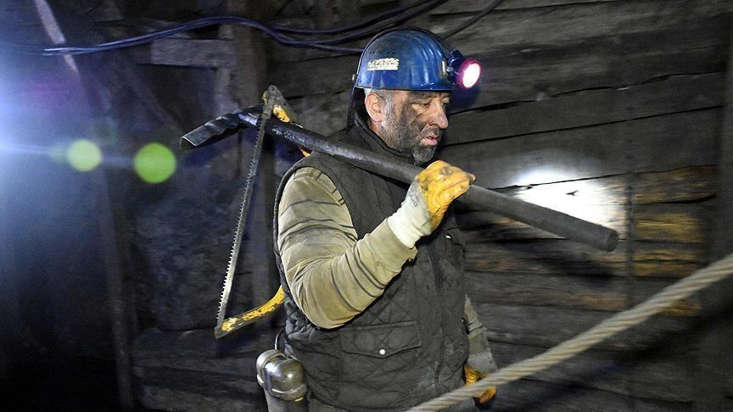
Primary Sector:
Describe the key concepts ‘primary’, ‘secondary’ and ‘tertiary’.

Slide 3
Describe the key concepts ‘primary’, ‘secondary’ and ‘tertiary’.
So, what is
‘The Primary Sector’?
How would you define it?
What did all of those jobs have in common?

Slide 4
The Primary Sector:
Describe the key concepts ‘primary’, ‘secondary’ and ‘tertiary’.
This sector includes jobs which involve working with a natural product.
People in this sector grow, find, harvest natural goods so they can be used
Natural things used in this sector include:
  Crops
  Plants
  Animals
  Rocks
  Precious stones e.g. diamonds
  Gold
  Coal
  Oil

Slide 5

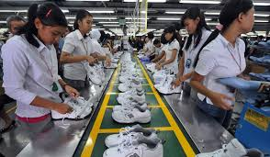
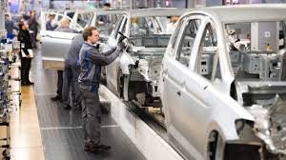
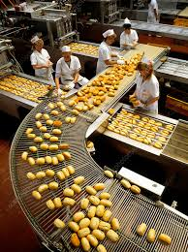
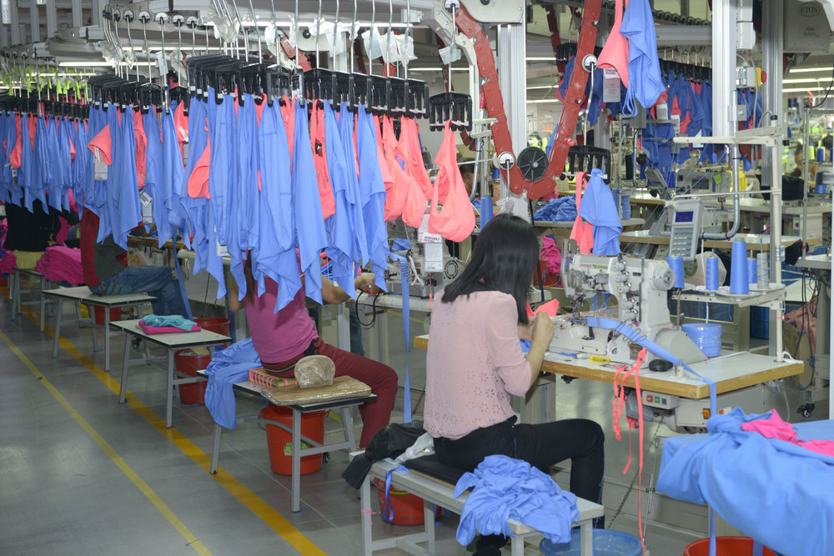
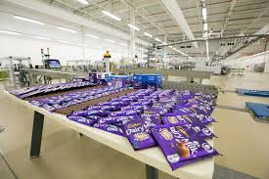
Secondary sector:
Describe the key concepts ‘primary’, ‘secondary’ and ‘tertiary’.

Slide 6
Describe the key concepts ‘primary’, ‘secondary’ and ‘tertiary’.
So, what is
‘The Secondary Sector’?
How would you define it?
What did all of those jobs have in common?

Slide 7
The Secondary Sector:
Describe the key concepts ‘primary’, ‘secondary’ and ‘tertiary’.
This sector includes jobs which use and change the natural products from the primary sector and turn them into other products
The reason for doing this is to sell the product to make money!
Products that are made in this sector include:
  Clothes
  Shoes
  Food products
  Cars
  Houses

Slide 8



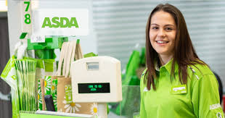

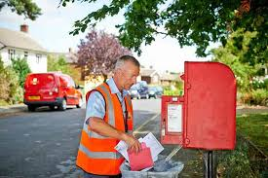
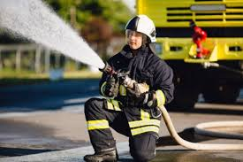
Tertiary sector:
Describe the key concepts ‘primary’, ‘secondary’ and ‘tertiary’.

Slide 9
Describe the key concepts ‘primary’, ‘secondary’ and ‘tertiary’.
So, what is
‘The Tertiary Sector’?
How would you define it?
What did all of those jobs have in common?

Slide 10
The Tertiary Sector:
Describe the key concepts ‘primary’, ‘secondary’ and ‘tertiary’.
This sector includes jobs which provide some sort of service for the general public
It doesn’t involve growing, or making new materials. It is more about doing things for people that they need
Services can include:
  Teacher
  Healthcare
  Waitress
  Shop worker
  Postman
  Fireman

Slide 11
Mini-Plenary
Describe the key concepts ‘primary’, ‘secondary’ and ‘tertiary’.
Decide which category the following jobs would fall into…

Slide 12
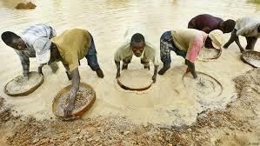
Describe the key concepts ‘primary’, ‘secondary’ and ‘tertiary’.
DIAMOND MINERS

Slide 13

Describe the key concepts ‘primary’, ‘secondary’ and ‘tertiary’.
LAWYER

Slide 14
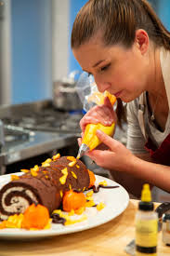
Describe the key concepts ‘primary’, ‘secondary’ and ‘tertiary’.
BAKER

Slide 15

Describe the key concepts ‘primary’, ‘secondary’ and ‘tertiary’.
NURSERY WORKER

Slide 16

Describe the key concepts ‘primary’, ‘secondary’ and ‘tertiary’.
WOOD WORKER

Slide 17

Describe the key concepts ‘primary’, ‘secondary’ and ‘tertiary’.
FARMER

Slide 18
Answers:
Diamond miners- Primary
  (they collect diamonds which are a natural resource)
Lawyer- Tertiary
  (they provide a service)
Baker- Secondary
  (they turn natural goods like eggs into a product to sell- like cakes!)
Nursery worker- Tertiary
  (they provide a service)
Woodworker- Secondary
  (they turn wood, a natural resource, into items to sell such as furniture)
Farmer-Primary
  (they harvest natural resources like wheat, eggs, cows etc.)

Slide 19
Killer Question:
Which sector do you think will be the biggest in Italy (which one will most people be employed in)?
Justify your thoughts!
Analyse the spread of employment in Italy

Slide 20
Italy’s Employment:
Primary | 5%
Secondary | 25%
Tertiary | 70%
In developed countries, like Italy, the tertiary sector is usually much bigger than any other.
This is because the people living there have a better quality of life (and more money to spend on luxuries) so there will be a bigger demand for services such as hotels, restaurants, teachers, lawyers etc.
Analyse the spread of employment in Italy

Slide 21
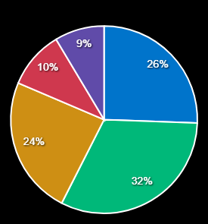
Analyse the spread of employment in Italy
Task: To create a pie chart to show Italy’s employment data on previous slide)
A pie chart is circular
There are 360⁰ in a circle
So 1% is the same as 3.6⁰
Or, to make it slightly easier, 5% is the same as 18⁰
If I wanted to show 5% on my pie chart, I would use my protractor to draw a section which was 18⁰ wide…
You will need:
A pencil
A protractor
A ruler
A compass
I think this will be very challenging- I will use worksheet 1.
I think I will be able to try this but need a bit of help- I will use worksheet 2.
I think I will be able to do this by myself- I am just going to use a plain piece of paper.

Slide 22
Your finished pie chart should have looked something like this:

Slide 23
Killer Question:
Which sector do you think will be the biggest in less developed counties, like India…?
Justify your thoughts!
Compare and contrast Italy’s employment with less developed countries

Slide 24
India’s Employment:
Compare and contrast Italy’s employment with less developed countries
Primary | 43%
Secondary | 25%
Tertiary | 32%
In less developed countries, like India, the primary sector is usually much bigger than any other. This is because the people living there have a poorer quality of life (with very little money to spend on luxuries) so more people will be employed in necessary jobs like gathering food through farming and fishing.

Slide 25
Plenary: Quiz!
Mark your answers using the next slides…
Describe what the primary sector is
Describe what the secondary sector is
Describe that the tertiary sector is
Give an example of a type of job in each sector
Which employment sector is biggest in Italy?
Why is this sector biggest?
Which sector is biggest in less developed country?
Why is this sector biggest in less developed countries?

Slide 26
Answers: Developing
Describe what the primary sector is
The primary sector is any job which involves finding or getting natural resources such as crops.
2) Describe what the secondary sector is
The secondary sector is any job which uses the natural resources from the primary sector to make a product to sell such as using diamonds to make jewellery.
3) Describe that the tertiary sector is
The tertiary sector is any job which provides a service for people, such as teaching children. It does not involve using any natural resources at all.
4) Give an example of a type of job in each sector
Any of the examples given on the previous slides (or your own example as long as it fits the descriptions above!)

Slide 27
Answers: Secure
5) Which employment sector is biggest in Italy?
The Tertiary Sector
6) Why is this sector biggest?
This sector is the biggest because Italy is a very developed country which means the people living there have good lifestyles. This means they can afford and expect to have many different services provided by the tertiary sector such as teachers, lawyers, hotels, restaurants, theatres, cinemas etc.

Slide 28
Answers: Secure+
7) Which sector is biggest in less developed country?
The Primary Sector
8) Why is this sector biggest in less developed countries?
People in less developed countries don’t have as much money and so cant afford to spend their money on ‘services’. Instead, most people have jobs which rely on gathering basic supplies like growing and harvesting food.

