Slide 1
How Developed is Italy?
Understand what the ‘The Human Development Index’ means.
Investigate how developed Italy is
Compare and contrast the development of Italy and The UK

Slide 2
What is development?
Understand what the ‘The Human Development Index’ means.
Most simply, development means people reaching a good standard of living.
If a country is undeveloped, it means lots of people living there don’t have a very good quality of life
If a country is developing, it means it is changing for the better
If a country is developed, it means that the majority of people there have a good standard of living.

Slide 3
Every country in the world is at a different stage of development…
Think of it as a scale like the one below:
Understand what the ‘The Human Development Index’ means.
Think of at least one country you would put at each stage and try to give a reason why you think this…
Developing
Developed
Undeveloped
Remember- development means how good is their quality of life?

Slide 4
Understand what the ‘The Human Development Index’ means.
Afghanistan
Bangladesh
Bhutan
Cambodia
India
Brazil
China
Mexico
UK
USA
Germany
Australia

Slide 5

Understand what the ‘The Human Development Index’ means.
Why did you pick those countries?
What things did you consider when thinking about how good someone’s life was?

Slide 6








How can we tell how developed a country is?
https://www.gapminder.org/dollar-street/matrix?thing=Homes

Slide 7
How can we tell how developed a country is?
Do children go to school? If so, are they good schools?
Can people afford luxuries like cars, phones etc?
Quality of people’s homes
Can people afford basic necessities, like food?
Do people have access to good quality health care?
Do children have the things they need for school?

Slide 8
https://www.gapminder.org/dollar-street/matrix?thing=Homes
Click on the link above which takes you ‘Dollar Street’
This lets you compare lots of different countries based on different things.
The link shows you homes- at the bottom of the street you see homes of the less developed countries and what they look like, at the top of the street are the more developed countries homes.
Play around with it by changing it from ‘homes’ to other things (teeth and toilets are always interesting to look at!)

Slide 9
The Human Development Index (HDI)
Understand what the ‘The Human Development Index’ means.
There are many different ways to compare how ‘happy’ or ‘well off’ people are.
The HDI was created to make it easier to compare how developed different countries are.
It takes into consideration 3 things:
  Living standards- How much money do people earn (this tells us whether they can afford the essentials like food, or have money to spend on luxuries like computers)
  Health- Are people healthy and can they get care if they are unwell (we judge this by looking at life expectancy- how long on average people live for)
  Education- Do people get a good education (e.g. how long do they go to school for, and can they read and write?)

Slide 10
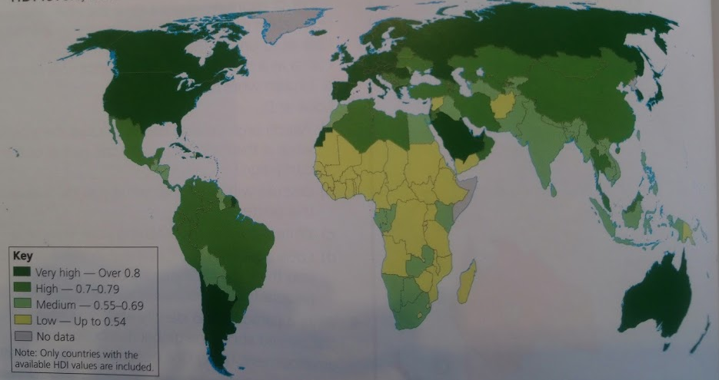
HDMI is scored between 0 and 1. The higher the number, the greater the level of development.
Using the map above, you should be able to tell me whether Italy is developed or not?

Slide 11
ITALY IS A DEVELOPED COUNTRY!
Italy is classed as ‘very highly’ developed.

Slide 12
Investigate how developed Italy is
Compare and contrast the development of Italy and The UK
There are 3 questions I would like you to find the answers to.
Open and complete worksheet 1 to complete your investigation.
Dev | The question as your subheading Your answer
Sec | Evidence (e.g. maps or tables cut from your information sheets and stuck in your book)
Sec+ | Explain how the evidence proves that your answer is correct
Is Italy more or less developed than the UK (using the HDI criteria)?
Does the UK or Italy make more money from trading with other countries (selling their goods)?
Is the North or South of Italy more developed?

Slide 13
Self-Assess
Open the worksheet 1 answers document
Check through your answers- correct anything you got wrong
Did you include everything? Is there anything you could add to improve your answers?

