Slide 1


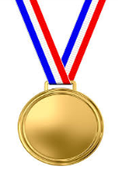
The Solar System
Developing
Secure
Secure +
I can: name the objects in the Solar System.
I can: describe some similarities and differences between the planets of the Solar System.
I can: explain why we know less information about some of the planets.

Slide 2
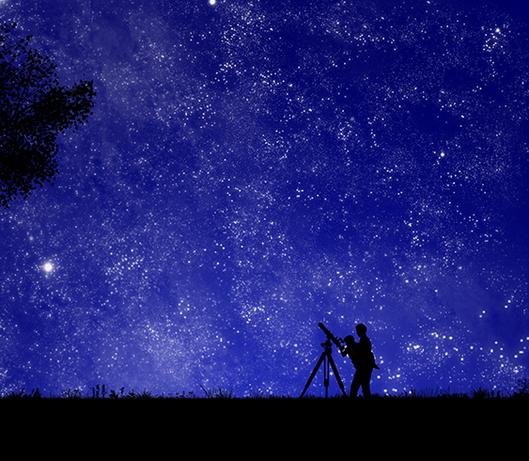
How big do you think our Solar System is compared to the rest of the known Universe?

Slide 3
Our Solar System
Draw a diagram of the objects in the Solar System.
Can you include their orbits?
l/o: To learn the objects in the solar system.

Slide 4
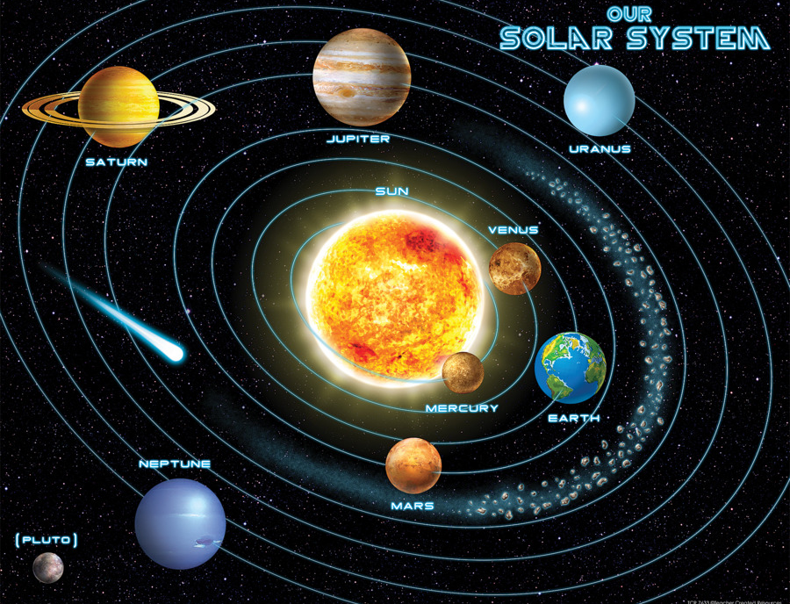

Slide 5
The Planets
There are eight different planets in the Solar System.
Make a mnemonic of the Solar System planets.
Use this to learn the names of the planets in their order away from the sun.
l/o: To learn the objects in the solar system.

Slide 6
Task
The table shows how far the planets are from the Sun compared with Earth.
Write “Sun” at one end of and “Pluto” at the other end.
Fold the paper in half, write “Uranus” on the crease.
Re-fold, then fold in half again, write “Saturn” on the 1/4 closest to the Sun, write “Neptune” on the 3/4 fold.
Fold from the Sun up to Saturn, write “Jupiter” at this 1/8 crease.
Fold from the Sun up to Jupiter, write “Asteroid Belt” at this 1/16 crease.
Fold from the Sun up to asteroid belt, write “Mars” at this 1/32 crease.
Write the rest of the planets evenly in the remaining space (in this order); Sun, Mercury, Venus, Earth, Mars.
Planet | Distance from Sun (compared with Earth)
Mercury | 0.4
Venus | 0.75
Earth | 1
Mars | 1.5
Jupiter | 5
Saturn | 10
Uranus | 20
Neptune | 30
l/o: To learn the objects in the solar system.

Slide 7
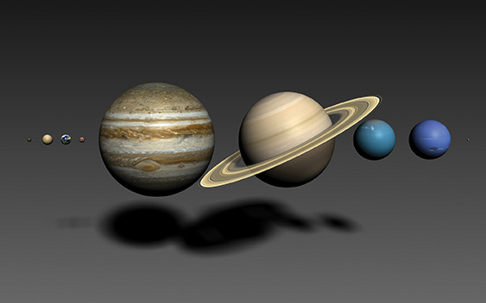
The scale of the Solar System
What is the biggest planet in the Solar System?
What is the smallest planet in the Solar System?
How does distance from the Sun affect the planets properties, for example, their surface temperature?
Why don’t we know very much about some planets?
l/o: To learn the objects in the solar system.
Notes:
1. Jupiter
2. Mercury
3. Increased distance from the Sun means lower temperatures. Inner planets are rocky and outer planets are gaseous.
4. Some planets are really far away so it’s difficult to collect data from them.

Slide 8
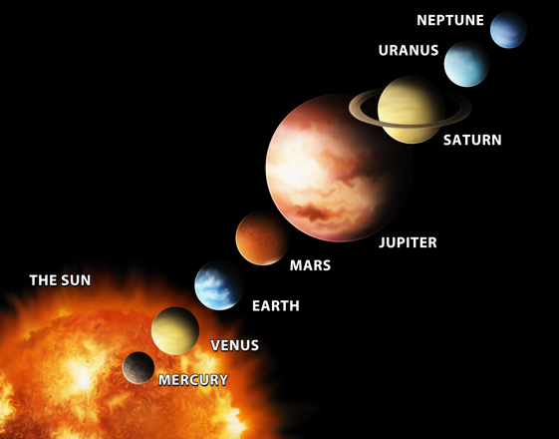
What planet am I?
Choose a planet in the Solar System.
Write down clues for your partner to try and guess which planet you are.
l/o: To learn the objects in the solar system.

Slide 9
Pick one question to answer.
Name the objects in the Solar System
Describe some similarities and differences between the planets of the Solar System.
Explain why we know less information about some of the planets.

