Slide 1
P1.4 Space
https://www.youtube.com/watch?v=vIR0GeHmBHM
https://www.youtube.com/watch?v=tRcPA7Fzebw

Slide 2



The Night Sky
I will be working scientifically to:
understand how scientific theories develop as earlier explanations are modified to take account of new evidence.
Developing
Secure
Secure +
I can: list some of the objects you can see in the night sky.
I can: describe the objects that you can see in the night sky.
I can: describe the structure of the Universe.

Slide 3
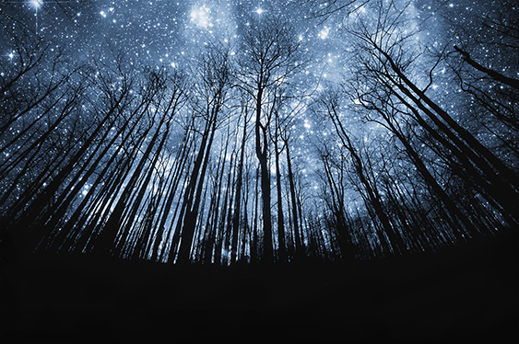
How many stars do you think you can see at night?
l/o: To understand what is in the night sky.

Slide 4
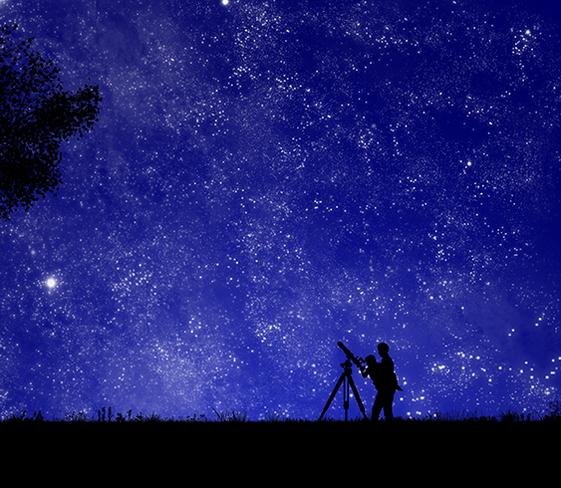
What is in the sky tonight?
Free programs like Stellarium can show you what the night sky may look like on a particular day.
l/o: To understand what is in the night sky.

Slide 5
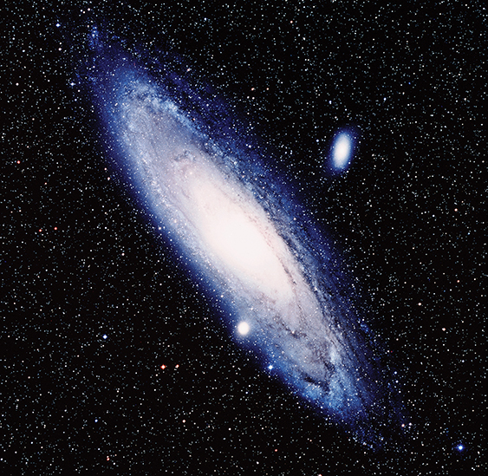
What is in the Universe?
There are lots of different objects in the sky but they are so far away they look the same to us.
You are going to learn about the different objects that are in the Universe.
l/o: To understand what is in the night sky.

Slide 6
Astronomer
Study the origin and the make-up of the universe.
Salary: £13,000 - £60,000
Collect data from satellites, develop new instruments, analyse data, test theories.

Slide 7
Read the passage on the sheet and complete the questions.
l/o: To understand what is in the night sky.

Slide 8
Answers
Access sheet
1 stars, galaxies (Solar System)
2 planets, moons
3 planets, moons, star (Sun)
4 moon, planet, star, Solar System, galaxy
5 Earth, Solar System, Milky Way galaxy, Universe
Extension
1 one million (1000 x 1000)
2 1000 km
3 Yes
Activity sheet:
1 star, galaxy (Solar System)
2 planets, moons
3 moon, planet, star, Solar System, galaxy, Universe
4 planets orbit stars, moons orbit planets, the Solar System contains a star and planets, a star is a ball of burning gas giving out heat and light, a galaxy contains billions of solar systems (if students include other objects found in the Universe, credit these, e.g., dwarf planet and asteroids).
5 Earth, the Solar System, Milky Way galaxy, Universe
6Planets, stars, and moons are part of the Solar System. Solar Systems are part of a galaxy.
l/o: To understand what is in the night sky.

Slide 9

Postcard to the universe
What are the different objects in the Universe?
Put all the objects of the Universe into a hierarchy.
Use this to write the address of the Earth.
l/o: To understand what is in the night sky.

Slide 10
What is in the Universe?
Think of all the objects in the Universe.
Rank them in size order.
l/o: To understand what is in the night sky.

