Slide 1
Why has China’s economy grown so quickly?
Understand what a BRIC country is.
Explain the reasons why China’s economy has grown so quickly
Assess the impacts of ‘The New Silk road’

Slide 2
Brain warm-up:
Last lesson you were taught that China has the 2nd biggest economy in the world…
But, can you remember how much their economy is worth?!
ECONOMY: the system of how money is made and used within a country. How much money a country makes…

Slide 3
£11.61 trillion!!!

Slide 4















Starter: What are the top 15 world economies?
8
9
10
11
12
13
14
15
1
2
3
4
5
6
7

Slide 5
Top 15 world economies:
1. United States
2. China
3. Japan
4. Germany
5. India
6. United Kingdom
7. France
8. Italy
9. Brazil
10. Canada
11. Russia
12. South Korea
13. Spain
14. Australia
15. Mexico

Slide 6
BRIC Countries
China is known as a BRIC country
What do you think BRIC could stand for (think about our starter activity)…
Understand what a BRIC country is.

Slide 7

BRIC
  Brazil
  Russia
  India
  China
These countries are grouped together because they all have rapidly growing economies!
Understand what a BRIC country is.

Slide 8
Explain the reasons why China’s economy has grown so quickly
Developing | Identify the reason for China’s economic growth
Secure | Explain the reason
Secure+ | Analyse how this would have helped China’s economy to grow
You may need to use the HINT document to help you with the S+ coloumn, but only use it if you need to- have a go yourself first!!!
Task: Complete worksheet 1 by using the information on the next 8 slides… I’ve done the first one for you as an example.

Slide 9

Explain the reasons why China’s economy has grown so quickly
LABOUR SUPPLY
China’s Population: 1.3 billion

Slide 10

Explain the reasons why China’s economy has grown so quickly
REDUCED POVERTY
Since 1990, 439 million people in China have been lifted out of poverty
POVERTY: being extremely poor and not being able to afford the basic necessities like food, water and shelter

Slide 11

Explain the reasons why China’s economy has grown so quickly
MORE FEMALE WORKERS
Link: The One Child Policy!
More women have been available to work as they have been having less children.

Slide 12
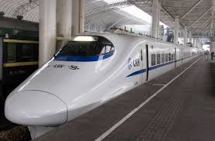
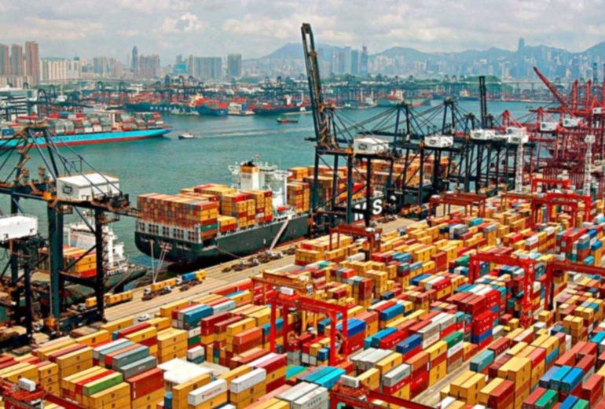
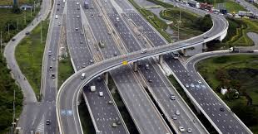
Explain the reasons why China’s economy has grown so quickly
INVESTMENT IN INFRASTRUCTURE
INFRASTRUCTURE: the basic facilities which help a country to run, including roads, railways and ports.

Slide 13

Explain the reasons why China’s economy has grown so quickly
LOW WAGES

Slide 14
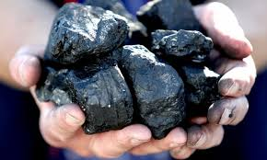
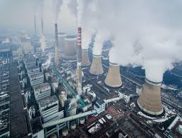

Explain the reasons why China’s economy has grown so quickly
ENERGY SUPPLY
Coal:
Coal power station in China:
China is the largest produced of coal and it uses the coal to run it’s many power stations which provide electricity to the country.

Slide 15

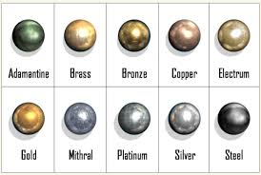

Explain the reasons why China’s economy has grown so quickly
NATURAL RESOURCES
China has a large amount of natural resources including metals such as gold and copper, and fossil fuels such as coal and oil.

Slide 16
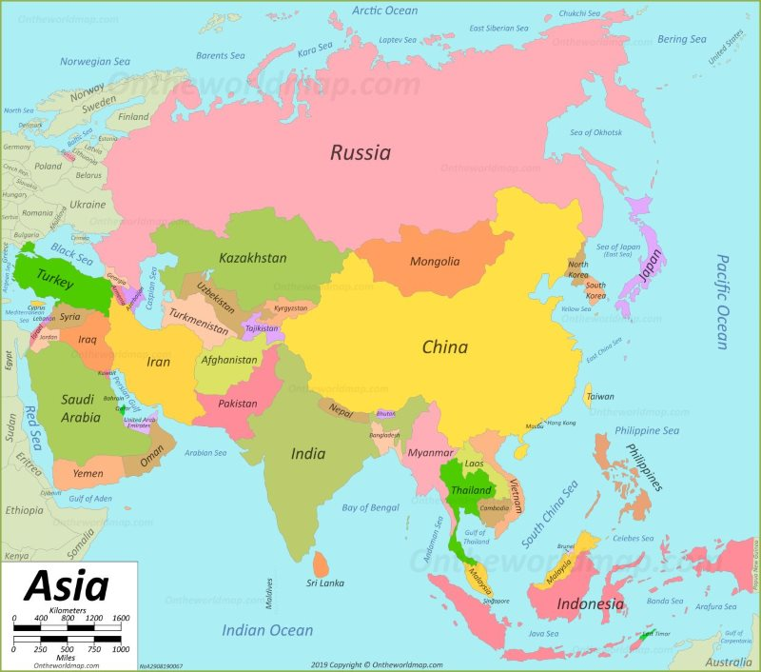
Explain the reasons why China’s economy has grown so quickly
LOCATION
China is surrounded by lots of other countries which have strong economies such as Japan, Russia, India, South Korea etc.

Slide 17

What is ‘The Silk Road’?
Assess the impacts of ‘The New Silk road’
https://www.dw.com/en/a-brief-history-of-the-silk-road/av-48634495
Watch the short video and answer the questions on worksheet 2.

Slide 18
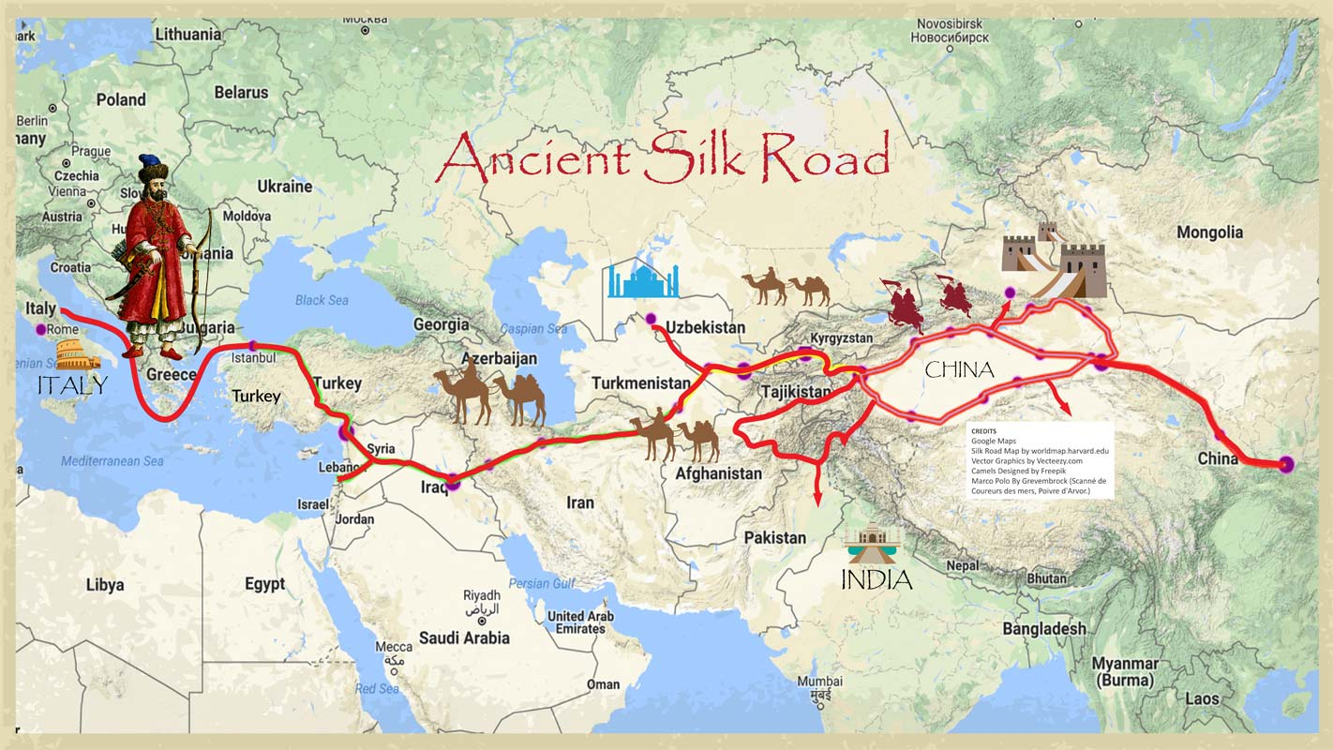
Assess the impacts of ‘The New Silk road’
Look at the maps of The New Silk Road on the following slide…
Describe The New Silk Road
Compare and contrast the maps with the ‘old’ Silk Road.

Slide 19
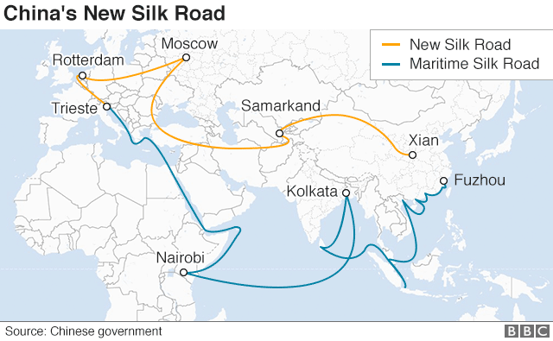
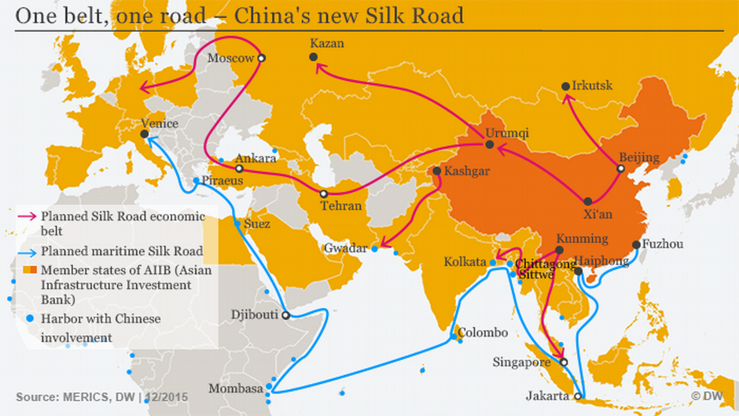

Slide 20
Look at the maps of The New Silk Road on the following slide…
Describe The New Silk Road
The New Silk Road gives China access to much more of the world than the old Silk Road. The old Silk Road went from Italy to China, whereas The New Silk Road connects China to most of Asia and lots of Africa as well.
Compare and contrast the maps with the ‘old’ Silk Road.
Both the old and new Silk Roads were developed in order to let people trade with different countries around the world. They both utilised road networks in order to do this.
However, The New Silk Road also uses lots of water ways and ports to transport goods which is much quicker and cheaper. It also allows more countries to connect with each other across the seas and oceans.

Slide 21
Assess the impacts of ‘The New Silk road’
Why is this evidence that China’s economy will continue to grow?
Why is this evidence that China is helping to create a ‘global marketplace’?

Slide 22
Assess the impacts of ‘The New Silk road’
These maps are evidence that China’s economy will continue to grow because The New Silk Road allows them to transport goods to more and more countries. The more countries China can export their goods to, the more money they can make. This will mean their economy will keep growing.
These maps show that China is creating land and sea routes to countries all over the world. In the past, China mainly traded with Europe, but the maps show that China can now trade with Asia and Africa too. This supports the idea that there is a global marketplace because countries all over the globe can buy from and sell to each other.

Slide 23
Assess the impacts of ‘The New Silk road’
Complete worksheet 3
Check your answers to all of your worksheets using the answer documents provided.

