Slide 1
To start, think to yourself…
What do you know about the Bermuda triangle?
If you are struggling you could guess. Have you even heard of it before?

Slide 2
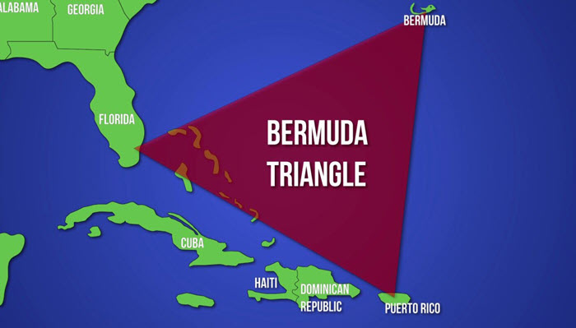

This fortnight’s lessons
This week you are going to be investigating one of the biggest mysteries of the modern day and from history.
We are going to investigate the mystery of the Bermuda Triangle.
You will find out exactly what happened to start the mystery and then use evidence to decide whether you think it is a ‘historical mystery’ or actually easily explainable.

Slide 3
The Bermuda Triangle
Learning outcomes:
To understand what the Bermuda Triangle is.
To analyse primary and secondary sources about the Bermuda Triangle.
To justify whether you believe the Bermuda Triangle exists using a range of evidence to support your view.

Slide 4

To understand what the Bermuda Triangle is.
What is the Bermuda Triangle?
On the following slide there is a short video.
Whilst you watch it, you need to answer the 10 questions on slide 5.
There are also available separately on the worksheet on the website.
You can pause/ rewind/ re-watch the video at any point and as many times as you need to get the answers you need!

Slide 5
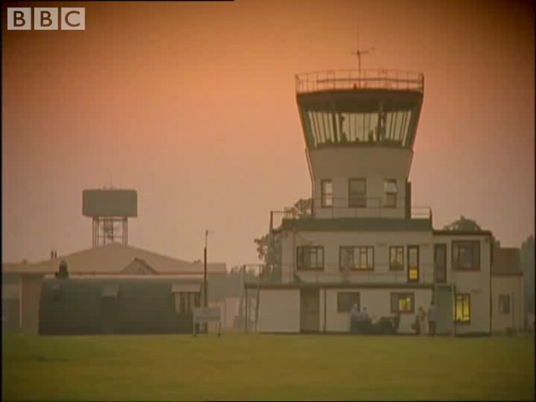
Use the video to answer the 10 questions on the next slide or from the work sheet attached.

Slide 6
Task 1
10 questions about the Bermuda Triangle (worksheet 1)
When did the myth of the Bermuda Triangle begin?
How many aircraft disappeared on that journey?
Why was flight 19 flying on this date?
Where did the flight take off from?
How long after the aircraft took off did they vanish?
What happened to the rescue plane sent to look for them?
What was found from any of the flights?
Which 3 places is the Bermuda Triangle between?
How large an area does the Bermuda Triangle cover?
What else has allegedly disappeared in the Bermuda Triangle?

Slide 7
TASK 1 ANSWERS
5th December 1945
5
Routine training mission
Fort Lauderdale, Florida (near Miami)
4 hours
It also disappeared
Nothing
Miami, Puerto Rico and Bermuda
1.5 million square miles
Thousands of other ships and planes.
How many did you get right?

Slide 8
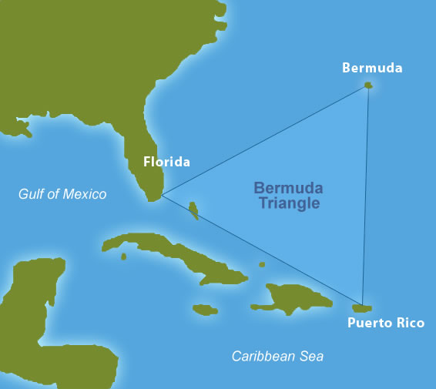
There are many different theories about why so many flights and ships have gone missing in this area of the world. Some people think it is an unexplained phenomenon, however scientists believe there could be one, or several, scientific explanations.

Slide 9

TASK 2- Watch the video. What theories 4 are there about the Bermuda Triangle and what do they say? Complete work sheet 2.
Again pause/ rewind/ re-watch the video as needed.

Slide 10
TASK 3 (worksheets 3 and 4)
Now that you know what the Bermuda Triangle is and understand some of the theories people believe about it, you need to investigate the evidence to decide whether the Bermuda Triangle really exists or whether it is coincidence.
Look at the sources in worksheet 3 and decide which column of the table they go into on worksheet 4.
You need to explain why they go in that side e.g. source A says that…
Evidence to support that the Bermuda Triangle does exist… | Evidence to support that the Bermuda Triangle does not exist…
Source Q says… | Source Z says…

Slide 11
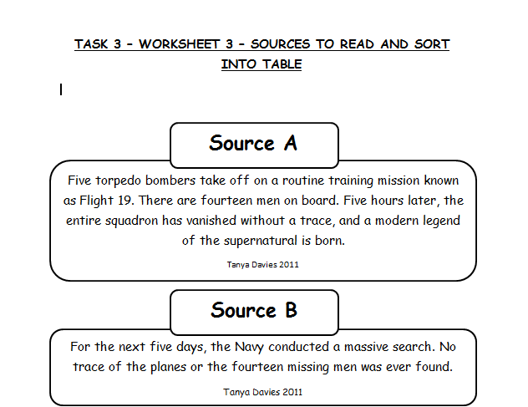
Example

Slide 12
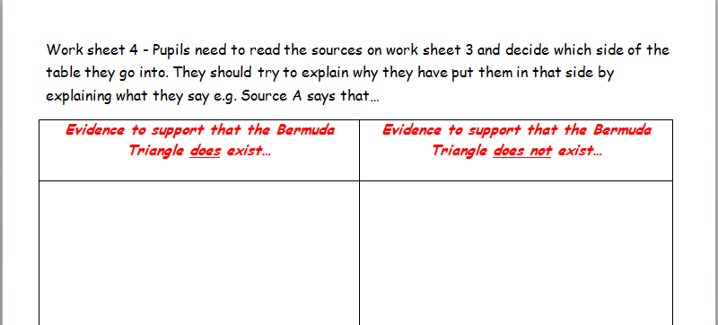
Example

Slide 13
TASK 4- does the Bermuda Triangle exist?
Now that you have considered the evidence, you need to form your own opinion about it.
Does it exist or is it merely a coincidence?
Make sure you justify your answer with your reasons! (you can also be in the middle with you opinion, as long as you explain why).
Starter sentence: after looking at all the evidence I think that the Bermuda Triangle does/doesn’t exist because…

Slide 14
Task 5- creative task
Using your own knowledge about the Bermuda Triangle plus extra research you may have carried out you can choose to complete one of the following creative tasks. This should take about two lessons (2 hours).
You can either:
Create a missing poster for one or all of the missing flights from December 1945.
Create an informative leaflet/ PowerPoint about the Bermuda Triangle using the 5W enquiry questions: Who? What? Where? Why? When? + How? It could also contain their own viewpoint on this theory.
Create a short informative video (using movie maker or software of their choice) about the Bermuda Triangle using the 5W enquiry questions: Who? What? Where? Why? When? + How? It could also contain their own viewpoint on this theory.

Slide 15
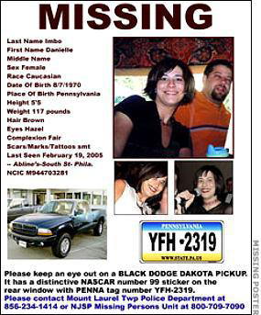
Poster Task success criteria
Create one missing poster for the people missing from the 5 bomber planes lost over the Bermuda Triangle.
You can either take the angle that the five planes are missing or that one individual is missing.
Things to be included in your poster are:
1. The word “MISSING”
2. The name of the missing person OR the name of the planes
3. The last known details of the victim/ planes whereabouts
4. Description of the physical appearance of the missing person or plane
5. A message stating that if anyone has any information, who they should contact

Slide 16

Informative leaflet/ PowerPoint success criteria
Create a leaflet or a PowerPoint telling another pupil in the school all about the Bermuda Triangle. You need to assume they have never heard of it.
Things to be included in your leaflet/ PowerPoint are:
1. An eye- catching title that makes people want to know more. Perhaps use alliteration or a rhetorical question.
2. Information about the Bermuda Triangle- use the 5Ws to make sure you include everything: What is the Bermuda Triangle? When did it happen? Where is it? Why do people think this happened? Who was involved in 1945 and further back in history? How do people feel about it?
3. Relevant pictures and diagrams that help people to understand the text.
4. Clear, self-written sentences or bullet points. Do not copy large swathes of text you do not understand- the reader will find it boring!

Slide 17

Movie maker (or other software) video - success criteria
Create a short informative video (using movie maker or software of their choice) about the Bermuda Triangle
Things to be included in your video are:
1. An introduction to tell the audience what you are going to be talking about.
2. Information about the Bermuda Triangle- use the 5Ws to make sure you include everything: What is the Bermuda Triangle? When did it happen? Where is it? Why do people think this happened? Who was involved in 1945 and further back in history? How do people feel about it?
3. Relevant pictures and diagrams that help people to understand the text.
4. Clear, self-written sentences or bullet points. Do not copy large swathes of text you do not understand- the reader will find it boring!

